Slide 1

Project Title: AI OPERATIONS AND DEPLOYMENT GUIDED USER INTERFACE
Student Name : Vignesh Karthikeyan R
Student Roll No : 2232MCA0004
Student Registration No : 67222200158
Guide Name : DR. Uma E
Guide Designation : Associate Professor
Guide Institute Name and Address: Department of Computer Science and Engineering, CEG Campus,
Anna University, Chennai -25

Slide 2
Problem Definition / Abstract
The project addresses the complexities of deploying and managing machine learning models by providing an intuitive platform for seamless data handling and automated model optimization
This solution empowers users across all skill levels to efficiently transition from data ingestion to scalable AI deployment, enhancing operational efficiency and reducing time to market.

Slide 3
Related Work / Existing System
Many existing systems, such as MLflow, DataRobot, H2O.ai, Amazon SageMaker, while powerful, require a certain level of expertise that can be a barrier for novice users.
This system seeks to address these limitations by providing an intuitive and automated platform that simplifies the entire machine learning lifecycle.

Slide 4
Objectives and Scope of the Proposed Work
Objective
Scope
The objective of the AI Operations and Deployment Guided User Interface is to provide a user-friendly and automated platform that simplifies the deployment and management of machine learning models.
Data Ingestion & Pre-processing
By enabling seamless data ingestion, preprocessing, model selection, and optimization, the platform aims to empower users of all skill levels to efficiently transition from data handling to scalable AI deployment.
Model Selection and Training
Model Evaluation & Deployment

Slide 5
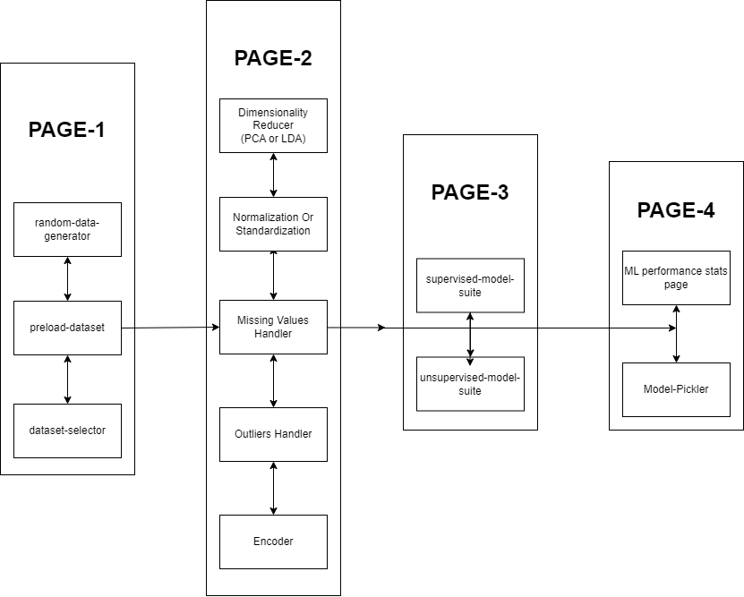
Block Diagram / System Architecture

Slide 6


Algorithm / Technique Proposed or Solution Methodology
Data Handling: Implement functionalities for seamless upload and validation of datasets in various formats (CSV, Excel, etc.).
Preprocessing Pipelines: Develop automated preprocessing pipelines that include data cleaning, normalization, and transformation based on best practices.
Algorithm Library: Curate a library of machine learning algorithms, ensuring that users can easily select and apply suitable models for their specific problems.
Automated Training: Implement automated model training workflows, including hyperparameter tuning using techniques such as Grid Search or Random Search.
Performance Metrics: Integrate functionalities to evaluate model performance using relevant metrics, providing visual feedback through dashboards.
Cross-Validation: Implement cross-validation techniques to ensure models are robust and generalizable.
Deployment Options: Develop one-click deployment functionalities that allow users to deploy models to various environments, such as cloud or on-premises solutions.

Slide 7
Analysis and Design - 1. Hardware and Software Requirements
Hardware:
AWS EC2 instance with below specs,
vCPUs: 2
RAM: 2 GB
30 GB of General Purpose SSD (gp2) storage, which is included in the Free Tier
Software:
Ubuntu 20.04 LTS
Python
Streamlit
AWS S3 for storing standard datasets & exporting Model Matrices
scikit-learn
Boto3 for AWS integration such as S3 manipulation etc.
Docker for app-containerization

Slide 8
Analysis and Design - 2. UML / DFD Diagram and ER Diagram

Slide 9
Work Plan
Week 1: Planning & Design Phase.
Week 2: Cloud setup, Docker setup.
Week 3: Data Loader Module Development.
Week 4-5: Data Pre-processing Module Development.
Week 6-8: Supervised & Unsupervised Model Suite Development.
Week 9: Model Exporter Module Development.
Week 11-12: Documentation and final report preparation.

Slide 10
Work Done So Far
Implemented cloud & docker setup.
Data Loader Module Development completed, which includes the functionality,
To generate custom data.
To use preloaded datasets from scikit-learn library.
To use own files as dataset.
Data Preprocessing Module Development completed, which includes the functionality,
To reduce dimensionality of dataset
To perform scaling of dataset
To manipulate missing values
To manipulate outliers
To perform class encoding

Slide 11
Work to Be Done
Supervised & Unsupervised Model Suite Development.
Model Exporter Module Development.
Documentation and final report preparation.

Slide 12
Time Schedule
Task | Week 1 | Week 2 | Week 3 | Week 4-5 | Week 6-8 | Week 9 | Week 11-12
Planning & Design Phase. | X
Cloud setup, Docker setup. |  | X
Data Loader Module Development. |  |  | X
Data Pre-processing Module Development. |  |  |  | X
Supervised & Unsupervised Model Suite Development. |  |  |  |  | X
Model Exporter Module Development. |  |  |  |  |  | X
Documentation and final report preparation. |  |  |  |  |  |  | X

Slide 13
References
D. Sculley, G. Holt, D. Golovin, et al. (2015), Hidden Technical Debt in Machine Learning Systems, NeurIPS
M. A. Hashmi, S. Rafiq (2019), Machine Learning: A Review of Learning Types, IJRTE
Diego Esteves, et al. (2021), MLOps: Challenges and Opportunities in Operationalizing Machine Learning, IEEE
B. Scellato, G. Rapposelli, S. Pasqua, et al. (2021), ModelOps: Cloud-Native Lifecycle Management of AI/ML Models, IEEE International Conference on Cloud Computing (CLOUD)
Official scikit-learn Documentation:
https://scikit-learn.org/stable/

Slide 14
Modules Completed
Data Loader Module (Page-1)
Csv-selector
Random-data-generator
Preloaded-dataset-selector
Preprocessing Module (Page-2)
Dimensionality-Reducer
Encoder
Missing-Value-Handler
Outlier-Handler
Scaler
Model Building Module (Page-3)
Numerical Model Suite
Pickler Module (Page-4)

Slide 15
Datasets used
Iris-dataset
Wine-dataset
Breast-cancer dataset
The above datasets are a part of sklearn.datasets module.

Slide 16
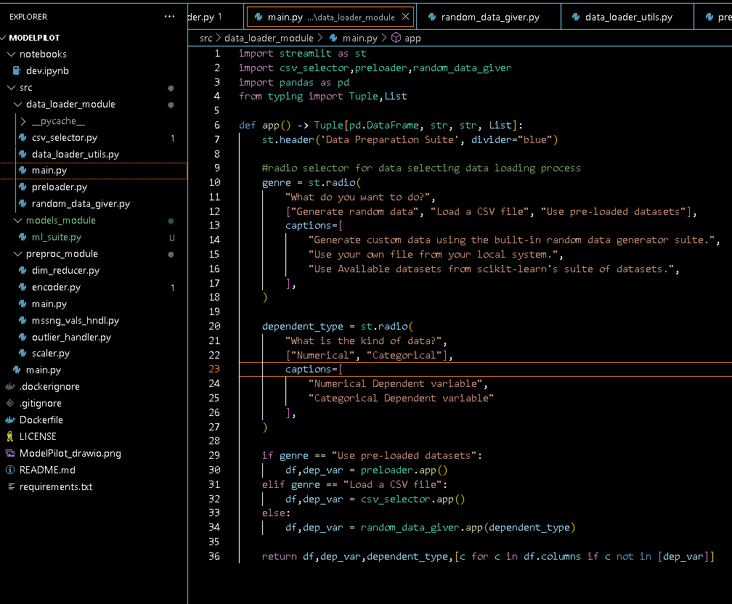
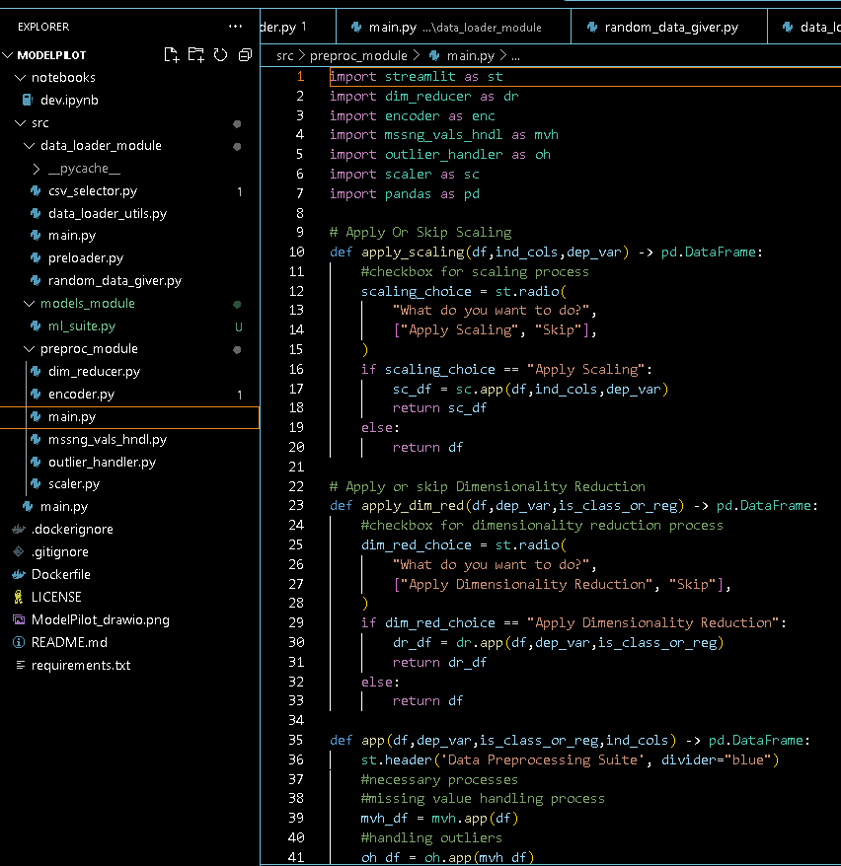

Slide 17
Pseudocode for 3rd Page
3rd Page: Model Building
Objective: Select, train, and evaluate a machine learning model.
Display: "Model Building" page title.
Check if preprocessed data exists:
If yes, proceed with model training.
If no, show a warning: "Please complete data loading and preprocessing first."
Separate features and target data from the preprocessed data.
Split the data into training and testing sets.
Ask user to choose a model (e.g., Random Forest, SVM, Logistic Regression).
Initialize the selected model based on the user’s choice.
When train-button clicked, train the selected model on the training data.
Show a success message when training completes.
Evaluate the model’s accuracy on the test data and display the accuracy score.
Save the trained model to the session state for access in the Pickling page.

Slide 18
Pseudocode for 4th Page
4th Page: Pickling
Objective: Save (pickle) the trained model.
Display: "Save Model (Pickling)" page title.
Check if a trained model exists in the session state:
If yes, proceed with saving.
If no, show a warning: "Please complete model training first."
When save-button clicked, save the trained model to a file (e.g., "trained_model.pkl").
Show a success message indicating the model has been saved.

