Slide 1
Benchmark of an LU Decomposition Algorithm in Python
Márton Papp, Ákos Szabó
ELTE FI

Slide 2


Introduction
Objective
  Implement & benchmark custom LU decomposition algorithm $\left(PA=LU\right)$ using Doolittle’s method with partial pivoting.
  Evaluate "pure Python" performance (no low-level optimizations).
Motivation
  LU decomposition is a fundamental tool for solving linear systems $\left(Ax=b\right)$ efficiently.
  High computational cost: $O(n^{3})$ complexity.
  Understanding Python’s limitations in numerical algorithms.

Slide 3

Methodology
Implementation Environment
  Hardware: Intel Core i5-1135G6 (4 cores), 8 GB RAM.
  Software: Python 3.14, NumPy 2.3 (for dense matrix storage) .
  Constraint: Custom implementation without external optimization libraries (e.g., LAPACK).
Benchmarking Protocol
  Dataset: Randomly generated square matrices $\left({A ∈ℝ}^{n∗n}\right).$
  Test Cases: Matrix sizes n $∈$ {10, 50, 250, 1000} to evaluate runtime scaling.
  Reliability: 100 independent trials per size to measure variability.
  Metrics:
    Execution Time (high-precision timer).
    Numerical Stability (${|\left|PA=LU\right||}_{F})$.

Slide 4
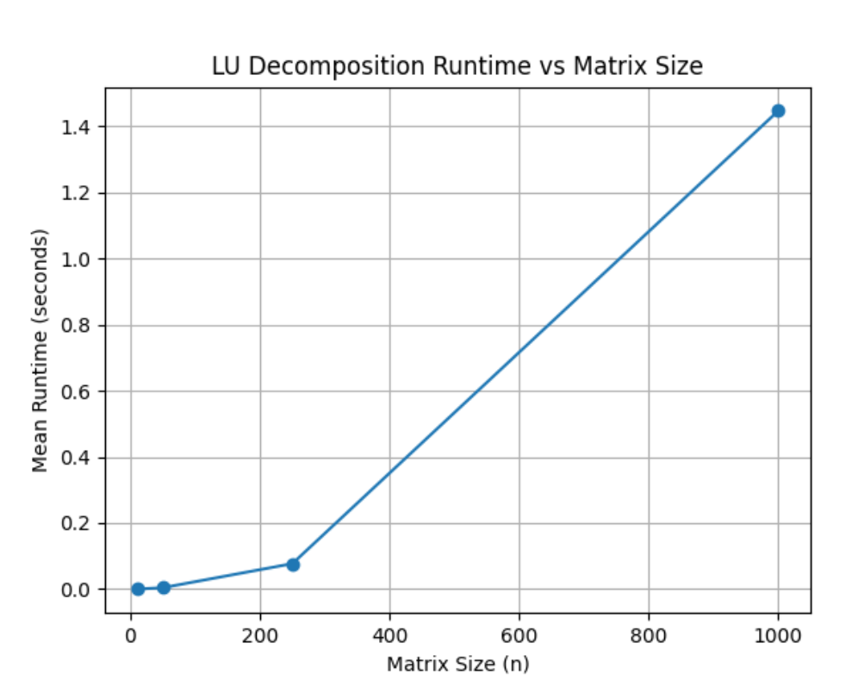
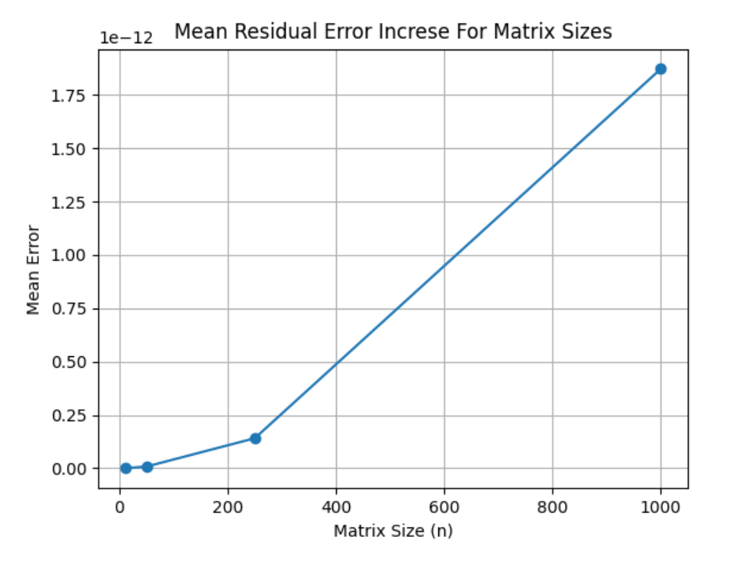


RESULTS
Runtime Analysis
Shows clear cubic growth ($O(n^{3}))$ aligning with theory.
Runtime rises sharply, exceeding 1.4s for n=1000.
Numerical Stability
Residual error (${|\left|PA=LU\right||}_{F})$ increases with size ${(10}^{−16} →$ ${10}^{−12})$
Despite growth, error remains negligible.

Slide 5

Conclusion
Key Findings
  Confirmed theoretical $O\left(n^{3}\right)$ complexity with predictable runtime scaling.
  High numerical precision ($PA ≈LU)$ achieved via partial pivoting.
Final Verdict
  Educational use: Ideal implementation for understanding algorithmic mechanics.
  Production use: For large scale systems, optimized compiled libraries (e.g., LAPACK) are necessary

