Slide 1
Weekly Report Generator
& Team Dashboard
An internal tool for weekly reporting, review and correction
Next.js
Express
PostgreSQL
Prisma
Your name · github.com/RVViduranga/weekly-report-dashboard
Notes:
This is an internal tool for weekly reporting. Team members file a structured report each week, managers review it and can send it back for correction, and everything rolls up into a dashboard. I'll walk through the architecture, the database design, how the review workflow works, and what I ran into along the way.

Slide 2
THE PROBLEM
Weekly reports live in chat messages
Nothing is comparable across people, feedback gets lost, and last week's version is gone the moment someone edits it.
One fixed structure
A review cycle
History is never lost
The same fields, same order, for the whole team - so a manager can actually compare
Not a one-way submission. Send it back with a comment, get it again
Older versions stay readable, and each comment stays attached to its version
These three requirements shaped every decision that follows.
Notes:
The point of a fixed template is comparability. If everyone writes their own format, the manager's dashboard is useless - so users can't add or reorder fields. And the review isn't fire-and-forget. A manager can send a report back with a comment, and the older version stays readable. That last requirement drove most of the database design.

Slide 3
SYSTEM ARCHITECTURE
Three pieces, one direction of trust
Next.js frontend
Express REST API
PostgreSQL
React 19 · Tailwind
12 pages, browser only
TypeScript · Prisma
Every rule enforced here
Neon, Singapore region
Constraints in the schema
fetch + cookie
Prisma
The token lives in an httpOnly cookie
Browser JavaScript cannot read it - so a script injected onto the page cannot steal the session
The frontend never touches the database; the API is the only path in
Notes:
Three pieces. The browser runs a Next.js app, it calls a REST API over fetch, and the API is the only thing that touches the database. The token lives in an httpOnly cookie, which means browser JavaScript can't read it. If a malicious script ever ran on the page, it could steal a token out of localStorage instantly, but it cannot touch an httpOnly cookie.

Slide 4
TECH STACK
What I chose, and why
Express 5
PostgreSQL
Explicit layers. No framework magic between me and the request.
The data is genuinely relational - real foreign keys, a real unique constraint.
Prisma
JWT + bcrypt
Typed queries and migrations from one schema file.
No third-party auth service standing in for something I should be able to explain.
Zod
Vitest + Supertest
One validation schema per endpoint; bad input never reaches a service.
Real HTTP against the real app, so the middleware chain is exercised.
Frontend: Next.js 16 with the App Router - a folder becomes a page, which suited 12 of them.
Notes:
I picked Express over something heavier because every line is explicit - there's no framework magic between me and the request. That matters when I have to explain or extend it. Postgres because this data is genuinely relational: a report belongs to a user and a project and has several child collections. I wanted real foreign keys and a real unique constraint, not application-level hope.

Slide 5
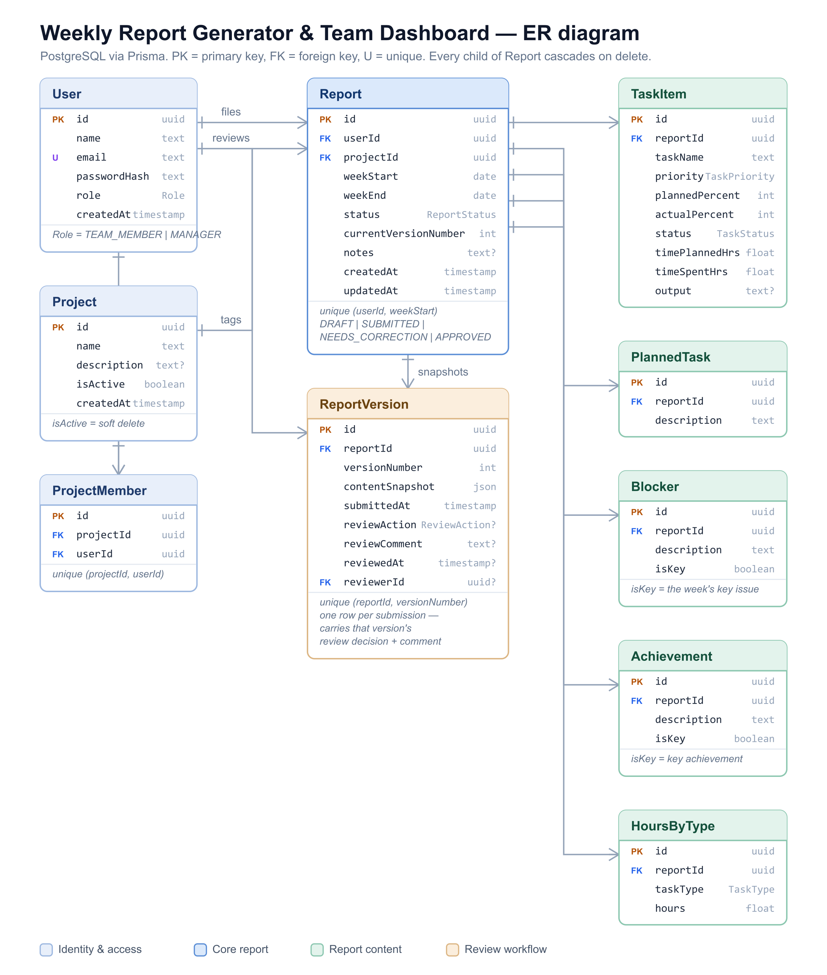
DATABASE DESIGN
Ten tables, four groups
Identity & access
User, Project, ProjectMember
Core report
Report - one per person per week
Report content
Tasks, planned work, blockers, achievements, hours
Review workflow
ReportVersion - the history
Notes:
Reading it left to right: users and projects, then the Report in the middle, then the five child tables that hold the report's content, and ReportVersion at the bottom which is the review history. Everything hangs off Report. One report per person per week - and that's a database constraint, not just a check in my code.

Slide 6
DATABASE DESIGN
Two decisions worth defending
History without duplicating tables
A project is deleted only when that is safe
The live Report row is edited in place
Each submission writes a ReportVersion holding a JSON snapshot
The decision and comment sit on that version row
So "which draft was this comment about?" is always answerable
Nothing references it, so the row really is deleted
Reports reference it, so isActive becomes false instead
Report.projectId is not nullable and carries no cascade, so Postgres refuses the other path
The alternative was versioning every child table too. That multiplies the table count and makes every query harder - for a history view the assignment only needed to be readable, not diffable.
Notes:
The alternative was to version every child table too - a new row set per version. That multiplies the table count fast and makes every query harder. A JSON snapshot per submission gives me the full history for a fraction of the complexity. On projects: if a manager deletes a project that three months of reports point at, hard-deleting either fails on the foreign key or orphans that history. Archiving hides it from new reports and keeps the old ones readable.

Slide 7
THE REVIEW WORKFLOW
Four states, and a loop
submit
approve
DRAFT
SUBMITTED
APPROVED
request changes
resubmit
NEEDS CORRECTION
A report loops between Submitted and Needs correction as many times as it takes.
Editable only while
Editable only by
A manager may change
Draft or Needs correction
the person who owns it
status and comment - never content
There is an automated test asserting the third rule.
Notes:
This is the core of the assignment, so I'll spend a moment here. Four states. A report loops between SUBMITTED and NEEDS_CORRECTION as many times as it needs to. The rule I care most about is the last one. A manager reviewing a report can approve it or send it back - but they cannot rewrite what the team member wrote. There's an automated test asserting exactly that.

Slide 8
IMPLEMENTATION
Submitting is one transaction
prisma.$transaction(async (tx) => {
await tx.reportVersion.create({
data: { versionNumber, contentSnapshot }
});
return tx.report.update({
data: { status: "SUBMITTED" }
});
});
Both writes, or neither
A snapshot saved without the status change would describe a report that was never submitted
The data would be lying about itself
Reviewing
Editing
The decision and comment are written onto that version's row
Then the report's status changes - again in one transaction
The client sends the full list of tasks, blockers and hours
The server replaces the child rows in a single nested write - no diffing
Notes:
The transaction matters. If the snapshot saved but the status update failed, I'd have a version row for a report that was never submitted - the data would be lying. A transaction makes those two writes atomic. On editing: I don't try to diff which task changed. The client sends the whole list, and the server deletes the old child rows and creates the new ones in a single nested write. Simpler, and the snapshots mean nothing is actually lost.

Slide 9
BACKEND STRUCTURE
Each layer has one job
routes/
URL, method, and who may call it
No req or res in services
controllers/
Read the request, shape the response
So the same function serves the API, the seed script and the tests
And a route file reads like a policy document
services/
Business logic and database access
middleware/
authenticate, requireRole
validators/
One Zod schema per endpoint
lib/
Prisma client, JWT, passwords, errors
Notes:
Each layer has one job. A route file reads like a policy document - you can see the whole API surface and who can call what in a few lines. Keeping HTTP out of the services isn't ceremony. It's why I could call the same logic from a seed script without spinning up a server.

Slide 10
ACCESS CONTROL
Two layers, two different questions
// route level - a fixed rule
router.get("/",
authenticate,
requireRole("MANAGER"),
listAll);
// service level - depends on data
if (role !== "MANAGER" &&
report.userId !== requester.userId) {
throw new AppError(404, "Not found");
}
"Is this person a manager?" is fixed. "Is this your report?" can only be answered after reading the row.
401
403
404
I don't know who you are
I know exactly who you are, and no
For someone else's report - on purpose
A 403 would confirm the report exists. A 404 reveals nothing - and there is a test asserting it.
Notes:
'Is this person a manager?' is a fixed rule, so it lives on the route. 'Is this your report?' can only be answered after reading the row, so it lives in the service. The 404 is deliberate. If I returned 403 for someone else's report, that response confirms the report exists. A 404 reveals nothing. There's a test asserting 404 rather than 403 for exactly that reason.

Slide 11
API DESIGN
Who may call what
POST /reports
signed in - creates their own
Two list endpoints
GET /reports/mine
signed in - their own only
/reports/mine forces the caller's own id into the where clause
So a team member's data is scoped in the query, not by a check afterwards
Every list takes page, pageSize and filters
GET /reports
manager - the whole team
PATCH /reports/:id
owner, while editable
POST /reports/:id/submit
owner
POST /reports/:id/review
manager
GET /reports/:id/versions
owner or manager
Notes:
Two list endpoints rather than one: /reports/mine forces the user's own id into the where clause, so a team member's own data is scoped in the query itself, not by a check afterwards. Validation is a schema per endpoint. Bad input never reaches the service layer, and the errors come back field by field so the form can put each message next to the right input.

Slide 12
FRONTEND
Three genuinely different jobs
Personal report page
Report history
Team dashboard
A form. Task table with planned vs actual, blockers, achievements, hours. Save draft or submit.
A list. Filter by status, paginated. Edit appears only where editing is allowed.
A table with filters: person, project, status, week range. Review from the row.
Reused across pages
One rendering path
StatusBadge
5 pages
The manager sees exactly what the team member submitted, because both use ReportDetail
StatusBadge is typed over the status union - add a status and TypeScript says it has no colour
ReportDetail
report view + review
VersionHistory
report view + review
ReportForm
create + edit
useRequireManager
3 manager pages
Notes:
These are three genuinely different jobs. One is data entry, one is a personal archive, one is a manager scanning across people - so they're separate pages rather than one screen with modes. ReportDetail being shared is why the manager sees exactly what the team member submitted; there's no second rendering path that could drift.

Slide 13
DASHBOARD
One call, nine queries in parallel
3 / 5
60%
2
6
submitted this week
3 on time, 2 pending
need correction
open blockers
Four charts
Two details worth mentioning
Tasks completed over eight weeks
Report status by team member
Workload by project
Hours by task type, team-wide
Compliance splits three ways: filed on time, filed after the week closed, and not filed at all
That last one is the absence of a row, so it is computed from the member list, not from reports
Replace this slide's top half with a screenshot of the real dashboard if you have room.
Notes:
The dashboard is a single API call. Nine queries run in parallel with Promise.all, so the response takes about as long as the slowest one rather than the sum. Compliance splits three ways: on time, late, and not filed. Late compares the first submission against the end of that week, so nobody can be late in a week that is still running. Not filed was the interesting one to compute - it is the absence of a row, so I start from the list of team members and subtract the ones who filed, rather than querying reports.

Slide 14
TESTING
Eighteen tests, all on access control
Unauthenticated
Wrong role
Every protected route rejects a request with no session
Team members are blocked from manager-only endpoints
Wrong owner
Right role, wrong action
A team member cannot reach another member's report
A manager cannot rewrite a team member's content
Almost all of it is reads and rejected writes. The two tests that do write put back what they changed, so the demo data survives the suite.
Notes:
I tested access control rather than happy paths because that's where a bug is expensive. A broken form is visible immediately; a permission hole is invisible until it matters. Supertest runs real HTTP against the real Express app, so the tests exercise the actual middleware chain, not a mock of it. That's why I split app creation from server startup.

Slide 15
AI CHAT ASSISTANT
Grounded in the reports, not the model
How it answers
What never leaves the server
Manager-only, behind the same requireRole guard
The week's reports are rendered as plain text into a system message
No vector store and no retrieval - a week is a few kilobytes
Six free models tried in order, because a shared pool answers 429
The Prisma select is the boundary, not the prompt
Names are selected; emails, ids and password hashes are not
The browser cannot send a system message, only user and assistant
A free model tier is not zero-retention: the provider may train on what is sent. Fine for seeded demo data, not for a real team - production would use a zero-retention tier or a self-hosted model.

Slide 16
CHALLENGES
Three things that went wrong
The report list took 3.1 seconds
9× faster
I measured before guessing: 67 ms of network, but seven relations loaded per row.
Moved the database into the same region, and gave list queries a lighter shape.
3138 ms → 335 ms
A config change broke it days later
Deployment ran into a wall
I changed TypeScript's module setting but did not regenerate Prisma's client
The next regeneration emitted ESM into a CommonJS project - and it crashed
Lesson: regenerate immediately, or the failure arrives detached from its cause
Free-tier hosting for a long-lived Node API now wants card verification
The API is containerised; the frontend is live on Vercel
I would rather say that plainly than hand over a link that half works
The app runs locally from the README in two commands.
Notes:
On the first one - the useful part wasn't the fix, it was measuring before guessing. I timed a trivial query, then the same query with each set of relations, and the relations were 80% of it. Two changes, nine times faster. The second taught me something I'll carry: when you change a config that generated code depends on, regenerate immediately. Otherwise the failure shows up much later, disconnected from the change that caused it. On deployment - I'd rather say plainly that I didn't finish it than hand over a link that half works.

Slide 17
WHAT I WOULD DO NEXT
Five, in the order I would do them
1
Shared types
API types are hand-copied into the frontend today. Generate them, so a change breaks the build instead of runtime.
2
Finish deployment
API and frontend on one origin, which also removes CORS and keeps cookies first-party.
3
Project membership
ProjectMember is in the schema and seeded, but nothing assigns people to projects yet - the dashboard could then filter by it.
4
Email reminders
Nudge anyone who has not filed by Friday afternoon.
5
Section comparison
Every member's blockers for one week, side by side.
Notes:
On the AI assistant - the honest answer is I didn't build it. If I did, I'd scope each query to the reports the asking manager is already allowed to see, so the assistant can't leak across the permission boundary the rest of the app enforces. The shared types one is the change I'd make first. Right now if I change the API shape, nothing tells me the frontend is stale until it breaks at runtime.

Slide 18
Thank you
Happy to walk through any part of the code.
12
10
18
28
pages
tables
tests
seeded reports
github.com/RVViduranga/weekly-report-dashboard
Notes:
Thank you. Happy to walk through any part of the code, or the database design in more detail.

