Slide 1
atools 1.4.x
Geert Jan Bex (geertjan.bex@uhasselt.be)
License: this presentation is released under the Creative Commons, see http://creativecommons.org/publicdomain/zero/1.0/

Slide 2
Scenario: parameter exploration

Slide 3
Use case 1: parameter exploration
temperature | pressure | humidity
293.0 | 1.0e05 | 87
… | … | …
313.0 | 1.3e05 | 75
#!/bin/bash –l
#PBS –l nodes=2:ppn=20
cd $PBS_O_WORKDIR mpirun weather –p 1.0e05 –t 293.0 –h 87
job_01.pbs
#!/bin/bash –l
#PBS –l nodes=2:ppn=20
cd $PBS_O_WORKDIR mpirun weather –p 1.003e05 –t 293.3 –h 67
job_30.pbs
…
#!/bin/bash –l
#PBS –l nodes=2:ppn=20
cd $PBS_O_WORKDIR mpirun weather –p 1.3e05 –t 313.0 –h 75
job_60.pbs
…

Slide 4
Solution: aenv
temperature | pressure | humidity
293.0 | 1.0e05 | 87
… | … | …
313.0 | 1.3e05 | 75
data.csv
#!/bin/bash –l
#PBS –l nodes=2:ppn=20
module load atools/1.4.4
source <(aenv --data data.csv)
cd $PBS_O_WORKDIR mpirun weather –p $pressure –t $temperature \
–h $humidity
job.pbs
$ array_ids=$(arange --data data.csv)
$ qsub -t ${array_ids} job.pbs

Slide 5
Data exploration: steps
Write PBS script with parameters
add line to initialize parameters
Create Excel sheet with data
Convert to CSV format
Submit with qsub -t …

Slide 6
Torque job arrays
Torque supports job arrays, i.e.,
$ qsub –t 1-100 job.pbs
#!/bin/bash –l
#PBS –l nodes=2:ppn=20
cd $PBS_O_WORKDIR cfd-sim –i "params-$PBS_ARRAYID" \
–o "result-$PBS_ARRAYID"
job_array.pbs
#!/bin/bash –l
#PBS –l nodes=2:ppn=20
cd $PBS_O_WORKDIR cfd-sim –i "params-1" \
–o "result-1"
#!/bin/bash –l
#PBS –l nodes=2:ppn=20
cd $PBS_O_WORKDIR cfd-sim –i "params-100" \
–o "result-100"
…

Slide 7
Features

Slide 8
More features: logs
Logging for
bookkeeping: success/failures?
redo failures
performance analysis
Scheduler provides logs
inconvenient
not always user-accessible

Slide 9
Logging: alog
#!/bin/bash –l
#PBS –l nodes=2:ppn=20
module load atools/1.4.4
source <(aenv --data data.csv)
cd $PBS_O_WORKDIR
alog --state start mpirun weather –p $pressure –t $temperature \
–h $humidity
alog --state end --exit $?
job.pbs
1 started by r1i1n3 at 2016-09-02 11:47:45
2 started by r1i1n3 at 2016-09-02 11:47:45
3 started by r1i1n3 at 2016-09-02 11:47:46
2 failed by r1i1n3 at 2016-09-02 11:47:46: 1
3 completed by r1i1n3 at 2016-09-02 11:47:47
…
job.pbs.log145485

Slide 10
Adapting PBS files: acreate
Automatically adapt PBS file for atools
only logging
logging and using aenv
$ acreate job.pbs > job_atools.pbs
$ acreate --data data.csv \
job.pbs > job_atools.pbs

Slide 11
Monitoring: arange
For running or finished job
$ arrange --data data.csv \
--log job.pbs.log145485 \ --summary

Slide 12
Resuming jobs: arange again
Resume a job that hit the walltime
Redo failed work items
$ array_ids=$(arange --data data.csv \
--log job.pbs.log145485)
$ qsub -t ${array_ids} -l walltime=5:00:00 \
job.pbs
$ array_ids=$(arange --data data.csv \
--log job.pbs.log145485 \
--redo)

Slide 13
More features: data aggregation
Sometimes convenient that each work item creates file
Files must be combined later = royal pain
File names are based on PBS_ARRAYID
Example for data.csv:
output-1.txt
a, b
1.3, 5.7
2.7, 1.4
3.4, 2.1
4.1, 3.8
…
data.csv
output-2.txt
…
output-100.txt
…

Slide 14
Simple reductions: areduce
Almost automatic data aggregation:
Takes care of
missing files (failed items)
incomplete data (failed items), use --t $(arange --data data.csv --list_incomplete)
correct order
For CSV, use --mode csv
single column row
areduce --t 1-100 --data data.csv \
--pattern output-{t}.txt \
--output output.txt
PBS_ARRAYID

Slide 15
Non-trivial reductions: areduce
More general data aggregation:
Reductor can be any executable
"appends" new data to existing file
takes two command line arguments
name of file with all output data
name of file to "append"
extra argument using --reduce_args …
areduce –-t 1-100 --data data.csv \
--pattern output-{t}.txt \
--empty empty.bin \
--reduce reductor.sh \
--out output.bin

Slide 16
Example reductor
#!/usr/bin/env python
from argparse import ArgumentParser
import pickle
if __name__ == '__main__':
arg_parser = ArgumentParser(description='create new pickle file from '
'two existing files')
arg_parser.add_argument('old', help='name of aggregation pickle file')
arg_parser.add_argument('new', help='name of pickel file to add to '
'aggregation')
options = arg_parser.parse_args()
with open(options.old, 'rb') as old_file:
old_data = pickle.load(old_file)
with open(options.new, 'rb') as new_file:
new_data = pickle.load(new_file)
for word, count in new_data.iteritems():
if word in old_data:
old_data[word] += count
else:
old_data[word] = count
with open(options.old, 'wb') as old_file:
pickle.dump(old_data, old_file)
redactor.py
read aggregated data
read data to add
add new data to aggregate
write aggregated data

Slide 17
Job statistics: aload
Load balance is mostly taken care of by scheduler, but
do all jobs approximately the same amount of work?
Use aload to analyze runs
report on work items: --list_tasks
report on nodes: --list_slaves
$ wload –workers run.pbs.log445948

Slide 18
Tuning

Slide 19
How to use atools well?
Work items should use at least a node
no technical reason, just credits
time(work item) > 1 minute
Limits to number of jobs in queue

Slide 20
What you hope/expect for…
strong scaling
weak scaling
execution time
nr. processes
Is this going
to happen?
system size
execution time ∼
nr. processes

Slide 21

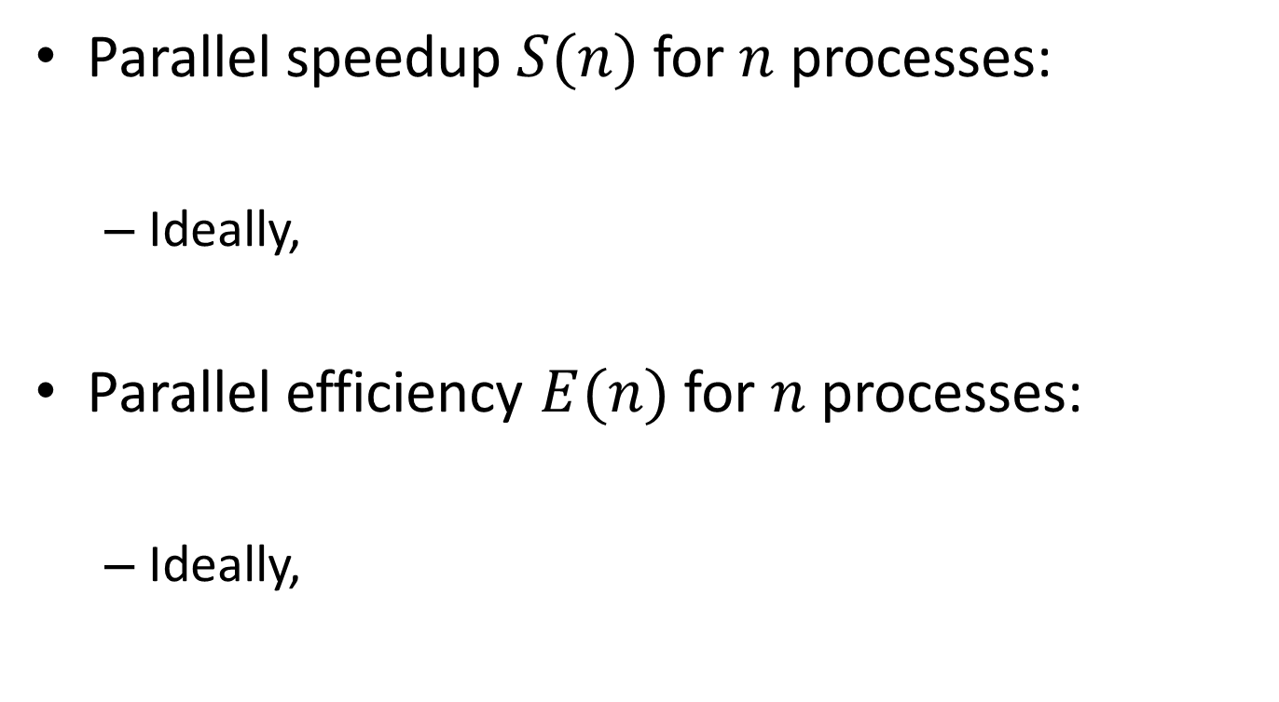



Definitions
Parallel speedup $S(n)$ for $n$ processes:
Ideally,
Parallel efficiency $E(n)$ for $n$ processes:
Ideally,
$$S(n)=\frac{T_{1}}{T_{n}}$$
$$S(n)=n$$
$$E(n)=\frac{T_{1}}{nT_{n}}$$
$$E(n)=1$$

Slide 22
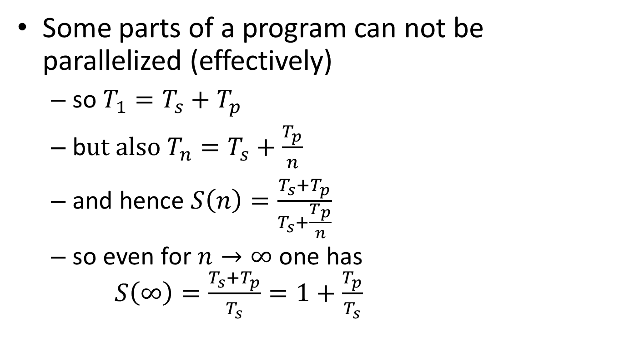
Strong scaling: oops!?!
Some parts of a program can not be parallelized (effectively)
so $T_{1}=T_{s}+T_{p}$
b$ut also T_{n}=T_{s}+\frac{T_{p}}{n}$
and hence $S\left(n\right)=\frac{T_{s}+T_{p}}{T_{s}+\frac{T_{p}}{n}}$
so even for $n→∞$ one has $S\left(∞\right)=\frac{T_{s}+T_{p}}{T_{s}}=1+\frac{T_{p}}{T_{s}}$
Hard limit on speedup due to serial part: Amdahl's law

Slide 23
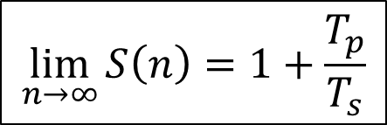

Amdahl's law
speedup
nr. processes
$$\lim_{n→∞}{S\left(n\right)=1+\frac{T_{p}}{T_{s}}}$$
$$\lim_{n→∞}{E\left(n\right)=0}$$

Slide 24
It gets worse…
Overhead!
communication takes time
finite bandwidth
non-zero latency
resource contention
memory subsystem: L3 cache, RAM, QPI
network access
nr. processes
nr. processes

Slide 25
Picking the sweet spot
sweet spot
speedup
sweet spot
2
4
8
nr. processes
efficiency
2
4
8
nr. processes

Slide 26
Throughput computing
N independent tasks
Total number of cores n << N
Execution time single task, 1 thread: t₁
Execution time single task, n threads: t_{n}
Multithreading or not?
However: memory?

Slide 27
Implementation

Slide 28
atools implementation
Front end
Bash scripts, wrappers around Python scripts
Bash features in PBS scripts
Back end
Python 2.7.x scripts

Slide 29
Bash feature refresher
Assigning result of command to variable
Creating file handle for command input from command output
$ array_ids=$(arange --data data.csv)
…
source <(aenv --data data.csv)
…
job.pbs

Slide 30
Conclusions

Slide 31
Is atools a panacea?
atools advantages
Easy to use
Supports MPI work items
Supports several schedulers (PBS torque, SGE,…)
atools disadvantages
Some overhead from the scheduler
atools is not a replacement for
Parsing files in Matlab or R
Using for-loops

Slide 32
References
Website https://github.com/gjbex/atools
Documentation http://atools.readthedocs.io/en/latest/
Developer geertjan.bex@uhasselt.be

