Slide 1
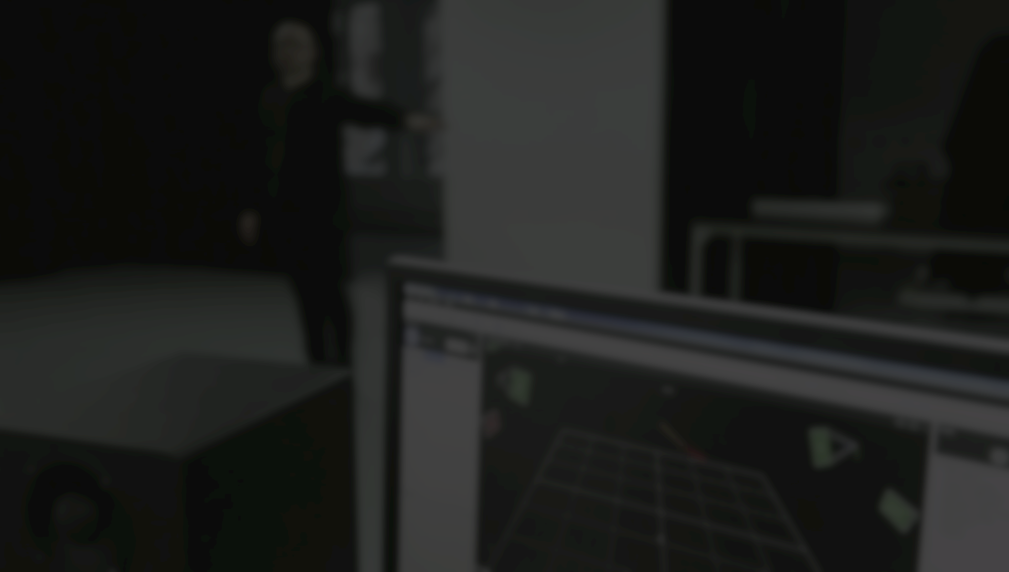
Structured interaction in the SoundThimble real-time gesture sonification framework Grigore Burloiu, Ștefan Damian, Valentin Mihai, Bogdan Golumbeanu CINETic UNATC // Bucharest, RO
AudioMostly ’17, August 23, 2017 // London, UK

Slide 2
Contents
Introduction: what is SoundThimble?
Concept and implementation
Interaction and sound design
Evaluation
Conclusion and future work

Slide 3
1. What is SoundThimble?
interactive sonification platform for Max & OSC
based on a high resolution Vicon motion capture system
oriented towards composers, performance and new media artists
employable in performance or installation scenarios
case study as an interactive audio installation

Slide 4
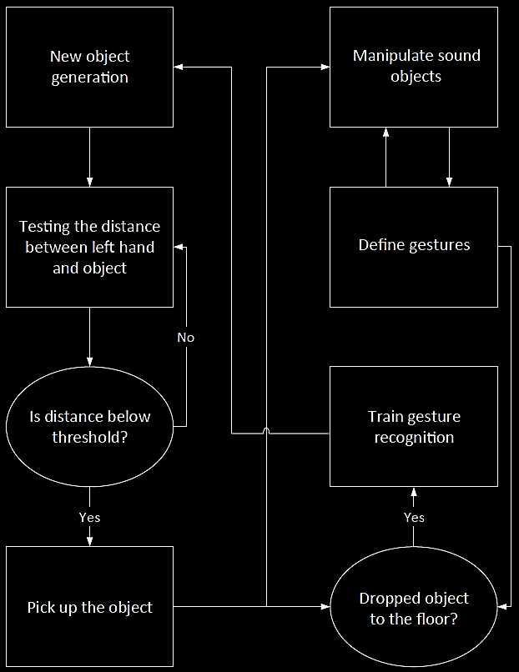
2. SoundThimble concept
sound-thimble = sound object (Schaeffer)
clearly defined sounding unit
manipulation, arrangement, composition
our proposed scenario
performative approaches
reflexive, kinaesthetic, connotative, empathetic, reduced (Worrall, 2013)
result: flexible sound interaction platform

Slide 5
2. Installation: scenario flow
Search phase
Manipulation phase
Arrangement phase

Slide 6
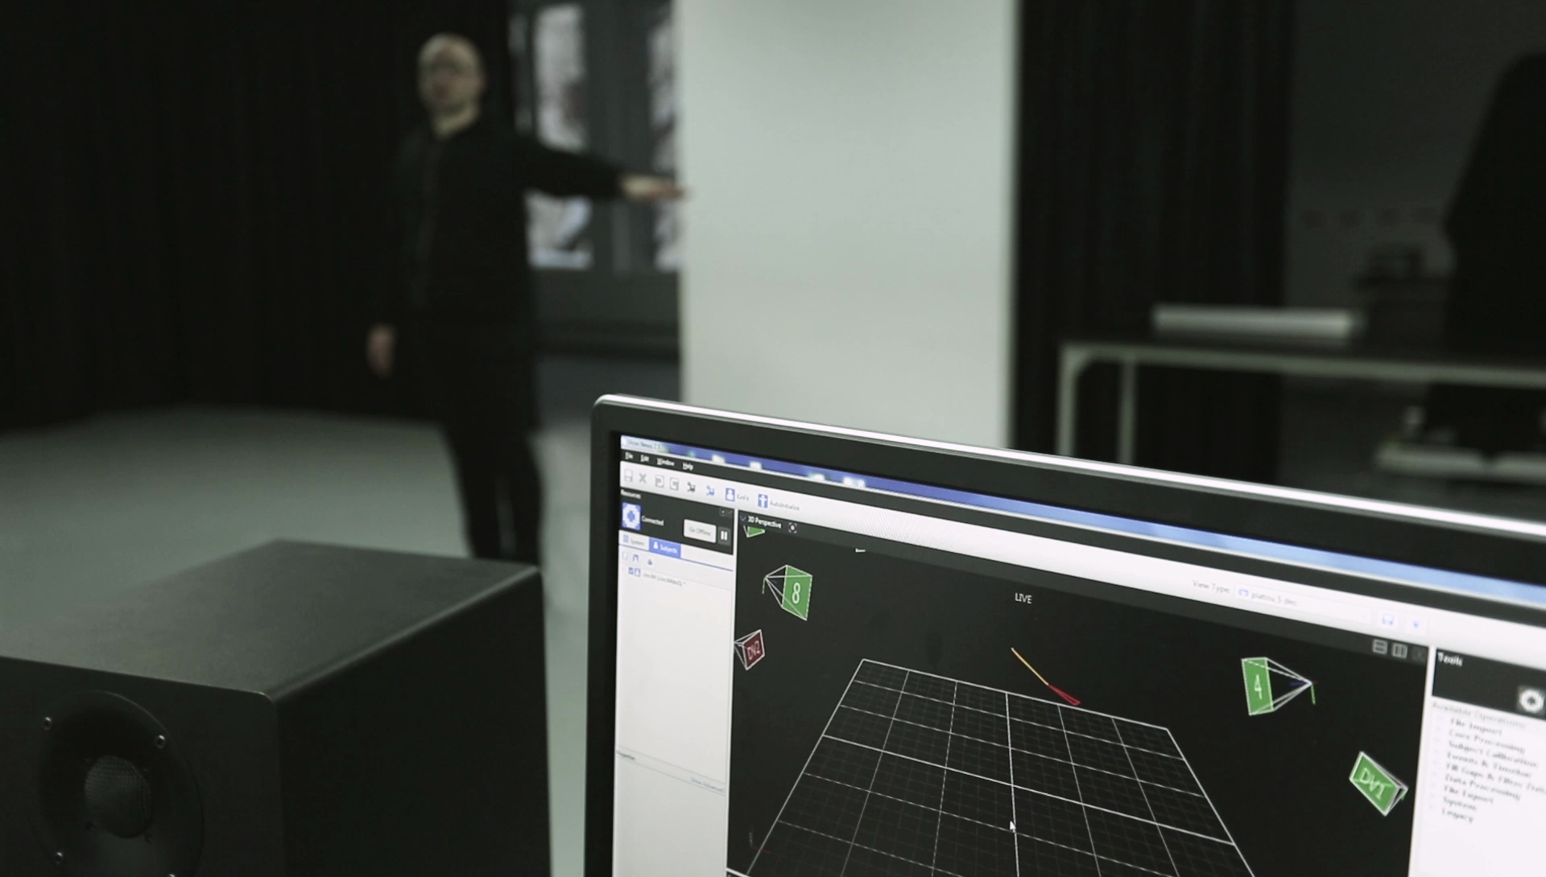

Slide 7
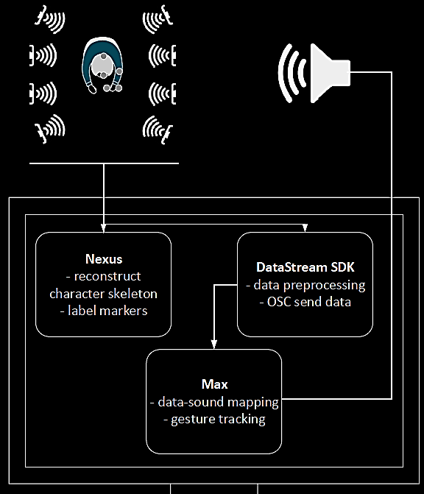
2. SoundThimble implementation
Nexus: character 5 markers, 2 segments
Max: gestures MuBu/IRCAM
Max: sonification each thimble has its own sonic features
Notes:
urmeaza demo cu recunoastere de gesturi?

Slide 8
3. Installation: interaction
X, Y, Z hand coordinates mapping
hotspots
gesture-based triggering & mapping
differentials (speed, acceleration) and relative coordinates (orthogonal/cylindrical, hand-head, hand-object, hand-hotspot etc)

Slide 9
3. Installation: sound design
Granular Synthesis
mappable parameters: grain position, size, envelope, density, pitch
Additive Synthesis
mappable parameters: main frequency, decorrelation
Spatial effects
mappable parameters: pan, spread, reverb, tone (eq)

Slide 10
4. Evaluation
14 participants
initial results
3 tests:
gesture recognition (how quick? how reliable?)
thimble search (how fast do people find it?)
sound manipulation (6 questions)

Slide 11
4. Gesture recognition
MuBu Hierarchical HMM module
trained on 3 gestures
MuBu-HHMM: continuous classification probabilities
which?
when?
when?

Slide 12
4. Gesture recognition
MuBu Hierarchical HMM module
trained on 3 gestures
161 gesture trials, 83% correct labeling
causes of wrong or no labeling:
defined gestures too short / quick / similar
inexact or reversed gesture execution

Slide 13
4. Thimble search
44 trials, 60.15s average search time
overall sample std dev: 38.55s

Slide 14
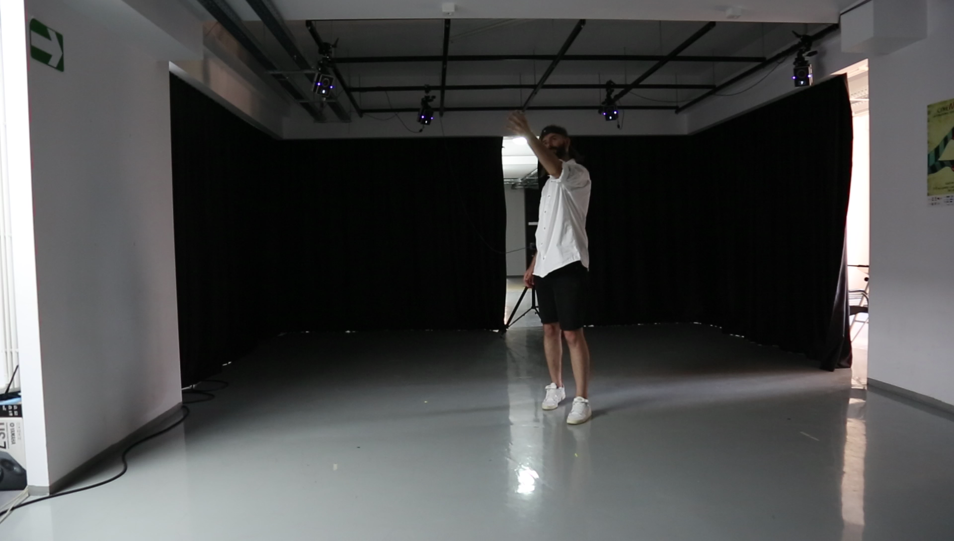

Slide 15
4. Sound manipulation
ease of finding a thimble
compelling sonic interaction
sonic expressiveness
clarity of sonic range
clarity of game structure
general platform evaluation

Slide 16
5. Conclusion and future work
multi-level platform: OSC raw data - Max modules - interactive systems
open source: portability, translatability
evaluation: further data analysis, improving design
collab w/ artists, musicians, composers
software development: Max external, fully featured SDK, other platforms (Pd, …)
multichannel-specific modules
character design: more marker configurations, 2 performers

Slide 17

Thank you!
stefandamian.sd@gmail.com
gburloiu@gmail.com

