Slide 1
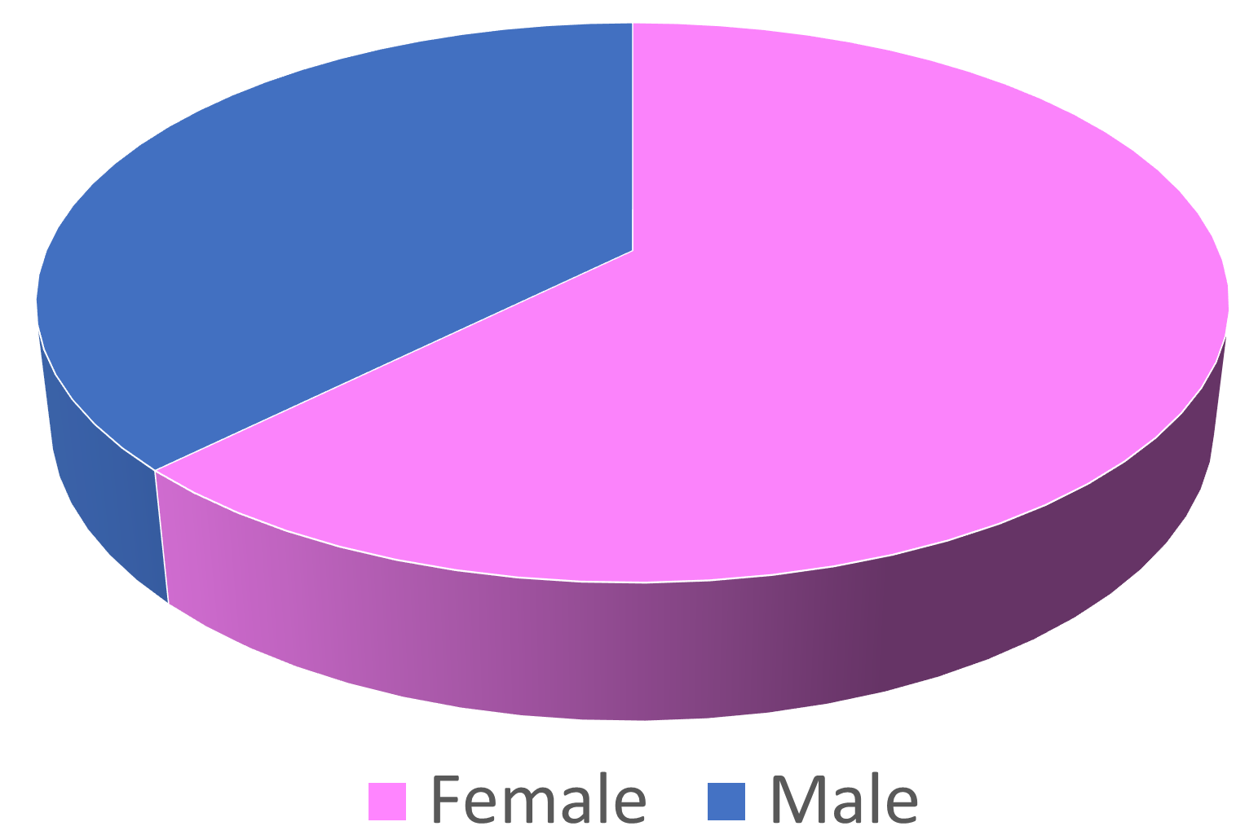
Centre ID | Number of patients | Number of visits
A | 1 | 6
B | 21 | 21
C | 3 | 21
D | 137 | 137
E | 53 | 105
F | 1 | 1
G | 21 | 22
H | 48 | 175
I | 10 | 33
J | 1 | 1
K | 14 | 19
L | 2 | 2
M | 24 | 111
N | 18 | 20
O | 25 | 27
P | 3 | 3
Q | 5 | 20
R | 6 | 17
 | Total = 393 | Total = 741

Slide 4
Notes:
Combined prednisolone and prednisone

Slide 5
 | Overall |  | Last 12m |  | 1-5 years
Single | 351 | 91.15% | 114 | 84.4 | 237 | 94.8
Combined | 34 | 8.85% | 21 | 15.6 | 13 | 5.2
Total | 385 |  | 135 |  | 250
Combinations:
Notes:
Figure linked to excel!

