Slide 1
EchoMind Enterprise — The Private AI Platform
A Secure, On-Premises AI Platform for Organizations
Ajace AI · Marketing Playbook · 2026-06-22

Slide 2
Agenda
01 EchoMind Enterprise — The Private AI Platform
02 The Problem: AI You Cannot Send to the Cloud
Ajace AI
2

Slide 3
01
EchoMind Enterprise — The Private AI Platform

Slide 4
EchoMind Enterprise — The Private AI Platform
EchoMind Enterprise is a private, on-premises AI platform designed for organizations that require the highest level of data security and control. By running on a customer's own NVIDIA GPU hardware, the platform provides a secure and reliable environment for modern AI capabilities.
Chat and conversation intelligence
Live meeting intelligence
Voice and speech recognition
Document generation and content creation
Ajace AI
4

Slide 5

EchoMind Enterprise — The Private AI Platform
Ajace AI
5

Slide 6

EchoMind Enterprise — The Private AI Platform
Ajace AI
6

Slide 7
02
The Problem: AI You Cannot Send to the Cloud

Slide 8
The Problem: AI You Cannot Send to the Cloud
Cloud AI assistants pose a significant risk to organizations that handle sensitive data. These assistants quietly send prompts, files, and recordings to outside vendors, which can compromise confidentiality and compliance. For instance, a cloud AI assistant may transmit sensitive information, such as meeting notes or customer data, to a third-party server without the organization's knowledge or consent.
Sensitive data is transmitted to outside vendors
Compliance and confidentiality are compromised
Organizations risk data breaches and reputational damage
EchoMind Enterprise solves this problem by providing a private, on-premises AI platform that runs entirely on the customer's own NVIDIA GPU hardware. This means that all AI processing occurs locally, without the need for internet connectivity or third-party AI APIs.
Ajace AI
8

Slide 9
Comparison of Cloud AI Assistants and EchoMind Enterprise
Cloud AI Assistants | EchoMind Enterprise
Send prompts, files, and recordings to outside vendors | Run entirely on customer's own NVIDIA GPU hardware
Risk data breaches and reputational damage | Maintain confidentiality and compliance
Compromise compliance and confidentiality | Ensure data sovereignty and control
Ajace AI
9

Slide 10

The Problem: AI You Cannot Send to the Cloud
Ajace AI
10

Slide 11
What EchoMind Enterprise Is
EchoMind Enterprise is a comprehensive private AI platform that offers five distinct modules to cater to various organizational needs. Each module is designed to provide a seamless and secure experience, ensuring that sensitive data remains within the organization's premises.
Knowledge Chat
Live Transcription
Boardroom
Voice Conversation
Document Studio
These modules are the core components of the EchoMind Enterprise platform, and each one is designed to address specific use cases and requirements.
Ajace AI
11

Slide 12
EchoMind Enterprise Modules
Module | Description
Knowledge Chat | A conversational AI that provides real-time information and insights to users
Live Transcription | A module that enables real-time transcription of audio and video content
BoardRoom | A module designed for meeting intelligence, providing insights and summaries of discussions
Voice Conversation | A module that enables secure and private voice conversations
Document Studio | A module for document generation, allowing users to create high-quality documents with ease
Ajace AI
12

Slide 13
What EchoMind Enterprise Is
Each module is carefully designed to ensure that sensitive data remains within the organization's control, eliminating the risk of data breaches or unauthorized access.
Ajace AI
13

Slide 14

What EchoMind Enterprise Is
Ajace AI
14

Slide 15
The Five Modules
EchoMind Enterprise is comprised of five distinct modules, each designed to address a specific need in the organization's AI strategy. These modules work together seamlessly to provide a comprehensive AI solution.
Chat
Live Meeting Intelligence
Voice
Document Generation
Model Management
Here's a closer look at each of the five modules and their features:
Ajace AI
15

Slide 16
The Five Modules
Module | Description
Chat | Enables organizations to build custom chatbots that can interact with customers, employees, or other stakeholders.
Live Meeting Intelligence | Provides real-time insights and analytics on meeting discussions, allowing for more informed decision-making.
Voice | Empowers organizations to create custom voice assistants that can interact with customers, employees, or other stakeholders.
Document Generation | Automates the creation of documents, reports, and other written content, reducing manual workload and increasing productivity.
Model Management | Allows organizations to manage and govern their AI models, ensuring compliance with regulatory requirements and maintaining data security.
Ajace AI
16

Slide 17
The Five Modules
Each module is designed to be highly customizable, allowing organizations to tailor the solution to their specific needs and goals.
Ajace AI
17

Slide 18

The Five Modules
Ajace AI
18

Slide 19
EchoMind Edge Devices
EchoMind edge devices are designed to connect to the organization's knowledge base while remaining fully offline. This is made possible by the platform's ability to run on-premises, using the customer's own NVIDIA GPU hardware. The edge devices can be deployed in the field, allowing for real-time processing and analysis of data without the need for an internet connection.
The edge devices can be deployed in various locations, such as data centers, remote offices, or even on-site with customers.
Ajace AI
19

Slide 20
EchoMind Edge Devices
Edge Device Type | Description
Standard Edge Device | A standard edge device that connects to the host's knowledge base and runs AI models locally.
Advanced Edge Device | An advanced edge device that includes additional features such as real-time data processing and advanced analytics.
Ajace AI
20

Slide 21

EchoMind Edge Devices
Ajace AI
21

Slide 22
Secure Offline-to-Online Content Export
In the EchoMind Enterprise platform, the secure process of exporting content from the offline world to the online layer is designed to mitigate the risks associated with data transfer. This is achieved through a carefully controlled and audited process that ensures the integrity and confidentiality of sensitive information.
The offline-to-online content export process involves several key steps:
1. Content is first extracted from the offline environment and stored in a secure, isolated area.
2. The extracted content is then reviewed and validated to ensure that it meets the required security and compliance standards.
3. Once validated, the content is encrypted and packaged for transfer to the online environment.
4. The encrypted content is then transmitted to the online layer using secure, end-to-end encryption protocols.
5. The online environment verifies the authenticity and integrity of the content before making it available for use.
Ajace AI
22

Slide 23
Secure Offline-to-Online Content Export Process
Step | Description | Risk Mitigation
1. Content extraction | Extracting content from the offline environment | Data loss or corruption due to improper extraction
2. Content validation | Validating content to ensure it meets security and compliance standards | Invalid or incomplete content due to inadequate validation
3. Content encryption | Encrypting content for secure transfer | Data breaches or unauthorized access due to weak encryption
4. Secure transmission | Transmitting content using end-to-end encryption protocols | Data interception or eavesdropping due to insecure transmission
5. Online verification | Verifying content authenticity and integrity | Data tampering or corruption due to inadequate verification
Ajace AI
23

Slide 24

Secure Offline-to-Online Content Export
Ajace AI
24

Slide 25
Offline and Online Layers
EchoMind Enterprise's architecture is designed with two distinct layers: an offline layer and an online layer. This separation of concerns enables customers to maintain the highest level of security and control over their sensitive work.
The offline layer consists of the AI models and the NVIDIA GPU hardware, which run locally on the customer's premises.
This layer is responsible for processing and generating insights, without any internet dependency at runtime.
The online layer, on the other hand, is a web-based interface that allows customers to configure, monitor, and manage the AI platform.
Ajace AI
25

Slide 26
Key differences between the offline and online layers of EchoMind Enterprise
Offline Layer | Online Layer
AI models and NVIDIA GPU hardware | Web-based interface for configuration, monitoring, and management
No internet dependency at runtime | Internet required for configuration and management
Air-gapped and isolated | Secure and controlled access
Ajace AI
26

Slide 27
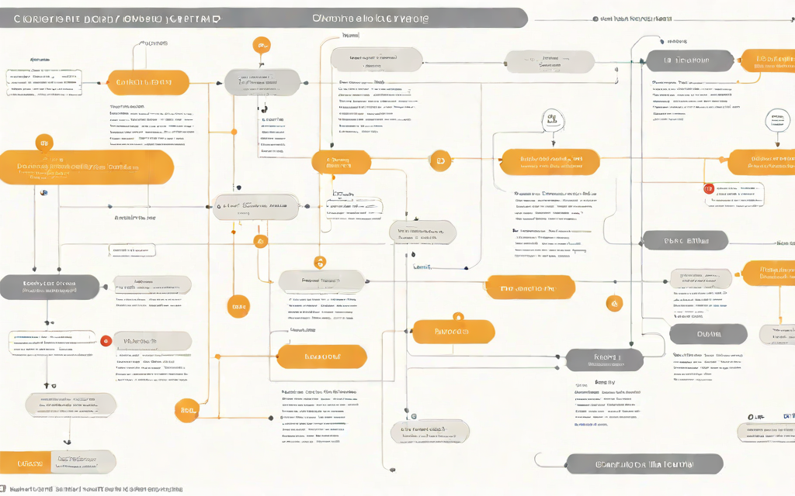
Offline and Online Layers
Ajace AI
27

Slide 28
A Building-Block Platform of N Customizations
EchoMind Enterprise is a building-block platform that allows organizations to customize and assemble the modules and layers to solve their specific problems. This modular design enables Ajace AI to perform N customizations, tailoring the platform to meet the unique needs of each customer.
The platform's modularity enables customers to:
select the specific AI capabilities they need
configure the platform to meet their unique requirements
integrate with existing systems and infrastructure
Ajace AI
28

Slide 29
Customization Options
Customization Type | Description
Model Selection | Customers can choose from a range of AI models to suit their needs
Configuration Options | The platform offers a range of configuration options to meet specific requirements
Integration Capabilities | EchoMind can be integrated with existing systems and infrastructure
Ajace AI
29

Slide 30

A Building-Block Platform of N Customizations
Ajace AI
30

Slide 31
We Do Not Sell Hardware We Solve Your Problem
Ajace AI does not sell hardware, but rather provides a private, on-premises AI platform that solves the problem of cloud AI assistants quietly sending prompts, files, and recordings to an outside vendor. Our solution is designed to meet the needs of organizations that require complete control over their data and cannot send it to the cloud.
By not selling hardware, we focus on providing a comprehensive solution that addresses the specific needs of each organization. Our experts will work with you to determine the right hardware and infrastructure required to ensure that your private AI platform runs smoothly and efficiently.
Our solution is not a hardware sale, but rather a tailored approach to meet your specific needs.
We recommend the right hardware and infrastructure to ensure seamless integration and optimal performance.
Ajace AI
31

Slide 32
Built on Local AI
EchoMind Enterprise's local AI architecture is designed to provide secure and efficient AI processing within the customer's premises. At the core of this architecture lies Llama-3.1-8B, a large language model that enables the platform to generate human-like text, respond to voice commands, and provide live meeting intelligence.
The platform utilizes TensorRT-LLM for efficient and high-performance AI inference, ensuring fast processing of complex AI tasks.
Furthermore, EchoMind's AI engine leverages nomic-embed-text for advanced text embedding capabilities, enabling the platform to understand and process vast amounts of text data with unparalleled accuracy and speed.
Ajace AI
32

Slide 33
Key Components of EchoMind's Local AI Architecture
Component | Description
Llama-3.1-8B | Large language model for text generation and response.
TensorRT-LLM | Efficient AI inference engine for fast processing.
nomic-embed-text | Advanced text embedding capabilities for text understanding.
Ajace AI
33

Slide 34
Who It Is For
EchoMind Enterprise is designed for organizations that require a high level of security and control over their data. This includes defense, government, legal, finance, and healthcare teams that handle sensitive information and cannot risk sending it to the cloud.
defense teams that require secure AI-powered threat analysis and intelligence gathering
government agencies that need to process sensitive data without internet dependency
legal firms that handle confidential client information and require AI-powered document review and analysis
finance institutions that need to analyze and generate reports on sensitive financial data without internet access
healthcare organizations that require secure AI-powered medical research and analysis
Ajace AI
34

Slide 35
Target Industries and Requirements
Industry | Requirements
Defense | Secure AI-powered threat analysis and intelligence gathering
Government | Processing sensitive data without internet dependency
Legal | AI-powered document review and analysis
Finance | Analyzing and generating reports on sensitive financial data without internet access
Healthcare | Secure AI-powered medical research and analysis
Ajace AI
35

Slide 36
Get Started With Ajace AI
To get started with Ajace AI, the first step is to define the scope and requirements of your EchoMind project. This involves identifying the specific use cases and functionalities you need to implement, such as chat, live meeting intelligence, voice, and document generation.
Define the scope and requirements of your EchoMind project
Identify the specific use cases and functionalities you need to implement
Determine the infrastructure and hardware requirements for your project
Work with Ajace AI to design and shape EchoMind to meet your security posture and compliance needs
Once you have a clear understanding of your project's requirements, you can work with Ajace AI to design and shape EchoMind to meet your specific needs. This includes advising on the infrastructure and hardware requirements that fit your security posture and compliance needs.
Ajace AI
36

Slide 37
APPENDIX
EchoMind Enterprise is designed to meet the stringent security requirements of organizations that cannot send their data to the cloud. To ensure maximum flexibility and control, the platform can be configured to meet specific system requirements.
The platform requires a dedicated NVIDIA GPU with a minimum of 8GB of VRAM.
The system requirements for EchoMind Enterprise are as follows:
Operating System: Windows 10 or Linux (Ubuntu 18.04 or later)
NVIDIA GPU: Quadro or Tesla with a minimum of 8GB of VRAM
CPU: Intel Core i7 or AMD Ryzen 7 (3.5GHz or higher)
For organizations that require a high level of security, EchoMind Enterprise can be configured to run in a completely air-gapped environment. This means that the platform can be set up to operate without any internet connection, ensuring that data remains completely secure and confidential.
Ajace AI
37

Slide 38
System Requirements for EchoMind Enterprise
System Requirement | Description
Operating System | Windows 10 or Linux (Ubuntu 18.04 or later)
NVIDIA GPU | Quadro or Tesla with a minimum of 8GB of VRAM
CPU | Intel Core i7 or AMD Ryzen 7 (3.5GHz or higher)
Ajace AI
38

Slide 39
Thank you
Ajace AI

