Slide 1
Transport Layer
Notes:
5.1 Transport Layer Protocols

Slide 2
Transport Layer : Objectives
Describe the purpose of the transport layer in managing the transportation of data in end-to-end communication.
Describe characteristics of the TCP and UDP protocols, including port numbers and their uses.
Explain how TCP session establishment and termination processes facilitate reliable communication.
Explain how TCP protocol data units are transmitted and acknowledged to guarantee delivery.
Explain the UDP client processes to establish communication with a server.
Determine whether high-reliability TCP transmissions, or non-guaranteed UDP transmissions, are best suited for common applications.
Notes:
Chapter 5: Objectives

Slide 3
Transportation of Data Role of the Transport Layer
The transport layer is responsible for establishing a temporary communication session between two applications and delivering data between them.
TCP/IP uses two protocols to achieve this:
Transmission Control Protocol (TCP)
User Datagram Protocol (UDP)
Primary Responsibilities of Transport Layer Protocols
Tracking the individual communication between applications on the source and destination hosts
Segmenting data for manageability and reassembling segmented data into streams of application data at the destination
Identifying the proper application for each communication stream
Notes:
5.1.1.1 and 5.1.1.2 Role of the Transport Layer

Slide 4
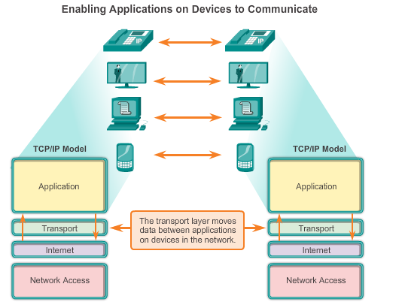
Transportation of Data Role of the Transport Layer (Cont.)
Notes:
5.1.1.2 Role of the Transport Layer (Cont.)

Slide 5
Transportation of Data Conversation Multiplexing
Segmenting the Data
Enables many different communications, from many different users, to be interleaved (multiplexed) on the same network, at the same time.
Provides the means to both send and receive data when running multiple applications.
Header added to each segment to identify it.
Notes:
5.1.1.3 Conversation Multiplexing

Slide 6
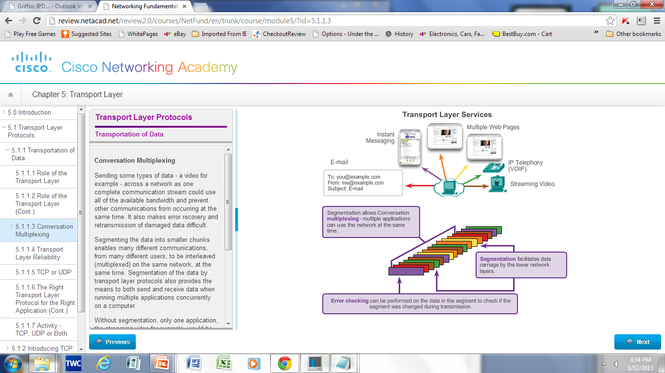
Transportation of Data Conversation Multiplexing (Cont.)
Notes:
5.1.1.3 Conversation Multiplexing (Cont.)

Slide 7
Introducing TCP and UDP Introducing TCP (Cont.)
Defined in RFC 793
Connection-oriented – Creates a session between the source and destination
Reliable delivery – Retransmits lost or corrupt data
Ordered data reconstruction – Reconstructs numbering and sequencing of segments
Flow control – Regulates the amount of data transmitted
Stateful protocol – Tracks the session
Notes:
5.1.2.1 Introducing TCP (cont.)

Slide 8
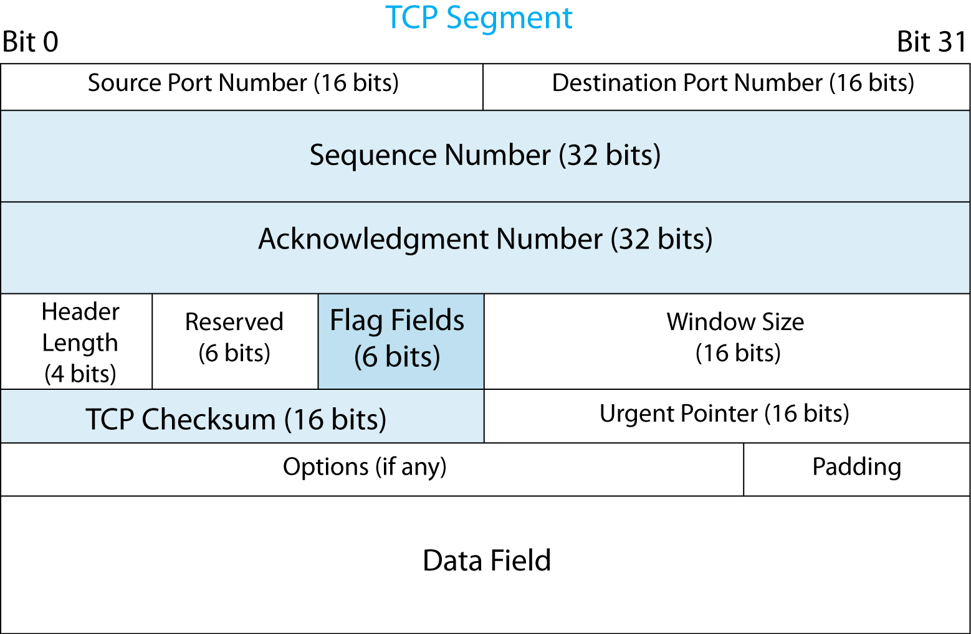
TCP Segment
The Sequence Number field gives the TCP segment’s order in the session.
The Acknowledgement Number field indicates which segment is being acknowledged.
These fields are 32 bits long.
Notes:
Read the text.
Go over the illustration.

Slide 9
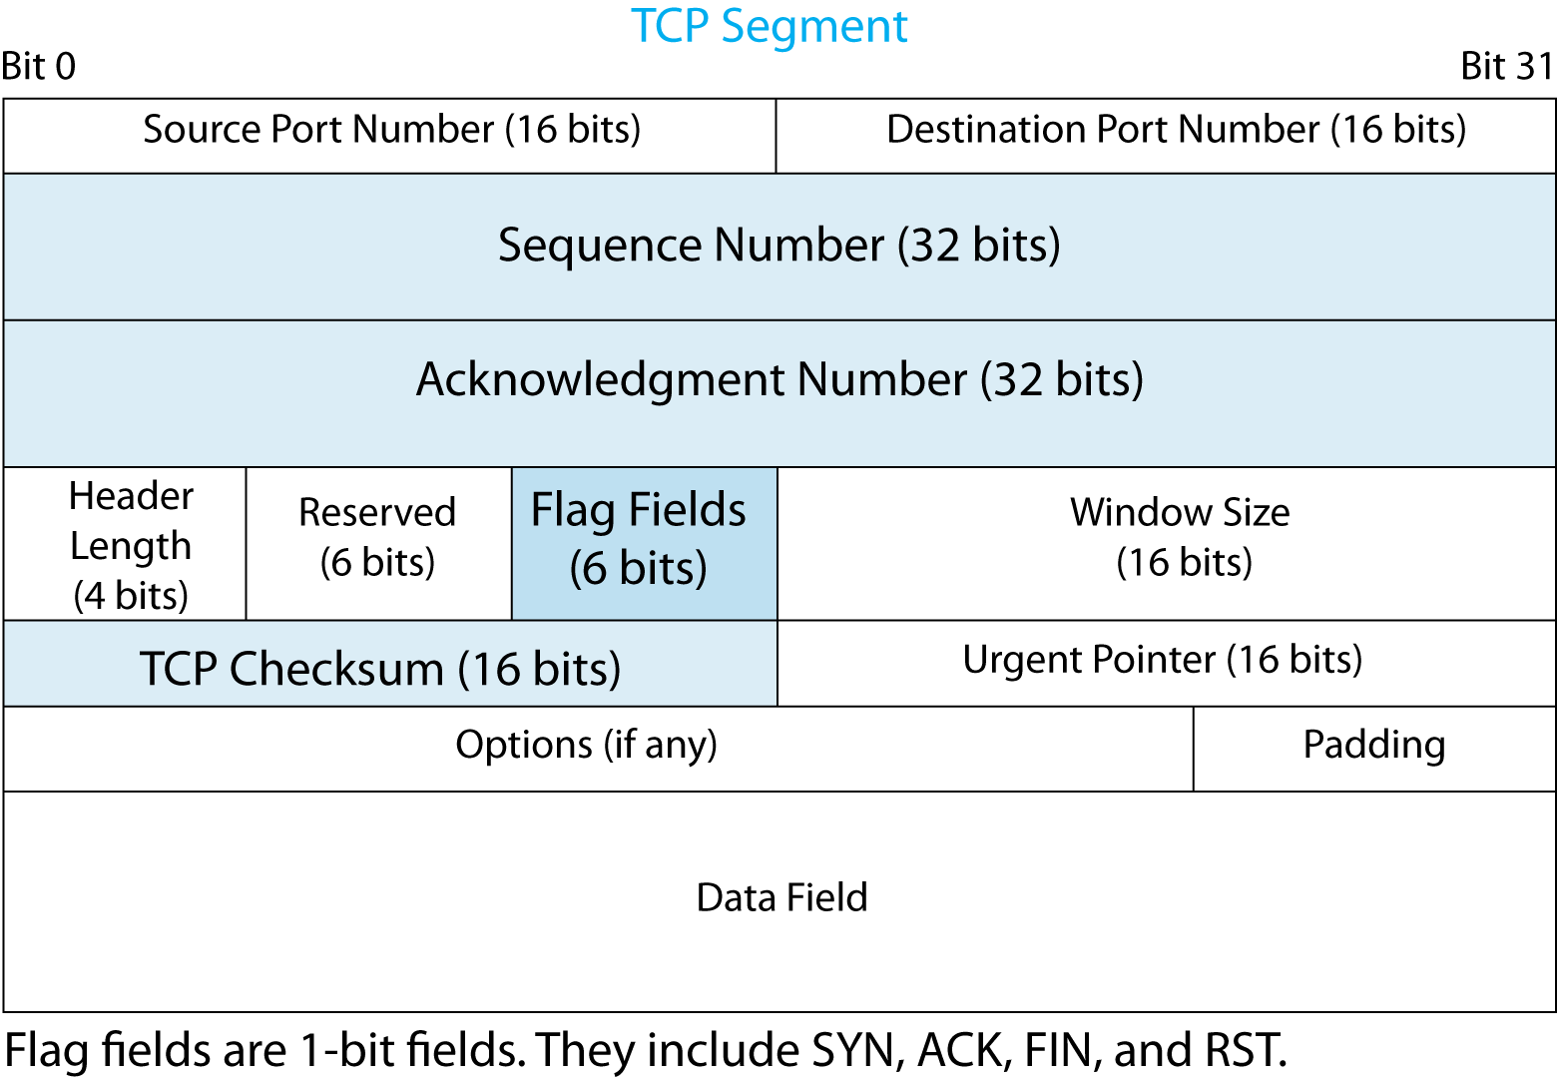
TCP Segment
Flag fields are one-bit fields.
If the value is 1, the flag field is Set.
If the value is 0, the flag field is Not Set.
Flag bits are SYN, ACK, FIN, URG, PSH and RST.
TCP has six flag fields.
Notes:
Read the text.
Go over the illustration.

Slide 10
Purposes of the TCP Flag fields
URG flag is used to inform a receiving station that certain data within a segment is urgent and should be prioritized.
PSH flag informs the receiving host that the data should be pushed up to the receiving application immediately.
FIN flag indicates the end of data transmission to finish a TCP connection. Verifies integrity of segment header and data. Terminates connection
SYN. Used to initiate and establish a connection. It also helps to synchronize sequence numbers between devices.
ACK. Helps to confirm to the other side that it has received the SYN.
RST. Used to RESET TCP connection due to unrecoverable errors.

Slide 11


TCP Segment
The TCP Checksum field is for error correction.
The sender computes the value in the field.
If the receiver computes the same value,
it sends an ACK.
If not, the receiver discards the segment and
sends nothing. The sender will resend the
segment. TCP is reliable.
Notes:
Read the text.
Go over the illustration.

Slide 12
TCP Segment
TCP segments always have headers.
SOME TCP segments do not have data fields.
Supervisory segments, such as SYN, do not carry data because the information to be conveyed, such as opening a connection, delivers no data.
TCP segments NEVER have trailers.
Notes:
Read the text.

Slide 13
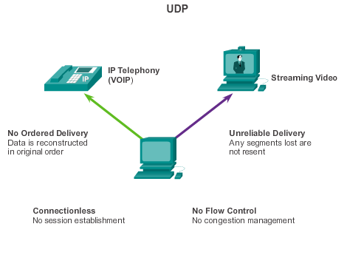
Introducing TCP and UDP Introducing UDP
Defined in RFC 768
Connectionless
Unreliable delivery
No ordered data reconstruction
No flow control
Stateless protocol
Applications that use UDP:
Domain Name System (DNS)
Video Streaming
VoIP
Notes:
5.1.2.3 Introducing UDP

Slide 14
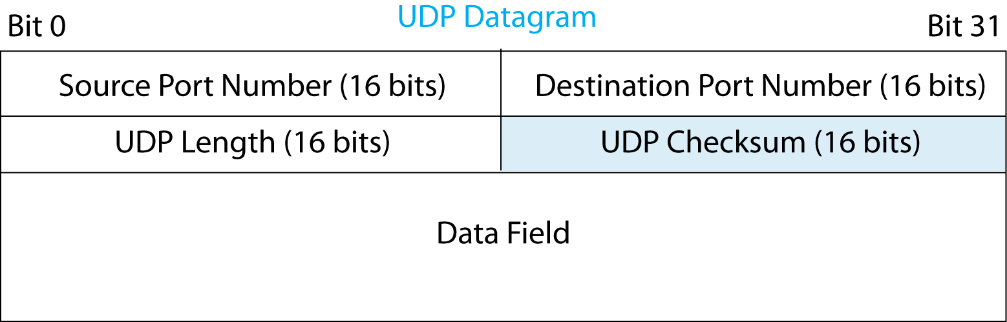
2.11: UDP Datagram
In UDP, the application message must fit into a single UDP datagram.
So, few header fields are needed.
The UDP Checksum field is for error detection.
If there is an error, UDP discards the datagram.
If it does not detect an error, it accepts the datagram but does not send an acknowledgement.
Notes:
Read the text.
Go over the illustration.

Slide 15
Transport Layer Standards
TCP
UDP
Connection-oriented
Reliable
Places a heavy load on the network
Connectionless
Unreliable
Places a light load on the network
Which is better?

Slide 16
Transportation of Data The Right Transport Layer Protocol
TCP or UDP
There is a trade-off between the value of reliability and the burden it places on the network.
Application developers choose the transport protocol based on the requirements of their applications.
Notes:
5.1.1.7 The Right Transport Layer Protocol for the Right Application

Slide 17
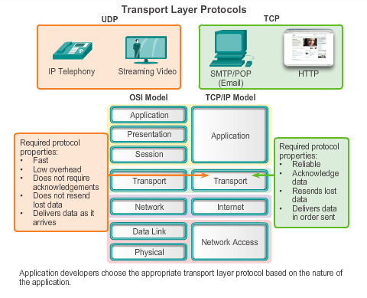
Transportation of Data The Right Transport Layer Protocol (Cont.)
Notes:
5.1.1.7 The Right Transport Layer Protocol for the Right Application

Slide 18
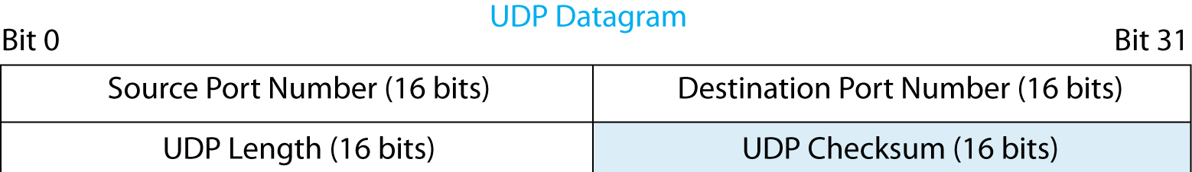
Port Number Fields
Both TCP and UDP headers begin with
a Source Port Number field and
a Destination Port Number field.
Notes:
Read the text.
Go over the illustration.

Slide 19
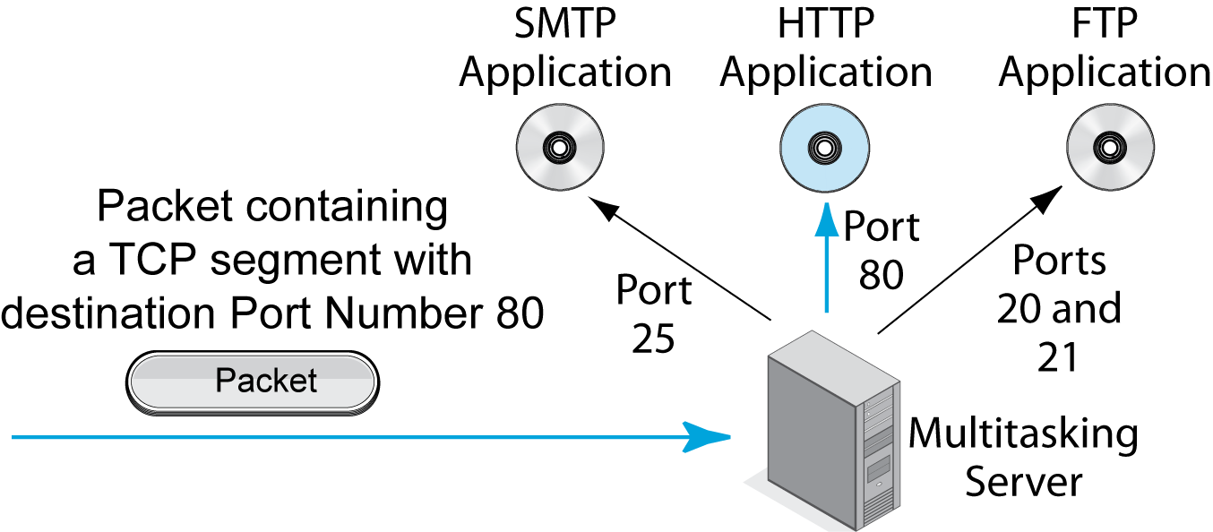
Port Numbers on Servers
Multitasking servers run multiple applications.
Each application is assigned a port number.
Notes:
Read the text.
Go over the illustration.
Demo…. On a server

Slide 20
Port Numbers on Servers
Major applications usually are given
well-known port numbers from 0 to 1023.
HTTP’s well-known port number is 80.
The File Transfer Protocol has two: 20 and 21.
Notes:
Read the text.
Go over the illustration.

Slide 21
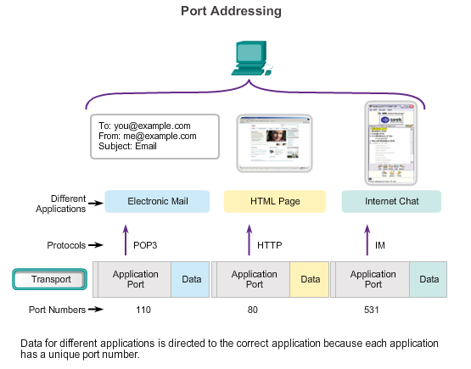
Separating Multiple Communications
TCP and UDP use port numbers to differentiate between applications.
Notes:
5.1.2.5 Separating Multiple Communications

Slide 22
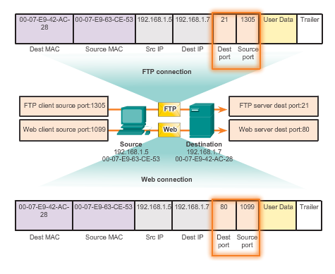
TCP and UDP Port Addressing (Cont.)
The combination of the source and destination IP addresses and the source and destination port numbers is known as a Socket.
Notes:
5.1.2.7 TCP and UDP Port Addressing (Cont.)

Slide 23
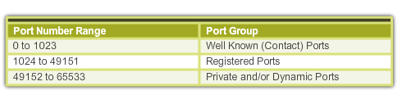
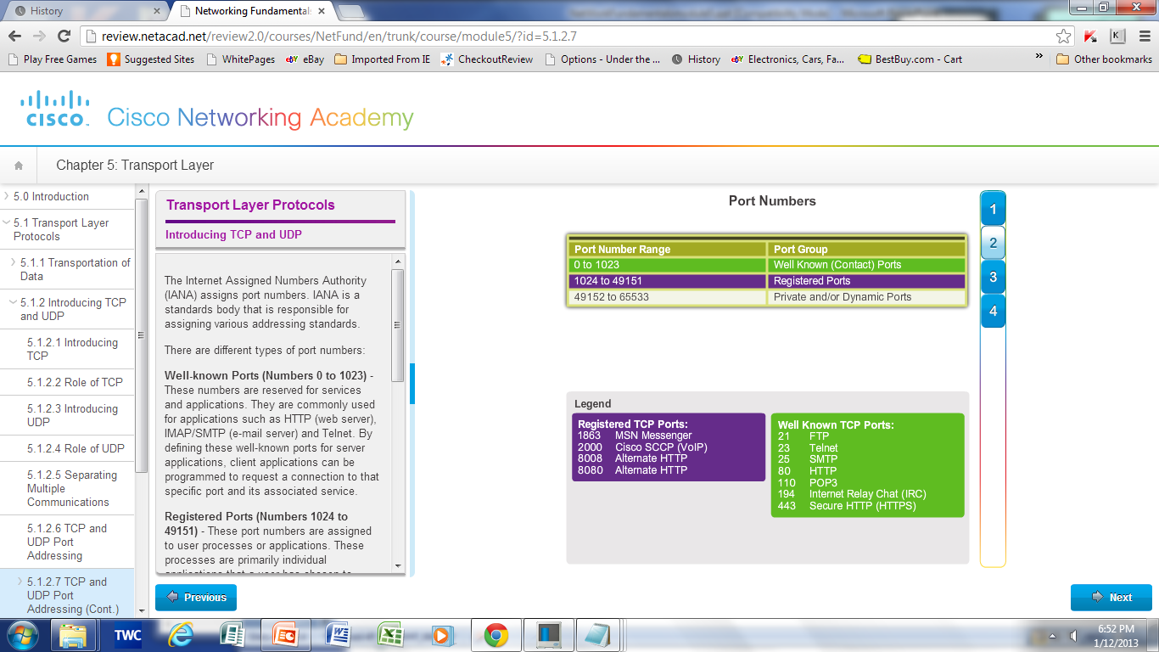
TCP and UDP Port Addressing (Cont.)
TCP Port Numbers
Notes:
5.1.2.8 TCP and UDP Port Addressing (Cont.)

Slide 24
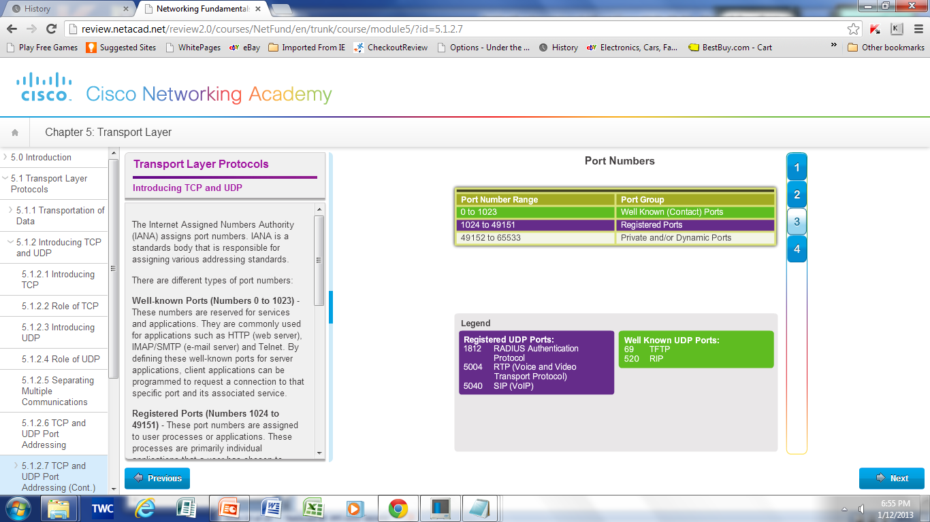
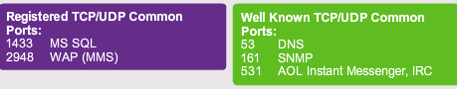
TCP and UDP Port Addressing (Cont.)
UDP Port Numbers
Notes:
5.1.2.8 TCP and UDP Port Addressing (Cont.)

Slide 25
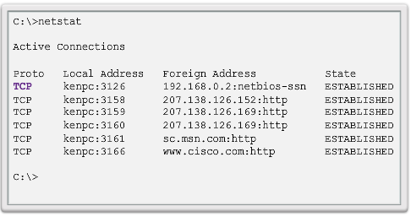
TCP and UDP Port Addressing (Cont.)
netstat is used to examine TCP connections that are open and running on a networked host.
Notes:
5.1.2.9 TCP and UDP Port Addressing (Cont.)

Slide 26
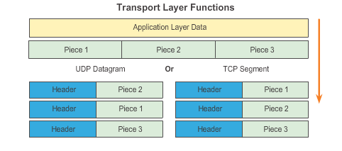
TCP and UDP Segmentation
The Transport Layer divides the data into pieces called segments and adds a header for delivery over the network.
Notes:
5.1.2.10 TCP and UDP Segmentation

Slide 27
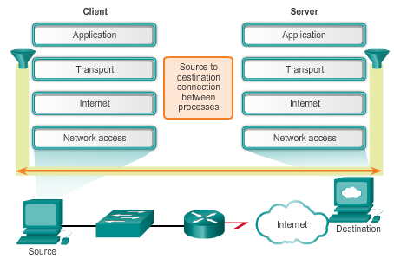
TCP Reliable Delivery
The reliability of TCP communication is obtained through the use of connection-oriented sessions.
Notes:
5.2.1.1 TCP Reliable Delivery

Slide 28
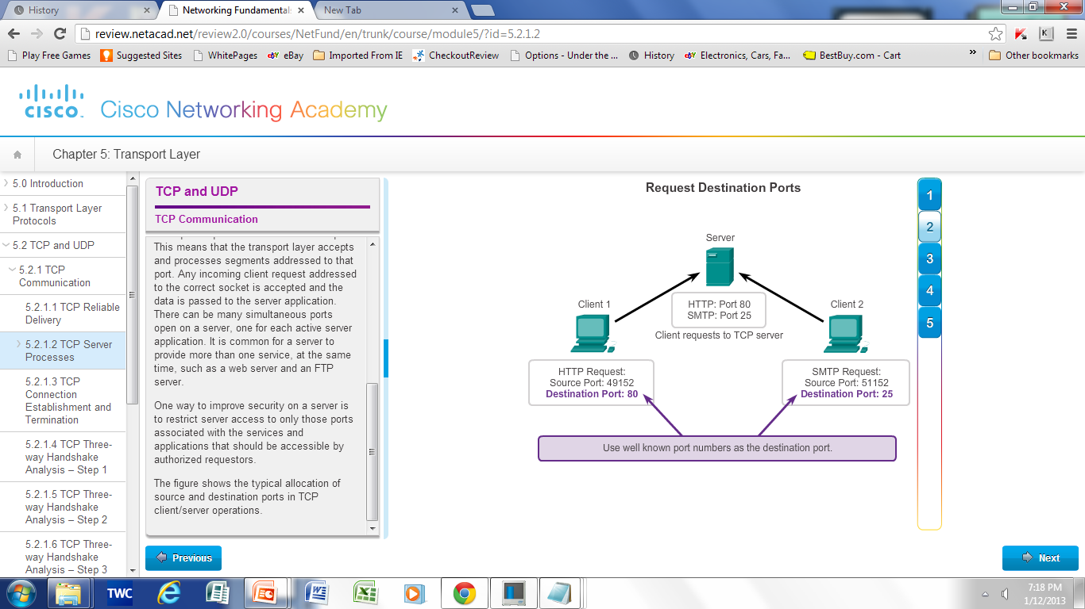
TCP Server Processes
Notes:
5.2.1.2 TCP Server Processes

Slide 29
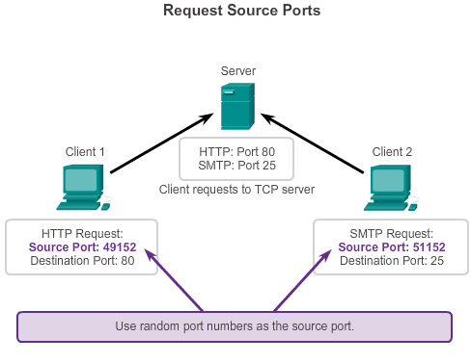
TCP Server Processes (Cont.)
Notes:
5.2.1.2 TCP Server Processes (Cont.)

Slide 30
TCP Connection, Establishment, and Termination
Three-Way Handshake
Establishes that the destination device is present on the network
Verifies that the destination device has an active service and accepts requests on the destination port number that the initiating client intends to use for the session
Informs the destination device that the source client intends to establish a communication session on that port number
Notes:
5.2.1.3 TCP Connection, Establishment, and Termination

Slide 31
TCP Message Types
Message | Description
SYN | Used to initiate and establish a connection. It also helps you to synchronize sequence numbers between devices.
ACK | Helps to confirm to the other side that it has received the SYN.
SYN-ACK | SYN message from local device and ACK of the earlier packet.
FIN | Used to terminate a connection.

Slide 32
Three-way Handshake
Step 1: In the first step, the client establishes a connection with a server. It sends a segment with SYN and informs the server about the client should start communication, and with what should be its sequence number.
Step 2: In this step, server responds to the client request with SYN-ACK signal set. ACK helps you to signify the response of segment that is received and SYN signifies what sequence number it should able to start with the segments.
Step 3: In this final step, the client acknowledges the response of the Server, and they both create a stable connection that will begin the actual data transfer process.

Slide 33
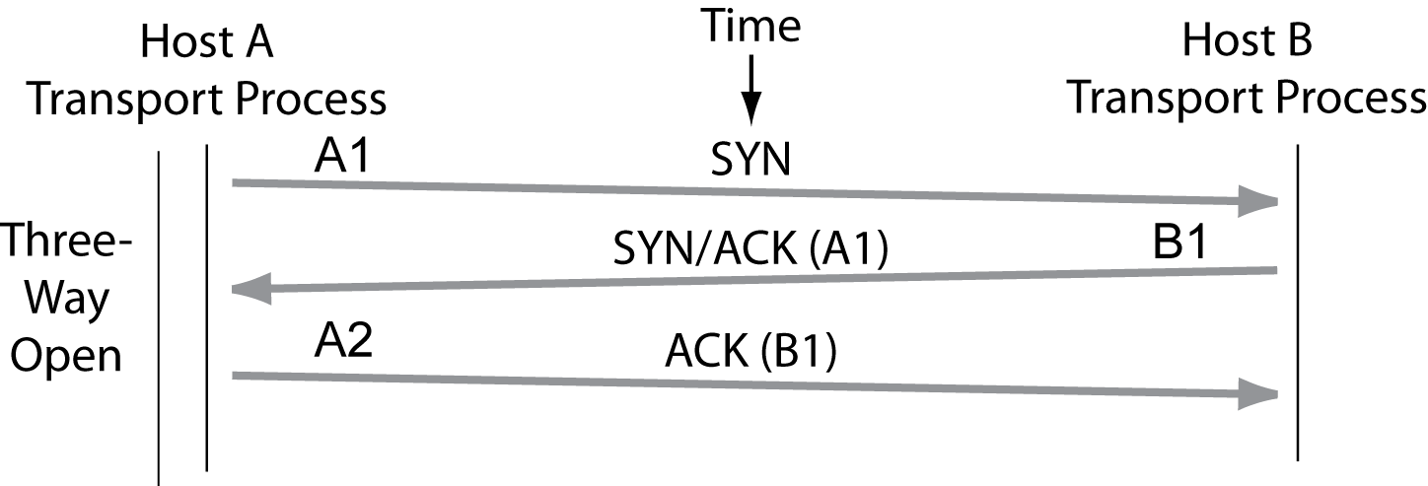
A TCP Connection
A connection opening requires three segments.
SYN segments have only headers with the SYN bit set.
Notes:
Go through the figure.

Slide 34
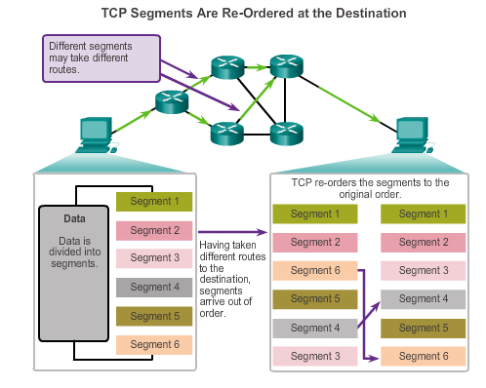
Protocol Data Units TCP Reliability – Ordered Delivery
Sequence numbers are used to reassemble segments into the original order.
Notes:
5.2.2.1 TCP Reliability – Ordered Delivery

Slide 35
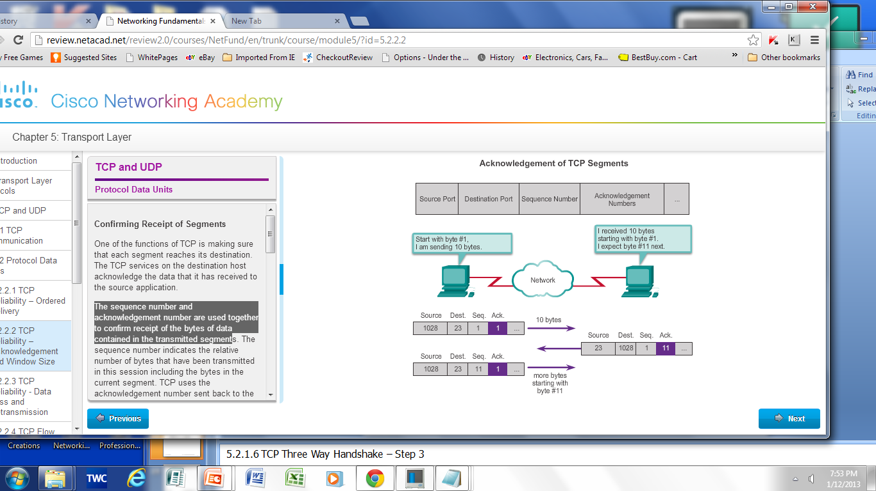
TCP Reliability – Acknowledgement and Window Size
The sequence number and acknowledgement number are used together to confirm receipt.
The window size is the amount of data that a source can transmit before an acknowledgement must be received.
Notes:
5.2.2.2 TCP Reliability – Acknowledgement and Window size

Slide 36
Protocol Data Units TCP Reliability – Data Loss and Retransmission
Data Loss and Retransmission
When TCP at the source host has not received an acknowledgement after a predetermined amount of time, it goes back to the last acknowledgement number that it received and retransmits data from that point forward.
Flow Control
Uses the Window Size field in the TCP header to specify the amount of data that can be transmitted before an acknowledgement must be received.
Adjusts the effective rate of data transmission to the maximum flow that the network and destination device can support without loss.
Manages the rate of transmission so that all data is received and retransmissions are minimized.
Notes:
5.2.2.3 TCP Reliability - Data Loss and Retransmission
5.2.2.4 TCP Flow Control - Window Size and Retransmission

Slide 37
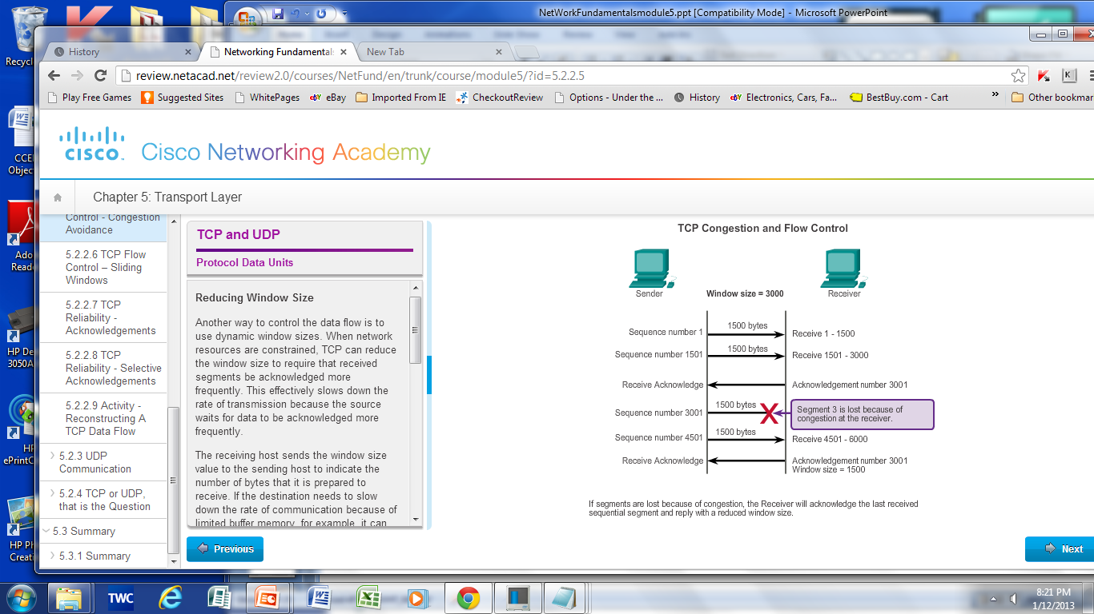
Protocol Data Units TCP Flow Control – Congestion Avoidance
Notes:
5.2.2.5 TCP Flow Control – Congestion Avoidance

Slide 38
UDP Communication UDP Low Overhead vs. Reliability
UDP:
Simple protocol that provides the basic transport layer function
Used by applications that can tolerate small loss of data
Used by applications that cannot tolerate delay
UDP used by:
DNS
Simple Network Management Protocol (SNMP)
Dynamic Host Configuration Protocol (DHCP)
Trivial File Transfer Protocol (TFTP)
IP telephony or VoIP
Online games
Notes:
5.2.3.1 UDP Low Overhead vs. Reliability

Slide 39
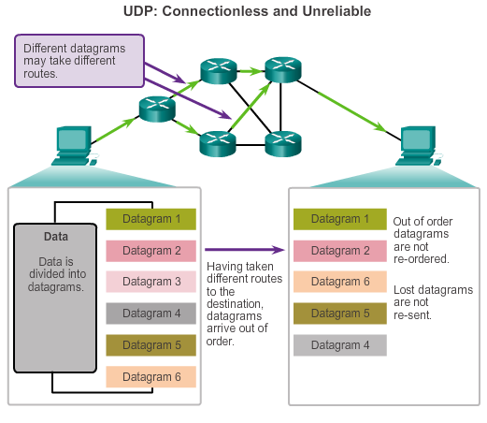
UDP Communication Datagram Reassembly
Notes:
5.2.3.2 Datagram Reassembly

Slide 40
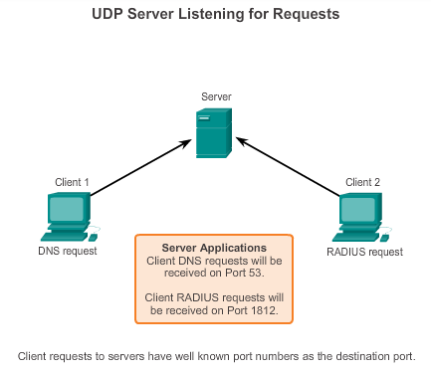
UDP Communication UDP Server Processes and Requests
UDP-based server applications are assigned well-known or registered port numbers.
Notes:
5.2.3.3 UDP Server Processes and Requests

Slide 41
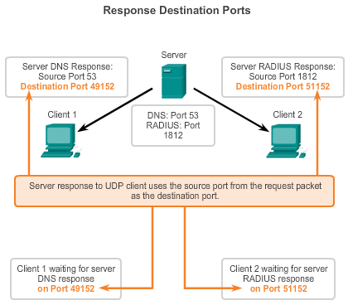
UDP Communication UDP Server and Client Processes
UDP client process randomly selects a port number from range of dynamic port numbers as the source port.
Notes:
5.2.3.4 UDP Client Processes

Slide 42
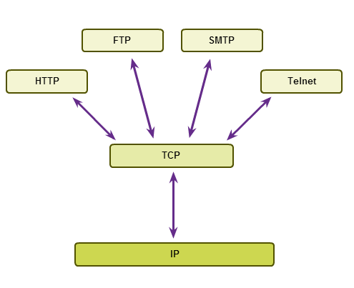
TCP or UDP, that is the Question Applications Using TCP
Notes:
5.2.4.1 Applications Using TCP

Slide 43
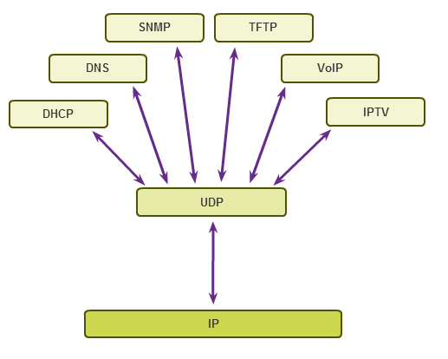
TCP or UDP, that is the Question Applications Using UDP
Notes:
5.2.4.2 Applications Using UDP

Slide 44
Summary
In this chapter, you learned:
The role of the transport layer is to provide three main services: multiplexing, segmentation and reassembly, and error checking. It does this by:
Dividing data received from an application into segments.
Adding a header to identify and manage each segment.
Using the header information to reassemble the segments back into application data.
Passing the assembled data to the correct application.
How TCP and UDP operate and which popular applications use each protocol.
Transport Layer functions are necessary to address issues in QoS and security in networks.
Ports provide a “tunnel” for data to get from the transport layer to the appropriate application at the destination.
Notes:
Chapter 5: Summary

