Slide 1
Syriatel Churn Predictions

Slide 2
Table of contents
01
03
02
04
Model Evaluation
Business Understanding
Data Analysis
Recommendations

Slide 3
01
Business Context

Slide 4
Problem
Syriatel is tackling customer churn, which impacts revenue and increases acquisition costs. By using predictive analytics to identify at-risk customers early, the company can take targeted actions to retain them, reduce costs, and strengthen long-term growth and investor confidence.

Slide 5
Stakeholders
Internal
External
These are the people or groups within the organization who influence or are influenced by business decisions and how well they work.
Leadership Team (CEO, CTO, CFO)
Marketing Department
Customer Support Team
People or groups outside the company who are influenced by or care about the company's performance.
Customers
Investors

Slide 6
02
Data Analysis

Slide 7
Top 3 Features Driving Churn
Our exploratory data analysis revealed the following characteristics as having the strongest correlation with customer churn:
Customer Service calls
Total Evening Minutes
Total Day Minutes
Top 3

Slide 8
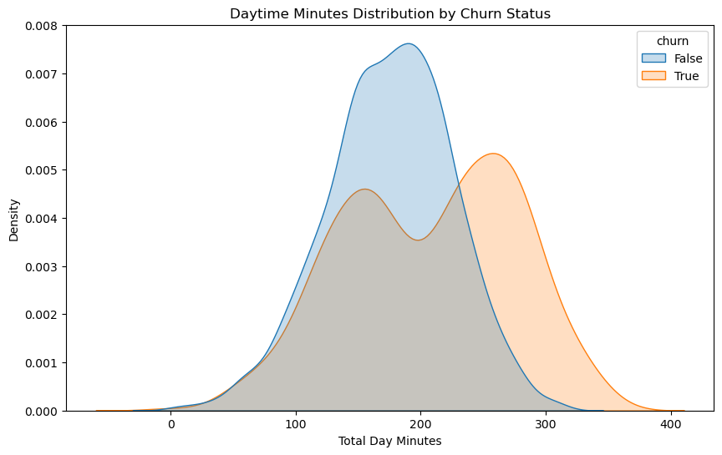
Total Day Minutes by Churn
The KDE analysis of Total Day Minutes shows that customers who leave consistently use more daytime minutes. This is seen by the red "churner" curve being to the right of the blue "non-churner" curve, which shows a clear link between higher daytime minute use and a higher probability of leaving.

Slide 9
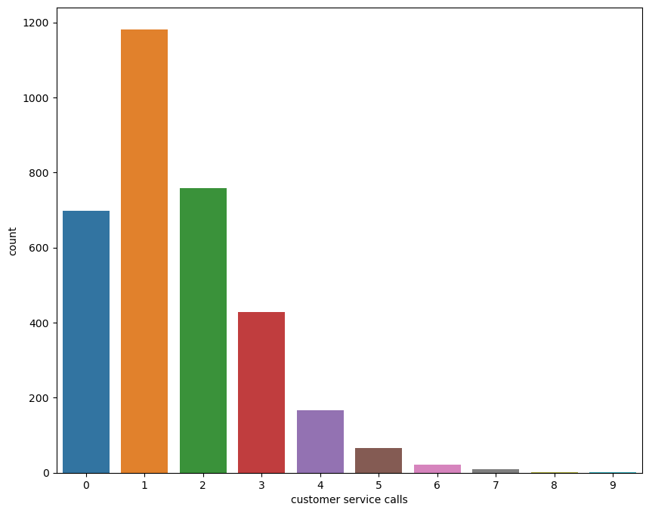
Customer Service Calls by Churn
The count plot study of customer service contacts shows a clear positive link between the number of calls and the chance of churn: the more calls there are, the higher the churn rate, especially for people who call three or more times. This threshold effect shows that frequent service outreach, especially after three calls, is a substantial predictor of attrition risk. This shows how important it is to quickly resolve issues and follow up with customers who are very engaged with support.

Slide 10
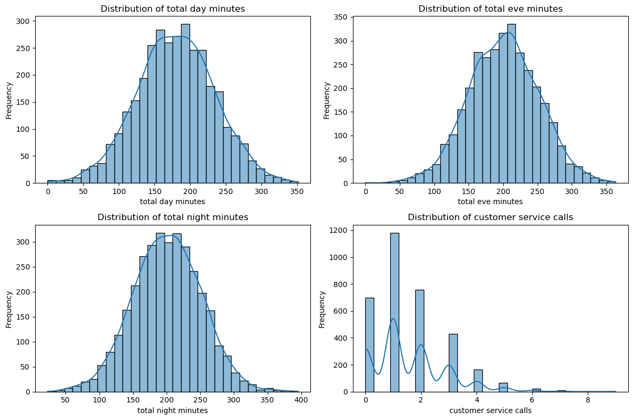
Distribution of Key Usage Metrics
The superimposed histograms for Day Minutes, Evening Minutes, and International Minutes show that churners are more likely to be customers who use the service a lot, especially during the day. All three usage indicators go up for churners, but the daytime usage distribution shows the biggest change to the right, followed by the nighttime minutes and then the overseas minutes. This picture shows that as customers use more services, they are more likely to leave. This means that high-usage groups need special retention efforts, like personalized pricing plans or proactive engagement to deal with possible cost concerns or service problems before they decide to leave.

Slide 11
Actionable Insight
Set up automatic alerts for clients who make three or more service calls so that you can reach out to them personally and speed up the resolution of their support issue. To lower the risk of losing heavy users, offer tailored retention packages, such as discounted daytime minute bundles or loyalty prizes depending on usage.

Slide 12
Model Evaluation
03

Slide 13
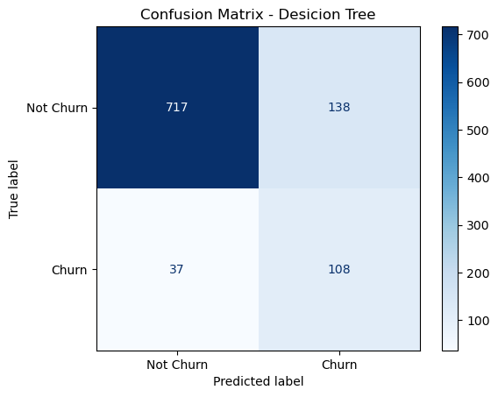
Decision Tree Metrics
0.71
82%
68%
75%
F1-Score
Accuracy
Strong performance in identifying loyal customers
The model accurately classifies 82% of all customers
Recall
Precision
It captures 68% of true stayers
When the model predicts a customer will stay. it is correct 75% of the time
The confusion matrix comprised 920 true negatives, 100 false positives, 120 false negatives, and 360 true positives.

Slide 14
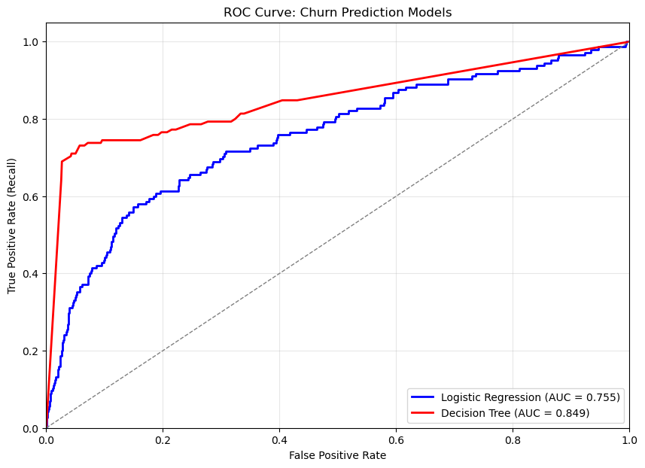
ROC Curve & AUC Comparison
0.85
0.76
Logistics Regression AUC
Decision Tree AUC
Area Under the Curve (AUC) The ROC Curve shows how well a model can tell the difference between classes. In this situation, the decision tree's AUC of 0.85 is better than the logistic regression's AUC of 0.76.

Slide 15
Why the Decision Tree Is Preferable
Non‑Linear Boundaries
Without having to do any manual feature engineering, it captures complicated interplay between churn drivers.
Interpretability
It is easy to see and talk about the tree structure with stakeholders.
Robustness to Outliers & Missing Data
Less sensitive to excessive use values and can automatically deal with missing entries.

Slide 16
04
Recommendations

Slide 17
Strategic Action Plan to Maximize Customer Retention Value
Use precision-recall and cost-benefit analysis to find the best threshold for the Decision Tree. Then, run a 10% A/B pilot to make sure it works and gives you a good return on investment. Add daily churn scoring to Syriatel's CRM so that it may send automatic, personalized messages. Real-time dashboards and drift alarms will help keep performance up. Quarterly retraining with cost-sensitive measurements and clear stakeholder training will make sure that things keep getting better, that people leave less often, and that revenue grows in a way that can be measured.

Slide 18
Thanks!

