Slide 1

APNABUS
Government Booking and Tracking
Notes:
To use this title animation slide with a new image simply 1) move the top semi-transparent shape to the side, 2) delete placeholder image, 3) click on the picture icon to add a new picture, 4) Move semi-transparent shape back to original position, 5) Update text on slide.

Slide 2
EQUIPPING THE ROADWAYS BETTER THAN THE RAILWAYS
— TEAM TECHKNIGHTS

Slide 3
OVERLOOK
The problem
Long queues at bus stands and waiting until a cancellation or arrival, also inefficiency in tracking, the uncertainty in general
The solution
A way to keep timely track of the bus as well as booking –individuale
How that works?
For tracking purposes, we will make use of mobile GPS and some HW modules as well, which will send location data over the air to the App’s Server. Simple?

Slide 4
MFAQ
How?, Will it?, What if?
“LIVE Tracking, But how?”
Consider using Google Maps, it tracks your location, it works pretty much the same way, but uses driver’s device instead.
“Will it work when there is no connectivity to the bus?”
In cases of no networks, the location will update in steps, the checkpoints in the way will send the location data. ( Future Purposes)
“What if the driver doesn’t have a device?”
For cases like that, a hardware mounted on the bus itself will do the job, pretty much like a vehicle tracker.

Slide 5
THE STAGE HAS BEEN SET go ahead and follow the basic 5 steps
1
2
3
4
5
App books the Tickets,
App tells you arrival time and location of the bus,
Emergency & Complaint Services
Web / Desktop App for use by authorized persons.
Ride review service, 5 stars
Reference : The basics you can find anywhere 5 Steps To Successful Storytelling Published on April 5, 2014 Featured in: Marketing & Advertising

Slide 6
Our app tackles multiple application domains.
Problem Tackle Domain
!
Management – Web / Desktop app for authorized personnel (RSRTC,BMTC) to track their buses. Route divert checking. Speed Checking etc.
Public – Ticket Booking, Emergency Services – The passenger can use this service in times of serious trouble An auto-generated message will be sent to 24*7 transport support team, which will then respond to the passenger or take necessary actions.

Slide 7
Google Firebase, for a easy and organized back-end and database Android (as language) for the front-end and application development Android-Studio as the development environment for the same Material Design for UI design
Tech behind the wall

Slide 8
Complaints!
!
There are two complaint modules
Emergency Services – When in serious trouble, passengers can use this service
General Complaints – such as journey issues like misbehavior of bus staff, inappropriate halts of buses etc.

Slide 9
Future of our project
GPS Module in the buses.
Web / Desktop app for authorized personnel (RSRTC,BMTC) to track their buses.
Notes:
Tip:
When using complex image as full-bleed background add a transparency (70%-90%) fill layer to give contrast to text.

Slide 10
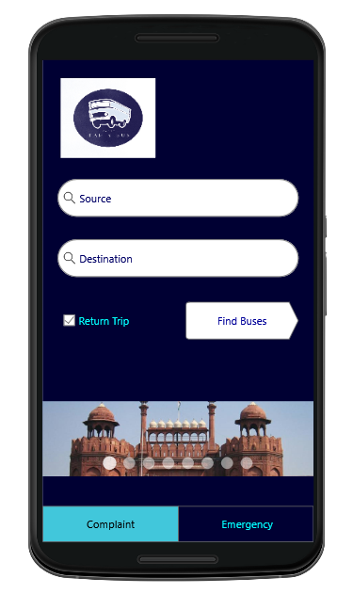
PROTOTYPE
The smartly designed UI is developed with ease of use in mind
This reflects in the overall transitions and feels
Easy navigation for Bookings
Simplified Tabs and windows
Emergency button at homepage

Slide 11
THANK YOU

