Slide 1
Time
velocity
volume
etc.

Slide 2
Original STG Model
+
History
Prediction
×
fine-tune
Linear Adapter
ReLU
Softmax

Slide 3



Input
N
M
$$A=U\left(−\sqrt{5},\sqrt{5}\right)$$
$$B=0$$
r
NALL
×
Norm
Linear
+
Leaky
ReLU
$W0$ + ∆W $→ W$
hidden
Dropout
k layers
out
Output

Slide 4

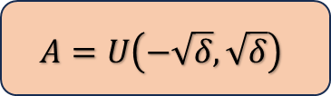

Input
(a)
Input
(b)
(c)
N
M
Original STG Model
NALL
$$A=U\left(−\sqrt{δ},\sqrt{δ}\right)$$
$$B=0$$
r
LA
…
LA
LA
Norm
×
×
×
Pool
Leaky
ReLU
+
Linear
ReLU
$W0$ + ∆W $→ W$
Dropout
k layers
update
+
Softmax
Output
Output
Output

Slide 5
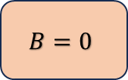
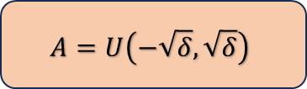

Up Projection
N
M
$$A=U\left(−\sqrt{δ},\sqrt{δ}\right)$$
$$B=0$$
r
Add & Layer Norm
+
×
× k Blocks
Dropout
×
ReLU & Softmax
LeakyReLU
+
Linear
Low-rank Adapter
× L Layers
NALL
$W0$ + ∆W $→ W$
×
update
STG BackBone
Feats. Conv
(a) The Framework
(b) Adapter Block
(c) Node Adaptive Low-rank Layer

Slide 6


Add & Layer Norm
Reshape param:
…
+
× k Blocks
Dropout
W_{out} (T × D_{out})
ReLU & Softmax
LeakyReLU
$$A=U\left(−\sqrt{δ},\sqrt{δ}\right)$$
×
$$BT=0$$
Low-rank Adapter
× L Layers
NALL
W_{in}×r
W_{out}×r
×
W_{in} (T × E × D_{in})
STG BackBone
Feats. Conv
…
For Each Node :
(a) The Framework
(b) Adapter Block
(c) Node Adaptive Low-rank Layer

Slide 7
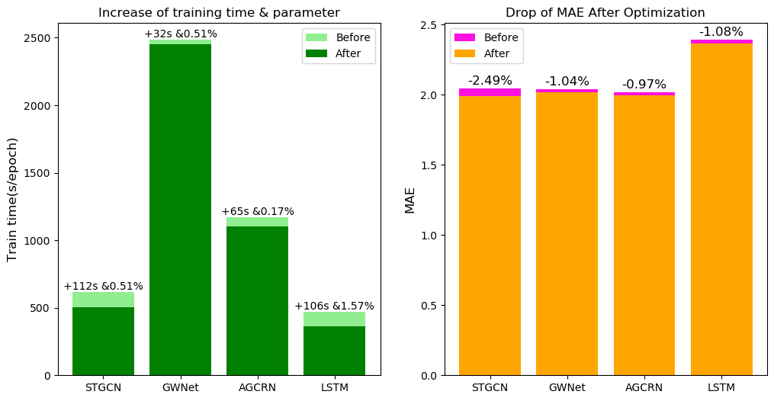
Efficiency (in one dataset & three model) 1 epoches(evaluate)

Slide 9
Improvement of few-shot test STGCN – METRLA
imp. | Average
proportions | MAE | RMSE | MAPE
5% | 0.63% | 0.40% | 0.19%
10% | 1.12% | 0.80% | 0.79%
all | 2.25% | 1.27% | 0.94%
 | 5% | 10% | 100%
MAE | 0.63% | 1.12% | 2.25%
RMSE | 0.40% | 0.80% | 1.27%
MAPE | 0.19% | 0.79% | 0.94%

Slide 10
Case Study
layer | 0 | 2 | 4 | 8 | 16 | 32
MAE | 0.00% | -0.60% | -1.58% | -2.33% | -1.10% | -2.43%
RMSE | 0.00% | -0.44% | -0.69% | -1.41% | -1.08% | -1.87%
MAPE | 0.00% | -5.18% | -4.71% | -2.49% | -3.70% | -1.75%
0.00% | 20.6941 | 20.5999 | 20.5208 | 20.4564 | 20.237
0.00% | 32.4375 | 32.3118 | 32.1969 | 32.0973 | 31.9374
0.00% | 0.1504 | 0.1455 | 0.1459 | 0.1453 | 0.1397

Slide 11
(a)
(b)
(c)

Slide 12
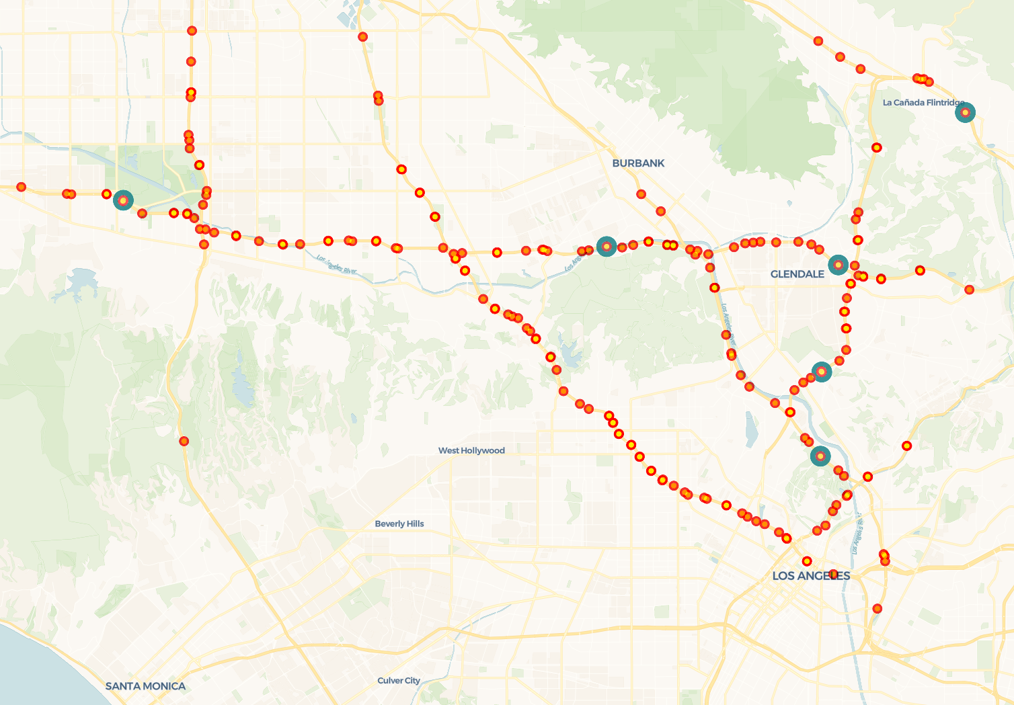
P200
P100
P0
P201
P1
P101

Slide 13
