Slide 1



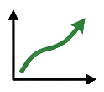


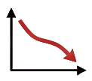





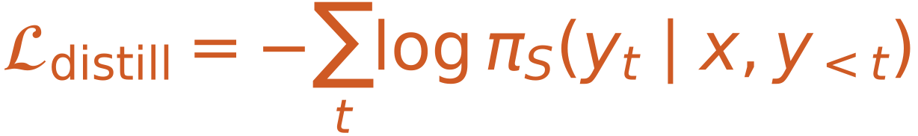




Mathematical Reasoning Trace
Topology-Guided Distillation
Step 2
Step 1
Layer 1
Implicit Process Reward Model
S1: Given x + y = 10
DEFINITION
DAG Scorer
$$r_{fmt}$$
$$r_{out}$$
Form Check
Outcome
S2: Given 2x - y = 5
DEFINITION
$$r_{topo}$$
PRM Aggregator
$$r_{final}$$
Step 3
Step 5
Layer 2
Choquet Reward
S3: Adding Eq. 3x = 15
COMPUTATION
Correct Traces
Clipped
Label Consistency
Step 4
Step 6
Layer 3
Length Penalty
S4: Therefore x = 5
DERIVATION
Format Violation
Estimator
Topology-Guided Distillation
S5: Substitute y = 10 - 5 = 5
SUBSTITUTION
dependency
sequential
Teacher
Revision instruction:
[Acyclic]
/ Directionally Consistent
Teacher-forced objective:
S6: Conclude x = 5, y = 5
CONCLUSION
[Connected]
/ No Orphan Conclusion
Student

Slide 2

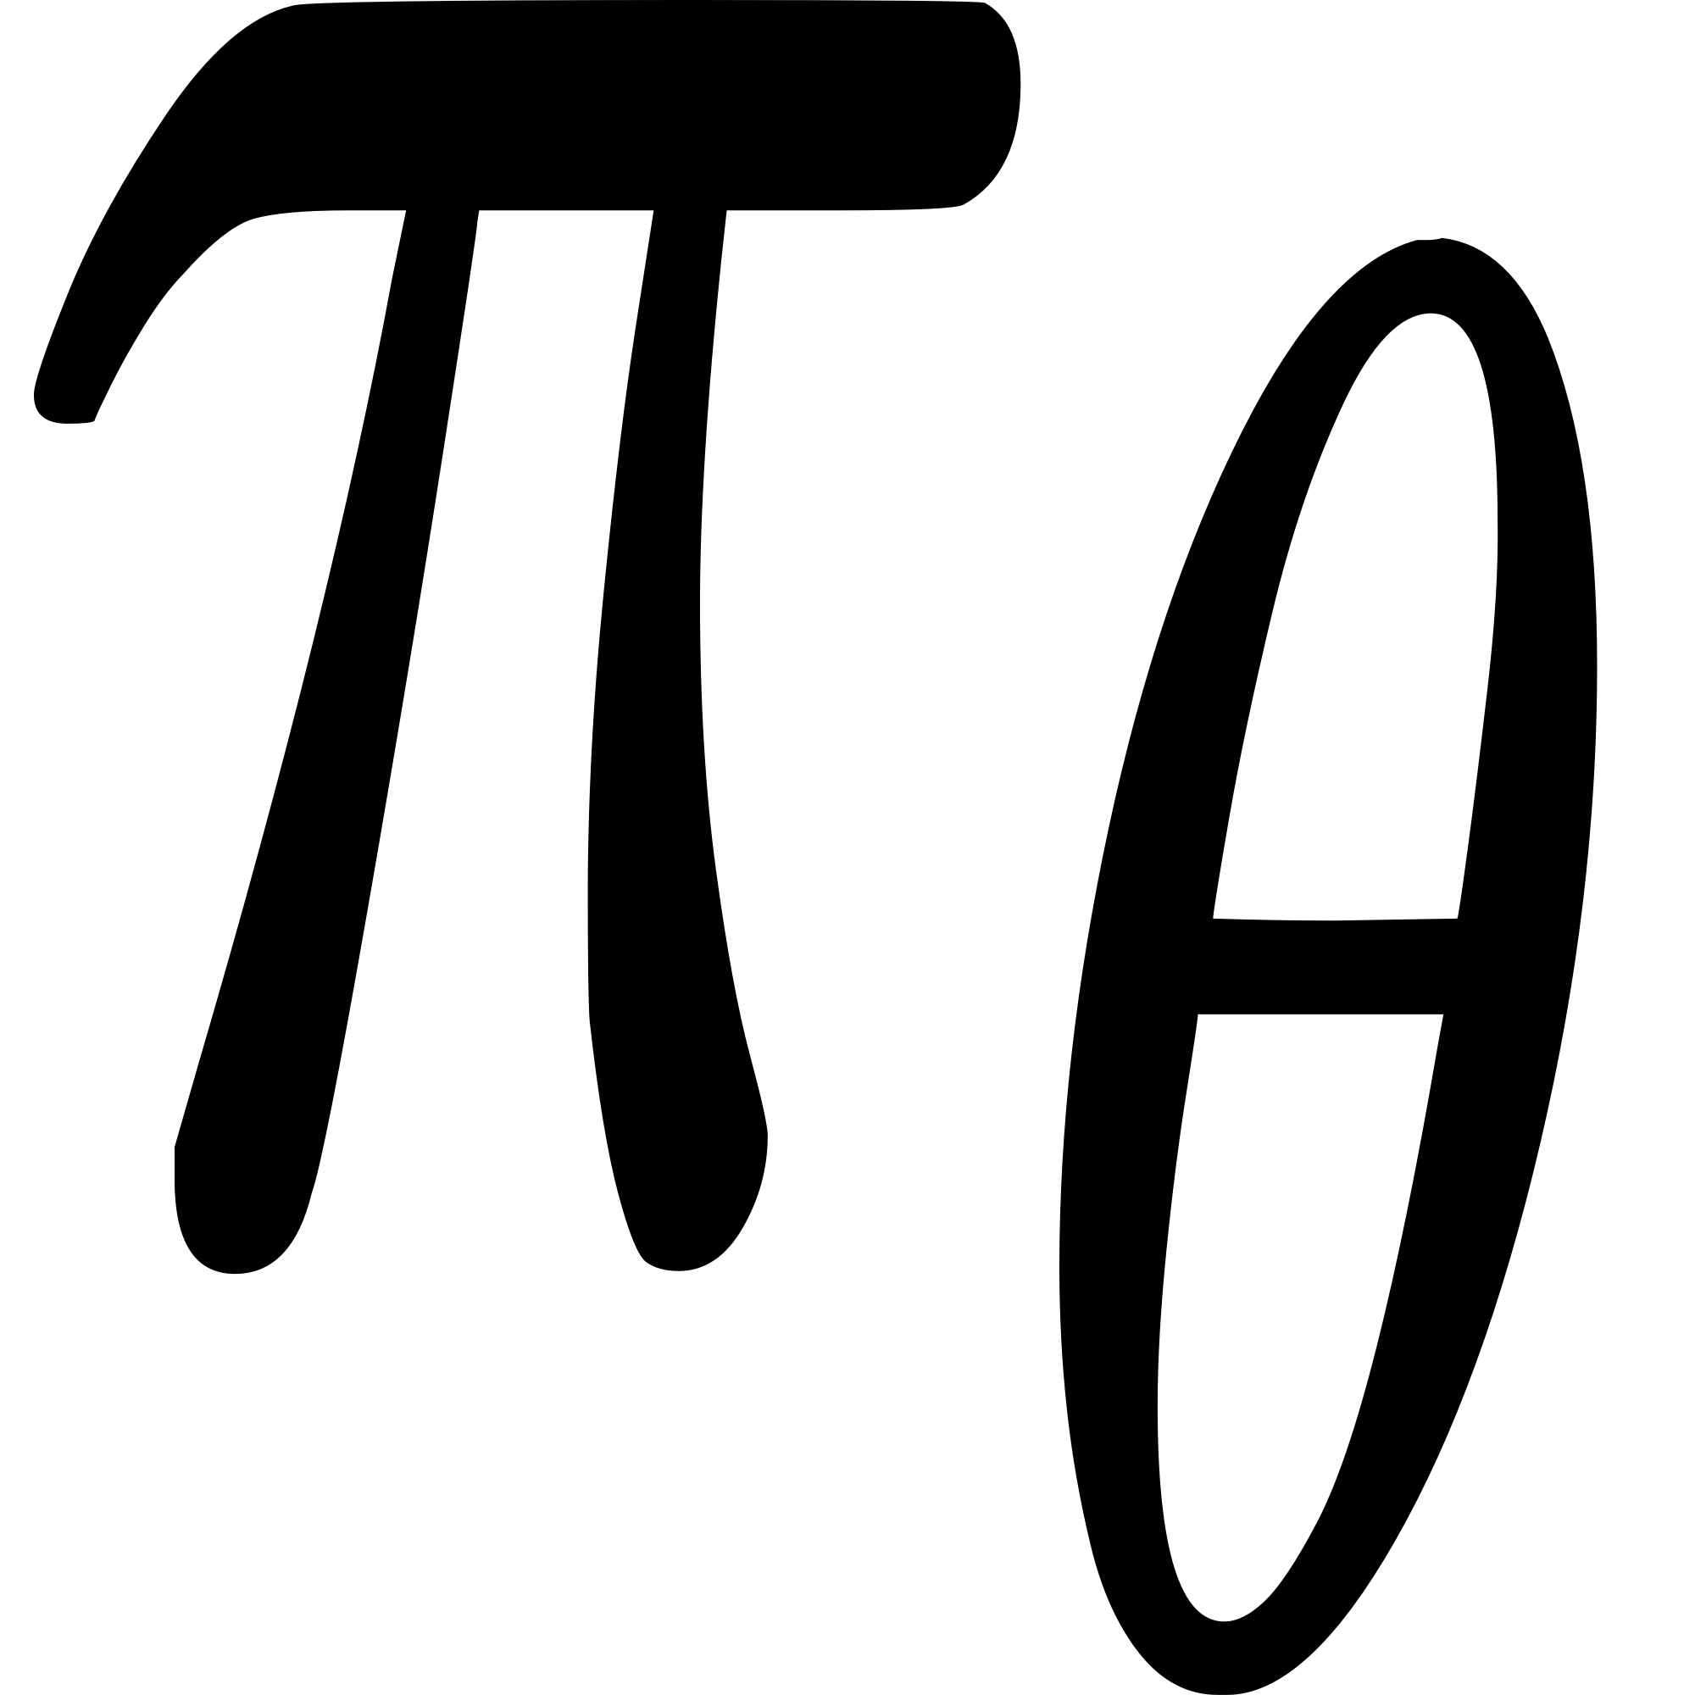


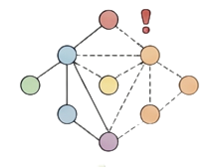
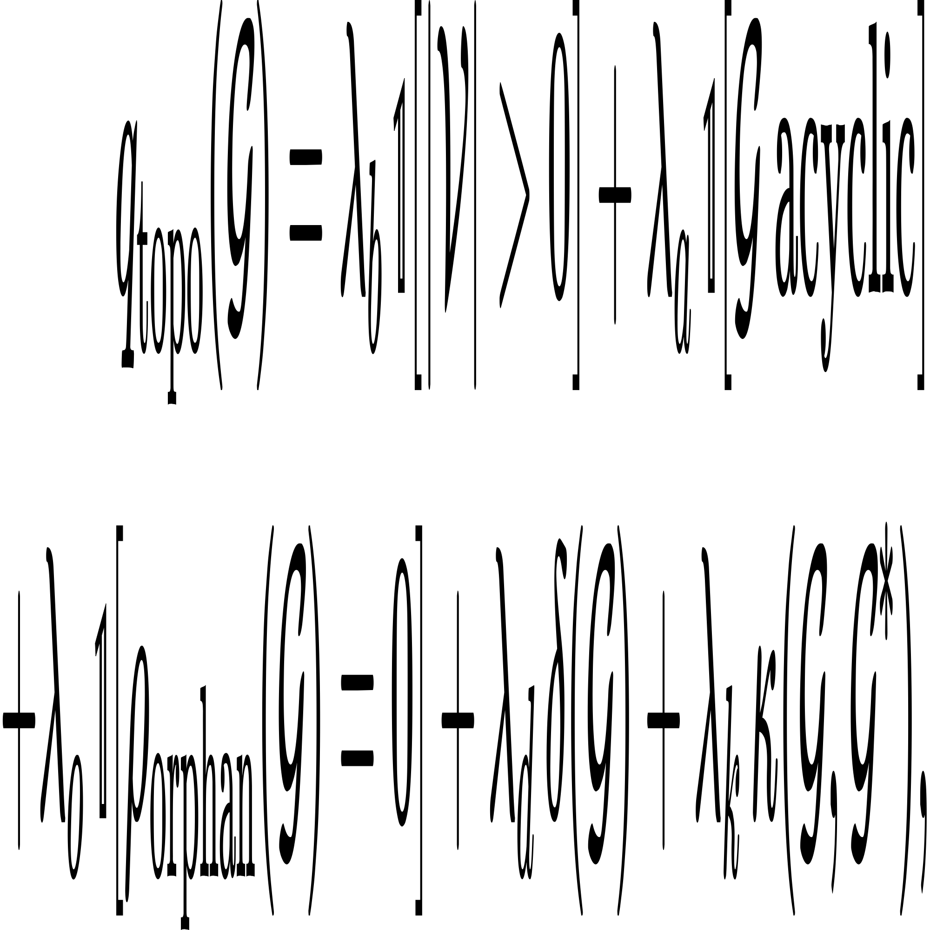


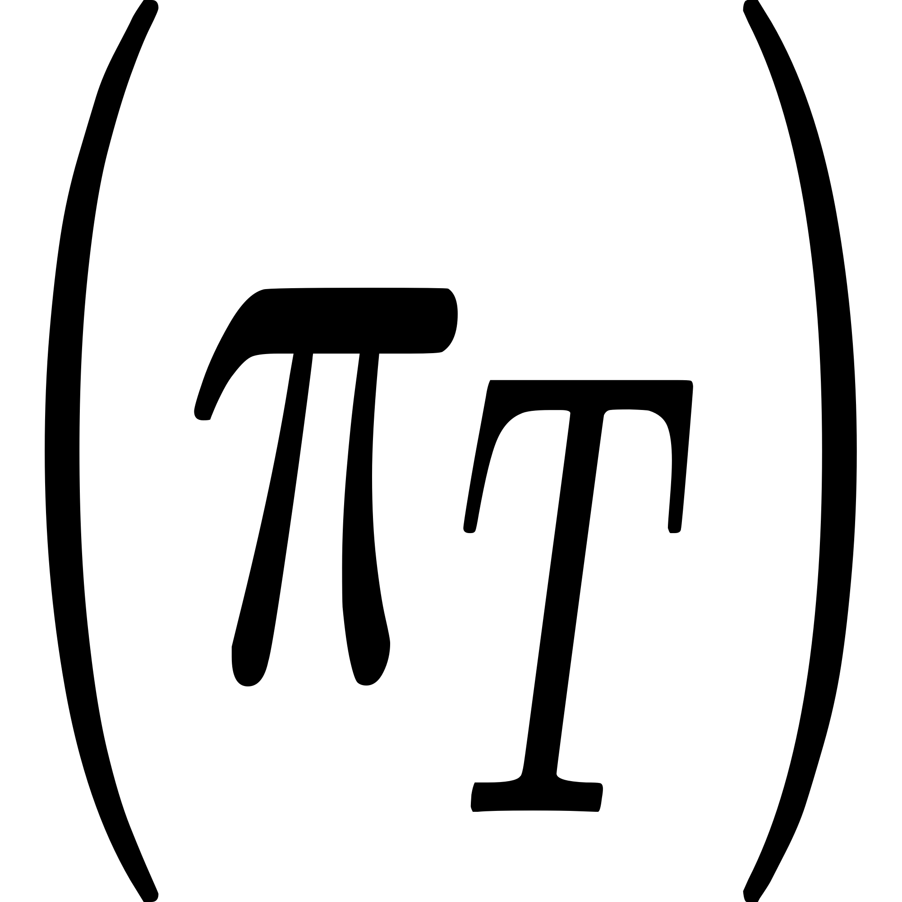
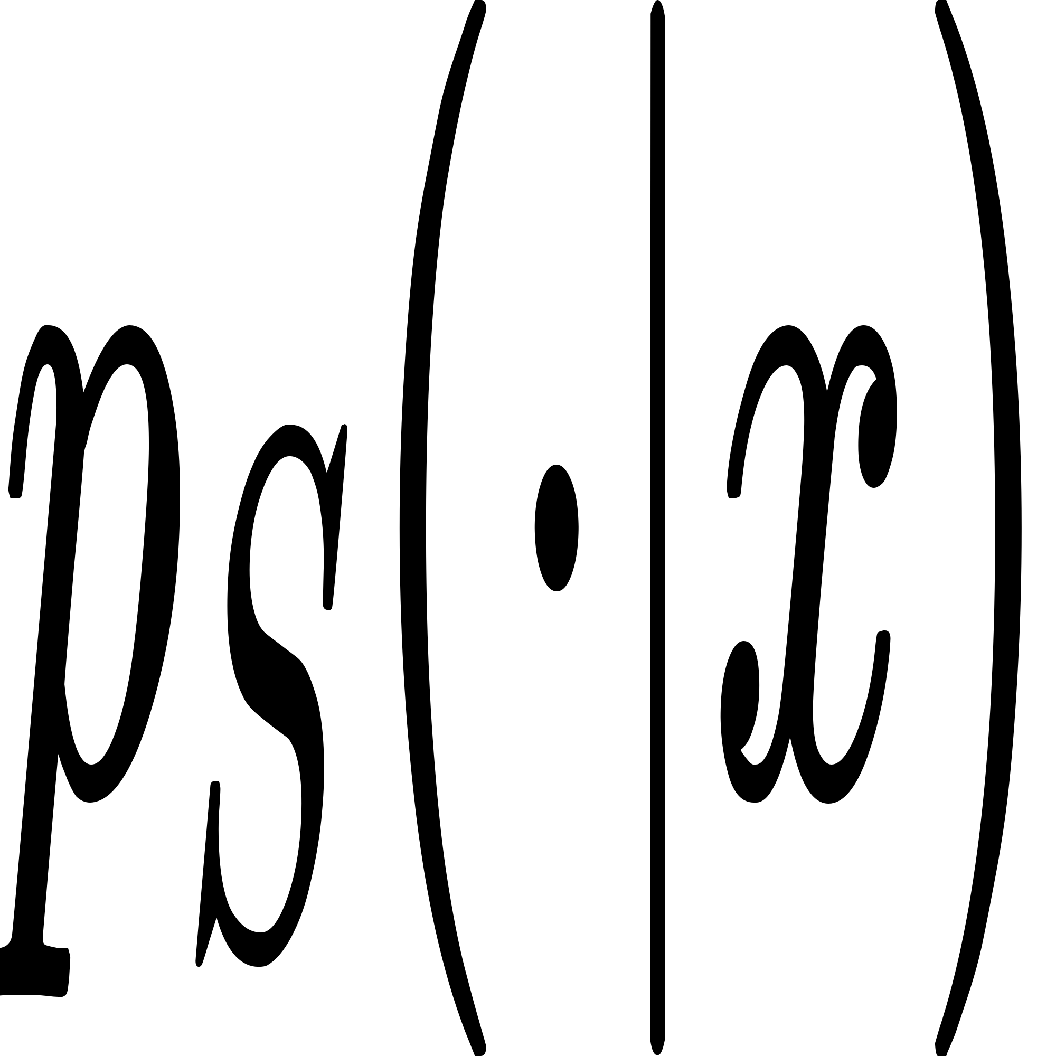

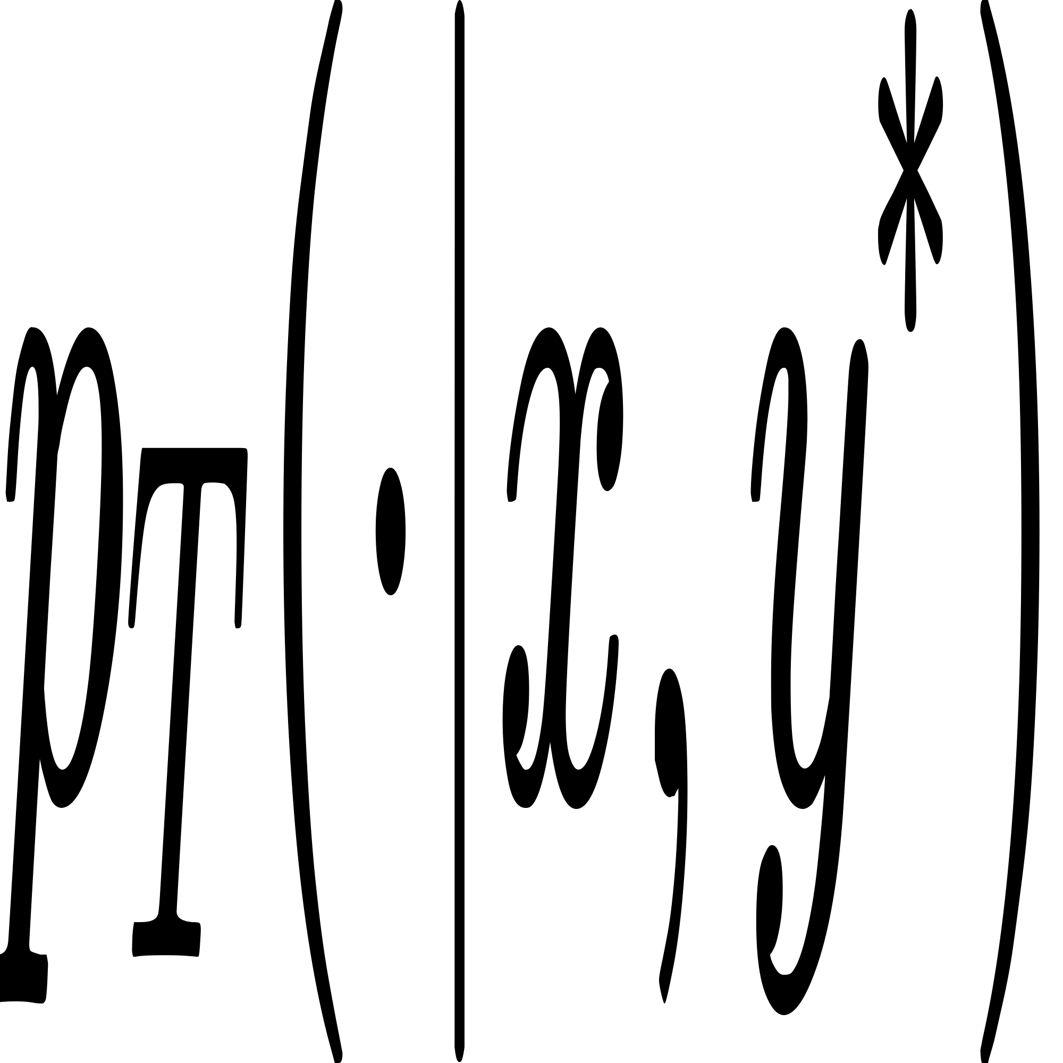






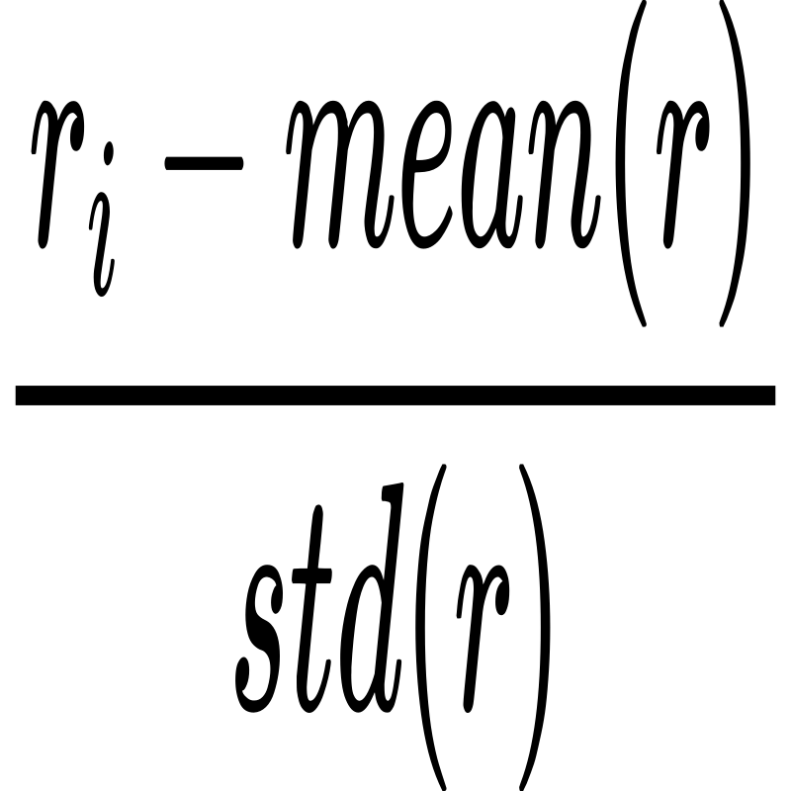








STAGE 1: Supervised Fine-tuning (SFT)
Structured Format
<think> ...<answer>...
System Prompts
for Public Data
LoRA
Fine-tuning
Warm-Start
Structured Reasoning Data
(Math Problems, Step-by-Step Solutions)
LLM
Stable Behavior
Token-level Gradient Update
STAGE 2: TopoPRM Post-Training
STAGE 3: Reasoning Distillation
Reasoning
Trace
DAG Scorer
Choquet Reward Aggregation
Teacher
Policy
Step Segmentation & Parsing
Rollout
1
2
Implicit Feature Extraction
$$r_{total}=(w_{o}·r_{out}+w_{f}·r_{fmt}+w_{I}·{Rr}_{len})$$
Large
Model
Topology-aware
Reasoning Trace
(Graph of Thought)
3
Build Dependency DAG
$$· (1+α·q_{topo}+(1−α)·q_{cont})$$
$$r_{topo}$$
$$r_{len}$$
$$r_{fmt}$$
$$r_{out}$$
Teacher-Forced
Distillation Loss
4
Topology Diagnostics
q_{topo}
Data
Quality Filter
$R$_{total} > Thread
5
Step Continuity Check
q_{cont}
GRPO with Choquet Reward
Typed
1. GRPO
2. Choquet reward
Def.
Def₁
Example=[{"step_id":1,"claims":{...},"raw":{...},"normed":{...},"edges":{2,3,4},"weights":{...},"dep_type":{...},"evidence":{...},"expr":{...},"claim":"step4 reuses the parity argument from step 1\"}]
Sample
Com.
C1
+1.2
Def₂
Deri₃
C2
+1.0
Rollout
Deri.
C3
+0.6
x : Problem
y*: CoT Answer
p : policy
Com₄
Wrong answer
with high
structural reward?
C4
- 0.3
Distilled Student
Subs.
C5
- 0.6
Sub₅
Conc₆
C6
- 0.4
High Quality Chain
(Chain of Thought)
Conc.
Reward Hacking
Hacking & Collapse Prevention

Slide 3
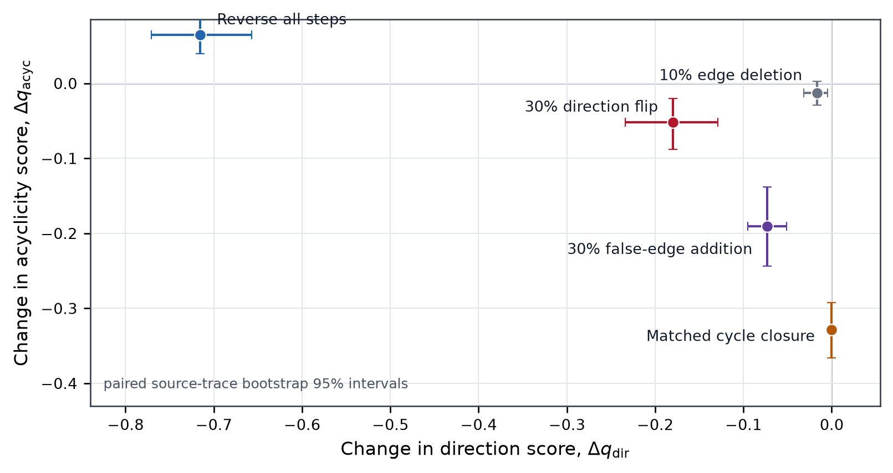
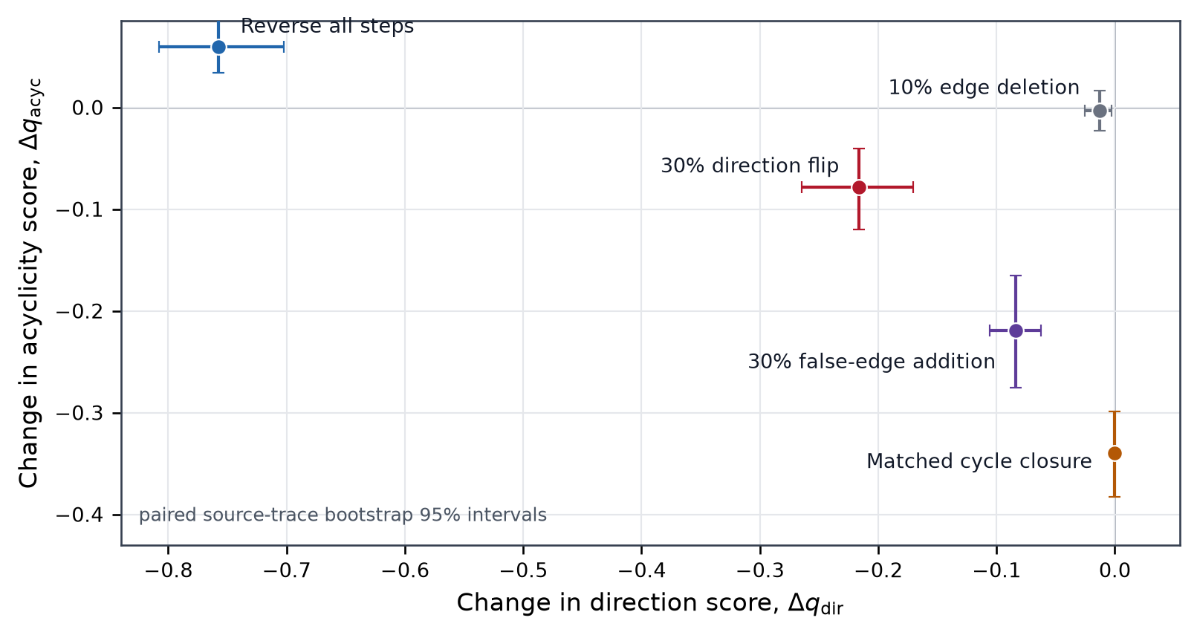
Direction and acyclicity respond to different failures
Frozen encoder | paired source-trace bootstrap 95% intervals
Direction
Reverse: Δq_dir=-0.715 [-0.771,-0.657]; Δq_acyc=+0.064 [0.040,0.091].
Acyclicity
Cycle closure: Δq_acyc=-0.328 [-0.366,-0.292]; Δq_dir=0.000 under matched backward mass.
Noise controls
6.8% deletion: Δq_dir=-0.017, Δq_acyc=-0.012; 24.4% false-edge addition: Δq_acyc=-0.190.
Corrected encoder: n=120; matched-cycle n=57.

Slide 4
TopoPRM: reward the graph before acyclic projection
Free-form trace -> raw directed support -> independent direction / acyclicity supervision
1 Free-form reasoning trace
2 Recover raw support before projection
3 Use both graph views
No graph syntax is required from the policy.
The encoder considers each unordered step pair.
Topology is a source, not an output format.
S1
Given x + y = 10
Raw graph H
Direction q_dir
Acyclicity q_acyc
S1
S2
S2
Given 2x - y = 5
kept separate before aggregation
outcome
format
continuity
q_proj
S3
S3
Add equations: 3x = 15
Topology-conditioned Choquet reward
S4
Therefore x = 5
S4
S5
Interactions reward agreement while preserving which structural property failed.
S5
Substitute and conclude y = 5
solid: retained support dashed: projection residual
Stage II · matched GRPO
Backward residual for q_dir
Cycle residual for q_acyc
Committed derivation
The complete reward changes rollout ordering.
The final answer may be correct even when its written support is backward or circular.
Acyclic projection G = Pi(H)
Student trace
Defect localizer
Checked target
S1
S2
S3
S4
S5
Outcome reward cannot expose this.
Stage III · Topology-Guided Distillation
Projection enables DAG operations; discarded edges remain supervision.
Backward / cycle / orphan defects select teacher revisions.

Slide 5
Direction and acyclicity are independently falsifiable
Controlled perturbations change one structural failure while holding trace content or graph mass fixed
1 Reverse the same written steps
2 Close a cycle at fixed graph mass
3 Do not collapse the two sources
Content is unchanged; only textual order is reversed.
Edge count, coverage, and backward mass are matched.
On reversed controls, 39.2% of traces move oppositely.
Original order
Backward edge, no cycle
corr(q_dir, q_acyc)
-0.907
S2
S1
S2
S3
S1
S3
forward support
Cross-trace standard deviation
Reversed presentation
Same mass, cycle closed
S2
q_dir
0.110
S3
S2
S1
S1
S3
support now points backward
q_acyc
0.107
Direction
-0.715
Acyclicity
+0.064
Direction
0.000
Acyclicity
-0.328
average
0.023
Averaging leaves 21.3% of direction-score spread.
Direction detects order inconsistency; reversal need not create a cycle.
Acyclicity detects circular support after direction mass is controlled.
Corrected frozen encoder: 120 paired traces; matched-cycle control: 57 pairs. Intervals are paired source-trace bootstrap, not training variance.
Mechanism evidence, not yet a downstream policy result.

Slide 6
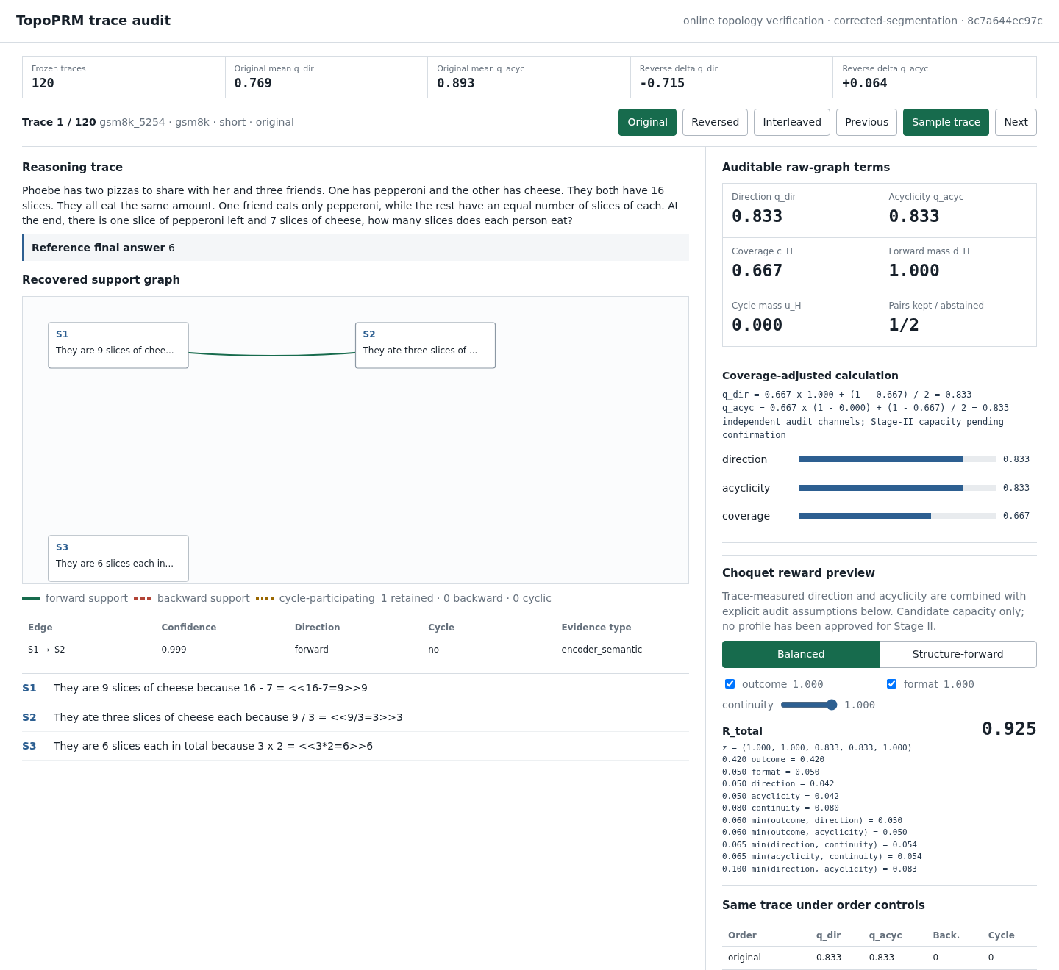
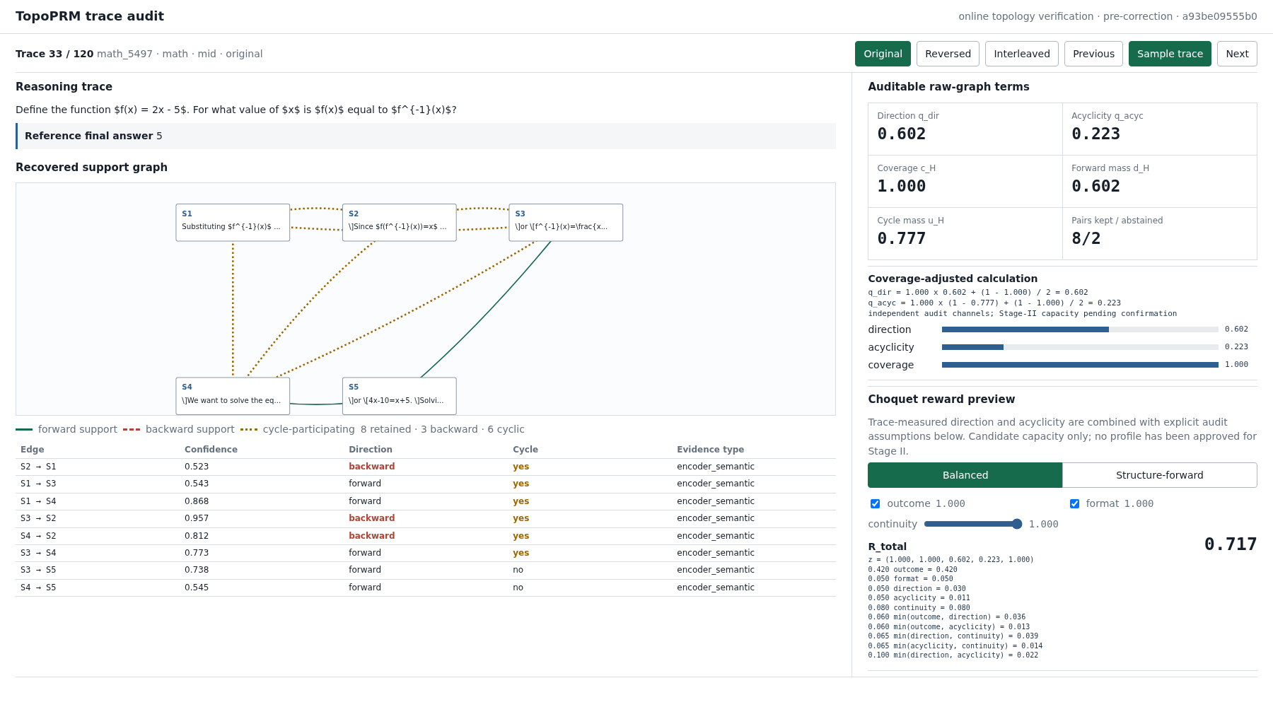
Trace-Level Verification: From Reasoning to Auditable Topology Reward
Live sampling, edge direction / acyclicity diagnostics, and exact five-source reward decomposition

Slide 7
Independent reasoning-edge annotation
Annotator A
Item 1 / 120
Predictions / IDs hidden
Saved 0 / 120
QUESTION
If 5^x = 100, what is the value of 5^(x+2)?
REASONING STEPS
DEPENDENCY DECISION
To get from 5^x to 5^(x+2), we may multiply by 5^2.
Candidate pair: S1 and S2
S1
S1 -> S2
S2 -> S1
No dependency
S2
Multiplying the right-hand side by 5^2 gives 5^(x+2) = 2,500.
CONFIDENCE
High
Medium
Low
Optional annotator comment
Click a directed relation only when one step supplies information used by the other.
Save + next
Skip
Previous
Matched order; three shuffled copies map labels to source coordinates.
Paper audit artifact | editable slide

