Slide 1
RURAL WATER SUPPLY AND SANITATION SYSTEM
Rollno | Name
CB.EN.U4CSE18212 | V Ashwin
CB.EN.U4CSE18227 | G Sri Ram
CB.EN.U4CSE18234 | K Chandramohan Reddy
CB.EN.U4CSE18266 | N Venkatasubramanian
Section: C Faculty in Charge: Ms. Bindu K R

Slide 2
Overview
Normalization
Creation of Tables
User Interface Screens
References

Slide 3
Initial Water_Supply_and_Sanitation Table
Water_Supply_and_Sanitation (Pincode, Panchayat, District, EmpID, FName, LName, EContact, JobCode, Designation, Shift, WSID, WStatus, WCapacity, WEstimation, Month, Year, Usage, SSID, SStatus, SEstimation, FID, Persons, FHead, Consumption, FContact, TransactionID, AccountNumber, Amount, DDate, ExpenseID, EDate, EAmount)

Slide 4
Functional Dependencies
Pincode -> Panchayat, District
EmpID -> EContact, LName, FName, JobCode
JobCode -> Designation, Shift
WSID -> WEstimation, WCapacity, WStatus, Pincode
WSID, Month, Year -> Usage
SSID -> SEstimation, SStatus, Pincode
FID -> FContact, Consumption, FHead, Persons, Pincode
TransactionID -> Amount, AccountNumber, DDate, DContact
ExpenseID -> EDate, EAmount, EMPID, WSID, SSID

Slide 5

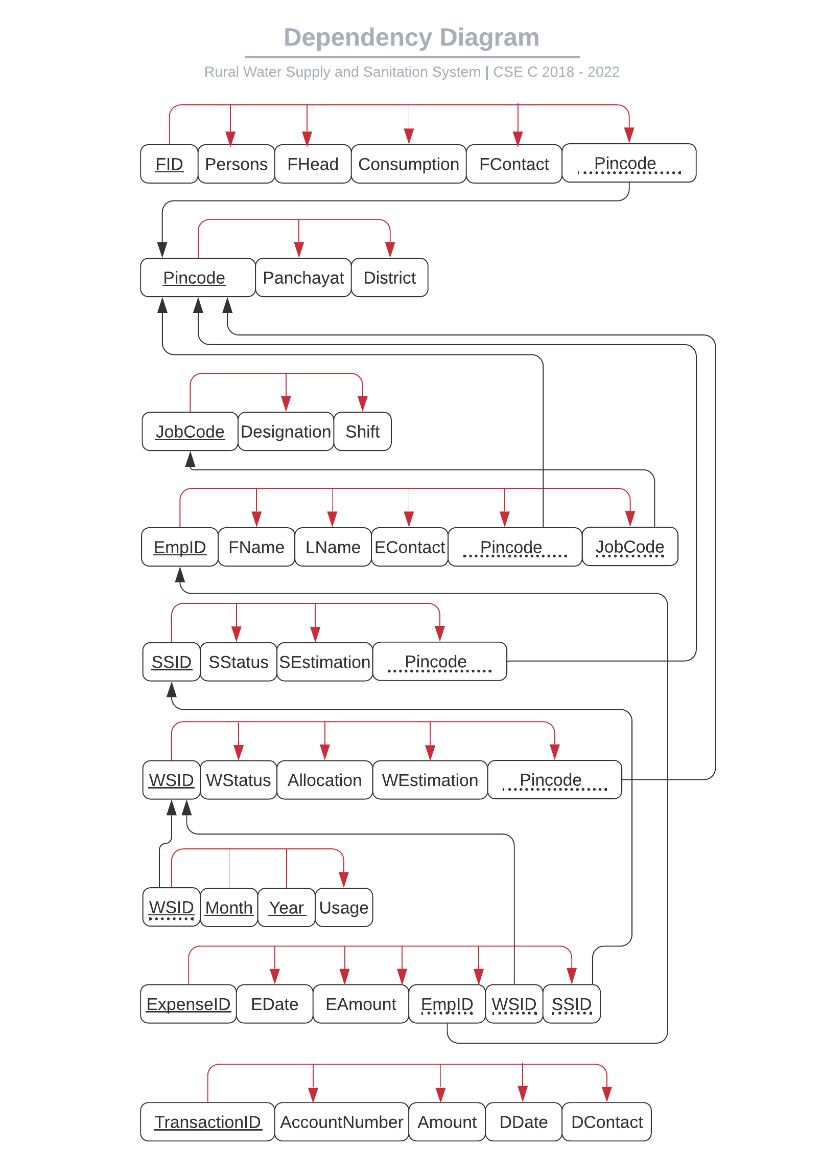
Dependency Diagram of Normalized Schema

Slide 6
Functional Dependency Closure
{Pincode}+ = {Panchayat, District}
{Panchayat}+ = {Panchayat}
{District}+ = {District}

Slide 7
Functional Dependency Closure
{EmpID}+ = {EmpID, FName, LName, EContact, JobCode, Pincode, Panchayat, District}
{FName}+ = {FName}
{LName}+ = {LName}
{EContact}+ = {EContact}

Slide 8
Functional Dependency Closure
{JobCode}+ = {JobCode, Designation, Shift}
{Designation}+ = {Designation}
{Shift}+ = {Shift}

Slide 9
Functional Dependency Closure
{WSID}+ = {WSID, WEstimation, WStatus, WCapacity, Pincode, Panchayat, District}
{WStatus}+ = {WStatus}
{WCapacity}+ = {WCapacity}
{WEstimation}+ = {WEstimation}

Slide 10
Functional Dependency Closure
{WSID, Month, Year} + = {WSID, WEstimation, WCapacity, WStatus, Pincode, Panchayat, District ,Month, Year, Usage}
{Month}+ = {Month}
{Year}+ = {Year}
{Usage}+ = {Usage}

Slide 11
Functional Dependency Closure
{SSID}+ = {SSID, SEstimation, SStatus, Pincode, Panchayat, District}
{SStatus}+ = {SStatus}
{SEstimation}+ = {SEstimation}

Slide 12
Functional Dependency Closure
{FID}+ = {FID, FContact, Consumption, FHead, Persons, Pincode, Panchayat, District}
{Persons}+ = {Persons}
{FHead}+ = {FHead}
{Consumption}+ = {Consumption}
{FContact}+ = {FContact}

Slide 13
Functional Dependency Closure
{TransactionID}+ = {TransactionID, Amount, AccountNumber, DDate, DContact}
{AccountNumber}+ = {AccountNumber}
{Amount}+ = {Amount}
{DDate}+ = {DDate}
{DContact}+ = {DContact}

Slide 14
Functional Dependency Closure
{ExpenseID}+ = {ExpenseID, EDate, EAmount}
{EDate}+ = {EDate}
{EAmount}+ = {EAmount}

Slide 15
Attribute Closure
{Pincode}+ = {Pincode, Panchayat, District}
{JobCode}+ = {Designation, Shift}
{EmpID}+ = {EmpID, EContact, LName, FName, Pincode, Panchayat, District}
{WSID}+ = {WSID, WEstimation, Capacity, WStatus, Pincode, Panchayat, District}
{WSID, Month, Year} + = {WSID, WEstimation, WCapacity, WStatus, Pincode, Panchayat, District , Month, Year, Usage}

Slide 16
Attribute Closure
{SSID}+ = {SSID, SEstimation, SStatus, Pincode, Panchayat, District}
{FID}+ = {FID, FContact, Consumption, FHead, Persons, Pincode, Panchayat, District}
{TransactionID}+ = {TransactionID , Amount, AccountNumber, DDate, DContact}
{ExpenseID}+ = {ExpenseID, EDate, EAmount, EMPID, WSID, SSID}

Slide 17
Canonical cover
EmpID -> FName
EmpID -> EName
EmpID -> EContact
EmpID -> JobCode
EmpID -> Pincode

Slide 18
Canonical cover
JobCode -> Designation
JobCode -> Shift
WSID -> WStatus
WSID -> WCapacity
WSID -> WEstimation
WSID -> Pincode

Slide 19
Canonical cover
SSID -> Pincode
SSID -> SEstimation
SSID -> SStatus

Slide 20
Canonical cover
FID -> Persons
FID -> FHead
FID -> Consumption
FID -> FContact
FID -> Pincode
WSID Month Year -> Usage

Slide 21
Canonical cover
ExpenseID -> EDate
ExpenseID -> EAmount
ExpenseID -> WSID
ExpenseID -> EmpID
ExpenseID -> SSID
ExpenseID -> DContact

Slide 22
Canonical cover
TransactionID -> AccountNumber
TransactionID -> Amount
TransactionID -> DDate
Pincode -> Panchayat
Pincode -> District

Slide 23
Super Keys
Pincode, EmpID, WSID, Month, Year, SSID, FID, ExpenseID, TransactionID

Slide 24
Anomalies
In Employee Table, Shift depends on Designation which is not a primary key.
This brought in partial dependency which created creation, updation and deletion anomalies.
We resolved this by decomposing those attributes to a new Jobs Table which acted as a foreign key in the Employee Table.

Slide 25
Conditions for 1NF
Each table should have a primary key.
The values in each column of a table should be atomic.
There should not be any repeating groups

Slide 26
Conditions satisfied and violated by the relation Water_Supply_And_Sanitation_System
Composite Primary Key is present
There are non-atomic values present in the relation.
a. There can be more than one EmpID, WSID and SSID mapped to one Pincode.
b. There is a many to many relation present here.
There are no repeating groups.

Slide 27
Solution
To reduce the table into 1NF, we make the values atomic by splitting them into different tuples in the same relations.

Slide 28
Conditions for 2NF
The relation must be in 1NF
All non-key attributes are fully functionally dependent on the primary key.

Slide 29
Dependencies
Pincode ->Panchayat, District
EmpID ->EContact, LName, FName, JobCode
JobCode -> Designation, Shift
WSID -> WEstimation, WCapacity, WStatus, Pincode
WSIDMonth, Year ->Usage

Slide 30
Dependencies
SSID ->SEstimation, SStatus, Pincode
FID -> FContact, Consumption, FHead, Persons, Pincode
TransactionID -> Amount, AccountNumber, DDate
ExpenseID -> EDate, EAmount, EMPID, WSID, SSID

Slide 31
Solution
Decompose the relations based on their partial dependencies

Slide 32
Decomposed Relations
Location - (Pincode, WSID, SSID, EmpID, FID, Panchayat, District)
Employee - (EmpID, FName, LName, EContact, JobCode, Pincode, Designation, Shift)
Water Sources - (WSID, WStatus, WCapacity, WEstimation, Pincode )
WaterUsage - (WSID, Month, Year, Usage)

Slide 33
Decomposed Relations
Sanitation Systems - (SSID, SStatus, SEstimation, Pincode )
Families - (FID, Persons, FHead, Consumption, FContact, Pincode)
Donation - ( TransactionID, AccountNumber, Amount, DDate )
Expenditure - ( ExpenseID, EDate, EmpID, WSID, SSID, EAmount )

Slide 34
Conditions for 3NF
The relation must be in 2NF
No non-key attribute should be transitively dependent on the primary key

Slide 35
Transitive Dependencies
EmpID -> EContact, LName, FName, JobCode
JobCode -> Designation, Shift

Slide 36
Solution
The transitive dependencies have been normalized by decomposing the relations into the following relations
Employee - (EmpID, FName, LName, EContact, JobCode, Pincode)
Job - ( JobCode, Designation, Shift )

Slide 37
Checking for BCNF
All the relations after being normalized to 3NF are present in BCNF as there are no non-key attribute determining is determining a key attribute.

Slide 38
Chase Method on Employee
Chase method is performed over the relation Employee after the transitive dependency is being resolved to check whether the decomposition is lossless

Slide 39
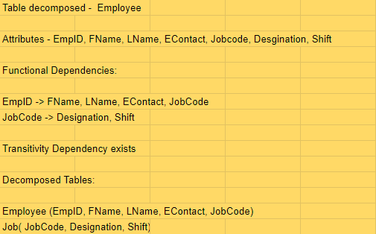
Attributes and dependency in Employee

Slide 40
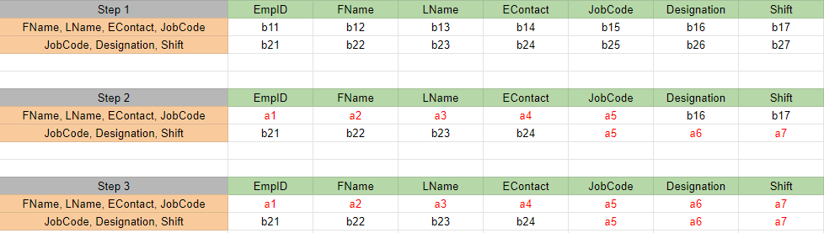
Chase method performed on Employee

Slide 41
Result
From the chase method performed over the relation employee we have found out the all attributes can be determined from the given functional dependencies and given decomposition.

Slide 42
Chase Method on Water Source
Chase method is performed over the relation WaterSource which has partial dependency which is being resolved to check whether the decomposition is lossless.

Slide 43
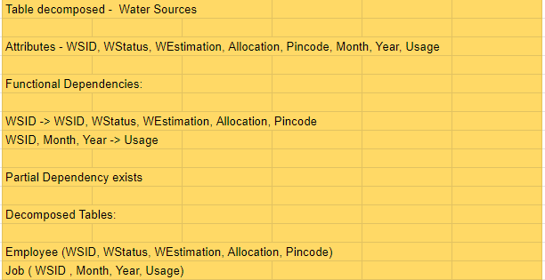
Attributes and dependency in Employee

Slide 44
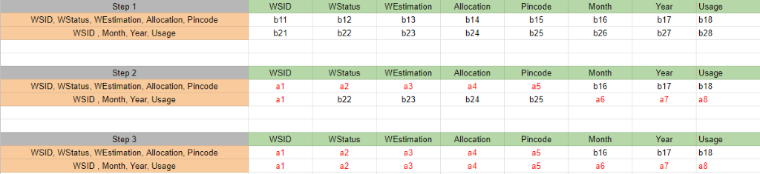
Chase method performed on Employee

Slide 45
Result
From the chase method performed over the relation WaterSource we have found out the all attributes can be determined from the given functional dependencies and given decomposition.

Slide 46
Dependency preserving
All the below listed dependencies have can be found in the decomposed tables as shown in the functional dependency diagram. Hence dependency is preserved.

Slide 47
Dependencies
Pincode ->Panchayat, District
EmpID -> EContact, LName, FName, JobCode
JobCode ->Designation, Shift
WSID ->WEstimation, WCapacity, WStatus, Pincode

Slide 48
Dependencies
WSID ->Month, Year Usage
SSID ->SEstimation, SStatus, Pincode
FID ->FContact, Consumption, FHead, Persons, Pincode
TransactionID ->Amount, AccountNumber, DDate
ExpenseID ->EDate, EAmount, EMPID, WSID, SSID

Slide 49
Final schema
Location - (Pincode, WSID, SSID, EmpID, FID, Panchayat, District)
Employee - (EmpID, FName, LName, EContact, JobCode, Pincode)
Job - ( JobCode, Designation, Shift )
Water Sources - (WSID, WStatus, WCapacity, WEstimation, Pincode )

Slide 50
Final Schema
WaterUsage - ( WSID, Month, Year, Usage)
Sanitation Systems - (SSID, SStatus, SEstimation, Pincode )
Families - ( FID, Persons, FHead, Consumption, FContact, Pincode)
Donation - ( TransactionID, AccountNumber, Amount, DDate )
Expenditure - ( ExpenseID, EDate, EmpID, WSID, SSID, EAmount )

Slide 51
Creation of LocationTable
create table Location
(
Pincode number(6) not null,
Panchayat varchar2(15),
District varchar2(20),
constraint pk_Pincode primary key (Pincode)
)

Slide 52
Insertion Of LocationTable
insert into Location values(641112,'Ettimadai','Coimbatore');
insert into Location values(641105,'Madukarai','Coimbatore');
insert into Location values(641041,'PN Pudur','Coimbatore');
insert into Location values(641062,'RG Pudur','Coimbatore');
insert into Location values(635602,'Adiyur','Vellore');
insert into Location values(641605,'Ugayanur','Tiruppur');
insert into Location values(609503,'Koothanur','Tiruppur');
insert into Location values(621702,'Ambil','Tiruchirappalli');
insert into Location values(626126,'Kunnur','Theni');
insert into Location values(641655,'Alathur','Coimbatore');

Slide 53
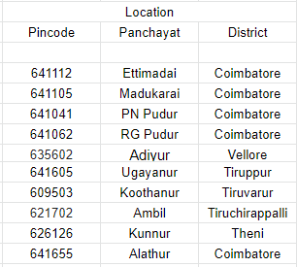
Sample Data
LocationTable

Slide 54
Creation of JobTable
create table Job
(
JobCode varchar2(3) not null,
Designation varchar2(20),
Shift varchar2(15),
constraint pk_JobCode primary key (JobCode)
)

Slide 55
Insertion Of JobTable
insert into Job values('J01','Admin','Full-time');
insert into Job values('J02','Planning Engineer','Full-time');
insert into Job values('J03','Project Manager','Full-time');
insert into Job values('J04','Accountant','Full-time');
insert into Job values('J05','Electrician','Morning');
insert into Job values('J06','Electrician','Evening');
insert into Job values('J07','Electrician','Night');
insert into Job values('J08','Plumber','Morning');
insert into Job values('J09','Plumber','Evening');
insert into Job values('J10','Pumber','Night');
insert into Job values('J11','House Keeping','Morning');
insert into Job values('J12','House Keeping','Evening');
insert into Job values('J13','House Keeping','Night');

Slide 56
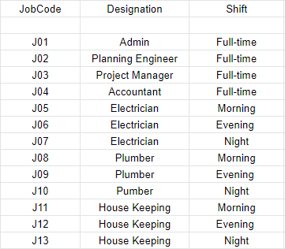
Sample Data
Job Table

Slide 57
Creation of EmployeeTable
create table Employee (
EmpID varchar2(4) not null,
FName varchar2(20),
LName varchar2(20),
EContact number(10),
JobCode varchar2(3),
Pincode number(6),
constraint pk_EmpID primary key (EmpID),
constraint fk_JobCode FOREIGN KEY(JobCode) REFERENCES Job(JobCode),
constraint fk_Pincode FOREIGN KEY(Pincode) REFERENCES Location(Pincode)
)

Slide 58
Insertion Of EmployeeTable
insert into Employee values('E001','Ashwin','Venkatesan',9867564361,'J01',641105);
insert into Employee values('E002','Senthi','kumar',8985663421,'J05',641041);
insert into Employee values('E003','Ganesh','Iyer',9676415267,'J07',641062);
insert into Employee values('E004','Suresh','Nair',9989432678,'J04',635602);
insert into Employee values('E005','Rama','Rao',8884587239,'J06',641605);
insert into Employee values('E006','Ashwin','Raman',9876523465,'J02',609503);
insert into Employee values('E007','Ramachandra','Iyer',9987643257,'J08',641112);
insert into Employee values('E008','Deva','Pillai',9876345656,'J04',621702);
insert into Employee values('E009','Dharun','Venkatesah',6308456579,'J03',626126);
insert into Employee values('E0010','Kavin','Thevar',9441343733,'J09',641655);

Slide 59
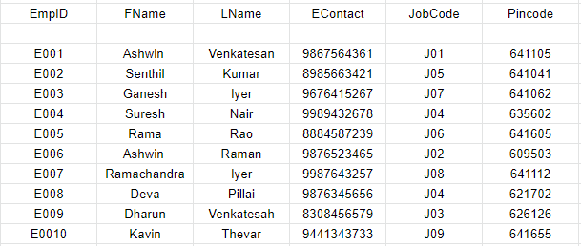
Sample Data
Employee Table

Slide 60
Creation of WaterSourceTable
create table WaterSource
(
WSID varchar2(4) not null,
WStatus varchar2(15),
WEstimation number(7),
WCapacity number(6),
Pincode number(6),
constraint pk_WSID primary key (WSID),
constraint fk_WPincode FOREIGN KEY(Pincode) REFERENCES Location(Pincode)
)

Slide 61
Insertion Of WaterSourceTable
insert into WaterSource values('W002','Constructed',5261510,120000,641041);
insert into WaterSource values('W003','Constructed',4500000,55000,641062);
insert into WaterSource values('W005','Constructed',5400000,75000,641605);
insert into WaterSource values('W007','Constructed',7500000,150000,641112);
insert into WaterSource values('W008','Constructed',7000000,135000,621702);

Slide 62
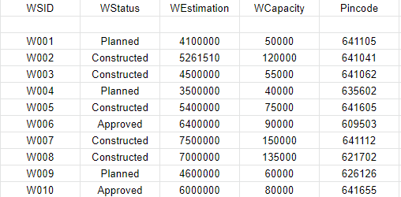
Sample Data
WaterSource Table

Slide 63
Creation of WaterUsage Table
create table WaterUsage
(
WSID varchar2(4) not null,
MONTH varchar2(10) not null,
YEAR number(4) not null,
USAGE number(6),
constraint pk_WSID_MONTH_YEAR primary key (WSID, MONTH, YEAR),
constraint fk_WSID FOREIGN KEY(WSID) REFERENCES WaterSource(WSID)
)

Slide 64
Insertion Of WaterUsageTable
insert into WaterUsage values('W002','January',2020,20000);
insert into WaterUsage values('W007','March',2020,30000);
insert into WaterUsage values('W008','November',2020,25000);
insert into WaterUsage values('W002','February',2020,9000);
insert into WaterUsage values('W008','January',2020,30000);
insert into WaterUsage values('W002','April',2020,25000);
insert into WaterUsage values('W007','February',2020,17000);
insert into WaterUsage values('W007','September',2020,22000);
insert into WaterUsage values('W008','June',2020,15000);
insert into WaterUsage values('W002','July',2020,21000);

Slide 65
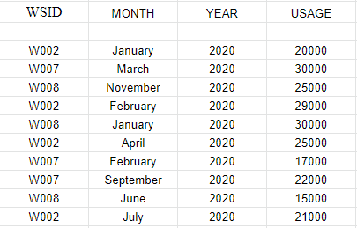
Sample Data
WaterUsage Table

Slide 66
Creation of SanitationSystems Table
create table SanitationSystems
(
SSID varchar2(4) not null,
SStatus varchar2(15),
SEstimation number(10),
Pincode number(6),
constraint pk_SSID primary key (SSID),
constraint fk_SPincode FOREIGN KEY(Pincode) REFERENCES Location(Pincode)
)

Slide 67
Insertion Of SanitationSystemsTable
insert into SanitationSystems values('S001','Constructed',2100000,641105);
insert into SanitationSystems values('S002','Constructed',2000000,641041);
insert into SanitationSystems values('S005','Constructed',2000000,641605);
insert into SanitationSystems values('S006','Constructed',1700000,609503);
insert into SanitationSystems values('S009','Constructed',2300000,626126);

Slide 68
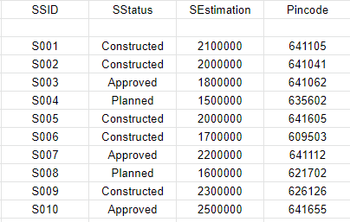
Sample Data
SanitationSystems Table

Slide 69
Creation of Families Table
create table Families
(
FID varchar2(6) not null,
Persons number(2),
FHead varchar2(10),
Consumption number(5),
FContact number(10),
Pincode number(6),
constraint pk_FID primary key (FID),
constraint fk_FPincode FOREIGN KEY(Pincode) REFERENCES Location(Pincode)
)

Slide 70
Insertion Of Families Table
insert into Families values('F00001',4,'Ashwin',7500,7358973592,641105);
insert into Families values('F00002',3,'Venkat',5000,9391357915,641041);
insert into Families values('F00003',8,'Sriram',15000,9989763459,641062);
insert into Families values('F00004',6,'Chandu',10000,9676313275,635602);
insert into Families values('F00005',2,'Senthil',1500,7702184949,641605);
insert into Families values('F00006',7,'Ganesh',13500,8985717469,609503);
insert into Families values('F00007',4,'Akash',75000,9490384823,641112);
insert into Families values('F00008',3,'RamaRao',5000,8356983593,621702);
insert into Families values('F00009',5,'Saravan',9000,9441754535,626126);
insert into Families values('F00010',6,'Manoj',10000,8886433659,641655);

Slide 71
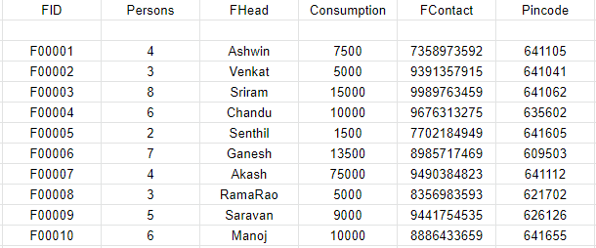
Sample Data
Families Table

Slide 72
Creation of Donations Table
create table Donations
(
TransactionID varchar2(6) not null,
AccountNumber number(15),
Amount number(10,2),
DContact number(10),
DDate varchar2(25),
constraint pk_TransactionID primary key (TransactionID)
)

Slide 73
Insertion Of DonationsTable
insert into Donations values('T00001',123456789009123,1500,9652836888,'2020-01-22');
insert into Donations values('T00002',123456769009224,1000,9676313275,'2020-04-11');
insert into Donations values('T00003',123565678432156,500,8985546789,'2020-01-02');
insert into Donations values('T00004',567895432167889,750,9678654329,'2020-05-07');
insert into Donations values('T00005',123564567897656,2500,7702184949,'2020-07-03');
insert into Donations values('T00006',678954325689567,1900,9490384823,'2020-01-10');
insert into Donations values('T00007',789456345678956,5000,9989654329,'2020-06-06');
insert into Donations values('T00008',657894325678976,35000,9989442189,'2020-05-15');
insert into Donations values('T00009',456789543267798,550,6302856789,'2020-02-21');
insert into Donations values('T00010',345678934523678,300,7302184965,'2020-03-20');

Slide 74
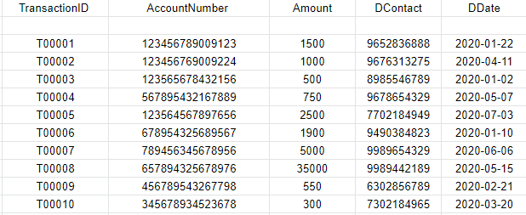
Sample Data
Donations Table

Slide 75
Creation of Expenditure Table
create table Expenditure (
ExpenseID varchar2(6) not null,
EDate varchar2(25),
EmpID varchar2(4),
WSID varchar2(4),
SSID varchar2(4),
EAmount number(10,2),
constraint pk_ExpenseID primary key (ExpenseID),
constraint fk_EmpID FOREIGN KEY(EmpID) REFERENCES Employee(EmpID),
constraint fk_EWSID FOREIGN KEY(WSID) REFERENCES WaterSource(WSID),
constraint fk_SSID FOREIGN KEY(SSID) REFERENCES SanitationSystems(SSID) )

Slide 76
Insertion Of ExpenditureTable
insert into Expenditure values('E00001','2020-01-01','E004','W003','NULL',15000);
insert into Expenditure values('E00002','2020-03-06','E009','W007','NULL',20000);
insert into Expenditure values('E00003','2020-04-09','E005','NULL','S006',10000);
insert into Expenditure values('E00004','2020-02-14','E001','NULL','S003',25000);
insert into Expenditure values('E00005','2020-01-25','E002','W004','NULL',5000);
insert into Expenditure values('E00006','2020-05-09','E003','NULL','S005',7500);
insert into Expenditure values('E00007','2020-04-16','E007','NULL','S002',12500);
insert into Expenditure values('E00009','2020-08-15','E004','W002','NULL',15000);
insert into Expenditure values('E00010','2020-05-15','E008','NULL','S008',12000);

Slide 77
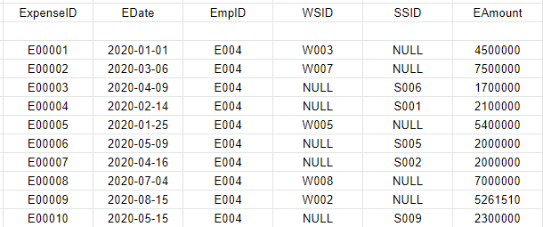
Sample Data
Expenditure Table

Slide 78
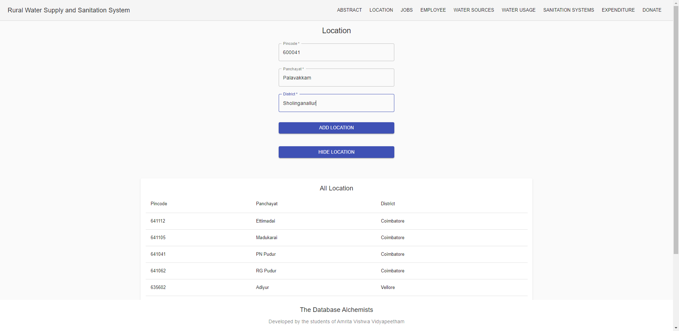
User Interface Screens
Location Table:

Slide 79
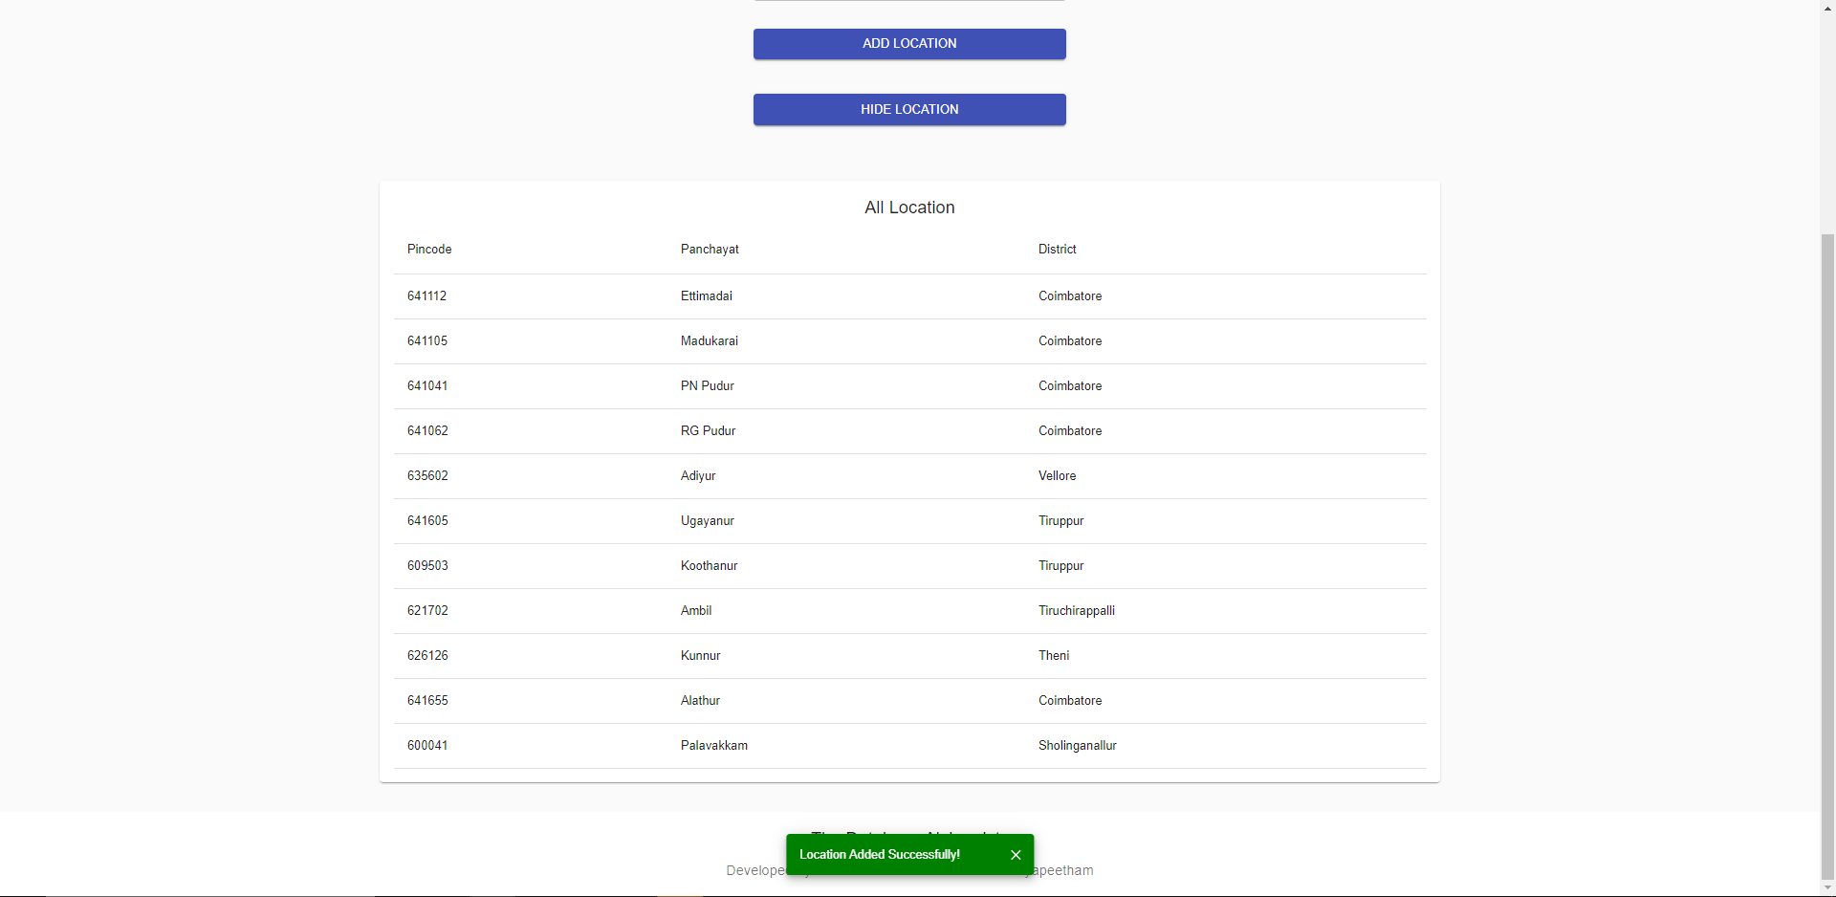
User Interface Screens
Location Table:

Slide 80
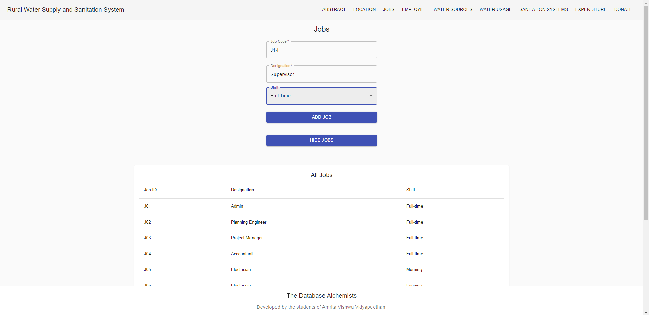
User Interface Screens
Jobs Table:

Slide 81
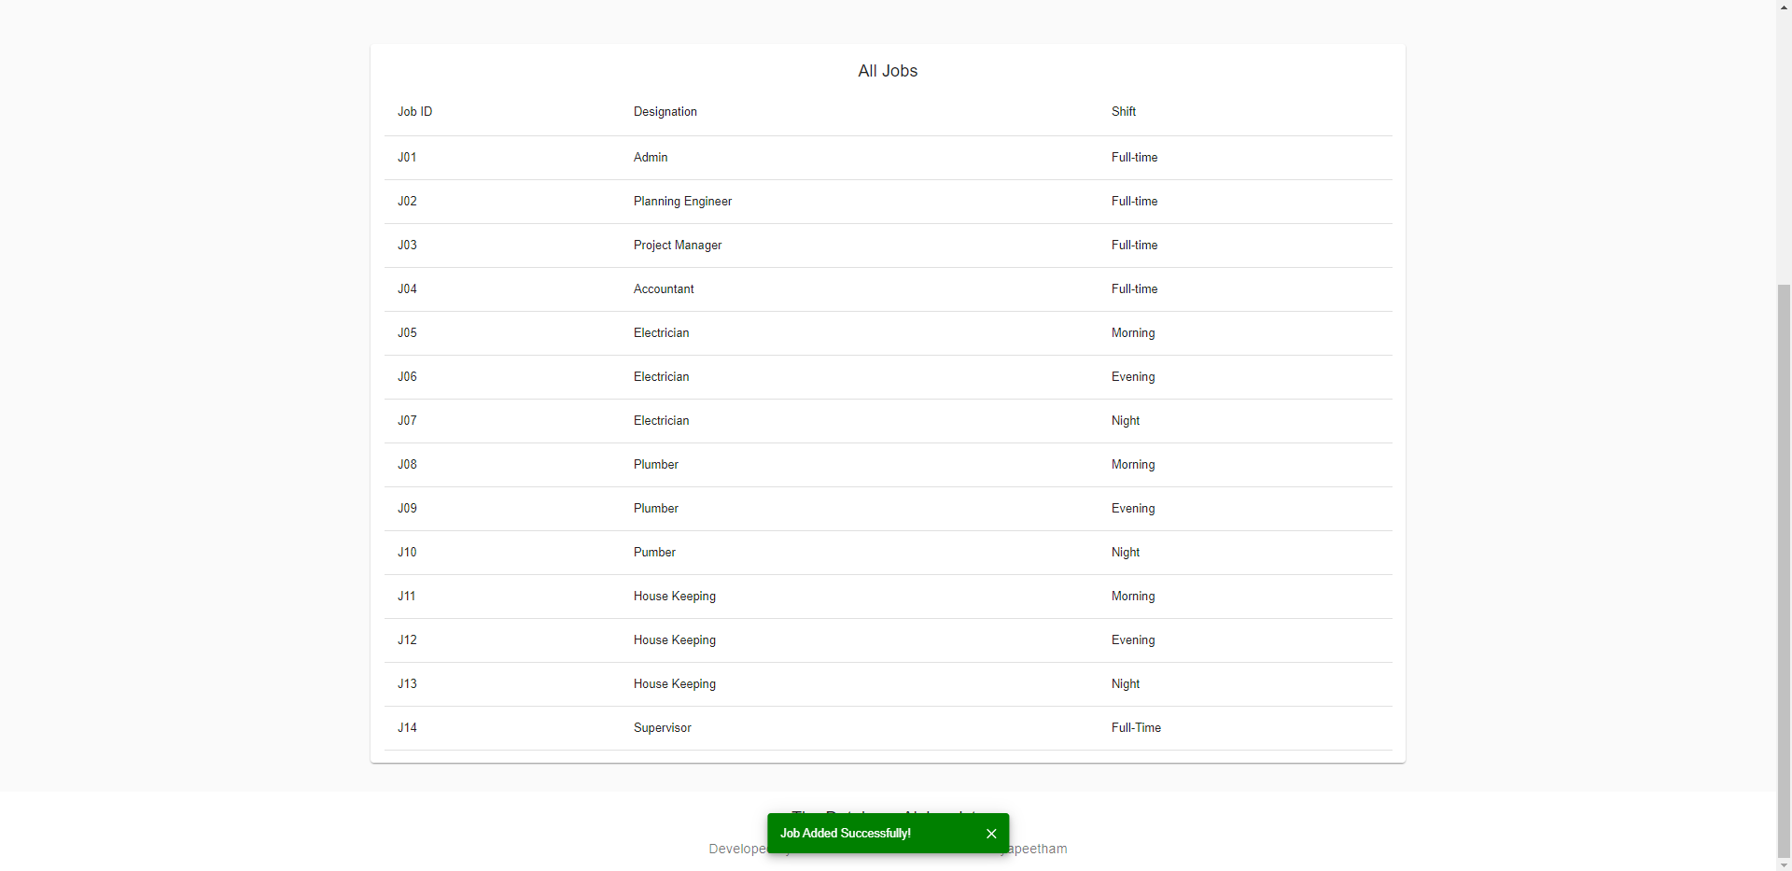
User Interface Screens
Jobs Table:

Slide 82
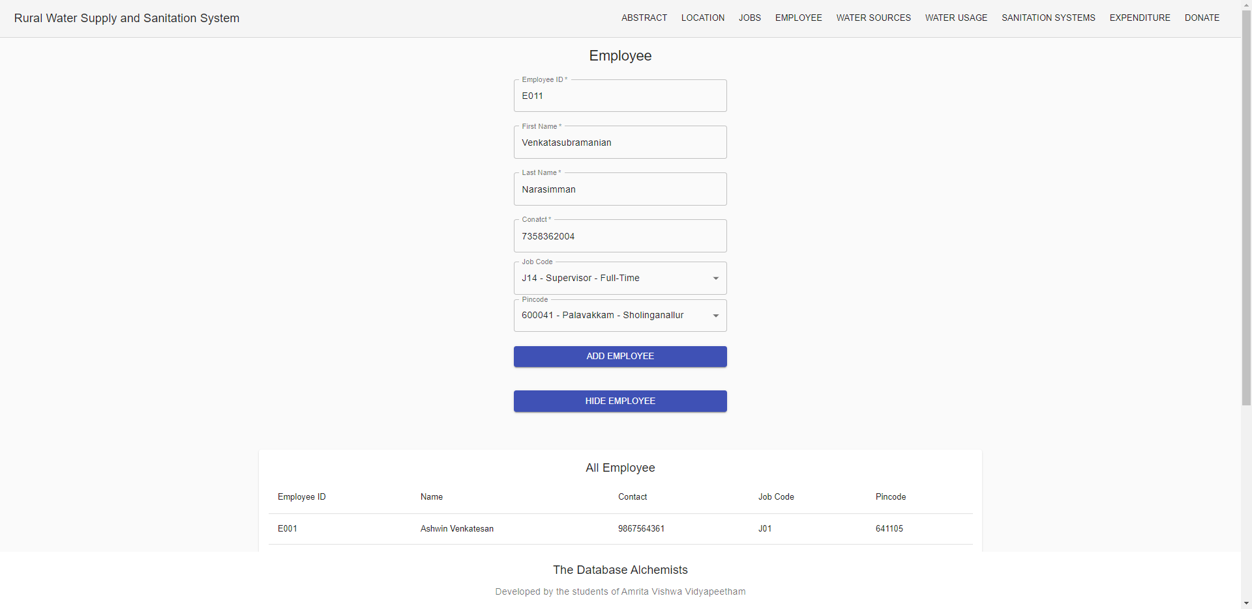
User Interface Screens
Employee Table:

Slide 83
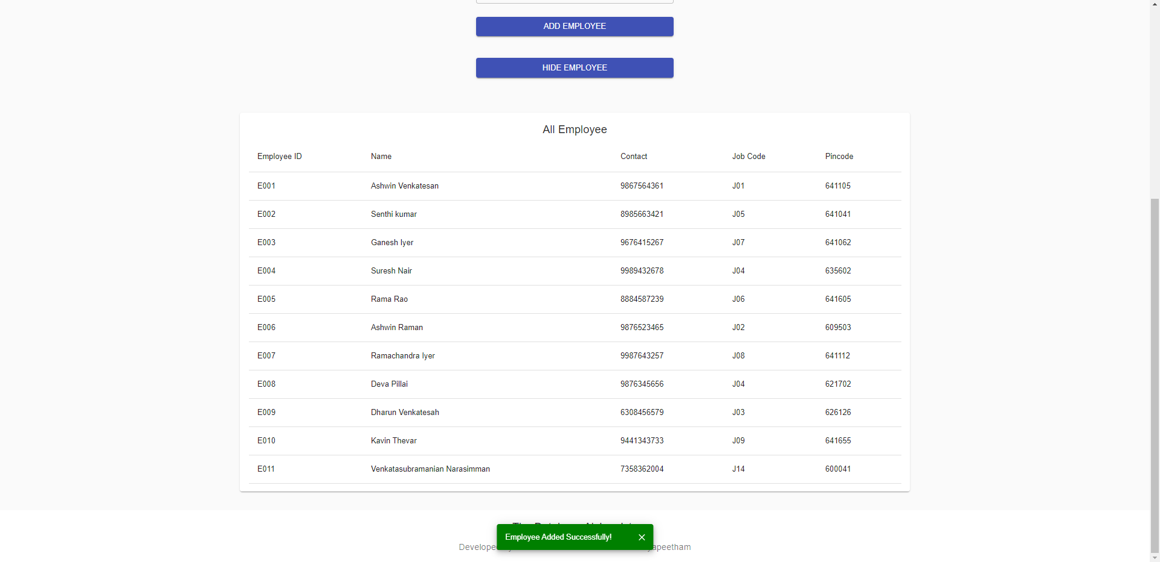
User Interface Screens
Employee Table:

Slide 84
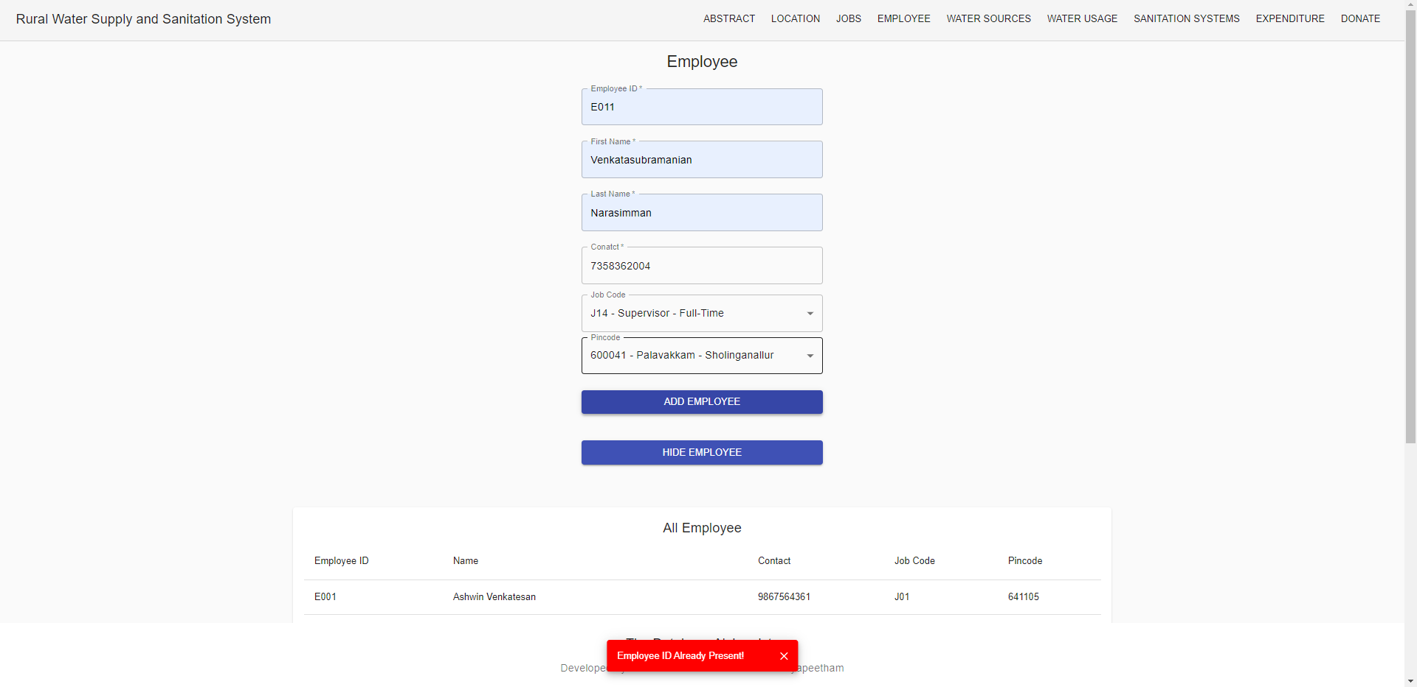
User Interface Screens
Employee Table (Validation of PK):

Slide 85
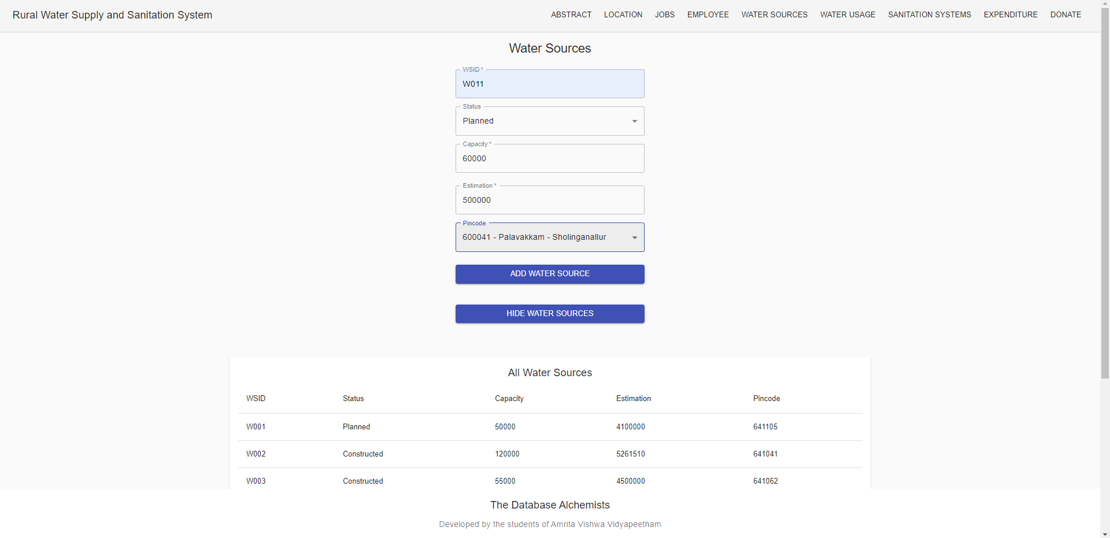
User Interface Screens
Water Source Table:

Slide 86
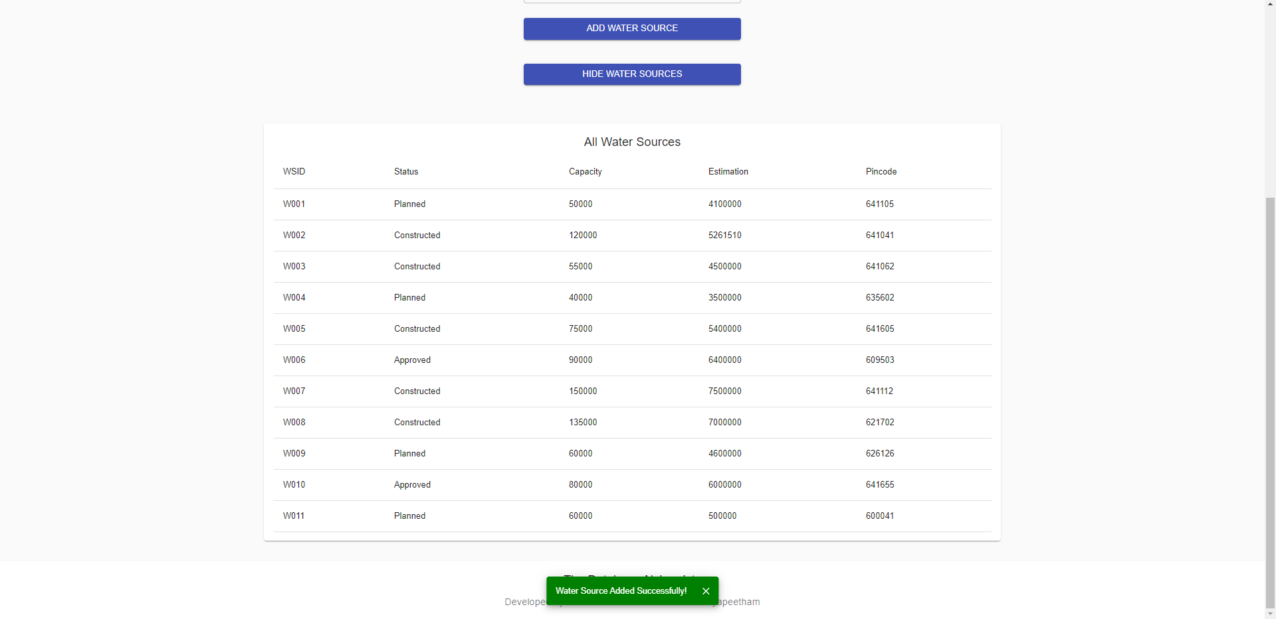
User Interface Screens
Water Source Table:

Slide 87
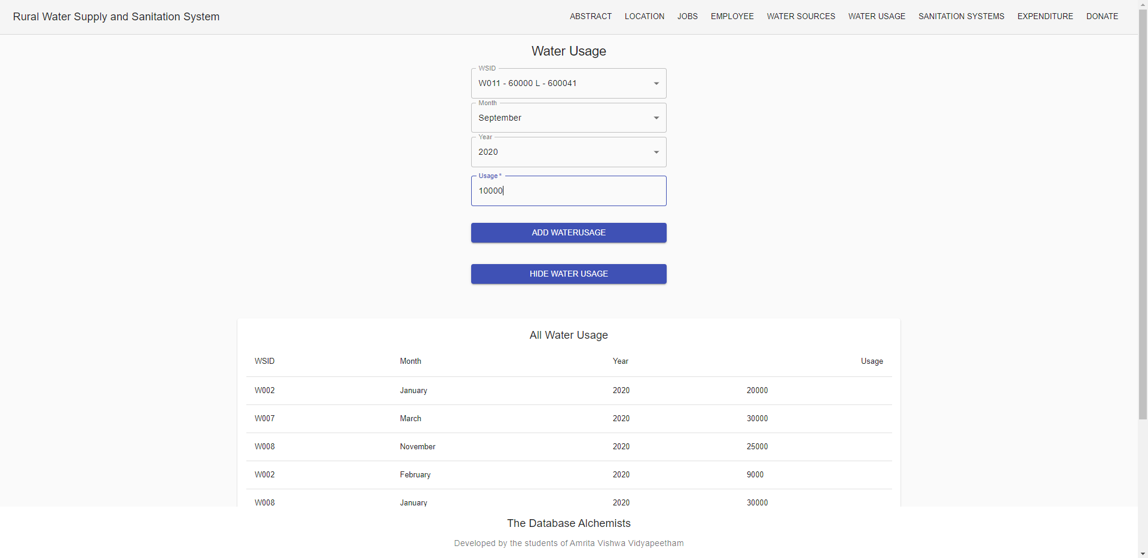
User Interface Screens
Water Usage Table:

Slide 88
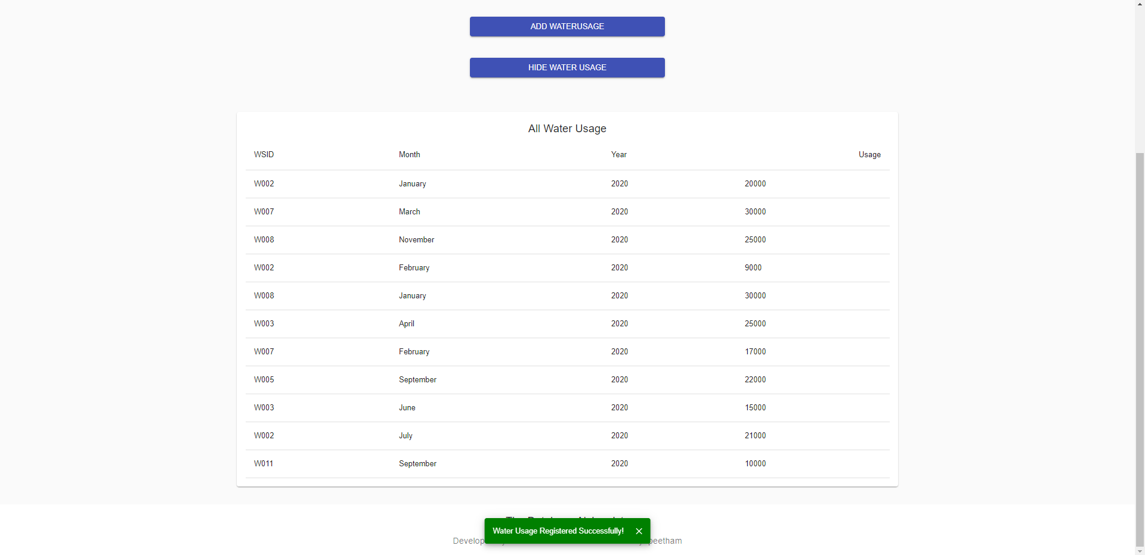
User Interface Screens
Water Usage Table:

Slide 89
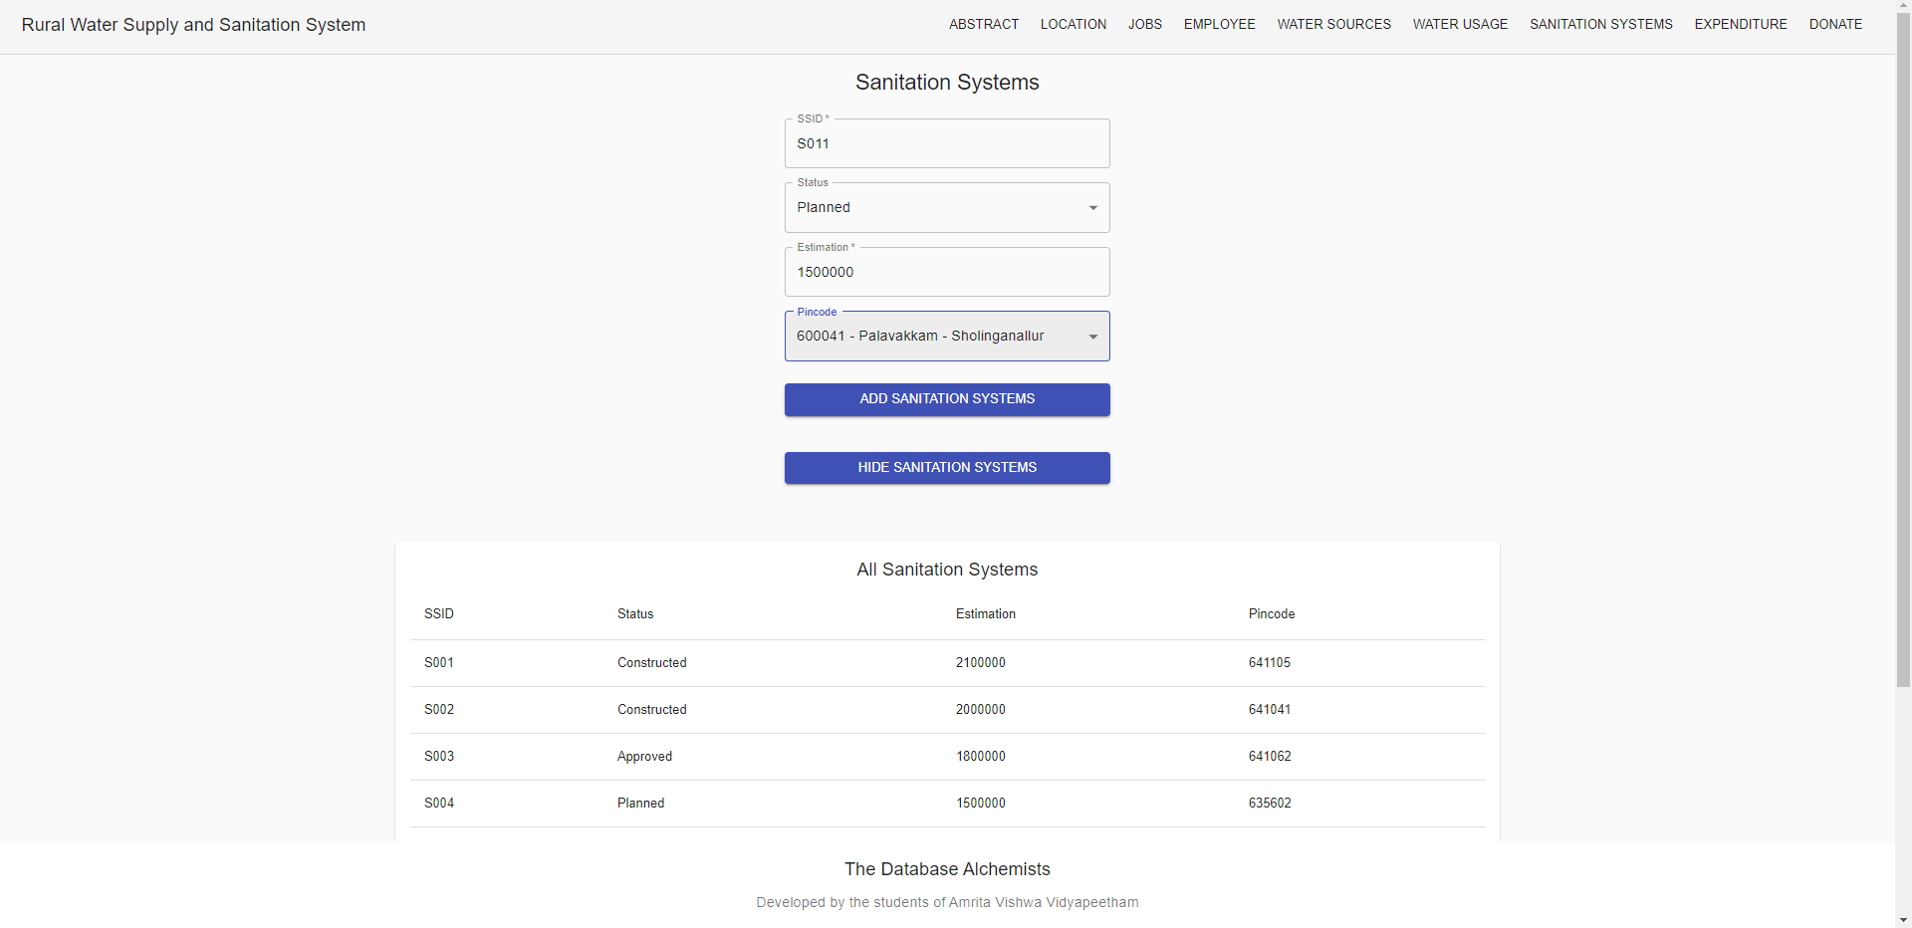
User Interface Screens
Sanitation Systems Table:

Slide 90
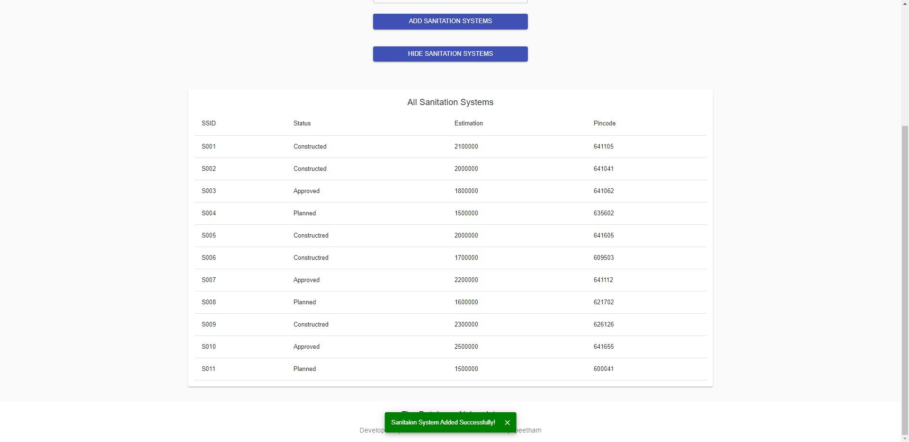
User Interface Screens
Sanitation Systems Table:

Slide 91
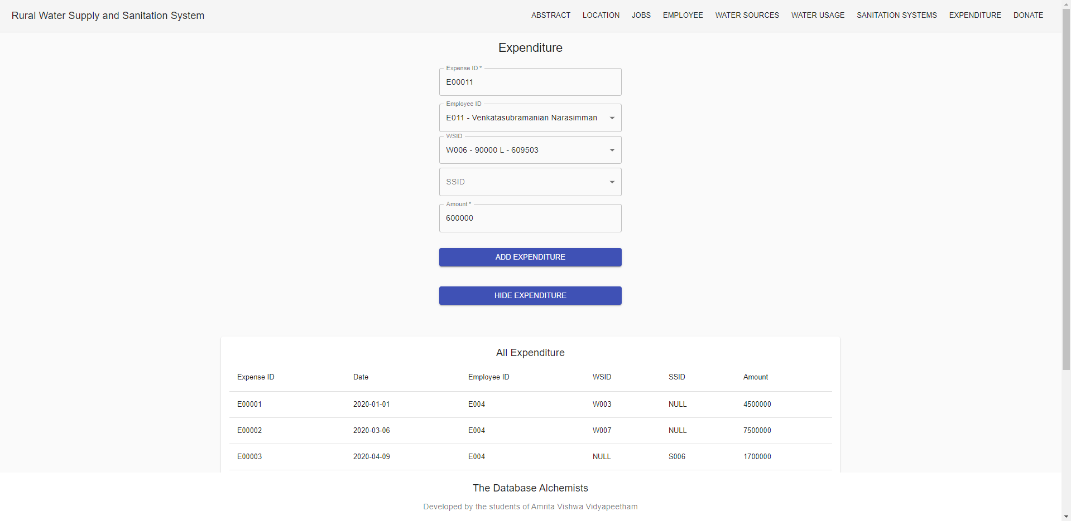
User Interface Screens
Expenditure Table:

Slide 92
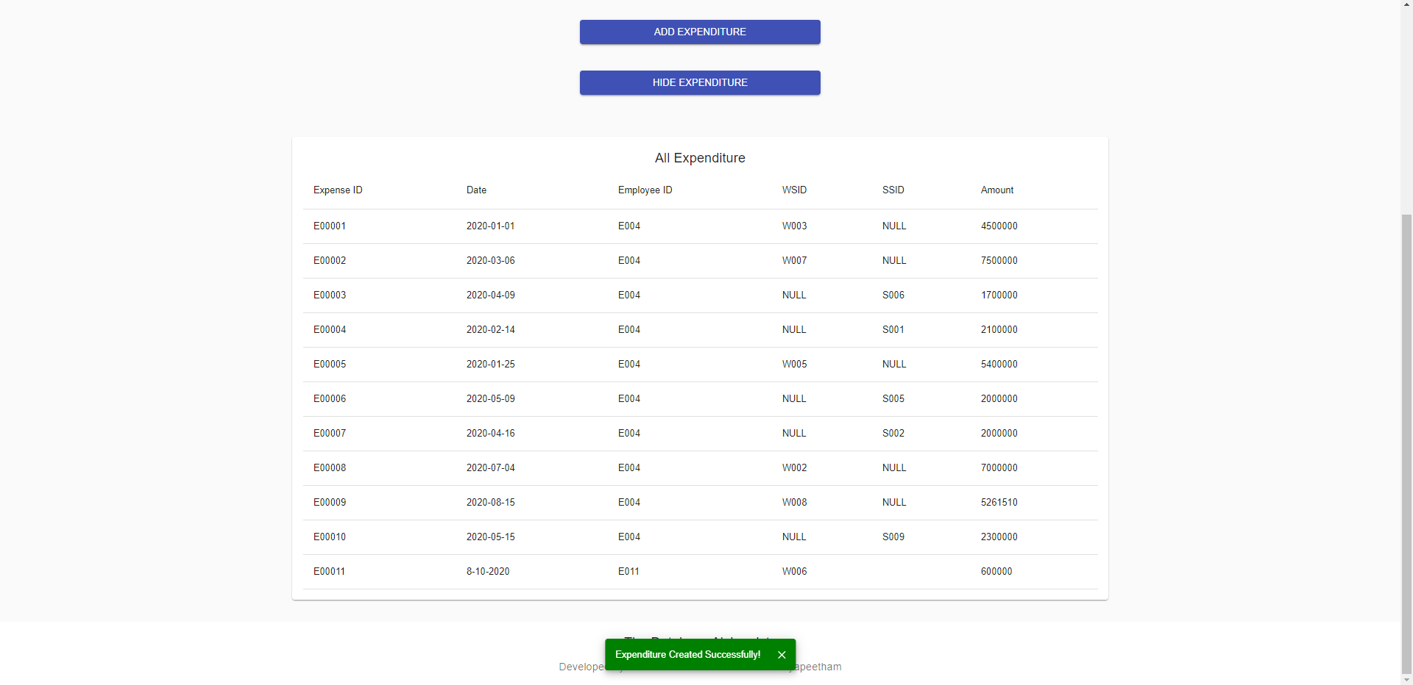
User Interface Screens
Expenditure Table:

Slide 93
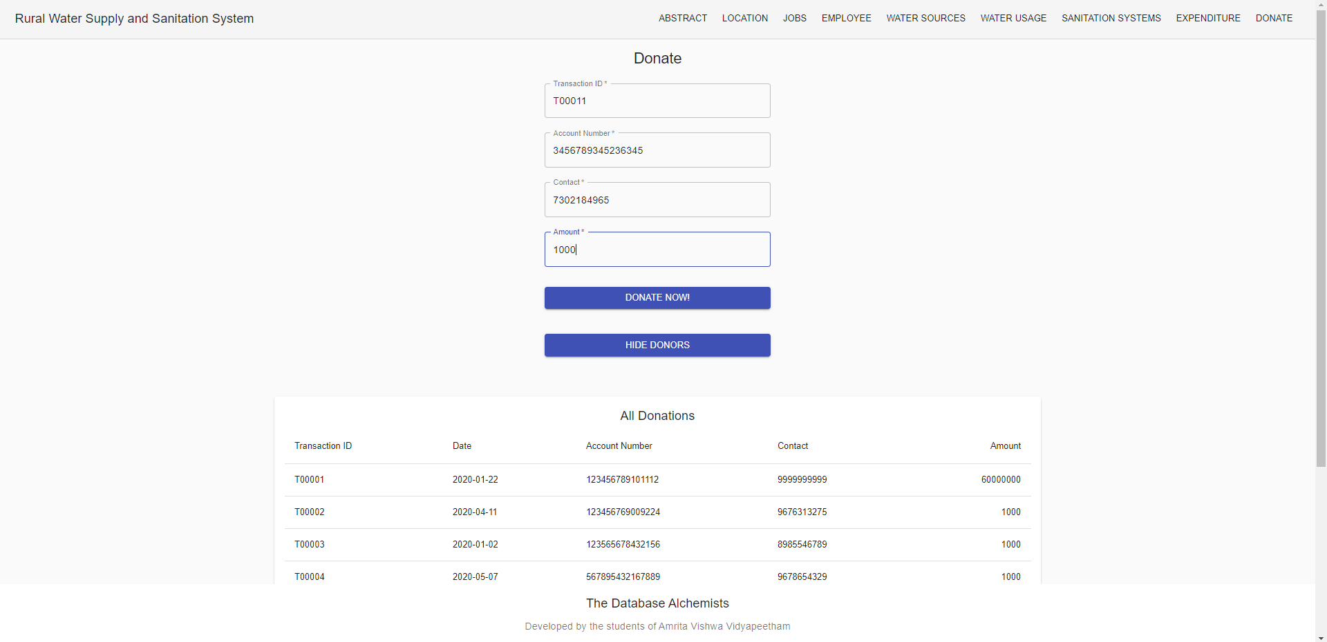
User Interface Screens
Donations Table:

Slide 94
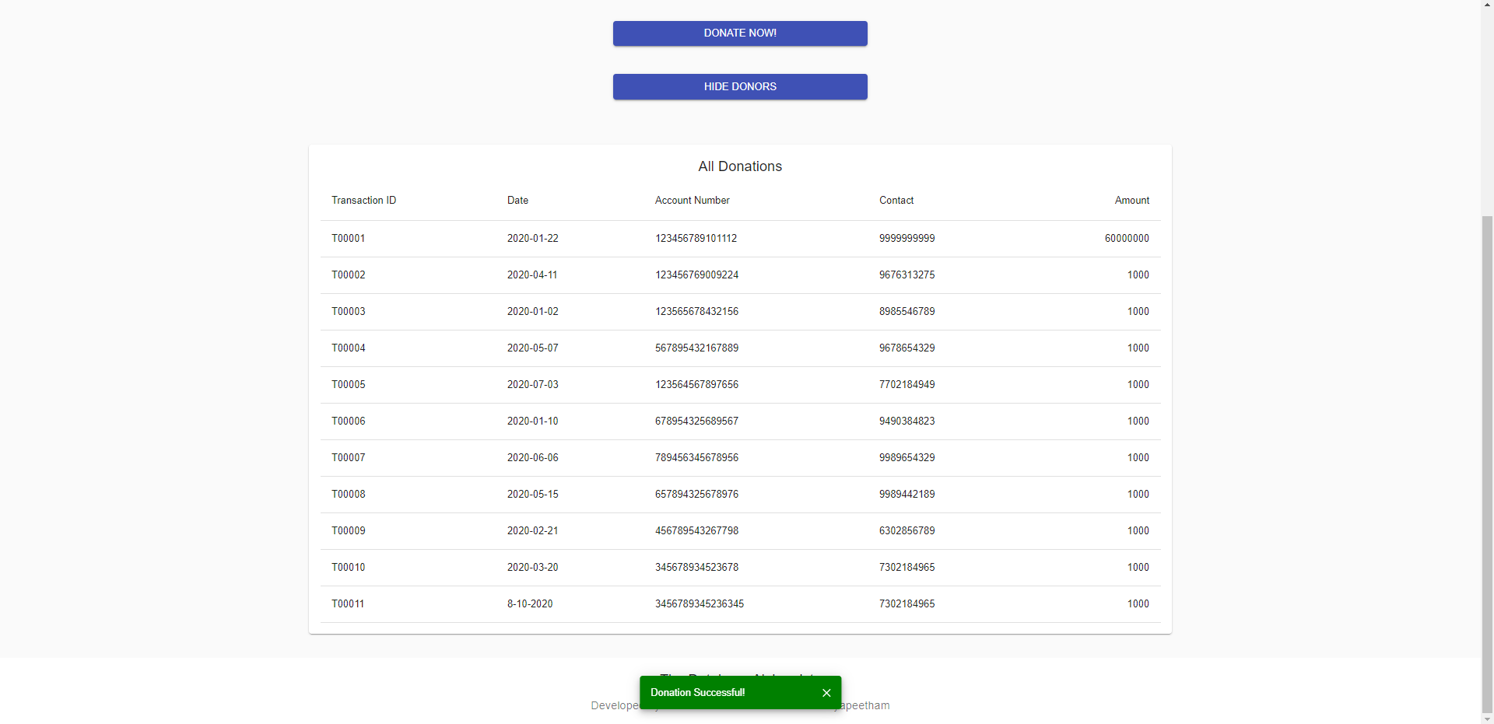
User Interface Screens
Donations Table:

Slide 95
Reference
React Tutorial for Beginners - Programming with Mosh
Website: YouTube
Date of Visit: 01/10/2020 – 09/10/2020
URL: https://www.youtube.com/watch?v=Ke90Tje7VS0
Example Live Project - Kerala Rural Water Supply and Sanitation Agency
Website: jalanidhi.kerala.gov.in
Date of Visit: 07/09/2020 – 09/10/2020
URL: https://jalanidhi.kerala.gov.in/page/render/reference/Jalanidhi_Analytics

Slide 96
Thank You
Happy to Answer your Questions!

