Slide 1
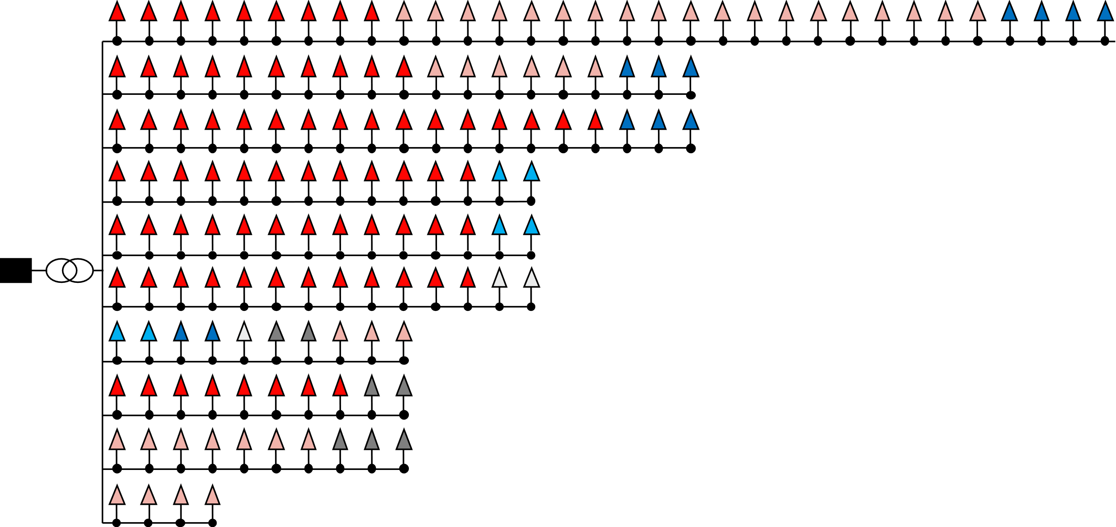

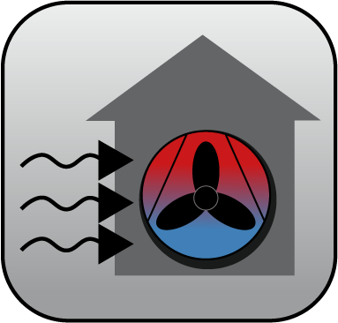
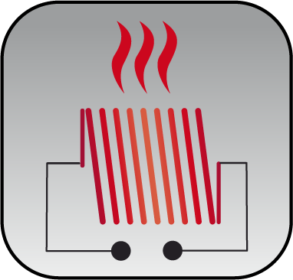




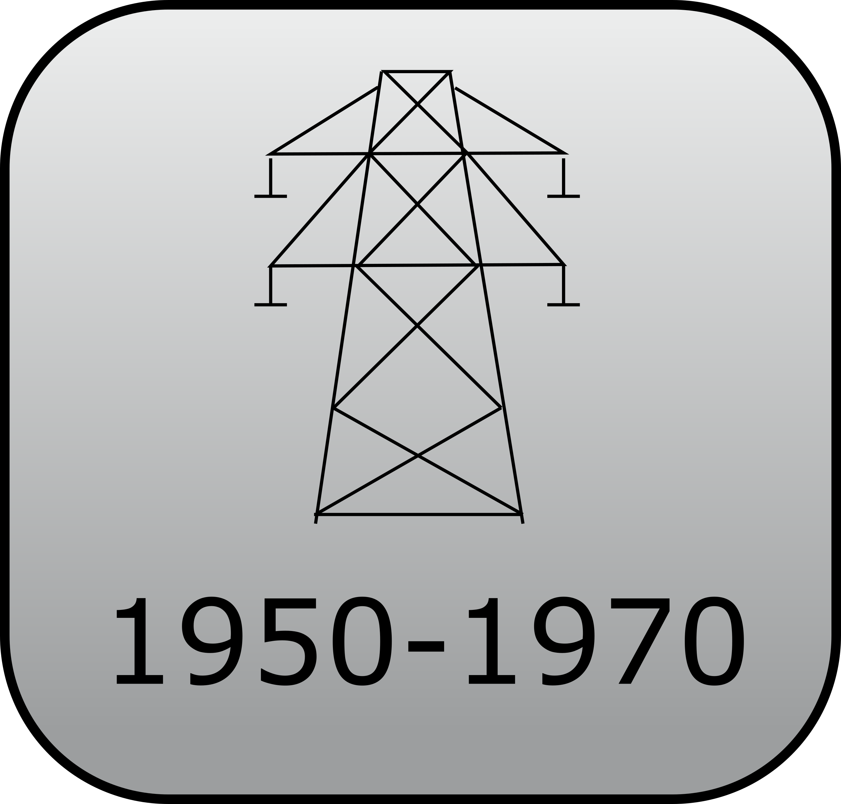







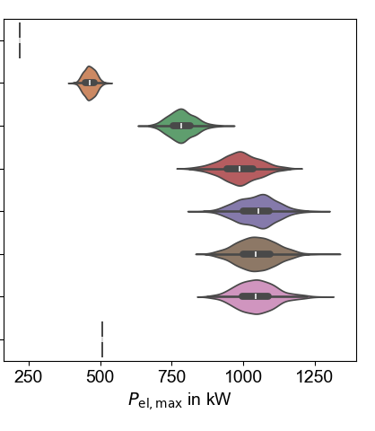
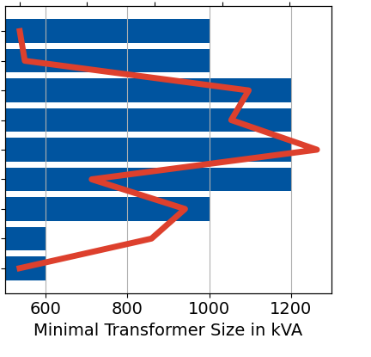
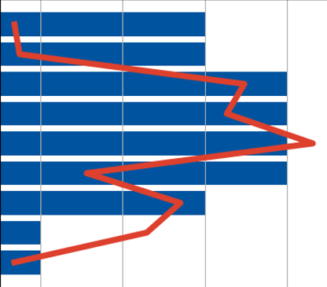
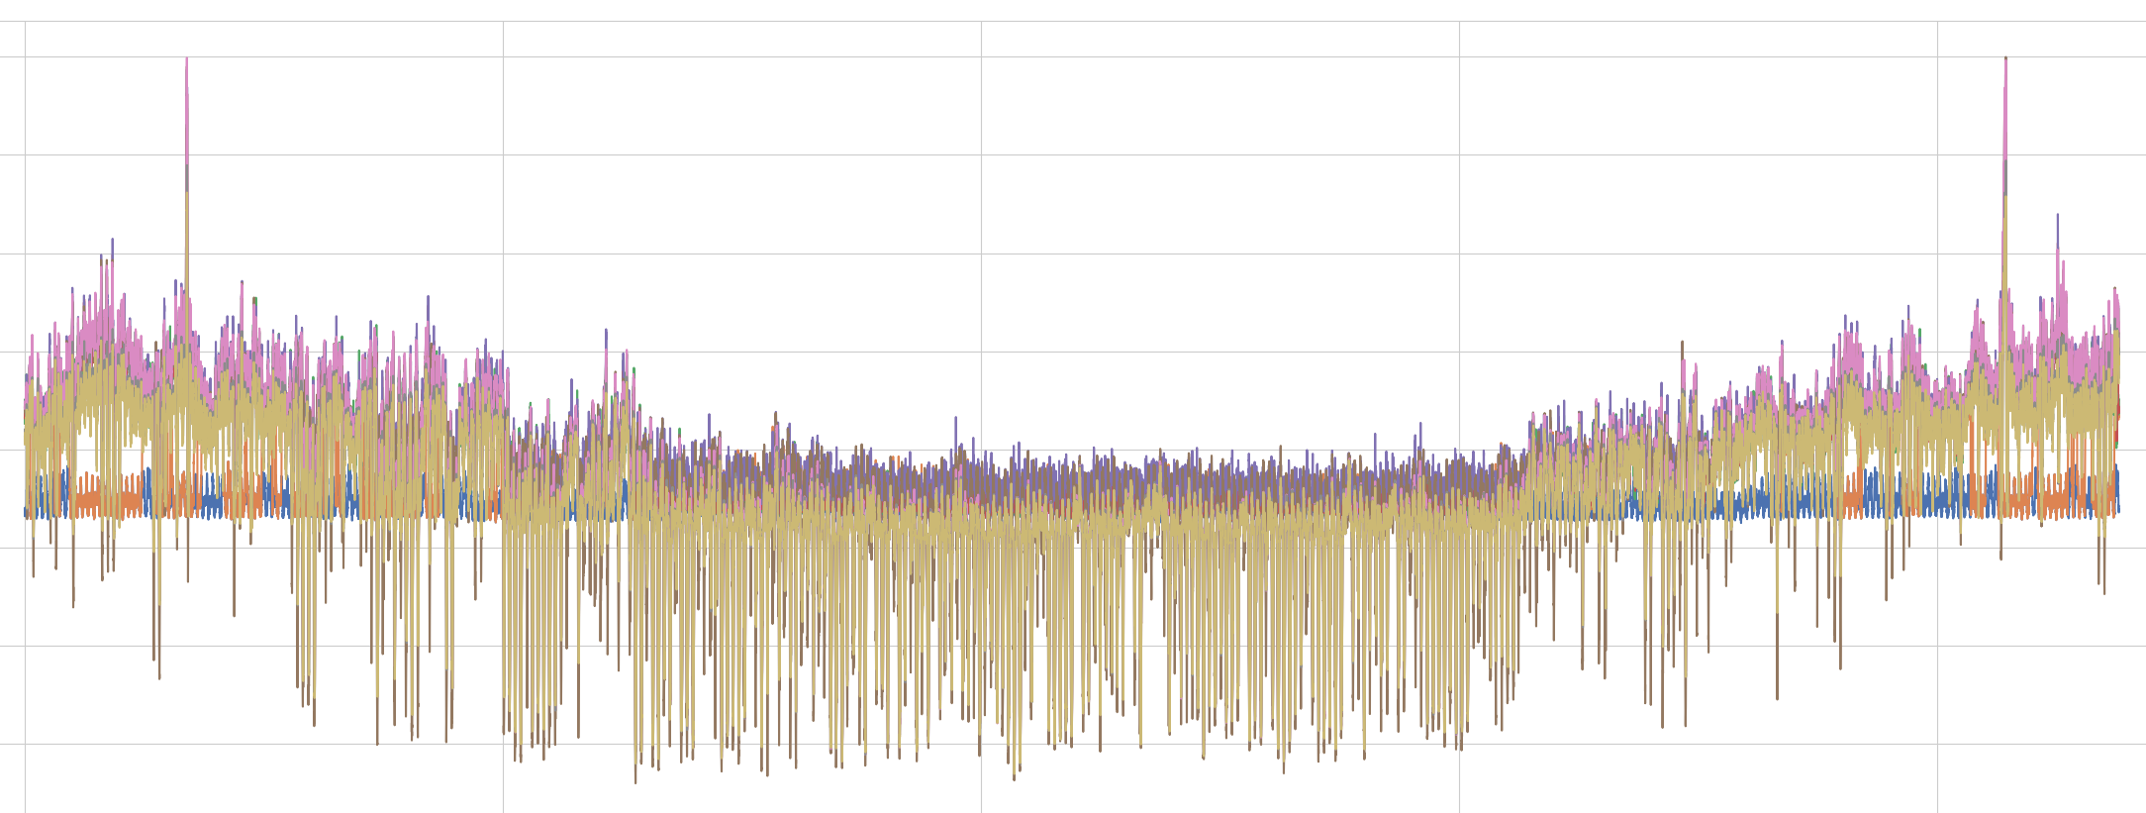


Possible system configurations
Typical Grid
Heat Technology
Electrical Technology
Building Envelope
Annual dynamic simulations of all configurations for all buildings
Monte-Carlo simulation for different technology shares
Simulate required transformer size
$$P_{el}$$
Hours in year
$P_{el,Max}$ in kW
Required transformer in kVA

