Slide 1
CityGML EnergyADE Exchange GIT Repository
4th Expert Meeting IBPSA Project 1, Rome
Avichal Malhotra, M.Sc
Lehrstuhl für Energieeffizientes Bauen, E3D
RWTH Aachen University
31.08.2019 – 01.09.2019

Slide 2
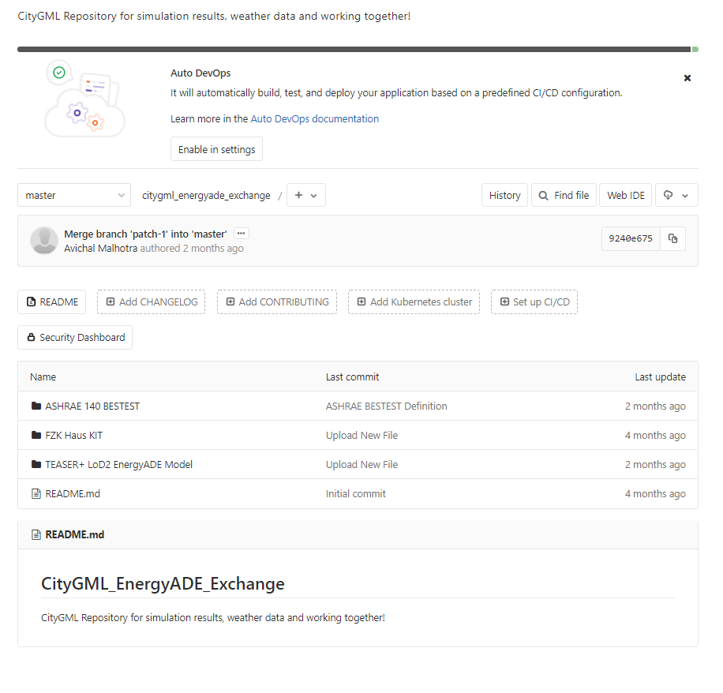


A platform to work and share data

Slide 3
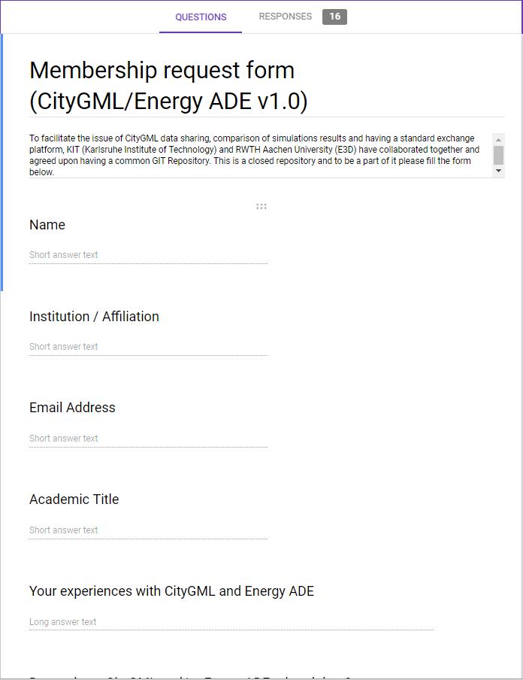
Form for membership
Data exchange for CityGML 2.0 and Energy ADE v1.0
16 responses till 26.08.2019

Slide 4
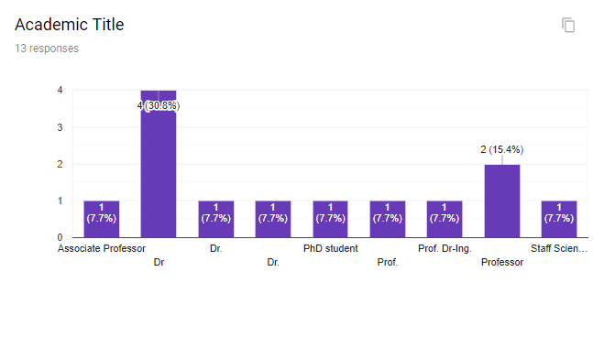
Responses : Academic Title

Slide 5
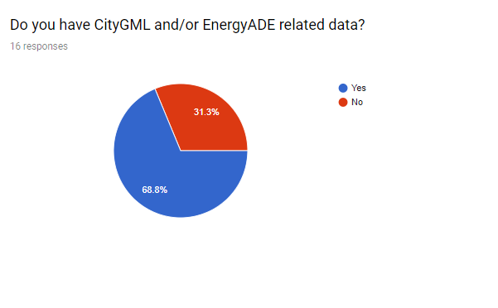
Responses: Experiences

Slide 6
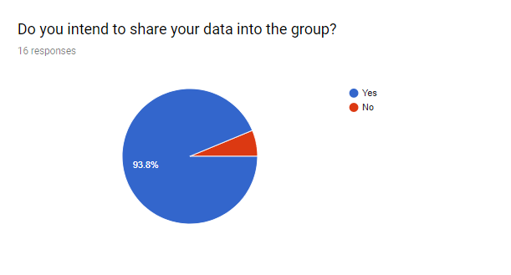
Responses: Sharing Data within the group

Slide 7
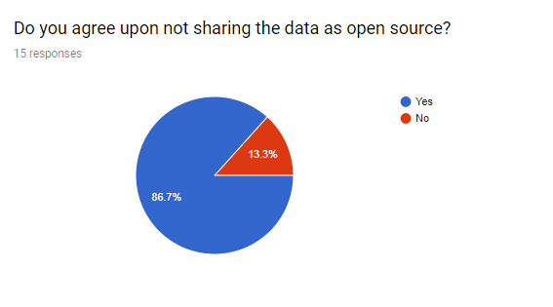
Responses: Sharing data as open source

Slide 8
Key Facts
Idea is to compare computational differences between multiple simulation platforms over a common data model
Presently, data exchange has been facilitated by KIT and E3D
Until now, results for EnergyPlus and Modelica(LoD2) has been uploaded
KIT uploaded the ASHRAE 140 BESTEST and FZK Haus to share the data model
All 16 participants of the membership form will be given access soon
If you wish to join the exchange platform, follow the link below to fill out the membership form: https://docs.google.com/forms/d/1JLVMQ9TGUfWT1zmFVB56-92an3woz33Hrz7B-1SVDvQ/viewform?edit_requested=true

