Slide 1
Workflow documentation dynamic simulation pandapipes
From Arkadi Butenko

Slide 2
Agenda
1
Important dependecies
2
Minimum input that is required
3
Simulation run and TEASER use
4
Simulation results

Slide 3

Important dependencies
1
Required installation if not already done:
Pandapipes installation with version 0.13.0
TEASER version 1.3.1
Dymola interface installation for the use of TEASER
Search in the installation Dymola folder C:\Program Files\YOUR_DYMOLA_FOLDER\Modelica\Library\python_interface for a .whl for installation with pip
Possible problems could occur if your in environment has a low numpy version since pandapipes requires version >=1.26 and <2.4

Slide 4
Minimum input that is required
2
To build the uesgraphs structure necessary files are:
network.geojson
Buildings.geojson
Supply.geojson
With those the graph can be constructed
To get the TEASER demand estimation necessary file is:
Buildings.geojson
This is used for the building information that is required for TEASER, check the example buildings.geojson to set the minimum parameters there which are:
archetype; year_of_construction; number_of_floors; height_of_floors; net_leased_area; with_ahu; internal_gains_mode
Check the TEASER documentation for detailed information about that

Slide 5
Minimum input that is required
2
To build the pandapipes simulations the following parameters are required to be set in uesgraphs_template_pp.xlsx:
Simulation sheet
Stop_time; timestep; mode; ground_depth
Demands sheet
dTNetwork; TReturn
Supply sheet
pIn; dpFlow; pReturn; TIn; Treturn (this should the same as in demands sheet)
Pipes sheet
dIns; kIns; roughness; ground_depth(again same as in simulation sheet)
Those are the necessary parameters for a simulation run
Important last file is ground_temperatures,csv over the simulation time, which has to be provided

Slide 6
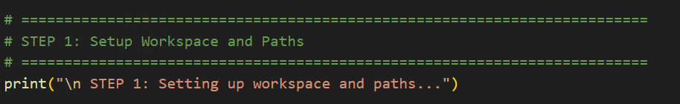
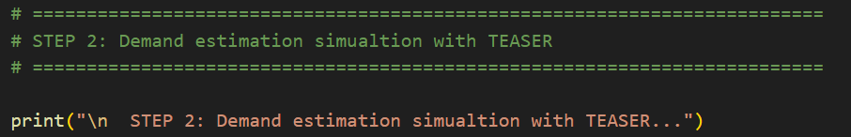
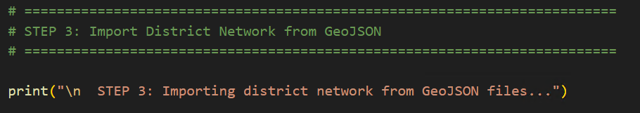
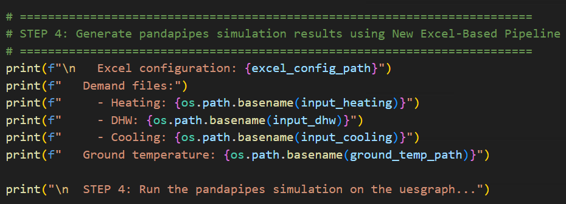
Simulation run and TEASER use
3
Check the example out in the examples folder with „e18_teaser_integration_pandapipes_sim.py“
You will see a workflow that is necessary to follow since it has the necessary functions that are needed to be called and set to use the pandapipes simulations and the TEASER integration within the uesgraphs
The main steps require setting the paths to the necessary files, calling the TEASER integration if needed, creating the graph and running the simulation

Slide 7
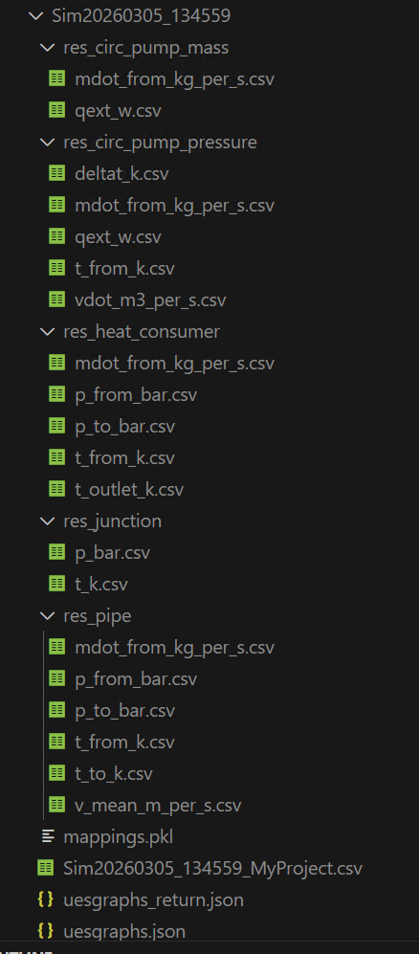
Simulation results
4
The following results are obtained by the simulation:
Mass flows and pressure differences at edges of the network
Pressures and temperatures at nodes of the network
Pressures, temperatures and mass flows of heat consumers
Temperatures, mass flow and thermal energy consumption at the supply pumps
Uesgraphs.json → Supply side (From Supply pumps to heat consumers)
Uesgraphs_return.json → Return side (From heat consumers to pumps)
Both .jsons have saved results in lists for each simulation timestep
On the pipes: dp, m_flow and Q_loss
On the network nodes: pressure and temperature

