Slide 1
Annex A.2 Summary of the Semantics of all Communicating MPI Routines
Ursprüngliche Formatierung beibehalten
Stages: i=initialization, s=starting, c=completion, f=freeing
Cpl: ic=incomplete, c=completing, f=freeing procedure
Loc: l=local, nl=non-local
Bold: exceptions, e.g., ic+nl = incomplete+non-local, and c+l = complete+local (both are defined as blocking)
Blk: b=blocking, nb=nonblocking. Note that from a user's view point, this column is only a hint. Relevant is, whe-
ther a routine is local or not and which resources are blocked until when. See both previous and last columns.
Bold: exceptions, e.g., nonblocking precudures without prefix "I", or that "I"only marks immediate return.
Op: part of operation type: b-op = blocking operation,
nb-op = nonblocking operation, p-op = persistent operation
Collective procedures:
- C = all processes of the group must call the procedure
- sq = in the same sequence
- S1 = blocking synchronization, S2 = start-complete-synchronization
Blocked resources: They are blocked after the call until the end of subsequent stage where this resource is not
further mentioned.
Remarks:
1) Must not return before the corresponding MPI_receive operation is started.
2) Not associated with an operation.
3) Usually, MPI_WAIT is non-local, but in this case it is local.
4) In case of a MPI_(I)BARRIER, the S1/S2 synchronization is required (instead of "may or may not").
5) Collective: all processes must complete, but with the free choice of using MPI_WAIT
or MPI_TEST returning flag=TRUE.
6) It also may not return until MPI_INIT was called in the children.
7) Addresses are cached on the request handle.
8) One of the rare cases that an incomplete call is non-local and therefore blocking.
9) One shall not free or deallocate the buffer before the operation is freed, that is MPI_REQUEST_FREE returned.
10) For MPI_WAIT and MPI_TEST, see corresponding lines for a) MPI_BSEND, or b) MPI_IBCAST.
11) The prefix "I" marks only that this procedure returns immediately.
12) One of the exceptions that a blocking procedure is local
13) MPI_(I)MRECV initiates the receive buffer whereas MPI_(I)MPROBE initiated the operation
through generating the message handle.
14) Nonblocking procedure without an "I" prefix
15) i stage only if flag=TRUE is returned else no operation is progressed
16) Collective: all processes must start, but with the free choice of using MPI_START or MPI_STARTALL for a given
persistent request handle, i.e., if one process starts a persistent request handle then all processes
of the associated process group must start their corresponding request handle, and if any process starts then
all processes must complete their handles.

Slide 2
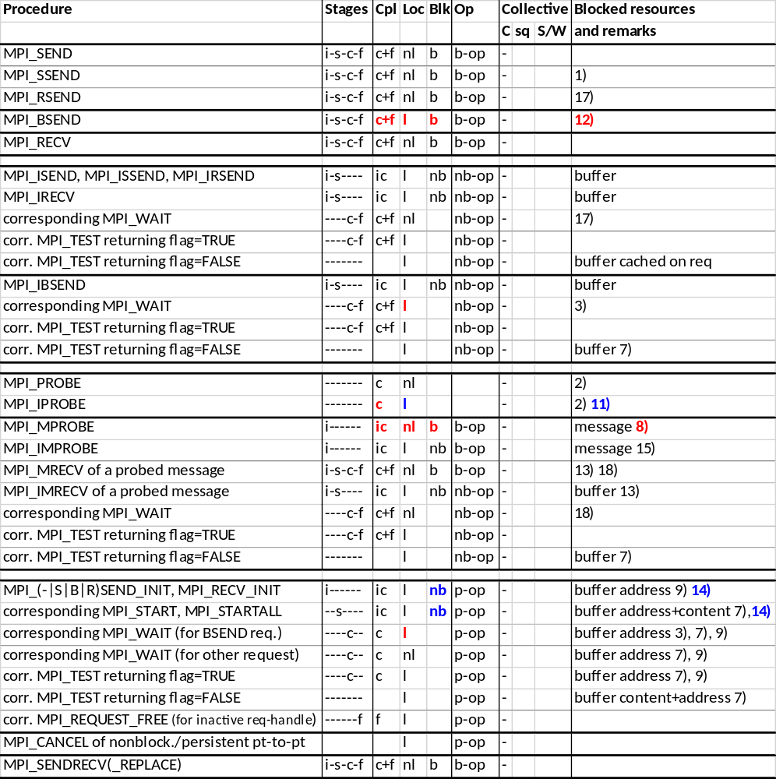
Einbetten → img2.png

Slide 3
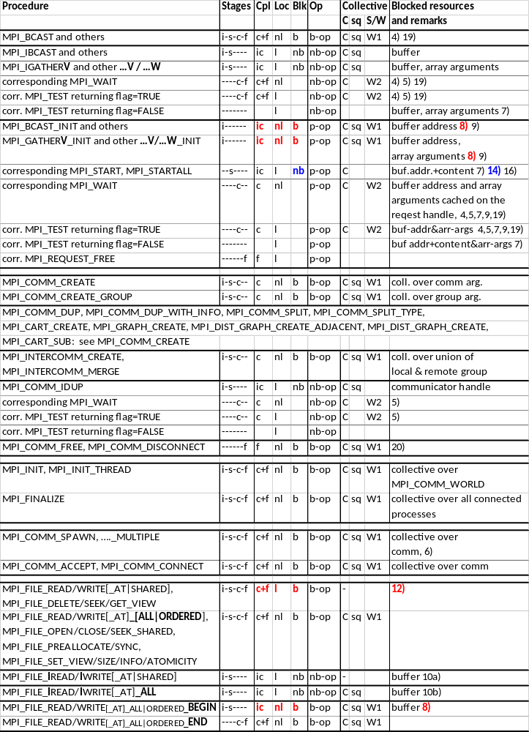
Einbetten → img3.png

Slide 4
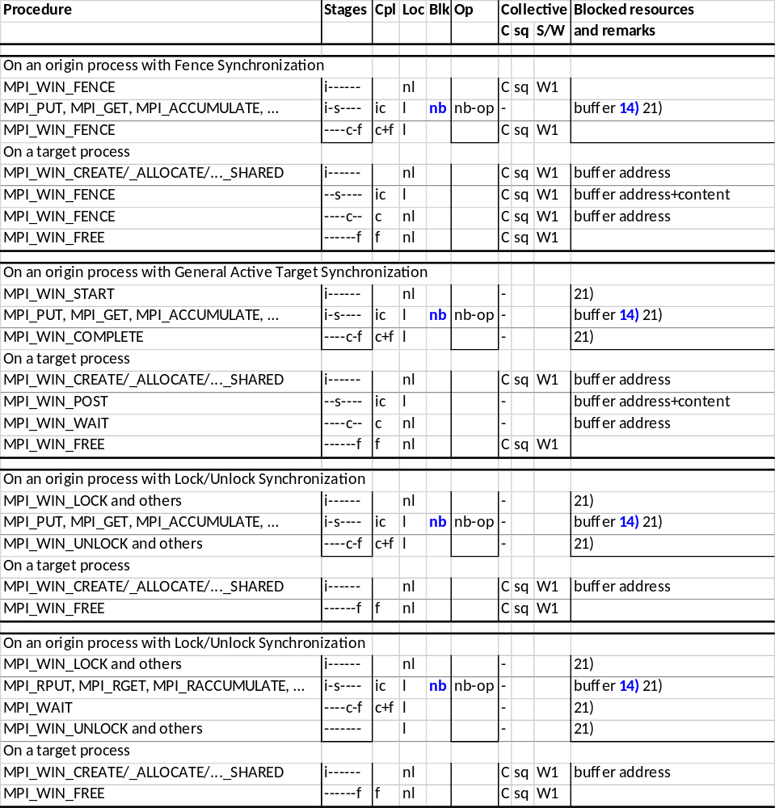
Einbetten → img4.png

Slide 5
→ img5a.png
MPI_A MPI_B
→ img5b.png
MPI_Bsend MPI_Recv
MPI_A MPI_B
→ img5c.png
MPI_A MPI_Recv
MPI_Bsend MPI_B

