Slide 1
LLNL’s debugging tools and next challenges
JOWOG34
Reading, UK, 6/5/2014
Dong H. Ahn and Greg Lee

Slide 2

Parallel debugging represents a significant loss in user productivity
Code development is on the critical path to our programmatic mission
Some classes of bugs take a heavier toll on the productivity of developers
The traditional debugging approach is not always effective
New debugging techniques are crucial to improving productivity

Slide 3
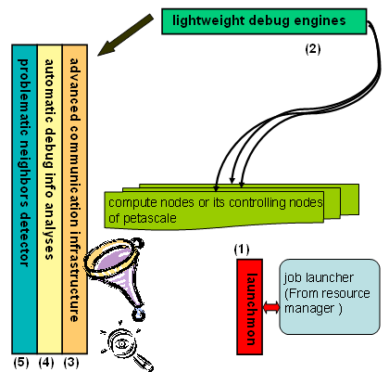
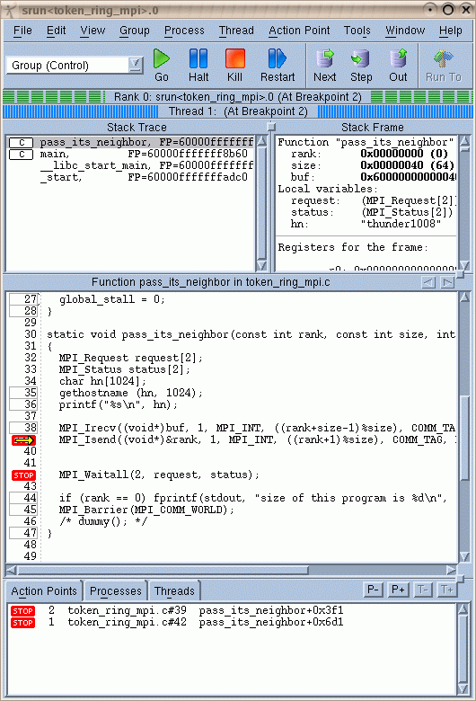
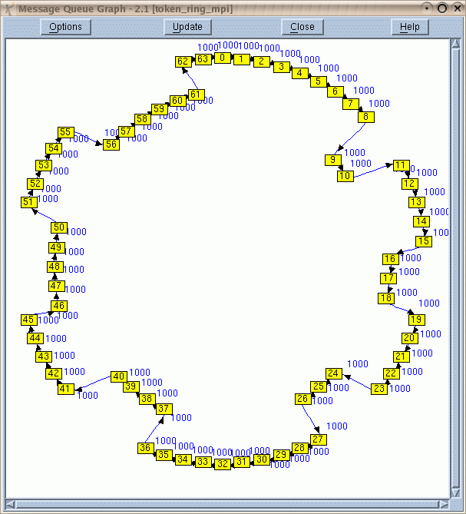
Our approach composes strengths of various types of debugging tools
Root cause analysis
at manageable subset
Feature Set
Scalable, lightweight tools infrastructure
…
Desktop
High-end

Slide 4
Our multiyear, multiphase collaborative project with RWS re-architected TotalView for higher scalability
Implemented a tree-based infrastructure using MRNet
Parallelized debugger operations to leverage the tree
Convert iteration in the front-end to…
Multicast down, and reduction up, the tree
Multicast
TotalView Client
Reduction
MRNet Comm. Proc
MRNet Comm. Proc
TotalView debugger server
TotalView debugger server
TotalView debugger server
TotalView debugger server

Slide 5
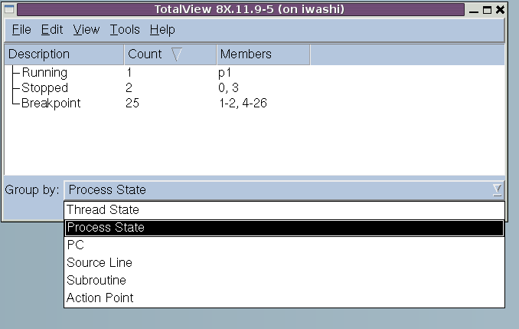
The improvements are being incrementally introduced through scalable early access program
Scalable Early Access program
Up to version 6
Demonstrated scalability for a majority of basic operations
Further improvements for start-up
New root window – previews of process/thread aggregation techniques
Field tested
Debugged various large-scale bugs
Soon be available in production versions – 8.14

Slide 6
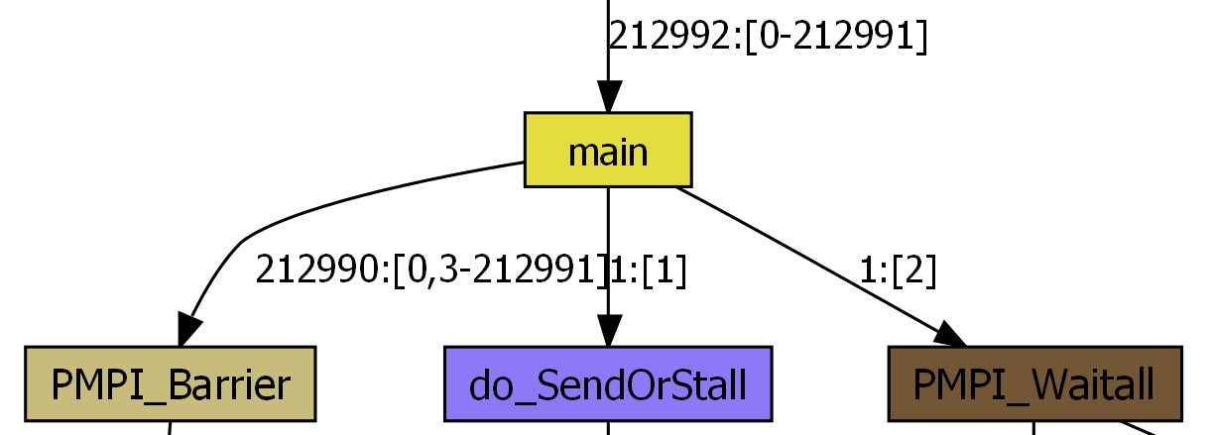
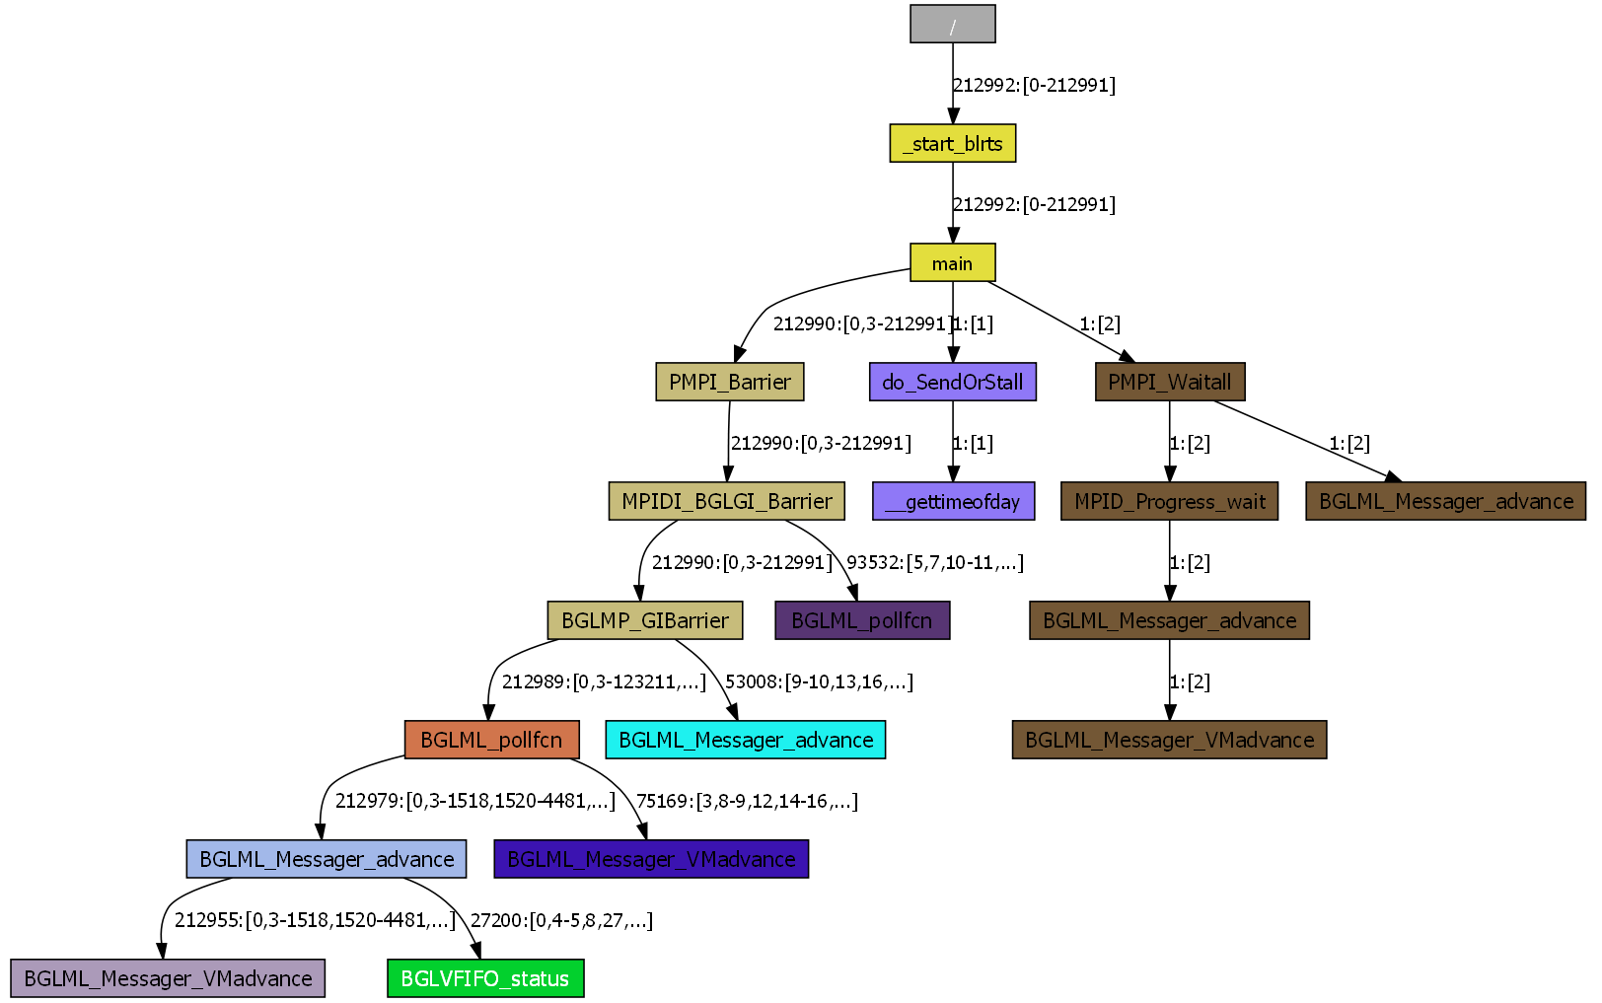
Meanwhile, we must reduce the search space to a level a human can comprehend and tools can manage
Task 0
Task 1
Task 2
Your Favorite Debugger

Slide 7
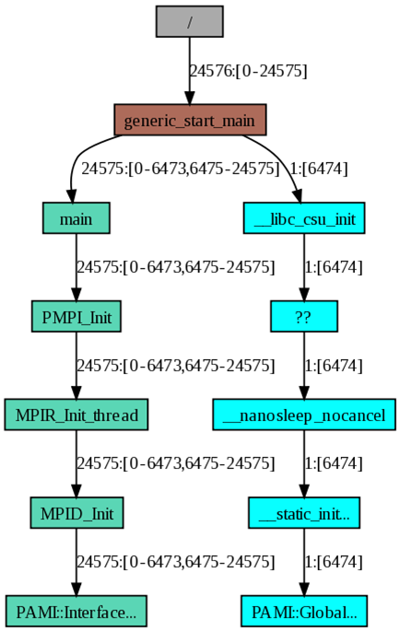
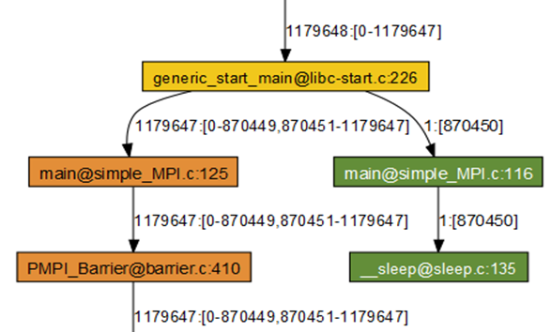
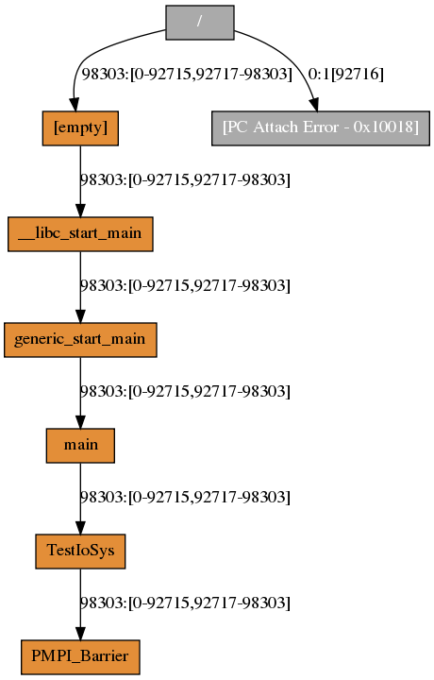
Quick outlier detection with STAT is highly effective in isolating the origin of many bugs in Sequoia.
A hang due to a decrementor on a core running super slow at over one million processes.
A crash during init. due to a bad CN.
Hang due to a bug in LUSTRE using the full 96 BGQ racks.
92716: bgqio199

Slide 8
We must also expand the capabilities of our lightweight tools
Feature Set
Scalable, lightweight tools infrastructure
…
Desktop
High-end

Slide 9
DySectAPI will enable STAT to diagnose more classes of bugs
Create probe trees to capture a user’s debugging intuition
Probe(Event, Condition, Domain, Action)
Event – Initial trigger
Condition – Predicate for probe triggering
Domain – Process scope and synchronization
Action – User actions performed upon triggering
Minimize user interaction at runtime
Reduce bug search space in time, code space, and process space
We plan to populate ready-made probes that then will serve as debugging know-how
Probe A
Probe B
Probe C
Probe D
Notes:
• We present a “prescription-based” debugging model
• Four main objectives in this model is to
• (1) Minimize human interaction at run-time
• (2) Base our search-process on both local and collective-states predicates
• (3) Narrow search space in a hierarchical way, by composing and chaining these predicates
• (4) Present condensed diagnostics in the process
• We combine concepts from existing paradigms, into a new one.
• Local-state evaluation from traditional debugging, Collective similar to Cray parallel assertions
• A probe is our way to generalize instrumentation-steps.
• A probe-tree should be understood as, when one probe is triggered - all immediate children probes are enabled. When those are triggered, they enable their immediate children probes and so on.
• We want to use all these properties to deal with the cognitive challenge and enable a scalable debugging machinery
It can be considered as domain specific language for debugging, which allows users to construct various higher-level debug queries

Slide 10
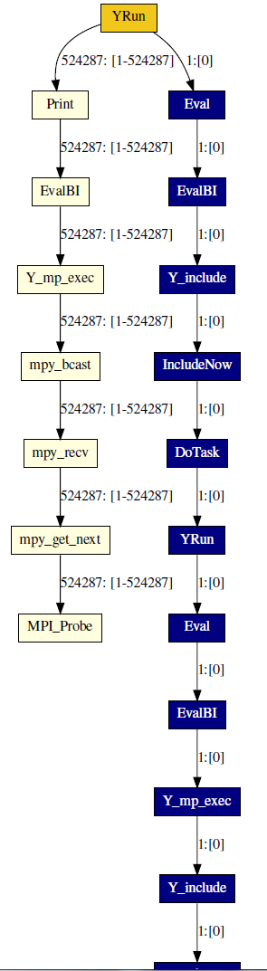
Non-deterministic concurrency errors at large scale are the next big challenge
A hang only appeared only when pf3d is scaled to half a million processes.
User refused to debug for 6 months…
Incorrect message mismatches due to non-deterministic communication patterns.
Non-deterministic concurrency errors are increasingly common and painful.
Demand for scalable—yet effective— techniques and tools for this class of errors.

Slide 11
Non-determinism hampers reproducibility in HPC.
Reproducibility
The ability to repeat program executions with the same results or the same behavior
Many sources of non-determinism hamper this ability
In particular, non-determinism in concurrency scheduling presents increasingly greater challenges
$ srun -n 128 ./tst
= 0.24512003
$ srun -n 128 ./tst
= 0.24511999
$ srun -n 128 ./tst
error: Segfault
$ srun -n 128 ./tst
= 0.24512000

Slide 12
Non-determinism is often the bane of parallel software development
Many sources of such non-determinism
Essential for performance, but unintended non-determinism is costly
Impacts the full development life cycle!
Debugging, testing, verification and validation
Architectural trends continue to magnify the harmful effects
RUN1
RUN2

Slide 13
PRUNER will innovate scalable ways to analyze and control concurrency.
Enable codes to achieve reproducibility effectively and scalably
Reproducible behaviors and results will aid in the full development lifecycle
A multilevel analysis and control toolset: the PRUNER toolset
Detects, controls, and eliminates targeted sources of non-determinism
Multilevel approaches
Tools are unified
App code
P1
P2
P3
Pn
func_1
func_2
…
recv(ANY_SRC
…
…
T1
…
…
…
T1
Tm
T1
Tm
Tm
T1
Tm
foo
bar
…
#pragma omp
…
func_l

Slide 14
PRUNER is investigating a scalable record and replay and dynamic verification techniques for MPI
Alternate Matches
MPI Program
Executable
Proc₁
Proc₂
……
Proc_{n}
Rerun
Epoch
Decisions
Schedule Generator
DAMPI - PnMPI modules
Run the given MPI program on a cluster
Piggy-back logical clocks with messages
Analyze Send/Receive clock values
Determine Alternate Send/Receive matches
Generate Schedule, and Rerun
MPI runtime

Slide 15
PRUNER is actively investigating a scalable, low-overhead data-race checker for OpenMP
Combine static analysis and runtime analysis
Our preliminary study suggests that
Google’s ThreadSantizer is a promising base run-time analysis component
Currently investigating ways to reduce overheads by feeding smaller code slices
Soon look at static analysis using Clang/LLVM or ROSE to produce such slices

Slide 16
LLNL pushes the frontiers of HPC debugging to provide most comprehensive debugging solutions
Not all bugs are created equal
Advance, bring and compose best capabilities from various types of tools
Our large-scale debugging tools efforts are already paying off
New efforts position us for future challenges
DySectAPI will expand the capabilities of our lightweight debugging
PRUNER will lead our way to debug non-deterministic problems with ease while also impacting code testing and verification

