Slide 1


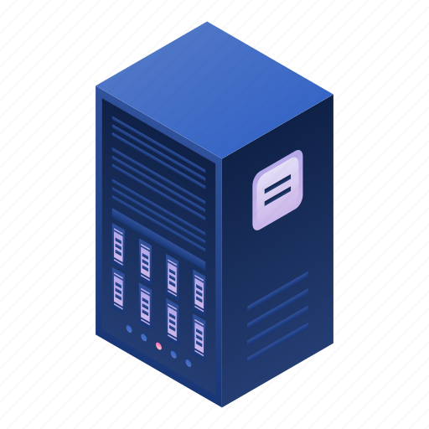

User Dashboard
Electric Vehicle Charging Stations
Overall Dashboard + Incidents (SIEM)
Corporate Users
Total Incidents Overview
Incident Trend Analysis
User Permission Changes
Top Risky Users
Incident Analysis Panel
CS/GS Incidents Overview
LDAP Access Analysis
Interactive
Tables to
view users accessing URLssorted
by Risk
Levels
User Anomalies Over Time
Charging Session Duration Distribution
Successful and failed authentication attempts
Pi Chart
Distribution of incident severity levels.
Incidents over Time
Top Accessed Applications
Interactive Tables to Investigate Logs
Pi Chart
HMI-SCADA/IED Infrastructure Insights
Standard Framework Mappings
IT Infrastructure Insights
Incidents Created, Incident Management Console with Support-Ticket-like comments thread for investigations and notes
Tree Map
illustrating the distribution of attacks mapped to MITRE CAPEC, CWE, NIST NVD CVE, and OWASP TOP 10.
SIEM Console
Incident Analysis Panel
Portal to SCADA DCS
(Distributed Control System)
Interactive
Tables to
Investigate
Logs sorted
by Risk
Levels
Anomaly Detection Overview
Firewall Findings
Pi Chart
DDoS, unusual user-agents, malicious payloads over time.
Radar chart - firewall rule violations and their frequency
APT
DDOS
Interactive Tables to Investigate Logs
Mitre ICS ATT&CK Chart Mapping
UEBA
YAML-Mapped Requests
CYBRANA — Cyber YAML-Based Resilience Applied with Next-Gen AI
PostgreSQL
DB
Team EQUATORS
Aaditya Rengarajan,
Ashwant Krishna R,
Hareesh S,
S Karun Vikhash
Information Technology Users
Operational Technology Infrastructure
Information Technology Infrastructure
Network Mapping
(Representation of Network as Graph)
User Access
Risk Level Scoring Engine
Benign URLs
Standard Frameworks
Mapping Engine
MITRE CAPEC → MITRE CWE → NIST NVD CVE
OWASP TOP 10
Malignant URLs
HMI-SCADA/IED
Log Analysis
EV CS/GS
Log Analysis
YAML
Rule Matching from
Stateful Packet Inspection
Spam
Phishing
Privilege Escalation
Anomaly Detection
DDOS+DOS
Malware
Defacement
Model for Attack Identification
Command Switching
Community Sourced Repository
Unusual
User-Agents
Malicious
Payloads
projectdiscovery
/nuclei
Signature
Based
Identity Theft
LDAP Access
Malware Injection
User Entity Behaviour
Analytics
Advanced Persistent Threats
Untimely Logon
Repeated Log-On Failures
Cryptographic Breach
Suspicious Packets
ML Based Request Handler
Inconsistent Behaviour
Abnormal Behaviour
Trained on KDD Cup 1999 DARPA IDS Logs, Server Logs, Firewall Logs

