Slide 1
MSSSM: Modeling Ethnic Violence
Model Extension and Global Sensitivity Analysis

Slide 2
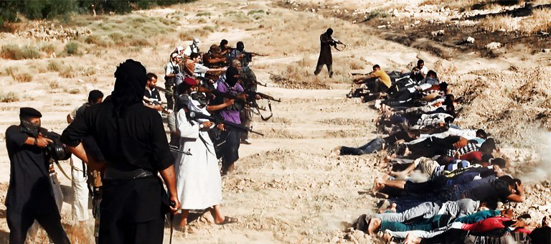
Ethnic Violence - Introduction
Still a major problem of humanity
Understanding the dynamics leading to etnic violence ➔ prevention
Modification of extisting model
Global sensitivity analysis to quantify the influence of model parameters

Slide 3
Base Model: Agents
Agent-based model; agents placed on 2D map
Two types of agents: civilians and LEOs
Two ethnic groups
Civilian
Hardship (H)
Legitimacy (L)
Risk Aversion (R)
Violence Threshold (T)

Slide 4
Base Model: Iteration
Random selection + movement of an agent
Inspection of new environment
Action
Civilian: Kill random opponent
LEO: Arrest random active civilian
Cloning of civilians on map
Update of the jail
Update of the map

Slide 5
Modified Model
L and T heterogeneous
Drawn from truncated normal distributions
Uniform distribution not realistic
Update of legitimacy: L_{new}=L_{old}(1-k_{L}) (violence) L_{new} = L_{old}+k_{L}(1-L_{old})L_{old} (arrest)
Violence has always the same effect
Arrests show saturation effect

Slide 6
Global Sensitivity Analysis
Aim: quantify the influence of input parameters X_{i} on model output Y = f(X₁,...,X_{k})
Input parameters are treated as random variables ➔ variance based
Base model: ρ_{tot}, χ₁, LEO/civilian, P_{c}, v, v*, k_{P}, J_{max}, L, T
Modified model: ρ_{tot}, χ₁, LEO/civilian, P_{c}, v, v*, k_{P}, J_{max}, μ_{L}, σ_{L}, μ_{T}, σ_{T}, k_{L}
Model output: cumulative number of killings normalized to the initial total population size

Slide 7
Global Sensitivity Analysis
Conditional variance as measure for the effect of input parameters
Monte Carlo used to compute the conditional variances

Slide 8
Global Sensitivty Analysis: Results
Several obtained values violate those constrains
Possible explanation: Monte Carlo sample too small
Increase was not possible ➔ possible future improvement

Slide 9
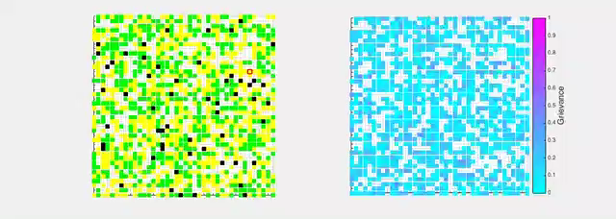
Visualization of Simulation

Slide 10
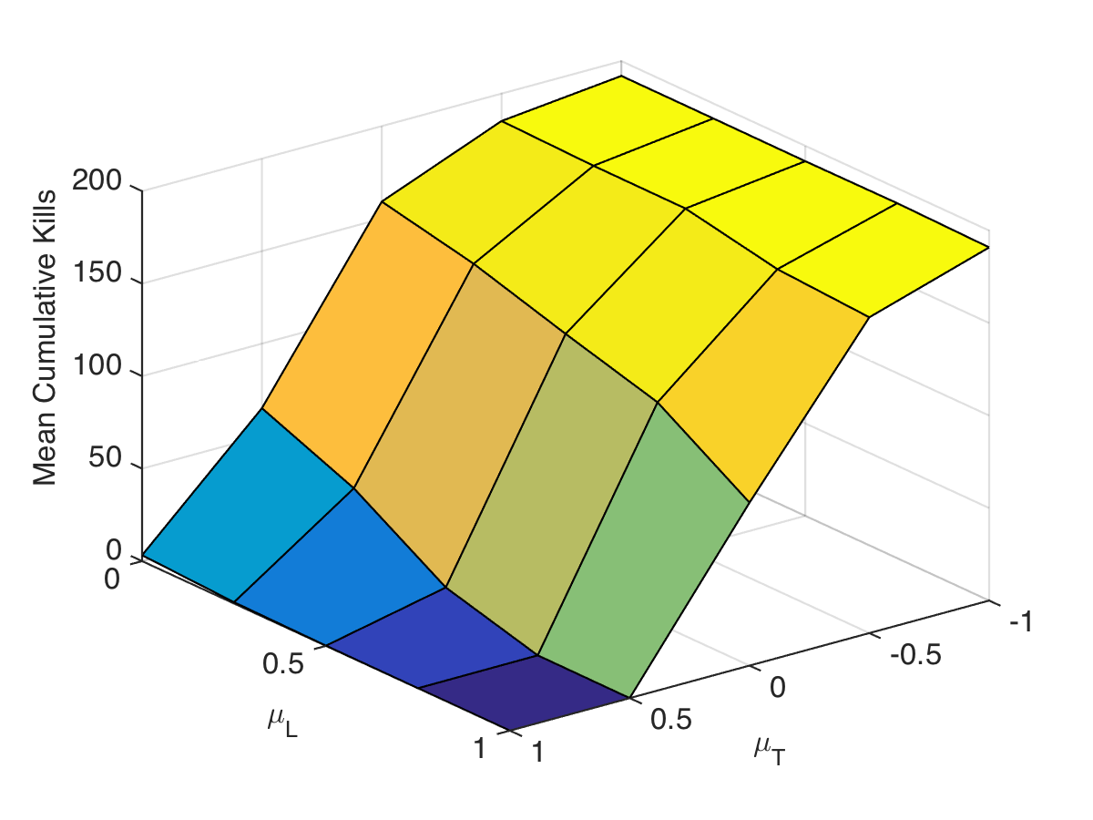
Dependence on L and T
Mean violence threshold is more influential
Effect of mean perceived legitimacy decreases with decreasing mean violence threshold

Slide 11
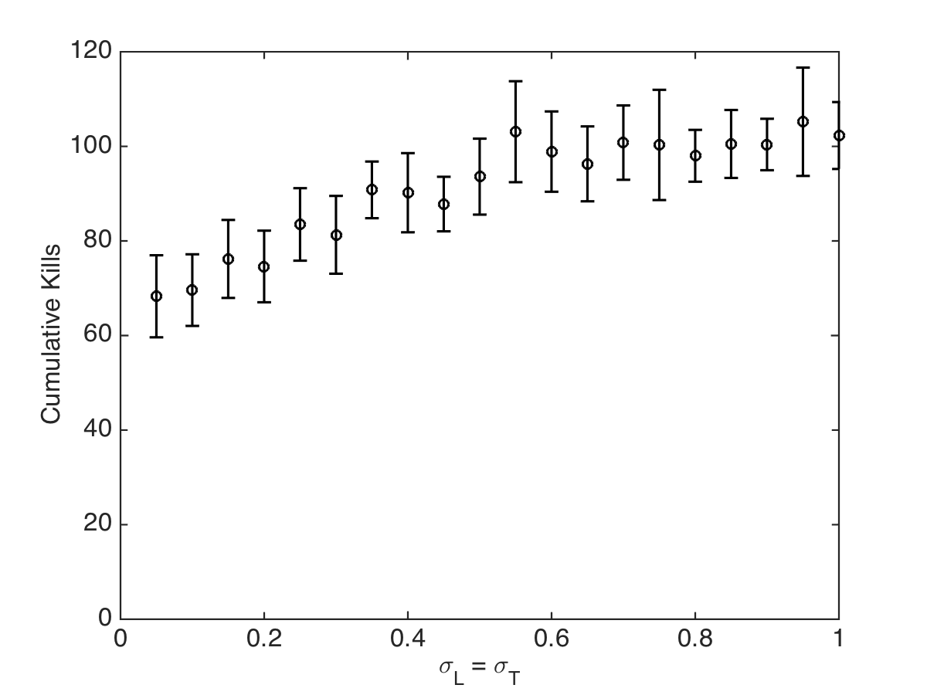
Dependence on σ_{L} and σ_{T}
Increasing heterogeneity increases the extent of violence
Reason: extreme individuals present in the society

Slide 12
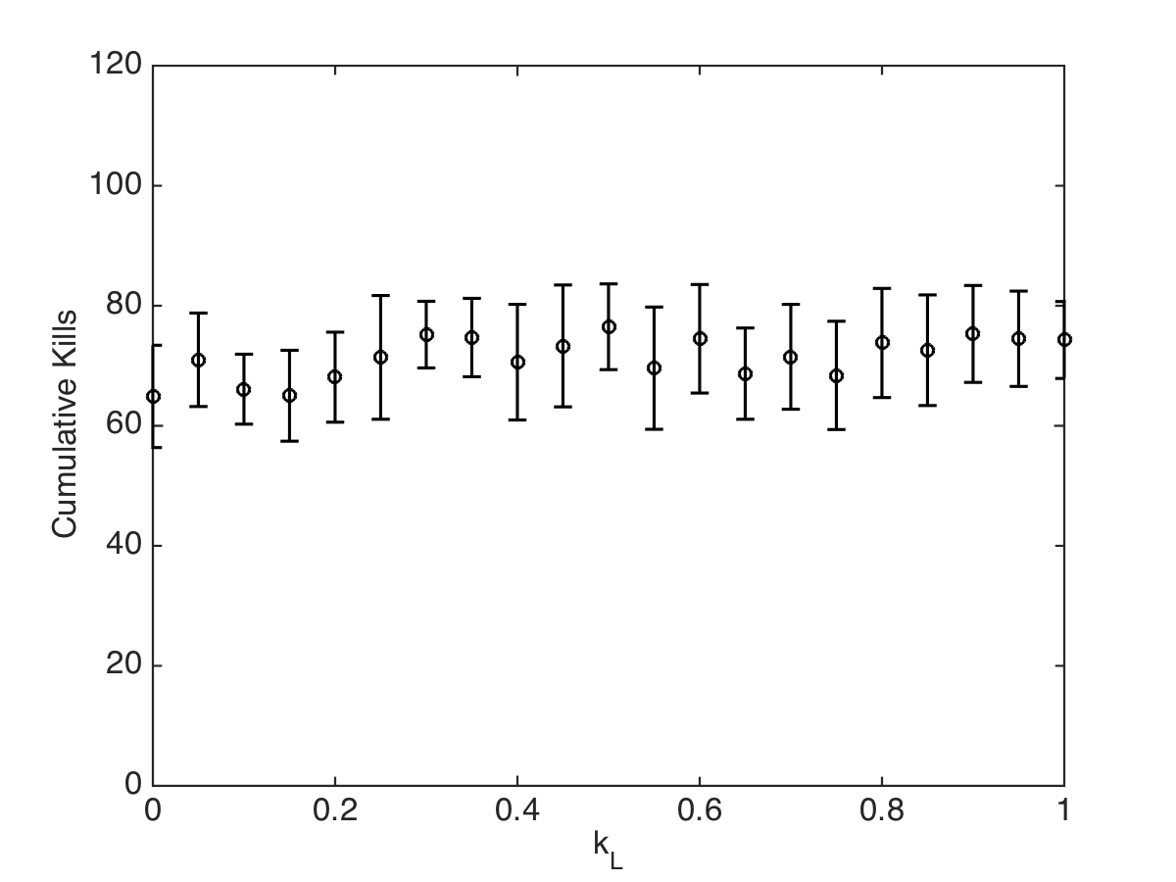
Dependence on k_{L}
Value of parameter k_{L} seems to have no influence
Probably due to limited range of the update

Slide 13
Summary and Outlook
Modified model describes the reality better
In societies with high mean violence threshold, the mean perceived legitimacy is important
Heterogeneous societies are expected to be more violent
Mechanism of updating the legitimacy has to be further improved
Debugging the global sensitivity analysis and repeating it

