Slide 1

Building High Performance Microservices with Apache Thrift
Rethinking service APIs in a Cloud Native environment

Slide 2




Presenters
Randy Abernethy
ra@apache.org, randy.abernethy@rx-m.com
Apache Thrift PMC
CNCF member
Partner RX-M Cloud Native Consulting
Jens Geyer
jensg@apache.org
Apache Thrift PMC
Senior Software Engineer at VSX Vogel Software GmbH

Slide 3
What is Cloud Native?
Microservice Oriented
Container Packaged
Dynamically Orchestrated

Slide 4
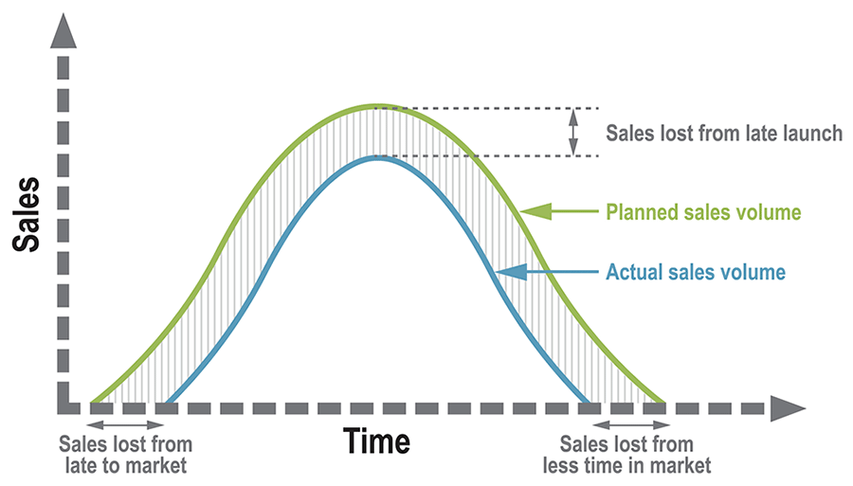
Problems Cloud Native Solutions Can Solve:
Extreme horizontal scale
Increased server density
Granular scaling
Improved and explicit modularity
Support for aspirational development processes
CI/CD
Agile development
Everything as code
Support for rapid adoption of new technologies
Time to Innovation/Market

Slide 5

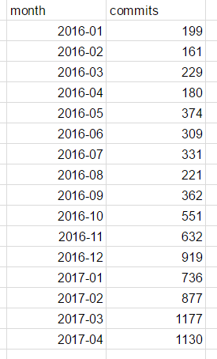
Cloud Native Adoption
Docker hub has seen 390,000% image pull growth since 2014
K8s has seen 567% growth in commits in just over a year
Google starts over 3,000 containers per second in their Borg/Omega environment
Pokemon Go: a 30,000 container cloud native application running on Google Container Engine
Kubernetes Commits
Source: Docker Blog

Slide 6
Contrasting Containers with VMs
VM A
VM B
App A
App B
Container A
Container B
App A
App B
OS
OS
Hypervisor
OS
H/W
H/W

Slide 7
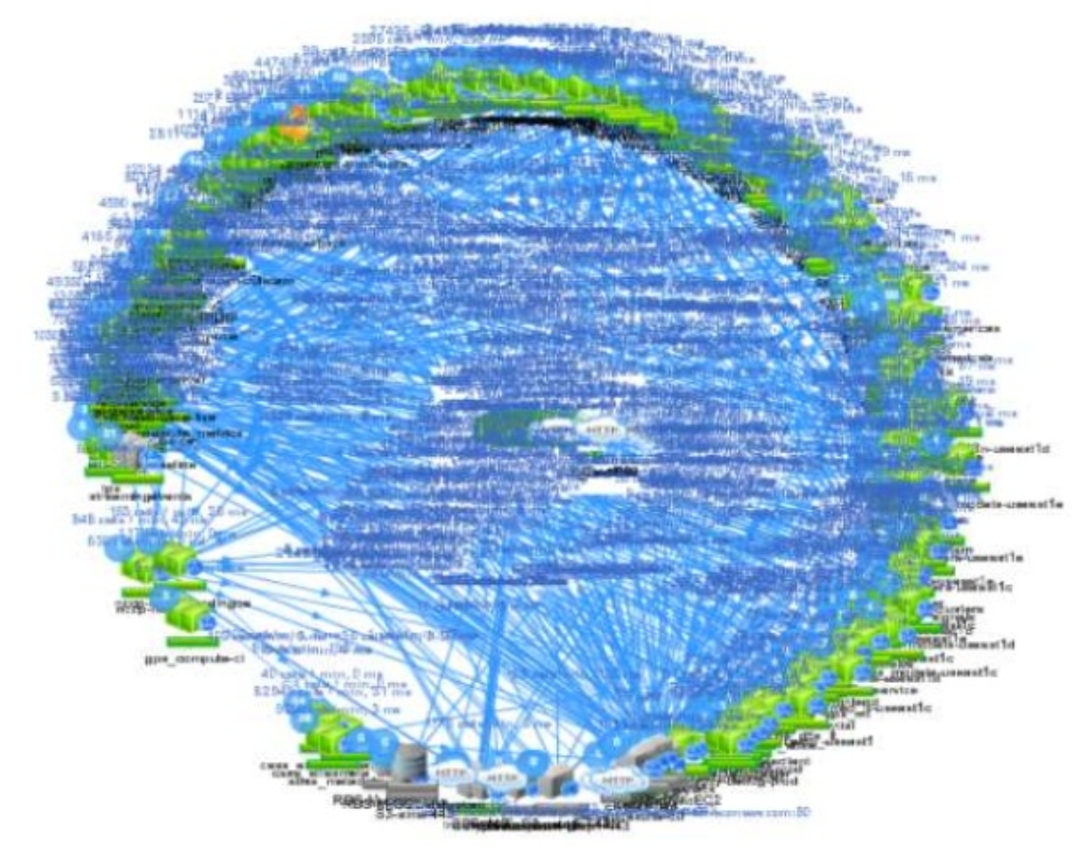
Challenges created by a microservice approach
Netflix Microservice “Death Star” Model
Explosion in the number of service instances to manage
Extreme need for reliable deployment
Dramatically different debugging and monitoring models
Increased pressure on networks to exchange procedure calls

Slide 8
Modern RPC
1980 - Bruce Jay Nelson is credited with inventing the term RPC in early ARPANET documents
The idea of treating network operations as procedure calls
1981 - Xerox Courier possibly the first commercial RPC system
1984 - Sun RPC (now Open Network Computing [ONC+] RPC, RFC 5531)
1991 - CORBA – Common Object Request Broker Architecture
The CORBA specification defines an ORB through which an application interacts with objects
Applications typically initialize the ORB and accesses an internal Object Adapter, which maintains things like reference counting, object (and reference) instantiation policies, and object lifetime policies
General Inter-ORB Protocol (GIOP) is the abstract protocol by which object request brokers (ORBs) communicate
Internet InterORB Protocol (IIOP) is an implementation of the GIOP for use over the Internet, and provides a mapping between GIOP messages and the TCP/IP layer
1993 - DCE RPC – An open (designed by committee) RPC solution integrated with the Distributed Computing Environment
Packaged with a distributed file system, network information system and other platform elements
1994 - MS RPC (a flavor of DCE RPC and the basis for DCOM)
1994 - Java RMI – a Java API that performs the object-oriented equivalent of remote procedure calls (RPC), with support for direct transfer of serialized Java objects and distributed garbage collection
RMI-IIOP implements the RMI interface over CORBA
Third party RMI implementations and wrappers are prevalent (e.g. Spring RMI)
1998 - SOAP (Simple Object Access Protocol) specifies a way to perform RPC using XML over HTTP or Simple Mail Transfer Protocol (SMTP) for message negotiation and transmission
2001 - Google Protocol Buffers – developed at Google to glue their servers together and interoperate between their three official languages (C++/Java/Python, JavaScript and others have since been added), used as a serialization scheme for custom RPC systems
2006 - Apache Thrift – developed at Facebook to solve REST performance problems and to glue their servers together across many languages
The basis for Twitter Finagle, an important facet of the Twitter platform
2008 - Apache Avro is a serialization framework designed to package the serialization schema with the data serialized, packaged with Hadoop
2015 - Google gRPC announced as an RPC framework operating over http/2 using protocol buffers for serialization
2017 - Google contributes gRPC to CNCF
What is modern RPC?
Cross platform
Polyglot
Evolvable
Fast
Monoliths are internally composed of modules which call each other through exposed functions/methods
This model is easy to translate to RPC style microservices
The largest Internet Scale firms have all adopted Modern RPC solutions internally to improve service performance
Google – ProtoBuf/Stubby (now moving from Stubby to gRPC)
Facebook – Thrift
Twitter – Thrift/Scrooge/Finagle

Slide 9
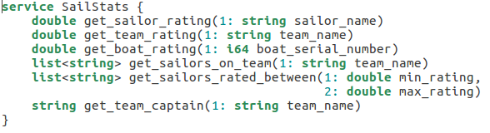
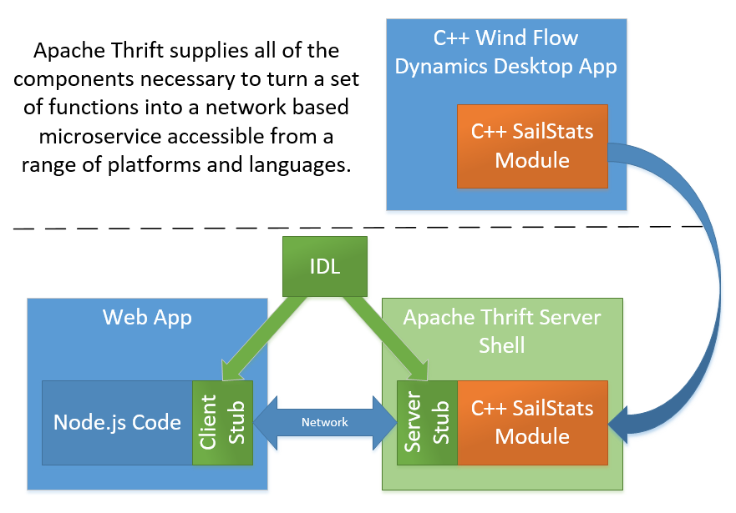
Fast does not have to be hard
To create an Apache Thrift service, simply:
Define it in IDL
Generate client stubs in your choice of languages
Generate a server stub and wire it to your implementation
Use a prebuilt Apache Thrift server shell to implement the service

Slide 10
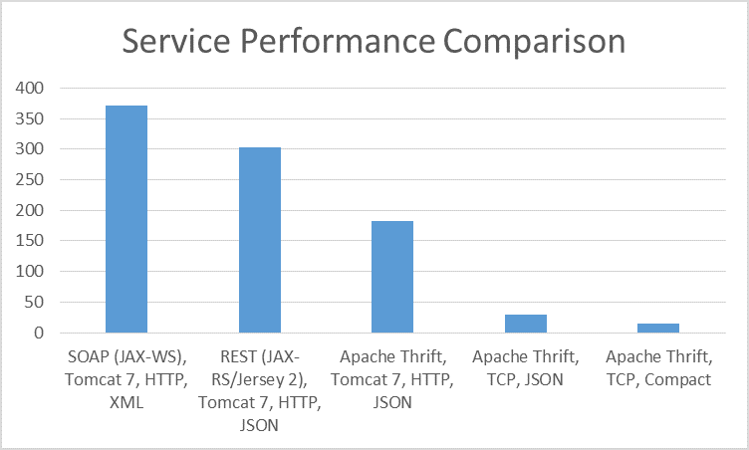
Isn’t REST fast enough?
For public, widely consumed APIs, REST is very good, leveraging the infrastructure of the web
For internal, high performance APIs, REST, HTTP and JSON text serialization can be slow and there’s no “web infra” to leverage
The chart at right shows seconds required for the same client on the same computer to call the same local service 1mm times
Each bar, uses a different tech stack to implement the service

Slide 11
Thrift Language Comparison
Thrift Local Loopback Test
Time to complete 1mm calls Client (Cli->) to server (->Svr)

Slide 12
Performance in the backend
Thrift
Compact Protocol
TCP
gRPC
ProtoBuf
HTTP/2
POST
Local Loopback Test
Time to complete 1mm calls API Tech / Language

Slide 13
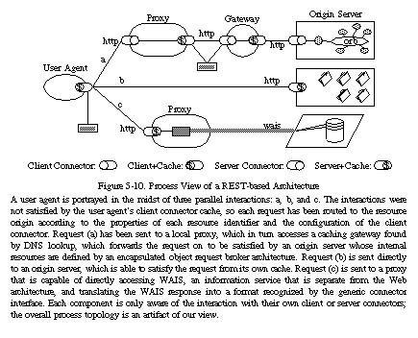
Performance over the Internet
The world wide web is the largest distributed system mankind has ever created
Systems leveraging the protocols of the Web (http/http/2) gain many benefits at little or no cost
Massively distributed caches
Security appliances/technologies
Gateways
Load balancers
Etc.
REST and to some degree gRPC and Thrift over http reap many of these benefits
Fielding, 2000

Slide 14
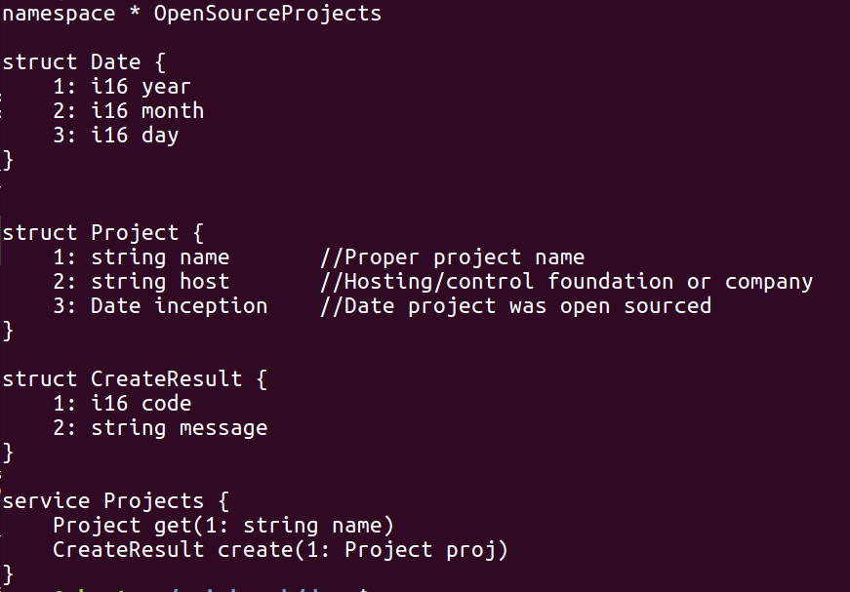
Demo
https://github.com/RX-M/api-bench
Imagine we need to build a service that tracks open source projects
Part I: Creating a Thrift microservice, containerizing it, orchestrating it
Part II: Evolving the service and rolling it out without breaking compatibility

Slide 15
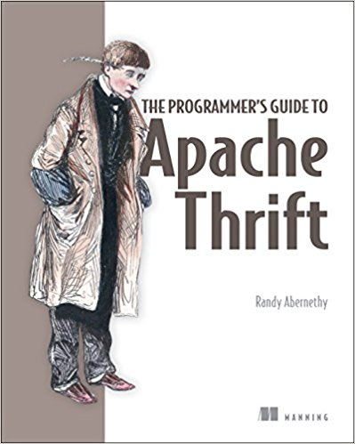
Apache Thrift Take Away
39% discount code: abernethydz
Good at Manning.com
Key Features of Apache Thrift
Servers and Serialization – a complete serialization and service solution in tree
Modularity – pluggable serialization protocols and transports with a range of provided implementations
Performance – light weight, scalable servers with fast and efficient serialization
Reach – support for an impressive range of languages, protocols and platforms
Rich IDL – language independent support for expressive type and service abstractions
Flexibility – integrated type and service evolution features
Community Driven Open Source – Apache Software Foundation hosted and community managed

Slide 16

Thank you!
Questions?

