Slide 1

Reinforcement learning
AI Talks
Employé, Fonction @ EURANOVA

Slide 2
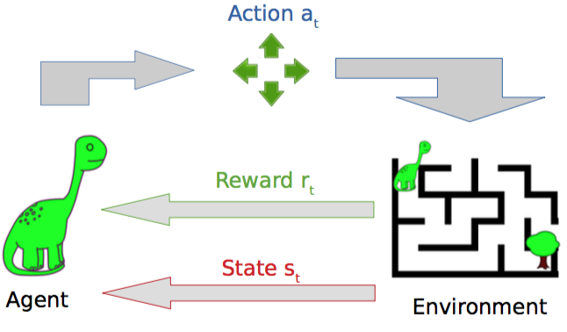
What is reinforcement learning?
A field of data science in which an agent explores an environment by performing actions for which it receives various rewards depending on the state he is in. The goal is to maximize the cumulative reward.
Notes:
S
https://deepsense.ai/what-is-reinforcement-learning-the-complete-guide/
https://adventuresinmachinelearning.com/reinforcement-learning-tutorial-python-keras/

Slide 3
Terminology
Agent/ Controller: the system that interacts with the environment
Reward: numerical value the agent receives from the environment for making an action in a given state
Return: total discounted reward(G_{t} = R _{t+1} + R _{t+2} + ...+ 𝛾^{T-1}R _{T} )
Value function: the goodness of each state, the expected return V_{𝛑}(s)=E_{𝛑}[G_{t}|S_{t}=s)
Policy: the agent’s behaviour function which maps states to actions
Model: agent’s representation of the env, the rules of the game or the system’s dynamics
Model based: learn transition probability and rewards and solve MDP
Model free: learn how to act without explicitly learn the transition probability P[s2|s1, a]
Episode: all states between initial and terminal states
Advantage: the gain of selecting an action in a given state: A(s, a) = Q(s, a) - V(s)
Notes:
https://towardsdatascience.com/the-complete-reinforcement-learning-dictionary-e16230b7d24e
https://medium.com/@jonathan_hui/rl-reinforcement-learning-terms-242baac11907

Slide 4
Use case examples
Gaming
Automated players
Robotics
high-dimensional control problems
Text mining
produce highly readable summaries of long texts
Trade execution
trading procedure promptly at optimal prices
without creating market swings
Healthcare
medication dosing
optimization of treatment policies for chronic disease
clinical trials
Notes:
S
https://perfectial.com/blog/reinforcement-learning-applications/

Slide 5
When should we use RL?
Information about the world is very limited; we have to learn our actions by interacting with the environment: trial and error is required, we learn also by failure
There is a reward signal which provides feedback to the agent in a delayed or immediate way
The interactions with the environment are sequential
When the exhaustive exploration of the environment is computationally infeasible
The problem can be modeled as a Markov decision process
Notes:
(a Go program cannot calculate all possible future states, which could be 10^170, while the universe is only 10^17 seconds old. This means even if the computer can compute one billion (10^9) possible game boards (states) in a second, it will take longer than the age of the universe to finish that calculation.)
https://www.oreilly.com/radar/reinforcement-learning-explained/

Slide 6

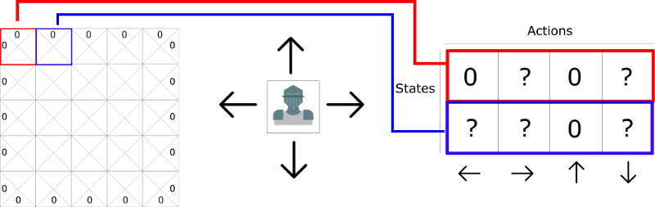
Q-Learning principles
Q Table
Table with maximum expected future reward, for each action at each state
Game
Q Table
0 are impossible moves
Notes:
S
https://www.freecodecamp.org/news/diving-deeper-into-reinforcement-learning-with-q-learning-c18d0db58efe/

Slide 7
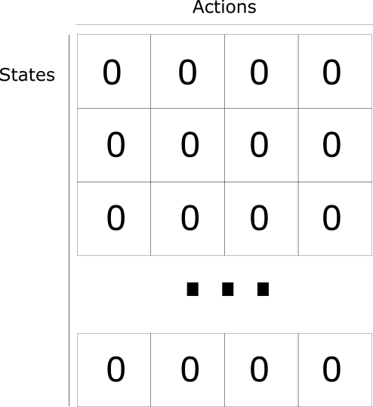
Q-Learning principles
Q Table
Table with maximum expected future reward, for each action at each state
Q Table
Game
Notes:
S
https://www.freecodecamp.org/news/diving-deeper-into-reinforcement-learning-with-q-learning-c18d0db58efe/

Slide 8
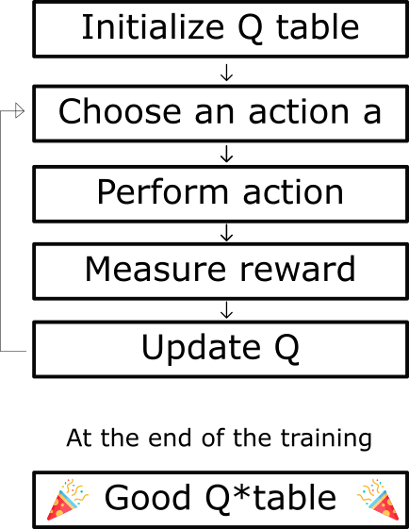
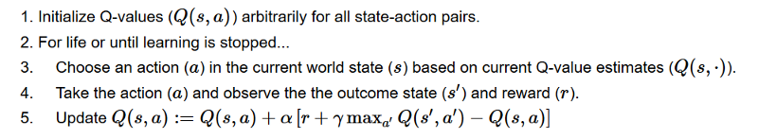
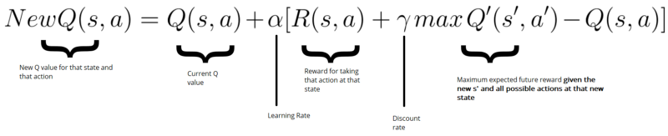
Q-Learning algorithm
Notes:
S
https://medium.com/@SmartLabAI/reinforcement-learning-algorithms-an-intuitive-overview-904e2dff5bbc

Slide 9
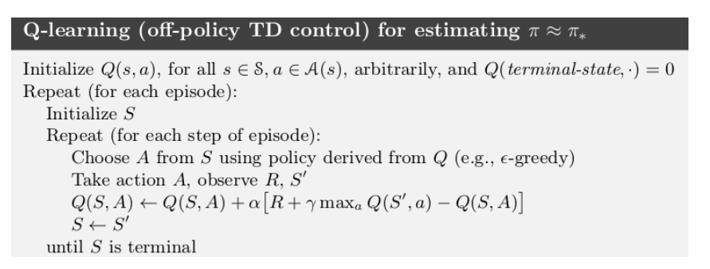
Q-Learning algorithm
Like SARSA, but it doesn’t follow a policy to find the next action but chooses it in a greedy fashion
Notes:
S
https://towardsdatascience.com/reinforcement-learning-temporal-difference-sarsa-q-learning-expected-sarsa-on-python-9fecfda7467e
https://www.geeksforgeeks.org/q-learning-in-python/
https://towardsdatascience.com/q-learning-54b841f3f9e4
https://www.analyticsvidhya.com/blog/2019/04/introduction-deep-q-learning-python/
It’s considered off-policy because the q-learning function learns from actions that are outside the current policy, like taking random actions, and therefore a policy isn’t needed
(>0 and <=1) : Discounting Factor for Future Rewards. Future rewars are less valuable than current rewards so they must be discounted. Since Q-value is an estimation of expected rewards from a state, discounting rule applies here as well.
: Step length taken to update the estimation of Q(S, A)

Slide 10
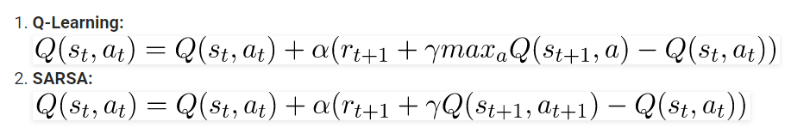
On policy vs off policy RL
Off policy: the agent learns the value function according to the action derived from another policy. For instance, a robot can figure out its policy by observing another robot or any other demonstration
Reuses the experience from old policies and learns about optimal policy while still exploring
On policy: the agent learns the value function according to the current action derived from the policy currently being used. The agent learns about the policy 𝛑 from the experience sampled from 𝛑
we start with a (S,A) pair, then we randomly sample from the environment to receive a reward R and end up in S’, sample again the policy to generate A’ and so on
Notes:
S
https://www.geeksforgeeks.org/sarsa-reinforcement-learning/

Slide 11
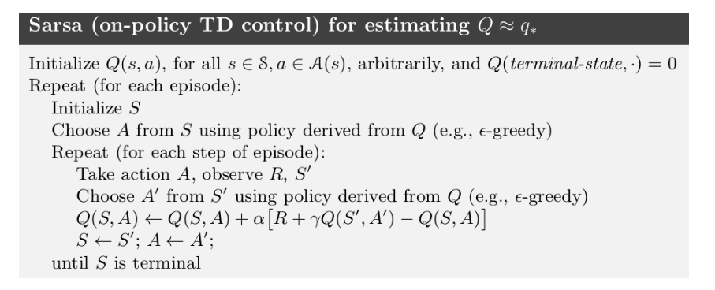
SARSA (State Action Reward State Action)
Notes:
S
https://towardsdatascience.com/reinforcement-learning-temporal-difference-sarsa-q-learning-expected-sarsa-on-python-9fecfda7467e
https://www.geeksforgeeks.org/sarsa-reinforcement-learning/
https://medium.com/swlh/introduction-to-reinforcement-learning-coding-sarsa-part-4-2d64d6e37617

Slide 12

Deep Q Learning
Q-Learning ⇨ Q-Table ⇨ like a cheat-cheat
ok when small environment
not sustainable when million of states
Approximate Q-Value with Neural Network
function approximator

Slide 13
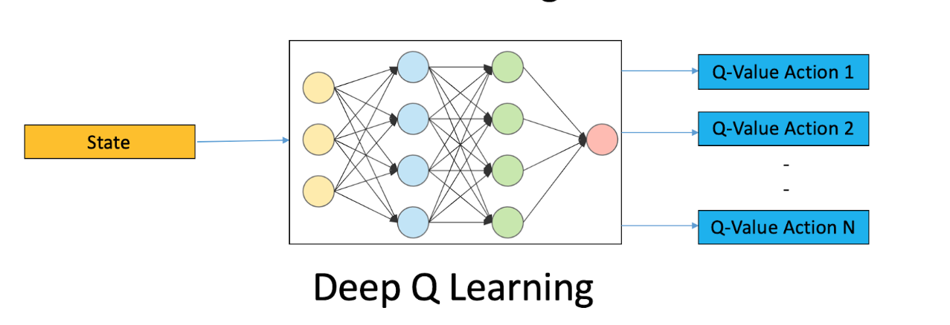
Deep Q Learning
Preprocess and feed the game screen (state s) to our DQN, which will return the Q-values of all possible actions in the state
Select an action using the epsilon-greedy policy. With the probability epsilon, we select a random action a and with probability 1-epsilon, we select an action that has a maximum Q-value, such as a = argmax(Q(s,a,w))
Perform this action in a state s and move to a new state s’ to receive a reward. This state s’ is the preprocessed image of the next game screen. We store this transition in our replay buffer as <s,a,r,s’>
Next, sample some random batches of transitions from the replay buffer and calculate the loss
It is known that: which is just the squared difference between target Q and predicted Q
Perform gradient descent with respect to our actual network parameters in order to minimize this loss
After every C iterations, copy our actual network weights to the target network weights
Repeat these steps for M number of episodes
Notes:
https://medium.com/@hugo.sjoberg88/using-reinforcement-learning-and-q-learning-to-play-snake-28423dd49e9b
https://www.analyticsvidhya.com/blog/2019/04/introduction-deep-q-learning-python/

Slide 14
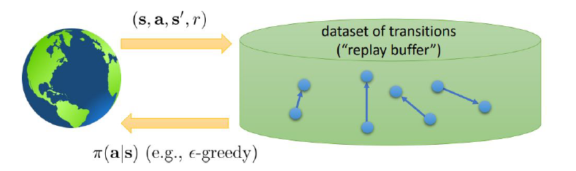
Deep Q Network
after the agent interacted with the environment as a result of the policy it follows, the transition (s, a, r, s’) is stored in the replay buffer
using SGD, the agent samples a number of experiences from the replay buffer, thus learning batch by batch
Notes:
https://www.analyticsvidhya.com/blog/2019/04/introduction-deep-q-learning-python/

Slide 15
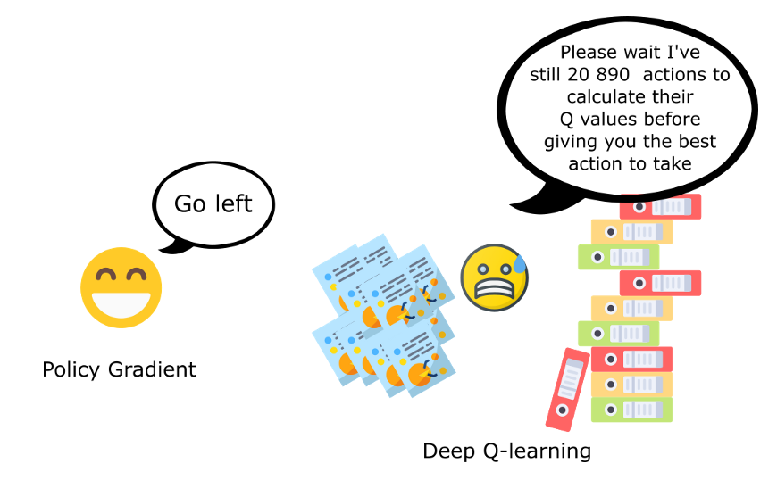
Welcome policy optimization

Slide 16
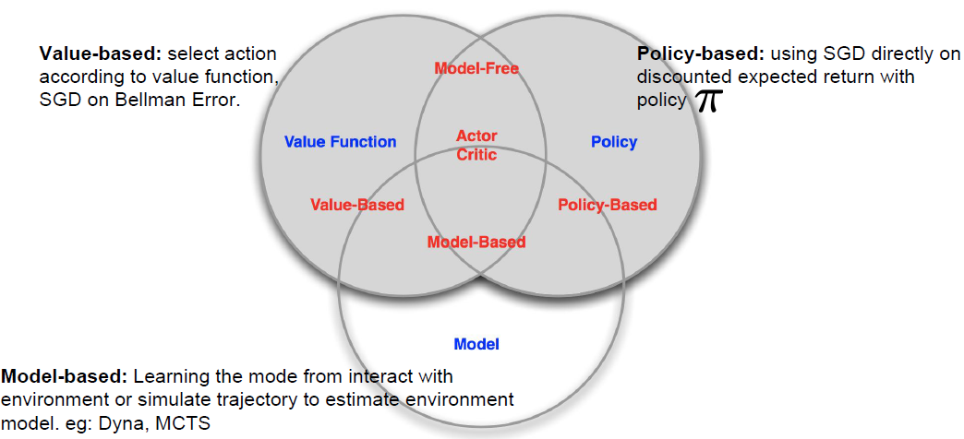
RL taxonomy

Slide 17
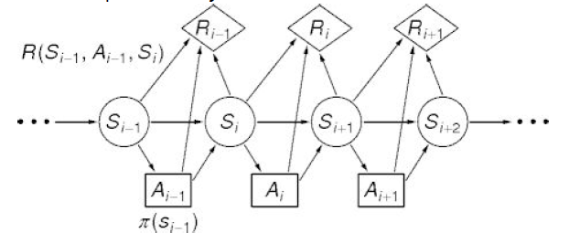
Markov decision process
Mathematical framework for decision making consisting of: a set of states (S), a set of actions (A), a reward Model R, the transition probabilities between states and the discounted factor
A state has the Markov property if it contains all needed information in order to predict the future; once it is known we can throw away the history
Notes:
M

Slide 18
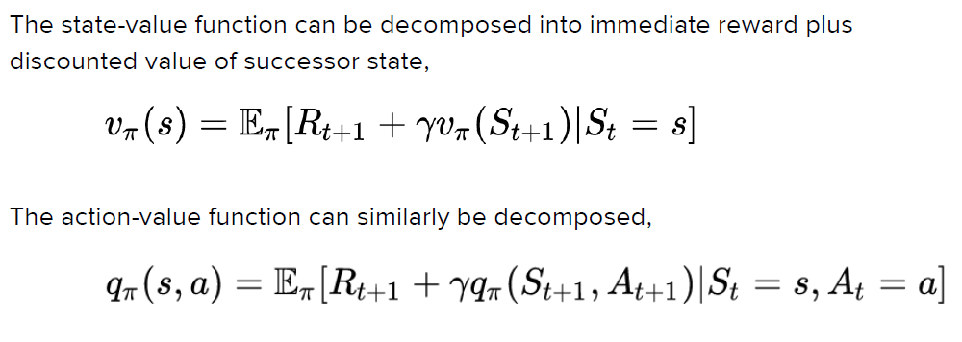
Bellman Equation

Slide 19
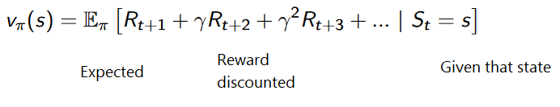
Three approaches to Reinforcement Learning
Value Based
Function telling maximum expected future reward the agent will get at each state.
Policy Based
Directly optimize the policy function π(s) without using a value function.
Model Based
Create a model of the behavior of the environment.
Notes:
https://medium.com/free-code-camp/an-introduction-to-reinforcement-learning-4339519de419

Slide 20
Value based vs policy based algorithms
Value based: approximate the mapping between an action and its value
ex: Q learning, Deep Q Networks, Double Dueling Q Networks
sample efficiency
Policy based: find the optimal policy without using Q-value as middleman
ex: REINFORCE
better for continuous and stochastic environments
faster convergence
Actor critic: merges the 2 algorithms, the actor learns the optimal policy while the critic evaluates the action by computing the value function.
ex: A2C, A3C, PPO

Slide 21
Monte Carlo vs TD Learning methods
Monte Carlo
When the episode ends (the agent reaches a “terminal state”), the agent looks at the total cumulative reward to see how well it did. In Monte Carlo approach, rewards are only received at the end of the game.
Then, we start a new game with the added knowledge. The agent makes better decisions with each iteration.
Temporal Difference Learning : learning at each time step
TD methods only wait until the next time step to update the value estimates. At time t+1 they immediately form a TD target using the observed reward Rt+1 and the current estimate V(St+1).
TD target is an estimation: in fact you update the previous estimate V(St) by updating it towards a one-step target.
Notes:
https://medium.com/free-code-camp/an-introduction-to-reinforcement-learning-4339519de419

Slide 22
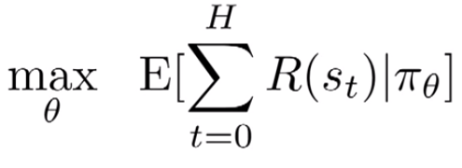
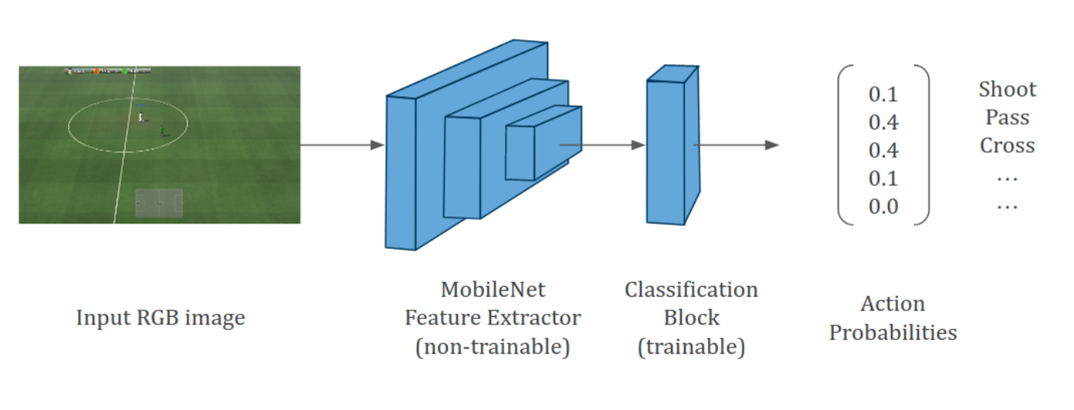
Policy Optimisation methods
the goal is to find directly a policy 𝝅_{𝞱}(a|s) that maximizes the sum of rewards:
It can be a NN that processes state information (for instance images) and outputs a distribution over possible actions. We sample from this distribution, a new state is reached, the process repeats
The weights in the NN is the 𝜽 vector. The policy is stochastic which leads to a smooth optimisation pb
Policy gradient loss L(𝛉) = E_{t}[log π _{𝜃}(a _{t} / s _{t})A _{t}] is the expectation over the log of the policy actions times an estimate of the advantage function(= an estimate of the relative value of the selected action in the current state)
Notes:
https://towardsdatascience.com/an-intuitive-explanation-of-policy-gradient-part-1-reinforce-aa4392cbfd3c

Slide 23
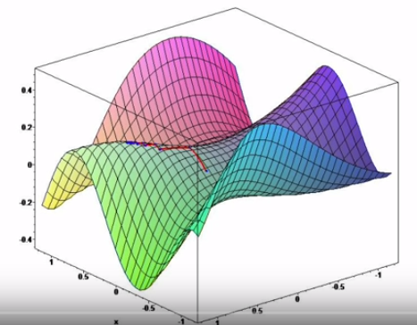
Policy gradients
Start with a random network, it is presented with an input state (e.g. image), it proposes an action which is then implemented and so on. The first phase consists in collecting experiences
The network samples from the distribution of actions, so we avoid always repeating the same strategy(exploration)
The goal is to search for a local maximum of the objective function J_{V}(𝛳) = ∑μ _{π𝜃}(s) v _{π𝜃}(s) where μ _{π𝜃}(s) is the probability of being in state s on the long run, using gradient ascent
The weights update happen at the end of the episode

Slide 24
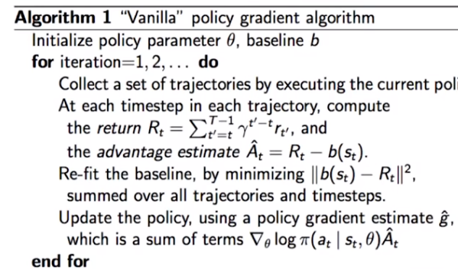
Vanilla policy gradient

Slide 25
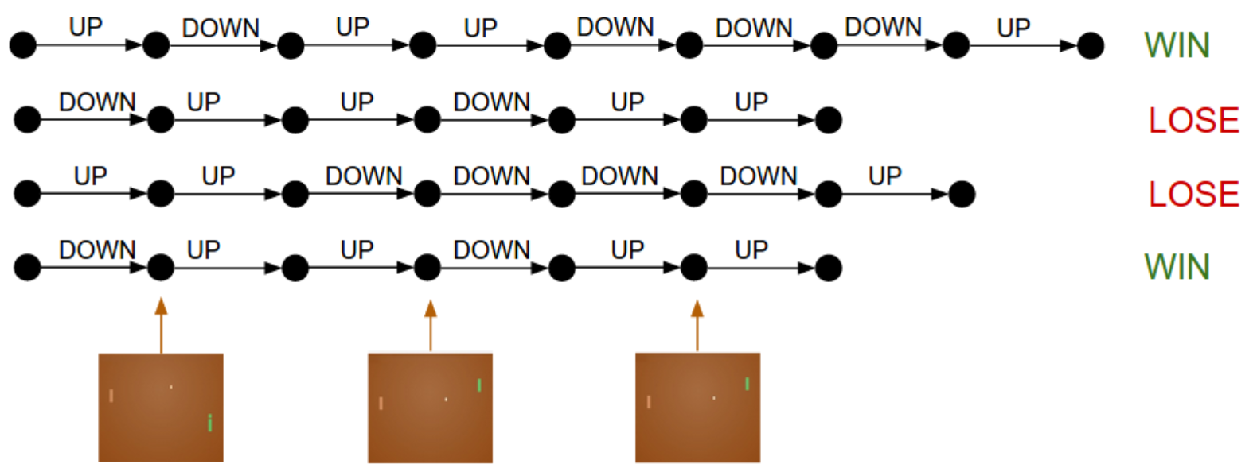
Policy gradients
For each episode we compute the gradients which will make the actions that lead to positive rewards to be more likely in the future and vice versa. This applies to all actions in an episode and on the downside good actions at the beginning of a lost game will also be penalised => credit assignment problem

Slide 26

Advantage function
defined as the discounted rewards (∑𝛾^{k}r_{t} + k)- baseline estimate
it is calculated after the episode sequence was collected from the environment, when all rewards are known
Baseline= value function, gives an estimate of the discounted sum of rewards from the current state onwards, it is guessing what the final return would be. It is approximated by a NN which takes a state as an input and returns the estimation of the discounted return (supervised learning)
the baseline function will be updated using the experience the agent collects from the environment by minimising the
it answers the question: how much better was the action that I took based on the expectation of what would happen, was it better than the expectation?

Slide 27
Policy based algorithms evaluation
Advantages:
easy to extend to continuous and high-dimensional action spaces
good convergence
can learn stochastic policies (allow the agent to explore the state space without always taking the same action)
Disadvantages:
the knowledge may not generalize well,susceptible to get stuck in local minima
instability created by constantly changing distributions of observations and rewards which are being generated by the followed policy, which changes with training
high sensitivity to hyperparameter tuning, initialization
less sample efficient than q learning methods because they use the collected experience once

Slide 28
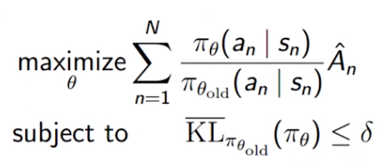
Trusted regions
when the advantage function is positive, it increases the likelihood of selecting the action probabilities it followed and vice versa
by running GD on the same batch, the update may lead to values which are wrong and are far away from the real advantage
solution Trust region policy optimization: we want to update the policy but without moving too far from the old policy. It proposes a surrogate objective function maximized subject to a constraint on the size of the policy update
PPO algorithm includes the KL constraint directly into the optimisation objective
Notes:
https://arxiv.org/abs/1502.05477

Slide 29
Sparse reward setting problem
instead of getting a rewards for every action, we get a reward at the end of the episode
difficulty to discriminate between the actions which were responsible for the final reward and the one that weren’t
As a consequence, the algorithms are sample inefficient
In complex environments, stochastic policies with sparse rewards may fail completely to find positive rewards
Solution => reward shaping : manually designing a reward function that guides the policy to the expected behaviour. This process is environment specific and suffers from the alignment problem (it may overfit to that specific reward function and not generalize as desired)

Slide 30
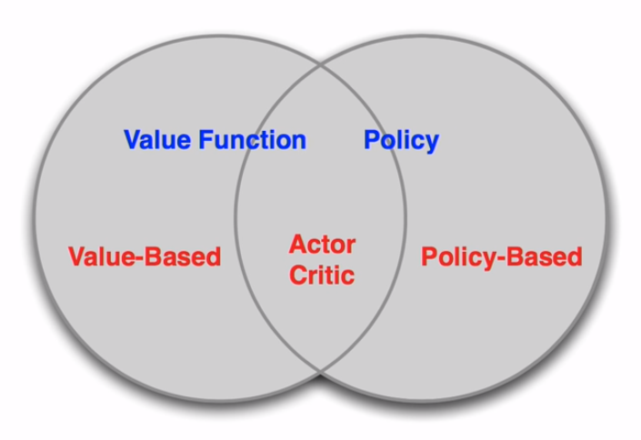
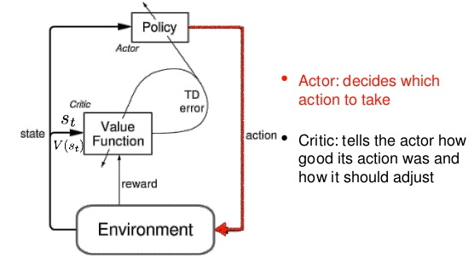
Actor critic
Learn a value function to update the policy
Actor = parametric policy, critic =value function. The critic criticises the behaviour of the actor in order to improve his learning. Both values and policy are learned simultaneously
The 2 models participate in a game where they get better in their own role as the training progresses (competitive learning)
Analogy: young child exploring an environment while guided by the critics of his mother
Notes:
https://sergioskar.github.io/Actor_critics/

Slide 31
Actor critic
Actor model
input: the current state
output: the best action to perform in the current state
Critic model
input: the environment and the actor’s action
output: the action value (Q-value)
the weights update happens at each step (TD learning) and not at the end of the episode like for policy gradients

Slide 32
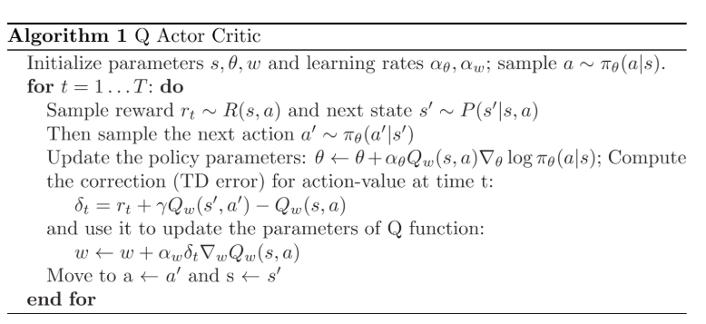
Actor Critic

Slide 33
Advantage Actor Critic (A2C)
Instead of learning the Q values directly, like basic Actor Critic models, the critic will learn the advantage values => the evaluation of an action is not only based on how good it is but on how much better it can be
the advantage function reduces the high variance of the policy networks and stabilizes the model
similar to A3C but with a single worker. It produces results comparable with A3C

Slide 34
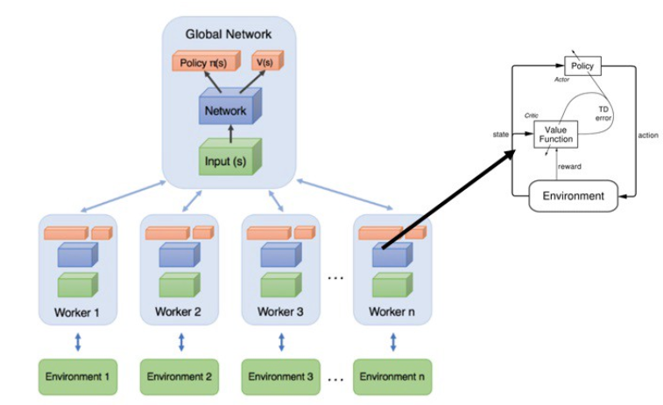
Asynchronous Advantage Actor Critic (A3C)
implements parallel training where multiple workers in parallel environments (with their own weights) independently update a global value function, that efficiently exploring the state space
the updates don’t happen simultaneously
After each update, the agents reset their parameters to those of the global network and continue their independent exploration for n steps until they update themselves again
the information flows not only from the agents to the global network but also between agents, as the reset to the global state contains information from all agents

Slide 35
Proximal Policy optimisation
designed at OpenAI and used for a variety of tasks
sample efficient and easy to tune
learns online (doesn’t use a replay buffer to recycle past experiences). Once the experience has been use for the update, it is discarded and the agent moves on
Each iteration, each of N (parallel) actors collect T timesteps of data. Then we construct the surrogate loss on these NT timesteps of data, and optimize it with minibatch SGD (or usually for better performance, Adam), for K epochs.
Uses a clipped surrogate objective which constrains the update in the policy to stay close to the old policy
Consists of 2 alternating threads: the first one the current policy is interacting with the environment generating episode sequences for which the advantage function is immediately calculated using the fitted baseline estimate for the state values and then every N episodes a second thread will collect all that experience and run gradient descent on the policy network using the clips PPO objective
These threads can be decoupled using remote workers
Notes:
https://openai.com/blog/openai-baselines-ppo/

Slide 36
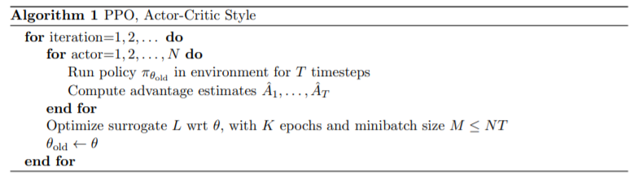
PPO
Notes:
https://arxiv.org/pdf/1707.06347.pdf

Slide 37
Learning resources
OpenAI course: https://hollygrimm.com/syllabus_rl
http://karpathy.github.io/2016/05/31/rl/
https://www.slideshare.net/zhihua98/deep-reinforcement-learning-from-scratch-84633163
https://medium.com/@SmartLabAI/reinforcement-learning-algorithms-an-intuitive-overview-904e2dff5bbc
http://louiskirsch.com/maps/reinforcement-learning
https://www.intel.ai/introducing-reinforcement-learning-coach-0-10-0/#gs.89wsvn

Slide 38
Implementation examples
Q learning, Sarsa: https://towardsdatascience.com/reinforcement-learning-temporal-difference-sarsa-q-learning-expected-sarsa-on-python-9fecfda7467e
https://github.com/ciortanmadalina/RL_overview

Slide 39
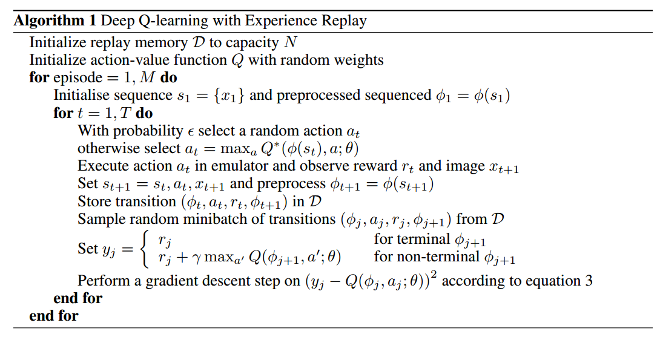
Deep Q Learning
Notes:
https://medium.com/@hugo.sjoberg88/using-reinforcement-learning-and-q-learning-to-play-snake-28423dd49e9b
https://www.analyticsvidhya.com/blog/2019/04/introduction-deep-q-learning-python/

Slide 40
Deep Q Learning
Because Q-Learning is expensive for storing the action-value pairs and high dimensional state spaces lead to the curse of dimensionality, it it used only in the discrete action task => need for a function approximator
DQN uses NN to approximate the action value
Uses SGD to calculate Q*
Performs online learning by sampling, sample experience: s, a, r, s’
observe the environment, select a state
take the action according to the current observation
update the NN weights and so on
Notes:
https://medium.com/@hugo.sjoberg88/using-reinforcement-learning-and-q-learning-to-play-snake-28423dd49e9b
https://www.analyticsvidhya.com/blog/2019/04/introduction-deep-q-learning-python/

