Slide 1
BITCOIN PRICE PREDICTION USING DEEP LEARNING
SUBMITTED BY : UNDER THE GUIDANCE OF:
ESHA MAHENDRA(9916102024) DR. SAJAIVIR SINGH
HARSHITA MADAN (9916102069)
SHIVANGI GUPTA (9916102126)

Slide 2
INDEX
INTRODUCTION TO BITCOIN
INTRODUCTION TO DEEP LEARNING
LITERATURE SURVEY
OUR PROJECT
WORK FLOW
ACTIVATION FUNCTIONS
STUDIED ALGORITHMS
NEURAL NETWORK OPTIMISATION
RESULT & CONCLUSION
PROPOSED PLAN
REFERENCES

Slide 3

What is Bitcoin?
Cryptocurrency is an internet-based medium of exchange which uses cryptographical functions to conduct financial transactions.
Bitcoin is the first cryptocurrency. It is a decentralized digital currency without a central bank that can be sent from user to user on the peer to peer bitcoin network without the need of intermediaries. The entire bitcoin network relies on the blockchain which is a shared public ledger.

Slide 4
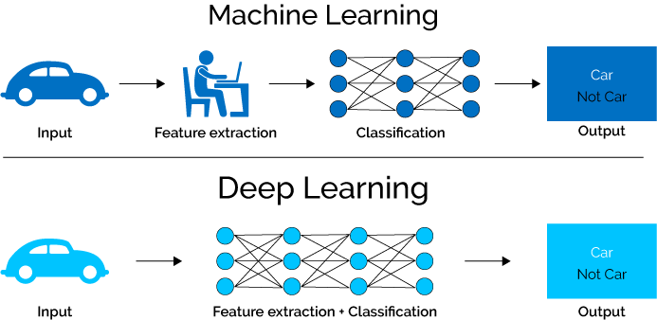
What is Deep Learning?
Deep learning is part of a broader family of machine learning methods based on artificial neural networks.
Learning can be supervised, semi-supervised or unsupervised.
Deep learning architectures such as DNN, DBM, RNN and CNN have been applied to several fields.^{[1]}

Slide 5
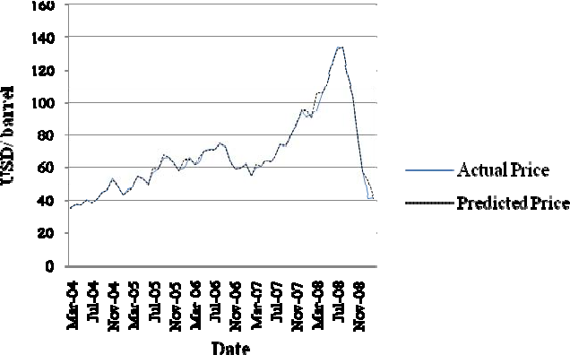
LITERATURE SURVEY
1. Forecasting Crude Oil Prices:
The deep learning model has been used to capture the unknown complex non-linear characterisitics of the crude oil price movements.
It contributes to literature by providing new methodolgy on how the deep learning models DBM and LSTM has been used to improve the crude oil forecasting accuracy^{[2]}

Slide 6
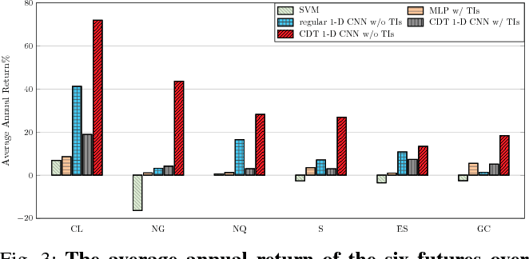
2. FINANCIAL MARKET PREDICTION USING DEEP LEARNING:
Financial markets are difficult to predict due to its complex system dynamic movement.
The experiment results show that the CNN model can effectively extract more generalized and informative features than previous machine learning approaches. It was proposed to predict the financial market aches.^{[3]}

Slide 7
Our Project
The objective of our project is to analyse dataset and train a model that can predict the bitcoin price using deep learning techniques such as GRU and LSTM which are effective learning models for training time-series data.^{[4]}
The various factors taken for price prediction are OPEN STOCK, CLOSING STOCK, HIGH VALUE, LOW VALUE and VOLUME.
The proposed approach is implemented in Python and validated for benchmark datasets.

Slide 8
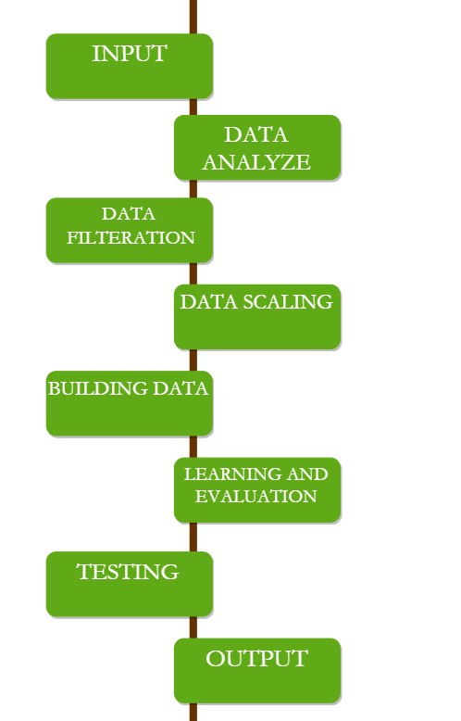
WORK FLOW

Slide 9
Data Analysis Phase: This phase analyzes data and its parameters to check any redundancy in data values that may affect prediction results. If the dataset contains any irrelevant parameters, then those data values are removed.
Data Filtration Phase: This phase filters data to remove all empty/redundant values.
Data-Scaling Phase: Before data are passed to the model, the data are scaled according to model requirements. In this way, this phase reshapes data to make them more suitable for the model.^{[5]}

Slide 10
Model-Building Phase: The proposed approach is implemented in python. Keras with tensor flow is used as the backened library to make the model more accurate. The Keras sequential model consists of two layers named LSTM and dense layers which process data in depth to analyze all kinds of pattern formed in dataset to make the model more precise.
Model Learning and Evaluation Phase: Data is trained using various LSTM units model and GRU.
Prediction Phase: Input values are passed to the model to give predicted values as the output. The output is compared with testing data to calculate accuracy and losses.

Slide 11
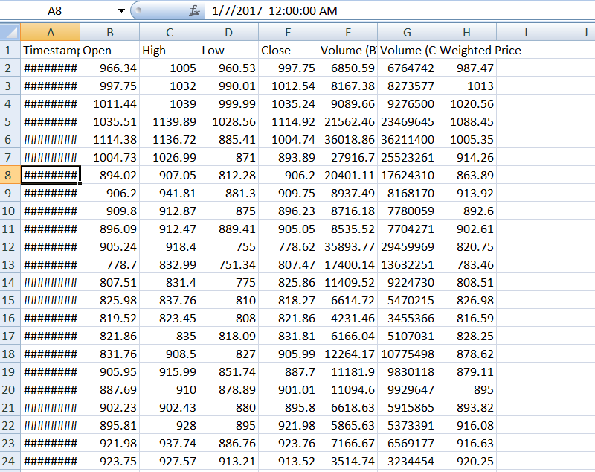
OUR DATASET LOOKS LIKE THIS!

Slide 12
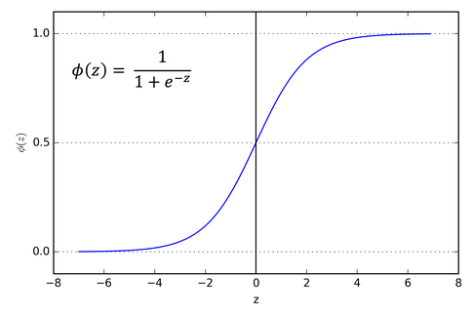
ACTIVATION FUNCTIONS USED^{[10]}
Sigmoid Function
The main reason why we use sigmoid function is because it exists between (0 to 1). Therefore, it is especially used for models where we have to predict the probability as an output.Since probability of anything exists only between the range of 0 and 1, sigmoid is the right choice.
The function is differentiable.That means, we can find the slope of the sigmoid curve at any two points.
The function is monotonic but function’s derivative is not.

Slide 13
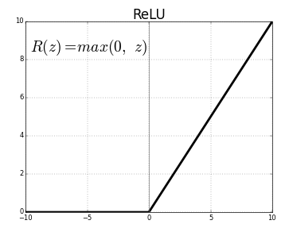
2. Relu Function
The ReLU is half rectified (from bottom). f(z) is zero when z is less than zero and f(z) is equal to z when z is above or equal to zero.
Range: [ 0 to infinity)
The function and its derivative both are monotonic.

Slide 14
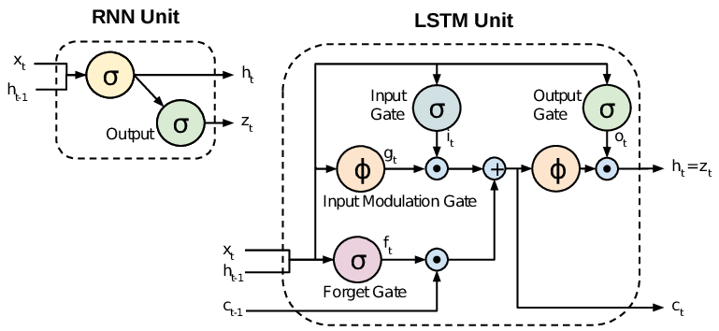
STUDIED ALGORITHMS
Long Short Term Memory (LSTM)
Long Short Term Memory is a kind of recurrent neural network capable of learning long-term dependencies. It is used for processing, predicting and classifying on the basis of time series data.^{[6]}

Slide 15
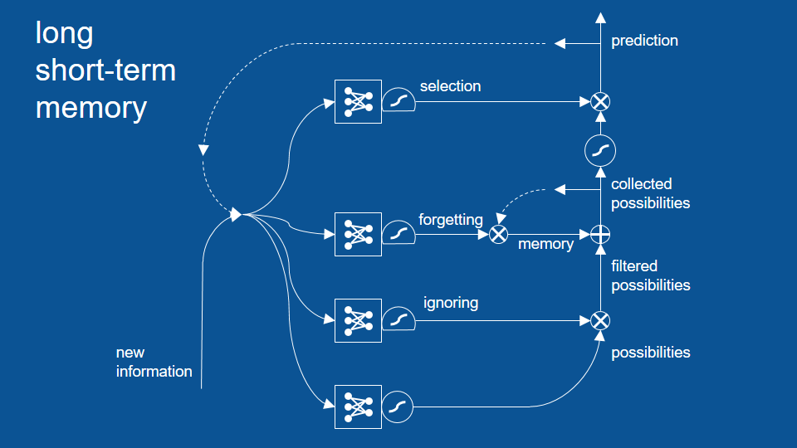
Forget Gate(f): It determines to what extent to forget the previous data.
Input Gate(i): It determines the extent of information to be written onto the Internal Cell State.
Input Modulation Gate(g):It is used to modulate the information that the Input gate will write onto the Internal State Cell by adding non-linearity to the information and making the information Zero-mean.
Output Gate(o): It determines what output(next Hidden State) to generate from the current Internal Cell State^{.[7]}

Slide 16
GATED RECURRENT UNIT(GRU)
Unlike LSTM, it consists of only three gates and does not maintain an Internal Cell State. The information which is stored in the Internal Cell State in an LSTM recurrent unit is incorporated into the hidden state of the Gated Recurrent Unit^{.[8]}
Update Gate(z): It determines how much of the past knowledge needs to be passed along into the future. It is analogous to the Output Gate in an LSTM recurrent unit.
Reset Gate(r): It determines how much of the past knowledge to forget. It is analogous to the combination of the Input Gate and the Forget Gate in an LSTM recurrent unit.
Current Memory Gate(): It is incorporated into the Reset Gate just like the Input Modulation Gate is a sub-part of the Input Gate and is used to introduce some non-linearity into the input and to also make the input Zero-mean.^{[9]}

Slide 17
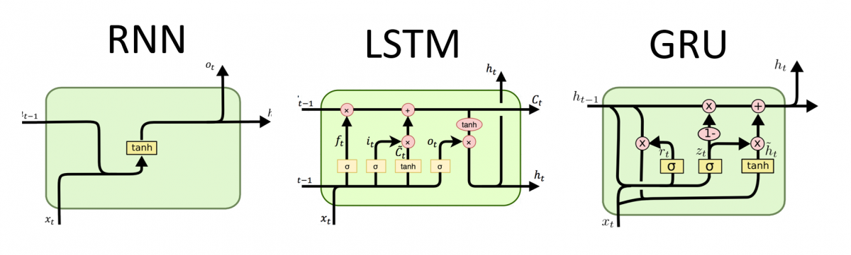

Slide 18
NEURAL NETWORK OPTIMISATION
Number of Layers:- It must be chosen wisely as a very high number may introduce problems like over-fitting and vanishing and exploding gradient problems .
Activation Function:- The popular choices in this are ReLU, Sigmoid & Tanh(only for shallow networks), and LeakyReLU. Generally choosing a ReLU/LeakyReLU do equally well.
Optimizer:- It is the algorithm used by the model to update weights of every layer after every iteration. Popular choices are SGD,RMSProp and Adam.
Batch Size:- It is indicative of number of patterns shown to the network before the weight matrix is updated. If batch size is less, patterns would be less repeating and hence the weights would be all over the place and convergence would become difficult. If batch size is high learning would become slow as only after many iterations will the batch size change.
Number of Epochs:- The number of epochs is the number of times the entire training data is shown to the model. It plays an important role in how well does the model fit on the train data. High number of epochs may over-fit to the data and may have generalization problems on the test and validation set, also they could cause vanishing and exploding gradient problems. Lower number of epochs may limit the potential of the model.

Slide 19
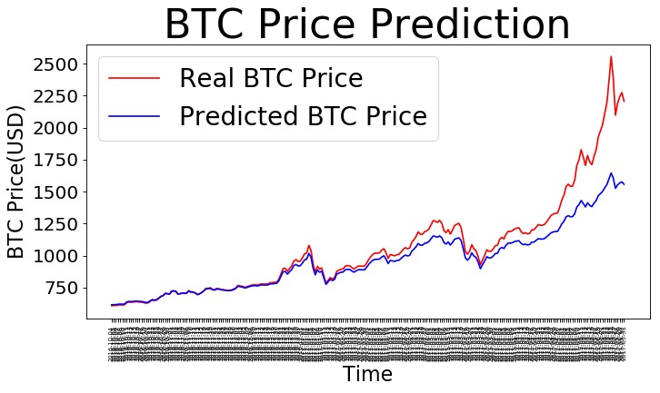
RESULTS & CONCLUSION
This is the plot of LSTM Model with RMSE value: 0.022

Slide 20
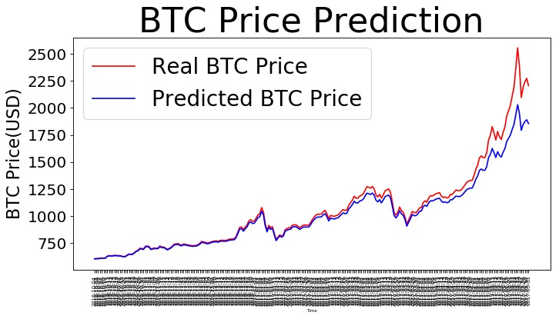
This is the plot of GRU Model with RMSE value: 0.014
We can see that in both the cases, both the models could not perform well for prediction for the higher BTC price, though GRU performed better than the LSTM model. For the lower price range both are successful in predicting the prices. Because of time series data and its non-linear nature prediction is difficult. GRU prediction is able to pick up the shape of observed data.

Slide 21

PROPOSED PLAN
Implementing using CNN and ARIMA.
Development of an API which fetches data from website and analyze it, then build model and brings output using Django. It will be Real Time Bitcoin Price Predictor with more new and efficient data updated time to time.

Slide 22
REFERENCES
[1] https://machinelearningmastery.com/what-is-deep-learning
[2]Yanhui Chen,Kaijin He,Geoffrey K.F.T, “Forecasting Crude Oil Prices: a Deep Learning based Model” International Conference On Information Technology and Quantitative Management, Held in 2017, pp: 300-307.
[3] Jia Wang, Tong Sun, Benyuan Liu, Yu Cao, Degang Wang, “Financial Market Prediction with Deep Learning” IEEE International Conference on Machine Learning and Applications” Held in 2018, pp:97-104.
[4]Yechang Yao,Jungho Yi,Shengjun Zhai,Yuwen Lin,Taeksung Kim, “Predictive Analysis of Cryptocurrency Price using Deep Learning” International Journal Of Engineering and Technology, (2018) , pp:258-264.
[5] S. Yogeshwaran,Maninder Jeet Kaur,Piyush Maheshwari , “Predicting Bitcoin Prices Using Machine Learning” IEEE Global Engineering Education Conference , Held in April (2019), pp:1449-1454.
[6] https://towardsdatascience.com/understanding-rnn-and-lstm-f7cdf6dfc14e
[7] https://towardsdatascience.com/understanding-gru-networks-2ef37df6c9be
[8] https://www.geeksforgeeks.org/introduction-to-recurrent-neural-network
[9]https://towardsdatascience.com/illustrated-guide-to-lstms-and-gru-s-a-step-by-step-explanation-44e9eb85bf21
[10]https://towardsdatascience.com/activation-functions-neural-networks-1cbd9f8d91d6

Slide 23
THANK YOU !

