Slide 1
Wait for:
Forward, Left, Right
Block: None
Wait for:
Forward, Left, Right
Block: None
Forward or Right
Any Event
Wait for:
Forward, Left, Right
Block: None
Wait for:
Forward, Left, Right
Block: None
Forward
Right
C
Left
else
Wait for:
Forward, Right
Block:
Left
C
Any Event
Left and [$leftCounter < $k]/
$leftCounter += 1
Any Event[forward lidar state is clear]
and
Any Event[target direction is straight ahead]
Left and [$leftCounter == $k]
Wait for:
Forward, Left
Block:
Right
Wait for:
Forward, Right
Block:
Left
Wait for:
Forward
Block:
Left, Right

Slide 2
Wait for:
Forward, Left, Right
Block: None
Wait for:
Forward, Left, Right
Block: None
Forward or Right
Any Event
Wait for:
Forward, Left, Right
Block: None
Wait for:
Forward, Left, Right
Block: None
Forward
Right
C
Left
else
Wait for:
Forward, Right
Block:
Left
C
Any Event
Left and [$leftCounter < $k]/
$leftCounter += 1
Any Event[forward lidar state is clear]
and
Any Event[target direction is straight ahead]
Left and [$leftCounter == $k]
Wait for:
Forward, Left
Block:
Right
Wait for:
Forward, Right
Block:
Left
Wait for:
Forward
Block:
Left, Right

Slide 3
Wait for:
Forward, Left, Right
Block: None
Wait for:
Forward, Left, Right
Block: None
Forward or Right
Wait for:
Forward, Left, Right
Block: None
Any Event
Wait for:
Forward, Left, Right
Block: None
Forward
Right
C
Left
else
Any Event
Wait for:
Forward, Right
Block:
Left
Left and [$leftCounter < $k]/
$leftCounter += 1
C
Any Event[forward lidar state is clear]
and
Any Event[target direction is straight ahead]
Left and [$leftCounter == $k]
Wait for:
Forward, Left
Block:
Right
Wait for:
Forward, Right
Block:
Left
Wait for:
Forward
Block:
Left, Right

Slide 4
Wait for:
Forward, Left, Right
Block: None
else
Any Event
C
Any Event[forward lidar state is clear]
and
Any Event[target direction is straight ahead]
Wait for:
Forward
Block:
Left, Right

Slide 5
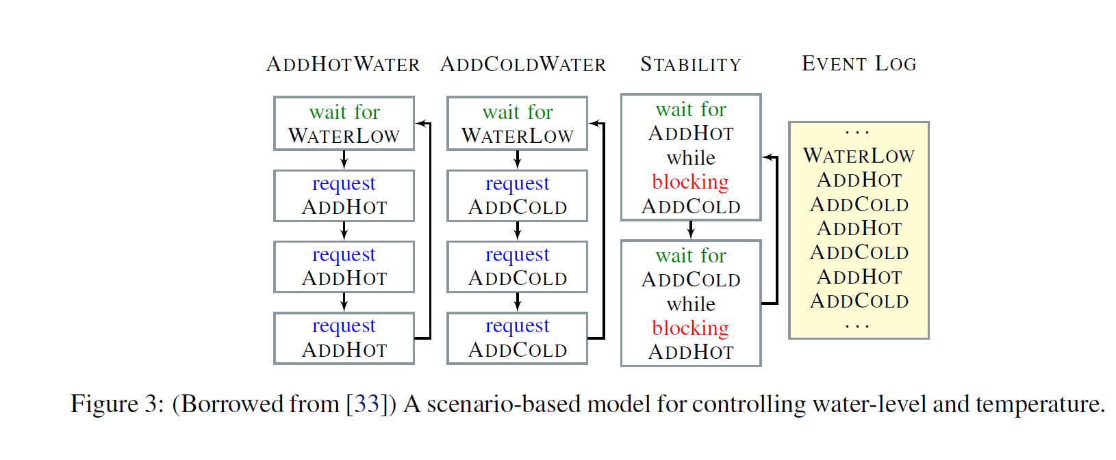
Wait for:
WaterLow
Wait for:
WaterLow
Wait for:
AddHot
Block:
AddCold
…
WaterLow
AddHot
AddCold
AddHot
AddCold
AddHot
AddCold
…
WaterLow
WaterLow
Request:
AddHot
Request:
AddCold
AddHot
AddCold
AddHot
Request:
AddHot
Request:
AddCold
Wait for:
AddCold
Block:
AddHot
AddHot
AddCold
Request:
AddHot
Request:
AddCold
AddHot
AddCold
AdCold

Slide 6
Wait for:
WaterLow
Wait for:
WaterLow
Wait for:
AddHot
Block:
AddCold
…
WaterLow
AddHot
AddCold
AddHot
AddCold
AddHot
AddCold
…
WaterLow
WaterLow
Request:
AddHot
Request:
AddCold
AddHot
AddCold
AddHot
Request:
AddHot
Request:
AddCold
Wait for:
AddCold
Block:
AddHot
AddHot
AddCold
Request:
AddHot
Request:
AddCold
AddHot
AddCold
AdCold
(a) AddHotWater
(b) AddColdWater
(c) Stability
(d) Event Log

Slide 7
Wait for:
Forward, Left, Right
Block: None
Wait for:
Forward, Left, Right
Block: None
Forward or Right
Any Event
Wait for:
Forward, Left, Right
Block: None
Wait for:
Forward, Left, Right
Block: None
Forward
Right
C
Left
else
Wait for:
Forward, Right
Block:
Left
C
Any Event
Left and [$leftCounter < $k]/
$leftCounter += 1
Any Event[forward lidar state is clear]
and
Any Event[target direction is straight ahead]
Left and [$leftCounter == $k]
Wait for:
Forward, Left
Block:
Right
Wait for:
Forward, Right
Block:
Left
Wait for:
Forward
Block:
Left, Right

