Slide 1
Digital Streaming System
a movie catalogue manager
for admins

Slide 2
Background
Full name: Ryann Jeffers Nepomuceno
1 year – Java Springboot/ReactJS
2 years – Java Spring via Apache Wicket

Slide 3
Project Abstract
What is this system about?
Scopes and Limitations
Code Architecture
Unit Testing
Other tools
Actual Demo

Slide 4
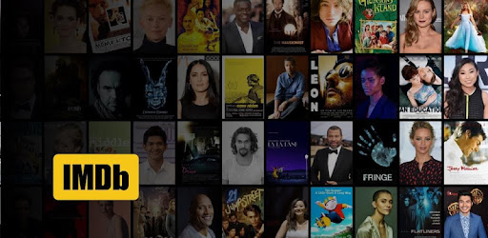

What is this system about?
iMDB (Internet Movie Database)
Rotten Tomatoes
Administrative functionality:
Authentication (admins)
Movies
Actors
Reviews

Slide 5





Tech Stacks
Java SpringBoot
Spring Eureka Server/Client
Spring Cloud Gateway
JPA/Hibernate
Lombok
JUnit5/JaCoCo agent
SonarQube
PostgreSQL
Postman/Swagger

Slide 6
Scope and Limitation
Add/Delete/Update/View:
Actors & Movies
Add/View:
Users & Reviews
Admin users only (no sessions/tokens)
Exception handling for backend
Unit Testing via JUnit

Slide 7
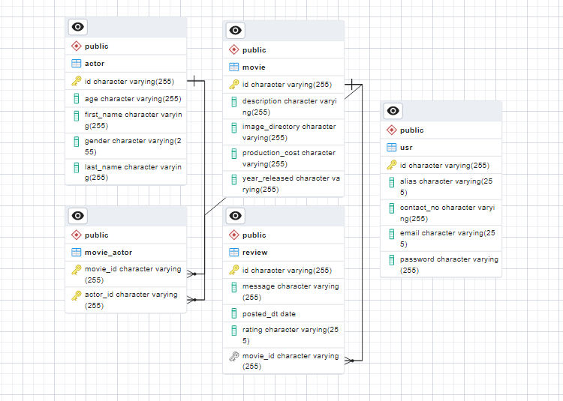
Entity-Relationship Diagram

Slide 8
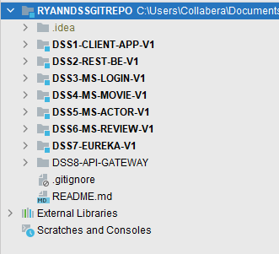
Code Architecture
Monolithic structure
Microservices structure

Slide 9
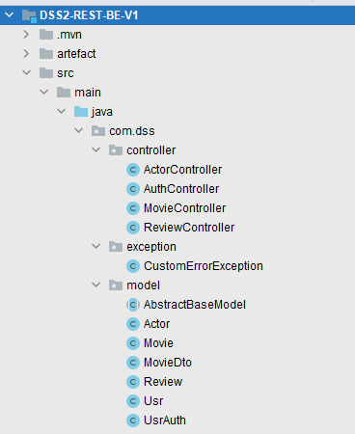
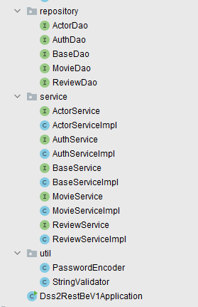
Code Architecture: Monolithic

Slide 10
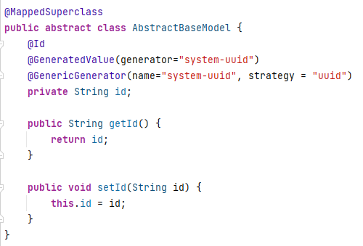
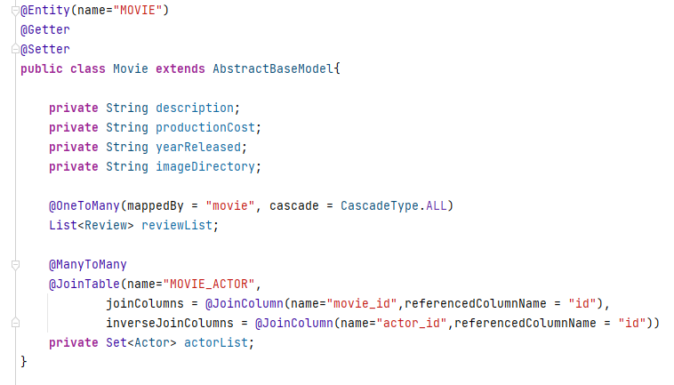
Code Architecture: Monolithic

Slide 11


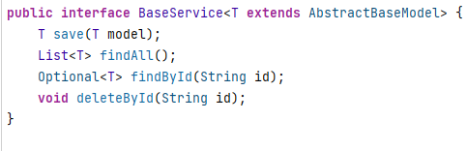

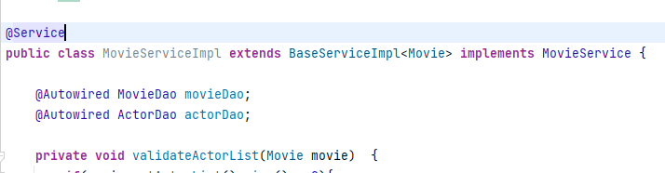
Code Architecture: Monolithic

Slide 12
Code Architecture: Microservices
DSS1 – Sample client app
DSS3 – Sample authentication
DSS4 – Movie service
DSS5 – Actor service
DSS6 – Review service
DSS7 – Server
DSS8 – Gateway

Slide 13
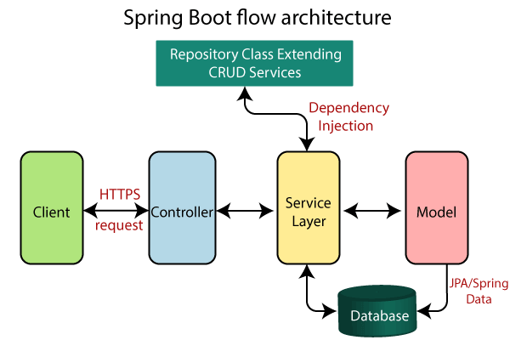
Code Architecture: Layers

Slide 14
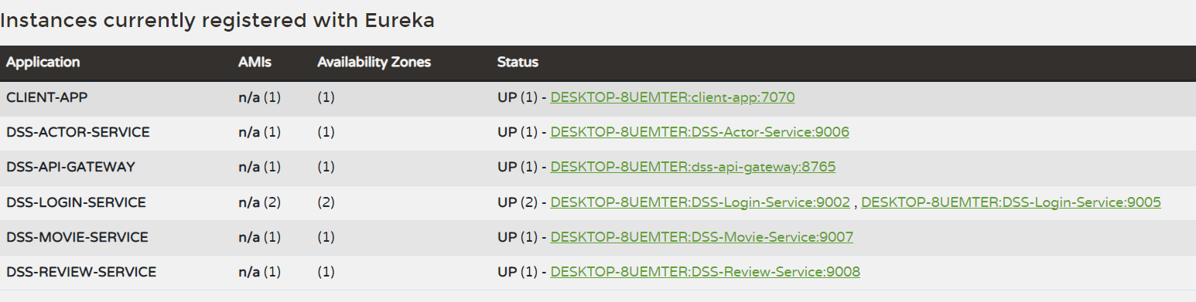
Code Architecture: Eureka Server

Slide 15
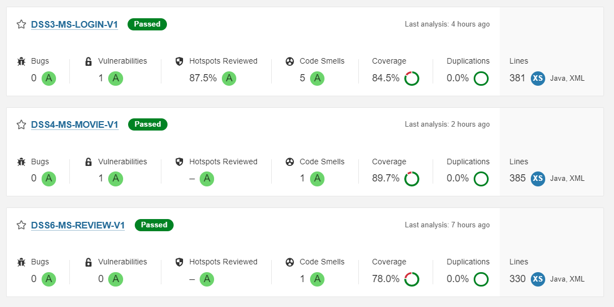
Unit Testing: SonarQube

Slide 16
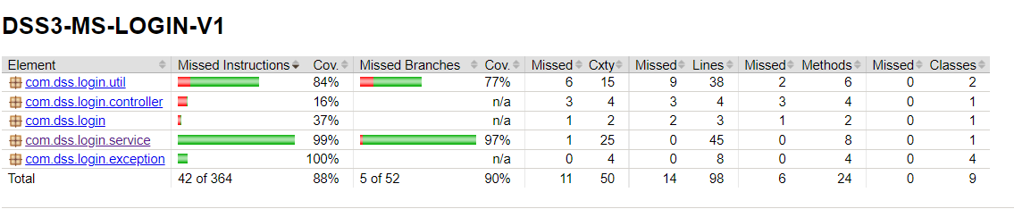
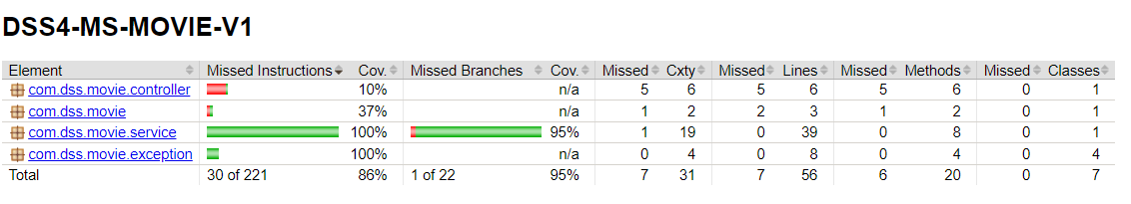
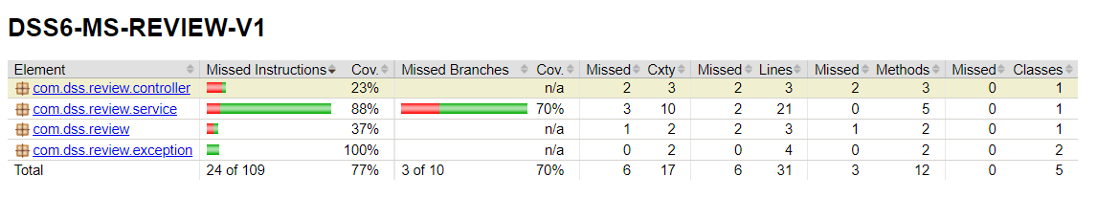
Unit Testing: JaCoCo agent

Slide 17
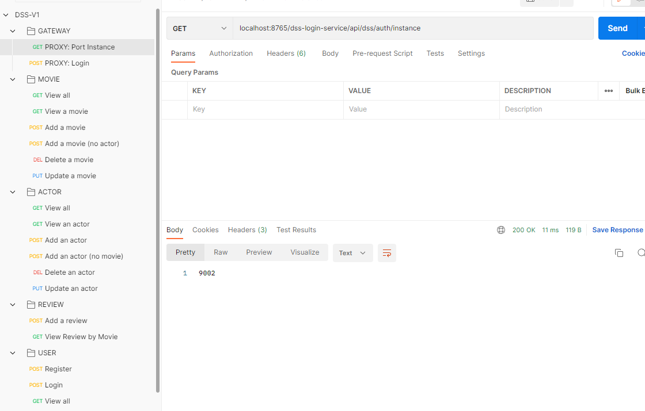
Postman

Slide 18
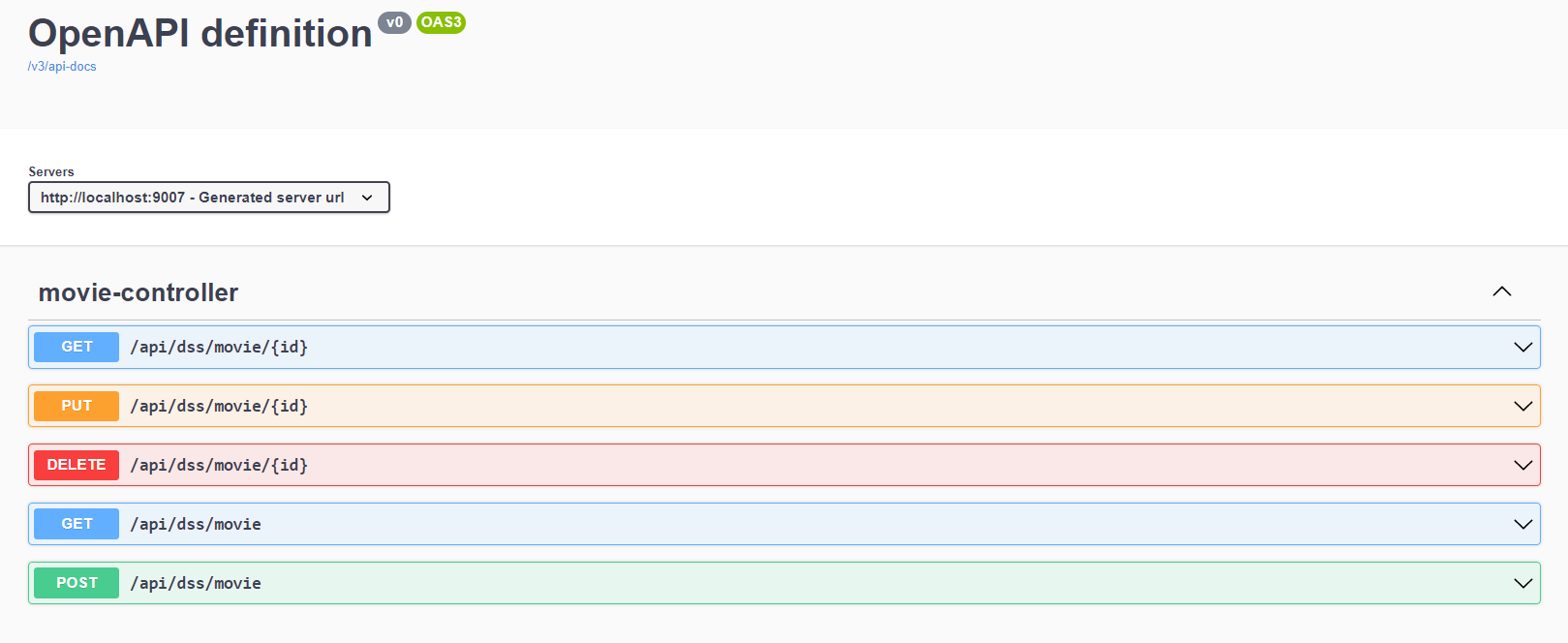
Swagger

Slide 19
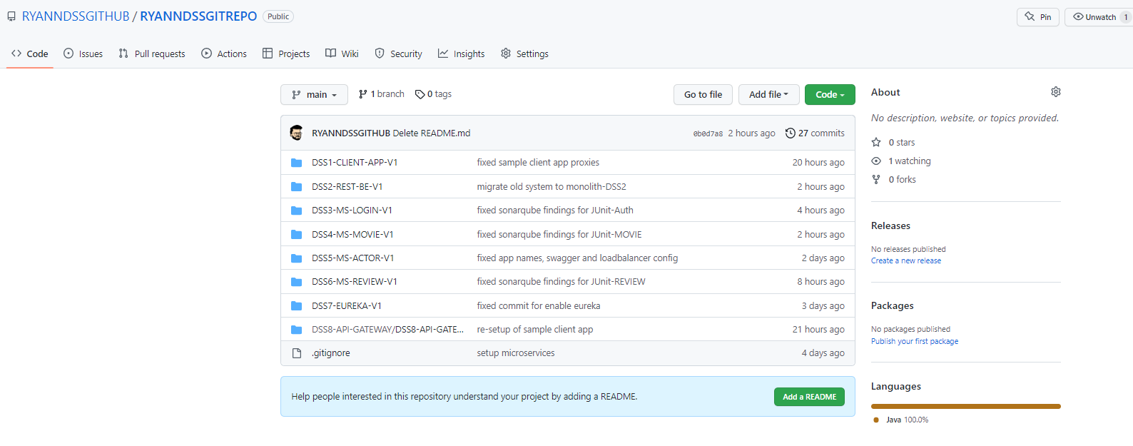
Git/GitHub

