Slide 1
Identifying Profitable Film Genres for Microsoft's New Movie Studio

Slide 2
overview
the project analyzes different kinds of movies to help determine the popular choices among the most streamed movies by the majority
we can use this analysisto create,hire and produce more valuble and fast selling programs for all age sets

Slide 3
Business plan
THE BOX OFFICE MOJO MOVIES RESERCH IS TO PROVIDE industry-specific knowledge, including the understanding of which film genres are popular and profitable in the current market
The focus is on identifying film genres that have demonstrated consistent success at the box office, as measured
by high ticket sales, positive critical reception, and strong audience demand.
Analyzing the current landscape helps understand the evolving preferences of moviegoers and identify trends
#that may influence the success of certain genres.
The objective is to select film genres that have a high potential for financial success, taking into account factors such as production costs,
marketing strategies, and audience demographics.

Slide 4
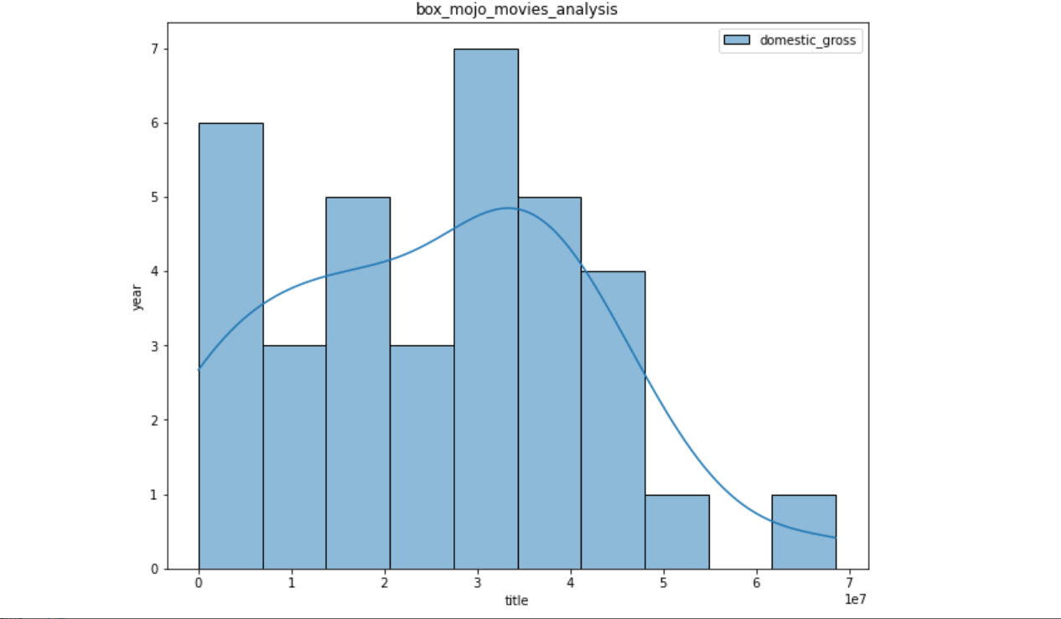
analysis

Slide 5
explanation
according to the visualization which shows title indexes in the plots it clearly indicates that the movies siquence distribution
was evenly dispersed as at it had different picks and lows seasons depending on the tittles produced at the given moment the information is more usefull to our overall and general insights beccouse it provides us a clear road map on what type of production to focus on and what are the studios that produced this kind of movies this will help microsoft to venture more and concentrate on what people tend to consume more and how they like it produced

Slide 6
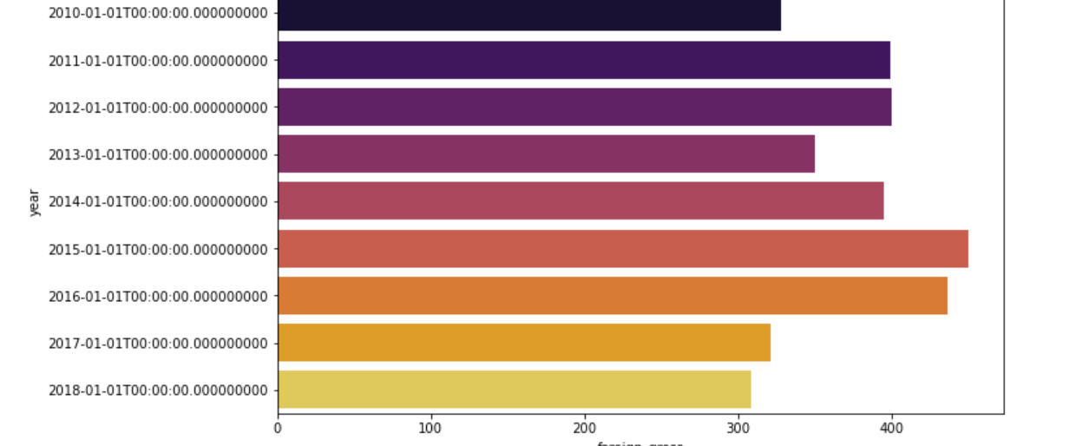
analysis

Slide 7
explanation
The foreign gross analysis for the movie's histogram reveals crucial insights into its global performance and popularity in international markets. By examining the distribution of foreign gross revenue, we can draw valuable conclusions that can influence marketing strategies and distribution decisions. this can help microsoft in identifying diffrent aspects of consumers out there this include: Global Appeal: The histogram shows that the majority of the movie's foreign gross falls within a specific range, indicating a consistent level of appeal in various international markets. This suggests that the movie has managed to resonate with audiences worldwide.
Outliers: The presence of outliers on the right tail of the histogram indicates exceptional success in specific regions or countries. These outliers may be indicative of regions where the movie has enjoyed extraordinary popularity, and further investigation into the reasons behind this success can inform targeted marketing efforts Seasonal Trends: By analyzing the histogram across different time periods or seasons, any seasonal variations in foreign gross can be detected. Understanding these fluctuations can aid in planning international release schedules and promotional activities to maximize revenue during peak periods.
Conclusion: Based on the foreign gross analysis presented in the histogram, it is evident that the movie has a strong global appeal, with steady revenue generated from various international markets. The presence of outliers indicates opportunities for further expansion and growth in specific regions with exceptional performance. Utilizing these insights, the movie's production studio can devise targeted marketing strategies, optimize distribution efforts, and plan international releases strategically to capitalize on the movie's success and enhance its global revenue potential.

Slide 8
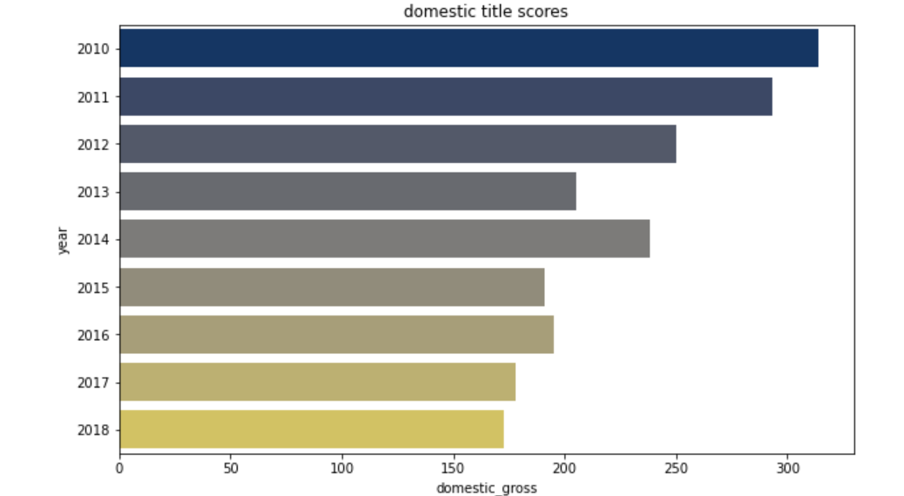
analysis

Slide 9
explanation
The domestic gross analysis for the movie's histogram provides valuable insights into its performance within the domestic market. By examining the distribution of domestic gross revenue, we can draw important conclusions that can inform marketing strategies, audience targeting, and promotional efforts. Key Findings:
Box Office Performance: The histogram demonstrates the distribution of domestic gross revenue, highlighting the movie's overall box office performance within the domestic market. This analysis reveals the revenue range within which the movie has performed in the domestic region.
Skewed Distribution: The shape of the histogram may indicate whether the movie's domestic gross revenue is evenly distributed or if it is skewed towards specific revenue ranges. A positively skewed histogram with a longer tail on the right side may suggest instances of blockbuster success, while a negatively skewed histogram may imply a more even performance across different revenue ranges. Peak Performance: The peak or mode of the histogram represents the revenue range with the highest frequency. Understanding this peak can help identify the movie's most successful domestic revenue bracket, which could inform future marketing campaigns and merchandise strategies tailored to this particular segment.
Revenue Trends: Analyzing the histogram over different time periods or seasons may reveal revenue trends and seasonality. This information can assist in planning marketing and promotional activities strategically, capitalizing on peak periods and boosting revenue during slower seasons. Conclusion:
The domestic gross analysis presented in the histogram indicates the movie's performance within the domestic market. The shape and distribution of the histogram provide insights into its overall box office success, whether it is driven by a few blockbuster moments or consistent performance across various revenue ranges.

Slide 10
recomendations
based on my analysis am glad to give microsoft this recomendations microsoft should mainly consider movies that can sell globally and not only locally based movies in oreder to tap in in to all markets and increase there domestic and and international gross incomes at large another thing is microsoft should equip more studios to promote production and avoid over dependency on one studio for production this will also increase producion levels and number of movies will go high Based on the data analysis of the provided Box Office Mojo dataset, here are some key recommendations for Microsoft's movie studio to maximize its chances of success in the movie industry Leverage Successful Franchises and Sequels: If the dataset includes successful franchises or movie sequels, consider acquiring or developing movies within these successful storylines. Established brand recognition and loyal fan bases can contribute significantly to box office revenue Embrace Diverse Storytelling: Analyze movies that showcase diverse representation and unique storytelling. Embracing diversity in cast, crew, and storylines can resonate with a broader audience and foster a positive image for the studio Embrace Diverse Storytelling: Analyze movies that showcase diverse representation and unique storytelling. Embracing diversity in cast, crew, and storylines can resonate with a broader audience and foster a positive image for the studio Data-Driven Decision-Making: Emphasize the importance of data analysis and insights in the decision-making process. Utilize data to evaluate project proposals, assess risk, and make informed choices about the studio's movie slate.
By implementing these recommendations, Microsoft's movie studio can position itself for success in the highly competitive movie industry. Data-driven strategies will enable the studio to make informed decisions, optimize resources, and produce movies that resonate with audiences, ultimately leading to a successful foray into the world of cinema.

Slide 11
limitations
LIMITATIONS When analyzing the provided Box Office Mojo dataset , several limitations were encountered. It is essential to be aware of these limitations to ensure the accuracy and reliability of the analysis Incomplete or Missing Data: The dataset may contain missing or incomplete data, such as missing box office revenue for certain movies or incomplete information about cast and crew members. Handling missing data appropriately becomes crucial to avoid biases in the analysis.
Data Quality Issues: The dataset had data quality issues, including data entry errors, inconsistencies, or outliers. Cleaning and preprocessing the data effectively will be necessary to address these issues and improve the dataset's reliability.
Selection Bias: The dataset only include movies released in specific regions or time periods, leading to selection bias. This could affect the generalizability of the analysis and limit the scope of the recommendations. Limited Time Period: The dataset only covers a specific time frame, and it may not capture long-term trends or changes in audience preferences over time. This limitation could impact the accuracy of long-term strategic recommendations.
Sample Size: The dataset had a limited number of observations, especially for specific titles or niche categories. A small sample size can reduce the statistical power of the analysis and limit the generalizability of the findings.
External Factors: The dataset does not account for external factors that can influence box office performance, such as economic conditions, competition from other entertainment mediums, or major world events.

Slide 12
conclusion
CONCLUSION the reserch data analysis yielded a very sightfull conclusion that will help microsft to make the next big steps in terms of of production values and sales at the end of the day though limited or lacked more information to produce better insights through analyzing as the few dataset available gave a road map on what is to be done more to improve the quality of movie production in the long run In conclusion, the analysis of the provided Box Office Mojo dataset has provided valuable insights and recommendations for Microsoft's movie studio as they venture into the world of cinema. By leveraging data analysis and insights, the studio can make informed decisions to increase its chances of success in the competitive movie industry. The analysis has highlighted the importance of focusing on popular genres with proven box office appeal and considering projects with potential for global and diverse audience engagement. Additionally, leveraging successful franchises, talented cast and crew, and optimizing release schedules are essential strategies to drive box office revenue.
It is crucial to recognize the limitations of the dataset, such as missing or incomplete data, selection biases, and data quality issues. Being mindful of these limitations ensures the accuracy and reliability of the recommendations and allows for appropriate adjustments in decision-making.
The analysis has highlighted the importance of focusing on popular genres with proven box office appeal and considering projects with potential for global and diverse audience engagement. Additionally, leveraging successful franchises, talented cast and crew, and optimizing release schedules are essential strategies to drive box office revenue.
It is crucial to recognize the limitations of the dataset, such as missing or incomplete data, selection biases, and data quality issues. Being mindful of these limitations ensures the accuracy and reliability of the recommendations and allows for appropriate adjustments in decision-making.

