Slide 1
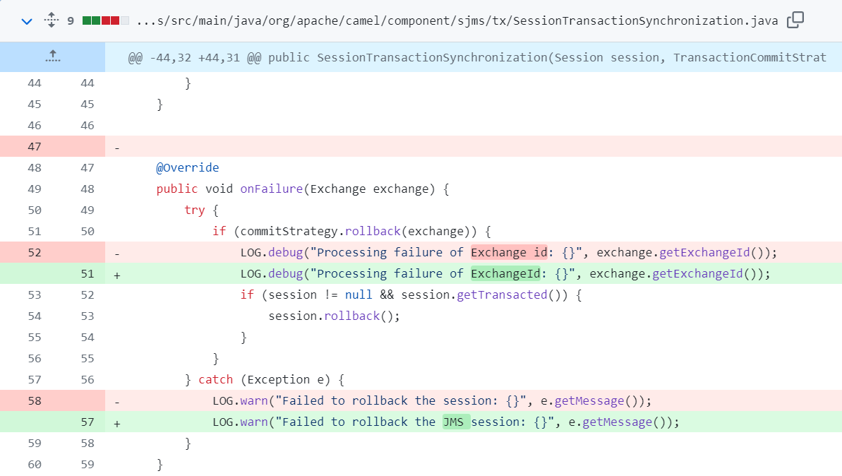
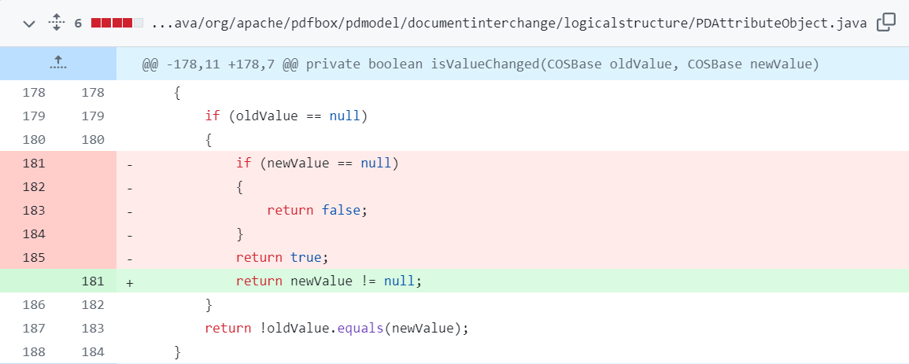
CAMEL-12335’s BFCSHA: 0ff3783f0d368703b5e7e9f38c963c4572de687d
Commit Time: Thu Mar 8 16:05:00 2018 +0000
File Name: SessionTransactionSynchronization.java
(a)
PDFBOX-2147’s BFCSHA: 11ac149fc1bc4b649210ca3f6c9e583fe3e9285c
Commit Time: Thu Jun 19 01:18:00 2014 +0000
File Name: SessionTransactionSynchronization.java
(b)

Slide 2
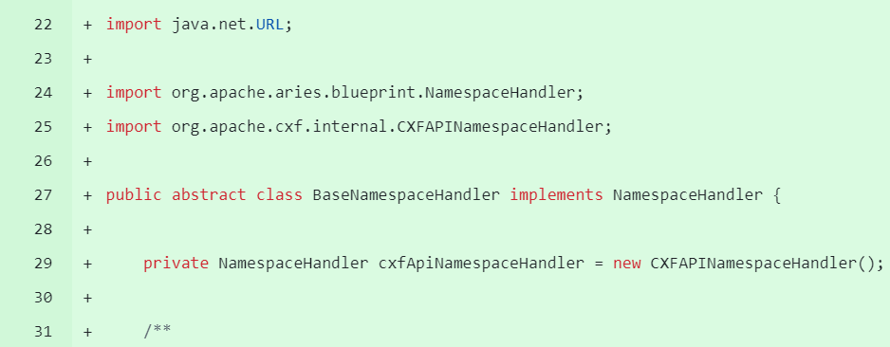
CAMEL-12335’s BFCSHA: 0ff3783f0d368703b5e7e9f38c963c4572de687d
Commit Time: Thu Mar 8 16:05:00 2018 +0000
File Name: SessionTransactionSynchronization.java
(a)
PDFBOX-2147’s BFCSHA: 11ac149fc1bc4b649210ca3f6c9e583fe3e9285c
Commit Time: Thu Jun 19 01:18:00 2014 +0000
CXF-7183’s BFCSHA: 0344b6bc0d1e61a3d3b5194f5ae3ebcdf62e8d56
Commit Time: Thu Dec 15 10:21:03 2016 +0100
File Name: PDAttributeObject.java
File Name: BaseNamespaceHandler.java （Newly Added File）
(b)
(c)

Slide 3
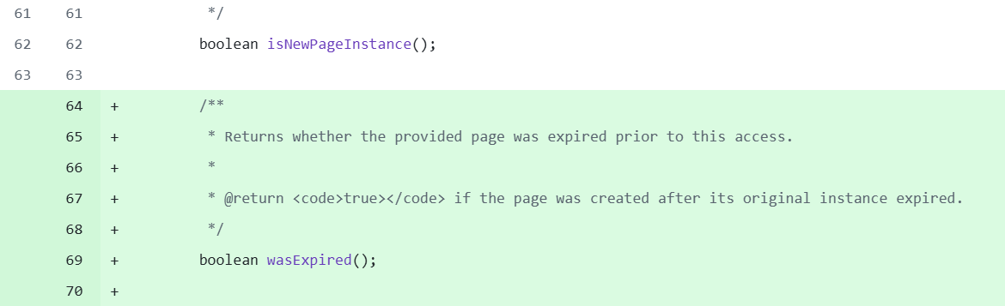
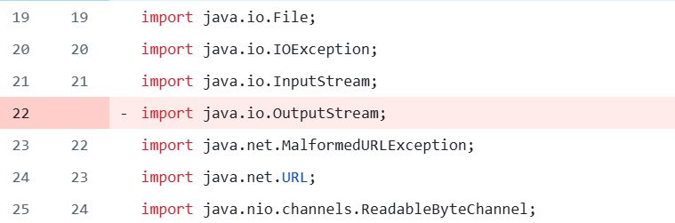
CAMEL-12335’s BFCSHA: 0ff3783f0d368703b5e7e9f38c963c4572de687d
Commit Time: Thu Mar 8 16:05:00 2018 +0000
PDFBOX-2147’s BFCSHA: 11ac149fc1bc4b649210ca3f6c9e583fe3e9285c
Commit Time: Thu Jun 19 01:18:00 2014 +0000
File Name: SessionTransactionSynchronization.java
File Name: PDAttributeObject.java
(a)
(b)
WICKET-6288’s BFCSHA: c4805d87012c2f0c2e80418453d0c60f3a5db7c7
Commit Time: Wed Jan 25 04:03:19 2017 -0200
CAMEL-9890’s BFCSHA: e3eb2c3c4f1f85c40641bf0f3aa334629f904cff
Commit Time: Wed Apr 20 13:59:37 2016 +0200
File Name: IPageProvider.java
File Name: JettyClassPathResource.java
(c)
(d)

Slide 4
WICKET-6288’s BFCSHA: c4805d87012c2f0c2e80418453d0c60f3a5db7c7
Commit Time: Wed Jan 25 04:03:19 2017 -0200
CAMEL-9890’s BFCSHA: e3eb2c3c4f1f85c40641bf0f3aa334629f904cff
Commit Time: Wed Apr 20 13:59:37 2016 +0200
File Name: IPageProvider.java
File Name: JettyClassPathResource.java
(a)
(b)
CAMEL-12335’s BFCSHA: 0ff3783f0d368703b5e7e9f38c963c4572de687d
Commit Time: Thu Mar 8 16:05:00 2018 +0000
PDFBOX-2147’s BFCSHA: 11ac149fc1bc4b649210ca3f6c9e583fe3e9285c
Commit Time: Thu Jun 19 01:18:00 2014 +0000
File Name: SessionTransactionSynchronization.java
File Name: PDAttributeObject.java
(c)
(d)

Slide 5
PDFBOX-2147’s BFCSHA: 11ac149fc1bc4b649210ca3f6c9e583fe3e9285c
Commit Time: Thu Jun 19 01:18:00 2014 +0000
File Name: SessionTransactionSynchronization.java

