Slide 1
Team Greg
https://github.com/RYNO8/Algothon-Greg

Slide 2
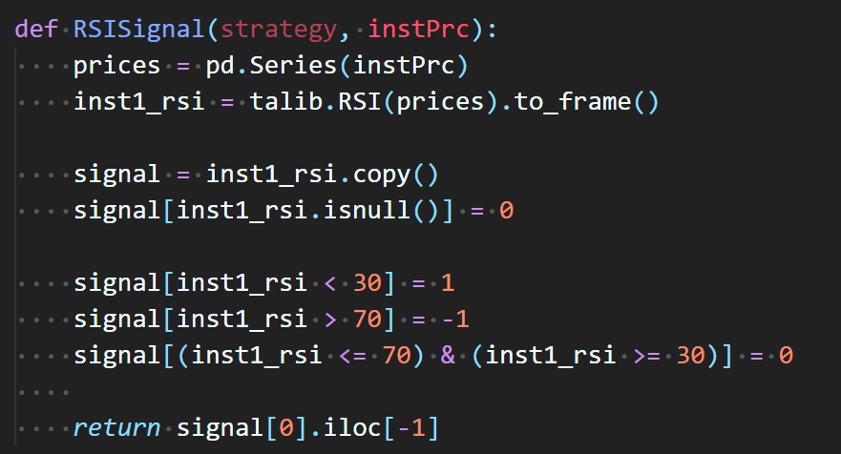
RSI (Relative strength index)

Slide 3
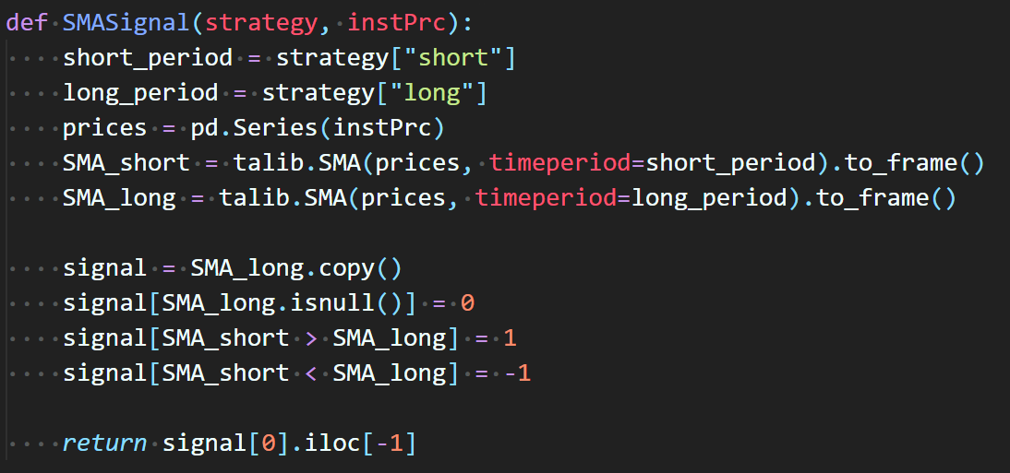
SMA (simple moving average)

Slide 4
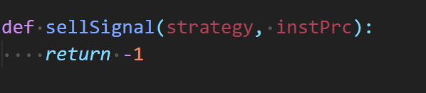
SELL

Slide 5
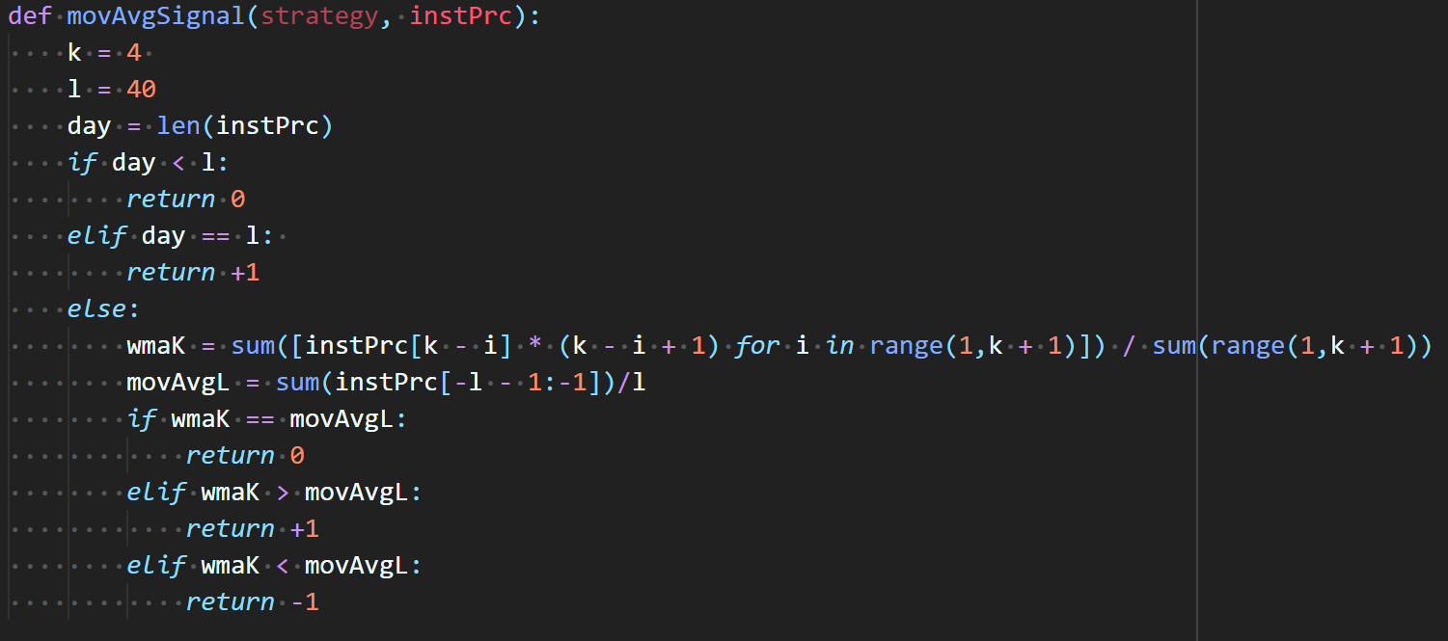
MOVAVG (weighted moving average)

Slide 6
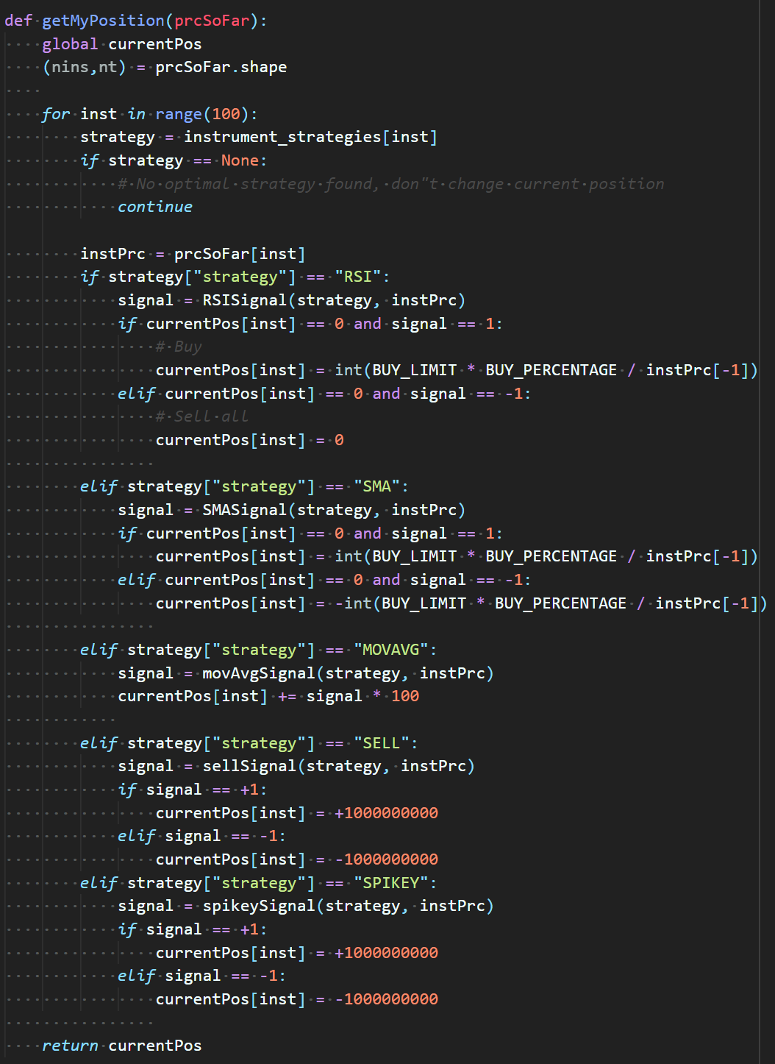
Signal to Position

Slide 7
Combining strategies
instrument_strategies = {
0: {"strategy": "RSI", "mean": 642.2065750000056},
1: {"strategy": "SELL", "mean": 1661.685400000004},
2: {"strategy": "SELL", "mean": 716.1606999999913},
3: {"strategy": "MOVAVG", "mean": 418.24525000000904},
4: {"strategy": "MOVAVG", "mean": 204.8790500000032},
5: {"strategy": "MOVAVG", "mean": 660.6695500000023},
6: {"strategy": "SELL", "mean": 272.80122499999743},
7: {"strategy": "SMA", "mean": 1374.7589999999946, "short": 20, "long": 40},
8: {"strategy": "SELL", "mean": 480.9752500000013},
9: None,
10: {"strategy": "SELL", "mean": 1838.0653000000093},
11: {"strategy": "SELL", "mean": 175.83562499999607},
12: {"strategy": "SELL", "mean": 1221.718100000011},
13: {"strategy": "SELL", "mean": 919.9443999999985},
14: {"strategy": "SELL", "mean": 1392.3925499999914},
…

