Slide 1
Techgig's Geek goddess 2018 Data science Semi final hackathon
Bharti Kukreja
Data scientist
Business Intelligence
VDSI

Slide 2
Coverage
Model Summary
Insights & Findings
Views

Slide 3




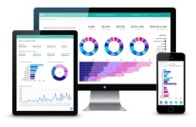



1 Model Summary
Infrastructure
Problem Statement
The client wants to monitor the performance of 10 popular Deodorants available in the market through a survey. The model should be able to predict First Impression about the scent i.e. Instant liking for a record.
Model Score
Step 1
Step 2
Data cleansed and fed to SPSS
Analyzed suitable modelling technique
Output summary from various model generated
Step 3
100%
Solution Approach
Developed a data analytics model that forecasts the instant likelihood of a deodorant based on a large and comprehensive historical data set.
In addition there are insights provided like why the likelihood is high/low.
Plan is to evolve the model to incorporate suggestions as part of the insights.
Step 4
Analytics Cloud
Score here represents how well the model performs.
Score = Number of correct predictions / Total records*100
Results and insights analysis
Model selected and implemented in R
What we think the data is
What the data says
Data loading and cleaning
Very Low Prob
Next Steps
Low Prob
Exploratory data analysis and removing unwanted factors
Giving feedback to production team based on insights.
Giving promotions based on insights
If discount data can be gathered then appropriate discount %age can be suggested to sales and pricing team.
Using customer demographic data the propensity to buy based on geography and age group can be predicted.
Medium Prob
High Prob
Logistic regression – changed to lasso regression
The Analytics
Model
Very High
Prob
Modelling
process
Prediction and results writing

Slide 4
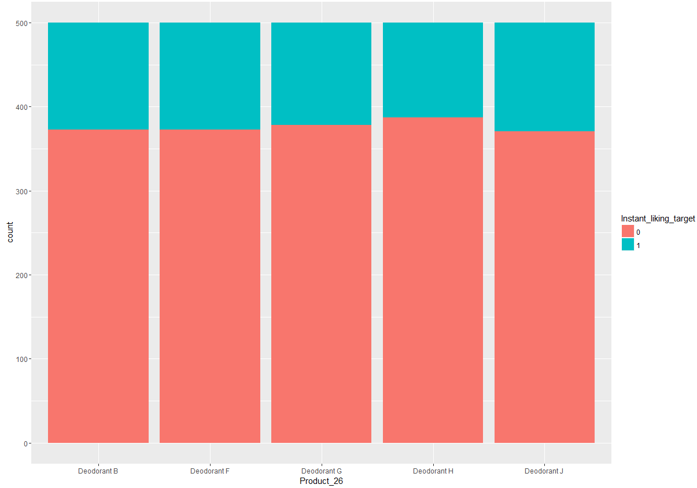
3 Views
Distribution of target amongst 5 deodorants

Slide 5
The data is normally distributed amongst all 4 deodorants, from this we can not conclude if 1 deodorant is more liked or one is less liked.

Slide 6
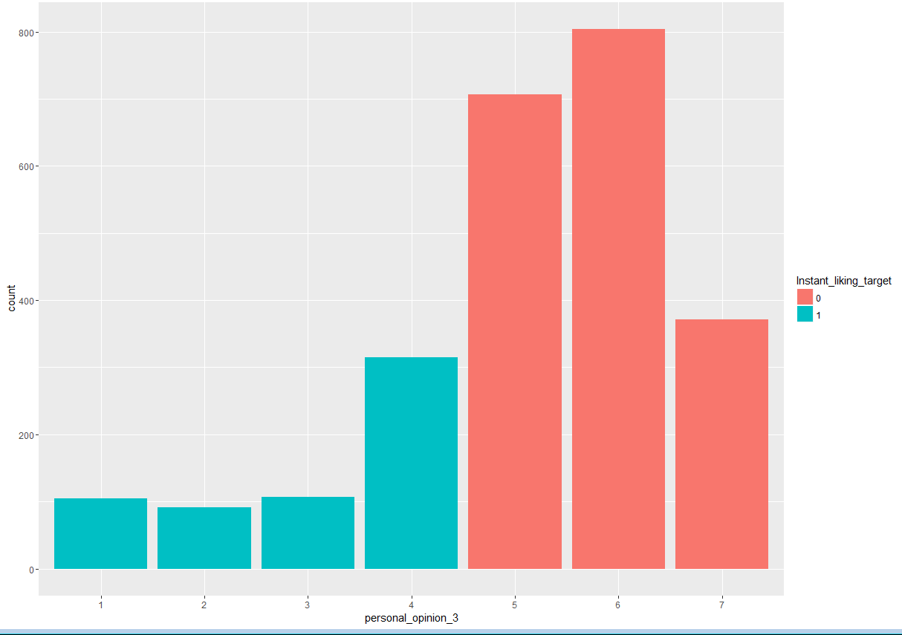
4 Insights & Findings
>personal opinion

Slide 7
The levels are
This is quite interesting thing that as the personal opinion about fragrance is improves the chances of instant liking being true decreases. At the threshold below 5 the instant liking is true always. Influence of/Affect of marketing. Y they did not like it what went wrong later.
[7] LIKE EXTREMELY
[6] LIKE A LOT
[5] LIKE MODERATELY
[4] NEITHER LIKE NOR DISLIKE
[3] DISLIKE MODERATELY
[2] DISLIKE A LOT
[1] DISLIKE EXTREMELY

Slide 8
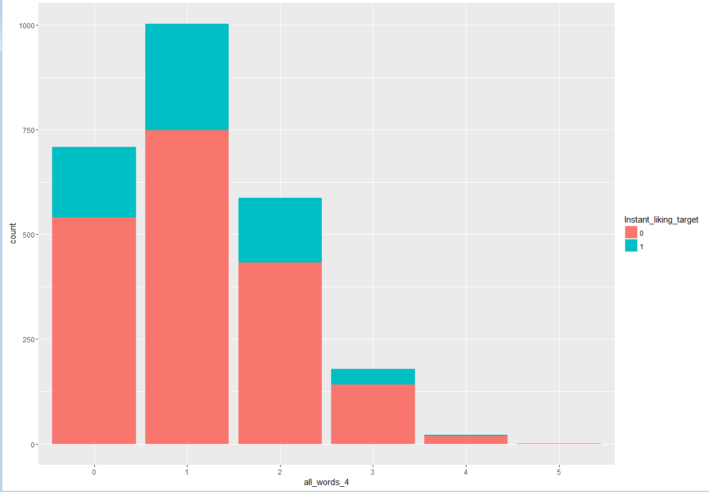
All words

Slide 9
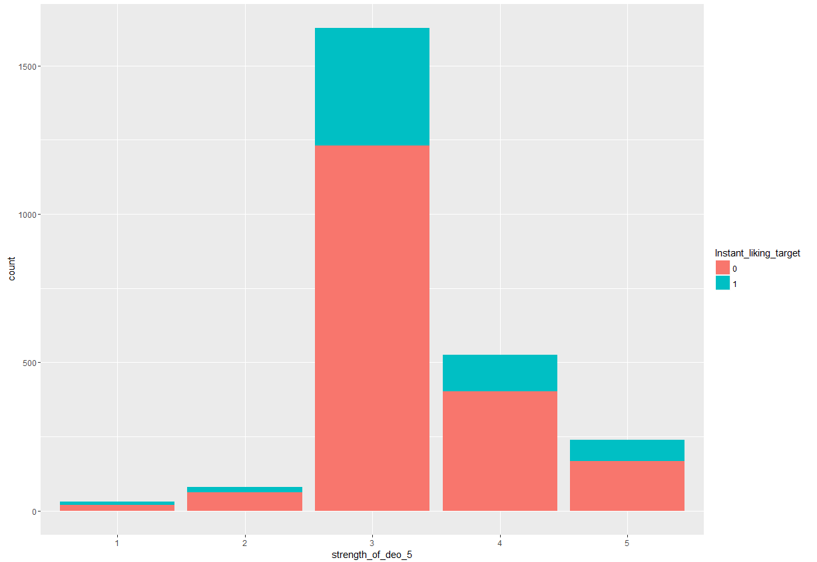
Strength of the Deodorant

Slide 10
strength_of_deo % age instant liking
1 33.33333333
2 23.75
3 24.33927474
4 23.42857143
5 29.41176471

Slide 11
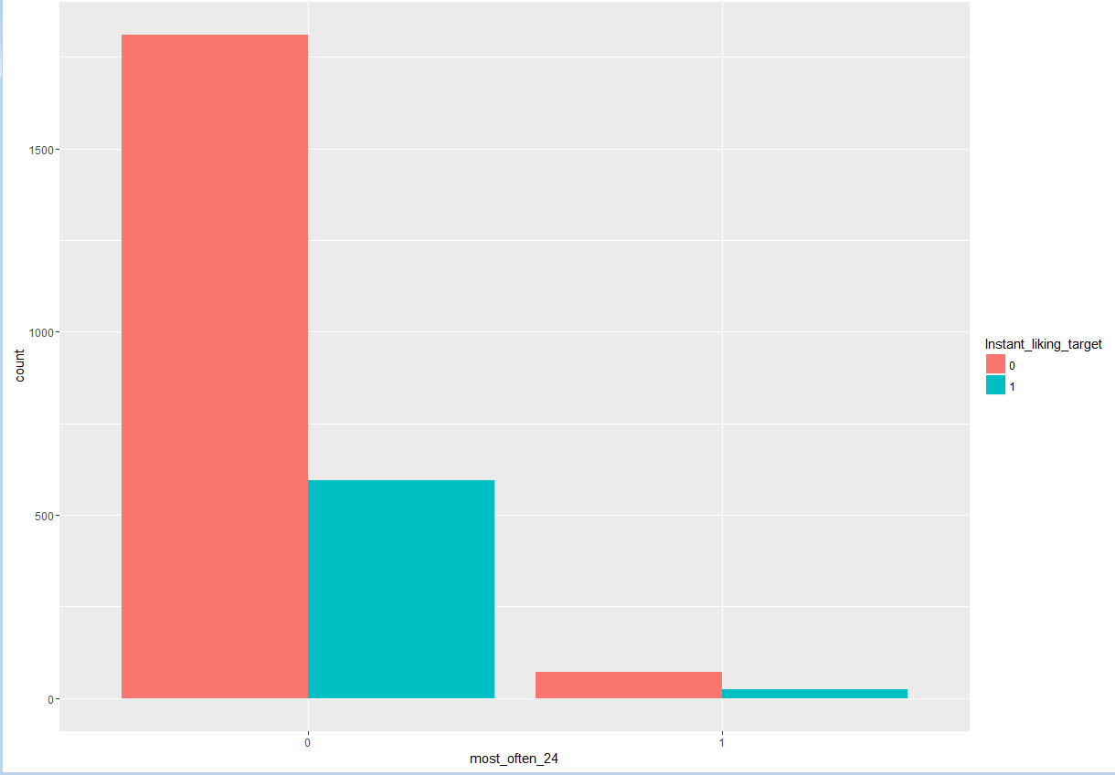
among the different products you just mentioned, which one do you most often wear?

Slide 12
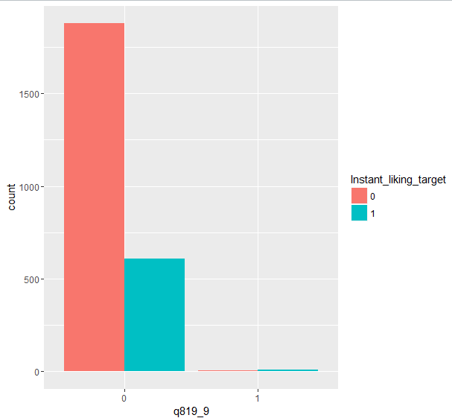
If this fragrance had a texture, would it be

Slide 13
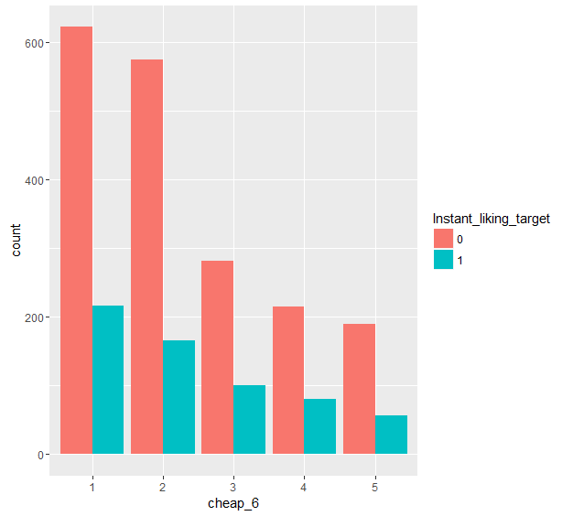
cheap | %age liking
1 | 25.77566
2 | 22.43243
3 | 26.17801
4 | 27.11864
5 | 22.85714
Cheap (4. Here is a list of attributes that can be used to describe a fragrance. For each attribute, please tell me how much you agree this statement applies to the fragrance you have just smelled. This fragrance smells.)

Slide 14
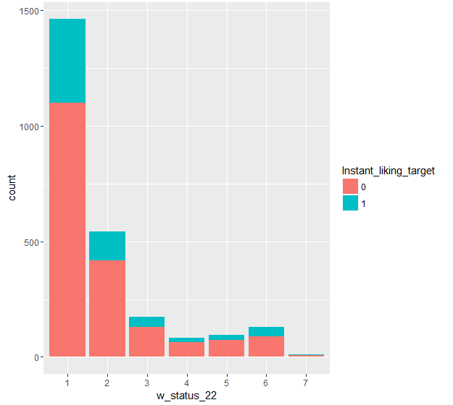
Working status
[1] Working full time
[2] Working part time
[3] Homemaker
[4] Student
[5] Retired
[6] Unemployed/looking for a job
[7] Other (specify)

Slide 15
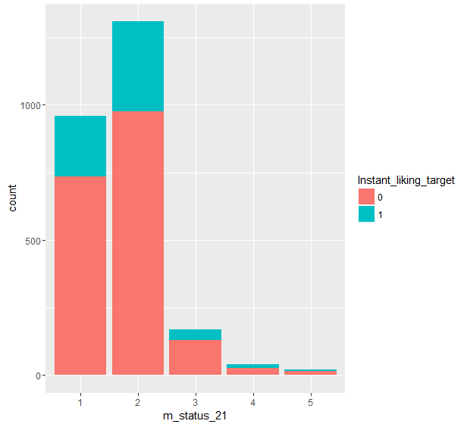
Marital status
[1] Single
[2] Married
[3] Separated/Divorced
[4] Widowed
[5] Other

