Slide 1
A
PROJECT REPORT
ON
FREELANCER MANAGEMENT SYSTEM (CODEWORK)
Submitted to:
Department of Computer Application (MCA), Visnagar
Affiliated to:
Sankalchand Patel University
Submitted by:
STUDENT NAME PRN NO.
1. Krunal Bhavsar 201609590000807
2. Gaurang Parmar 201609590000684

Slide 2
PROJECT PROFILE
PROJECT NAME | CODEWORK FREELANCER MANAGEMENT SYSTEM
OBJECTIVE | We provide information about freelancers and freelancing services
FRONT END TOOL | PHP 7.4.1
BACK END TOOL | MySQL 5.0
SYSTEM SOFTWARE | Windows 10
DOCUMENTATION | MS Office 2019
OTHER TOOL | Dreamweaver CC, Visual Studio Code
DEVELOPED BY | Krunal Bhavsar Gaurang Parmar

Slide 3
DRAWBACK OF EXISTING SYSTEM
The current website takes more money as commission.
In existing system, mostly website focus on clients because they spends money, but there are less facilities for freelancer like it is not easy to find first project for freelancer but clients get there freelancer very easily.

Slide 4
NEED FOR NEW SYSTEM
Various freelancer can be found for different type of website development and designing work.
Client can post project and choose a best freelancer from all of list.
Browse freelancer profiles, compare proposals and select the best one, award your project and your freelancer goes to work.
Pay when you are satisfied!
Codework has no access fees, subscriptions, monthly fees or annual fees. There are no fees to post a project or set up a user account. Employer commissions and upgrade fees are also waived for volume customers.
Freelancers get there first project easily according to their experience and level of learned skills.

Slide 5
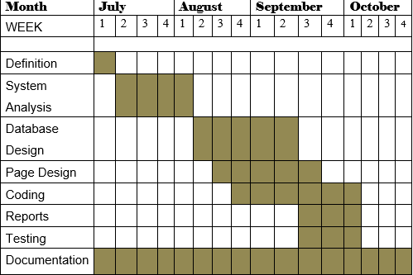
Timeline Chart

Slide 6
HARDWARE TOOLS
PROCESSOR : Intel Dual Core
RAM : 2GB
HARD-DISK : 320GB
WINDOWS : WINDOWS XP or later

Slide 7
SOFTWARE TOOLS
FRONT END TOOL : PHP 7.4
BACK END TOOL : MySQL 5.0
OTHER TOOLS : MS Office 2019
Clients Side
Browser : Any HTML 5 Supported Browser

Slide 8
SYSTEM DESIGN

Slide 9
DATA DICTIONARY
1. users (Admin/Client/Freelancer)
Sr.No | Field Name | Type | Size | Constraints | Description
1 | Id | Int | 11 | Primary Key | User id
2 | Name | Varchar | 30 | Not null | User name
3 | Email | Varchar | 30 | Unique key | User email
4 | password | Varchar | 128 | Not null | User password
5 | Type | Varchar | 10 | Not Null | User Type
5 | lang | Varchar | 10 | Not null | Programming language
6 | Cv | Varchar | 50 | Not null | Path of resume file
7 | Id_proof | Varchar | 50 | Not null | Path of Id/proof file
5 | date | Time stamp | - | Current timestamp | Date Update Records
Description: - Admin login information.

Slide 10
3. feedbacks
Sr.No | Field Name | Type | Size | Constraints | Description
1 | Fbid | int | 11 | Primary key | Feedback id
2 | Name | Varchar | 30 | Not null | user name
3 | Email | Varchar | 50 | Unique key | user email
4 | Msg | Varchar | 255 | Not null | Feedback message
5 | uid | int | 11 | Null | Foreign Key | Users id or can be null if not logged in
6 | Is_read | Tinyint | 1 | Not null | Msg read or not
7 | date | Time stamp | - | Current timestamp | Feedback Date
Description: - user feedback details.

Slide 11
4. projects
Sr.No | Field Name | Type | Size | Constraints | Description
1 | Pid | Int | 11 | Primary key | Project id
2 | Name | Varchar | 30 | Not null | Project name
3 | Detail | Text | - | Not null | Project detail
4 | catagory | Varchar | 30 | Not null | Project catagory
5 | File | varchar | 255 | Not null | Browse project file
4 | Lang | Varchar | 20 | Not null | programming language
5 | cid | Int | 11 | Not null | foreign key | Client id
6 | Fid | Int | 11 | Not null | foreign key | Freelancer id
7 | Status | Varchar | 20 | Not null | Project status
8 | Cost | Int | 11 | Not null | Project cost
9 | Paid | int | 11 | Not null | Project paid
10 | Date | Time stamp | - | Current timestamp | Project Date
Description: - client post project details.

Slide 12
4. requests
Sr.No | Field Name | Type | Size | Constraints | Description
1 | Rid | Int | 11 | Primary key | Request id
2 | Pid | Int | 11 | Not null | foreign key | Project id
3 | Fid | Int | 11 | Not null | foreign key | Freelancer id
4 | Msg | Varchar | 255 | Not null | Message
5 | Status | Varchar | 20 | Not null | Project status
6 | Date | Time stamp | - | Current timestamp | Project Request date
Description: - freelancer project request details.

Slide 13
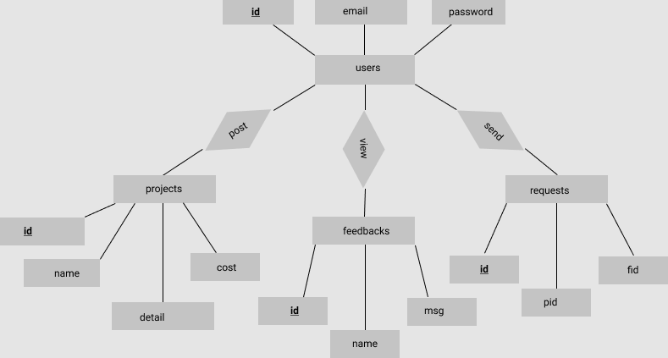
E R DIAGRAM

Slide 14
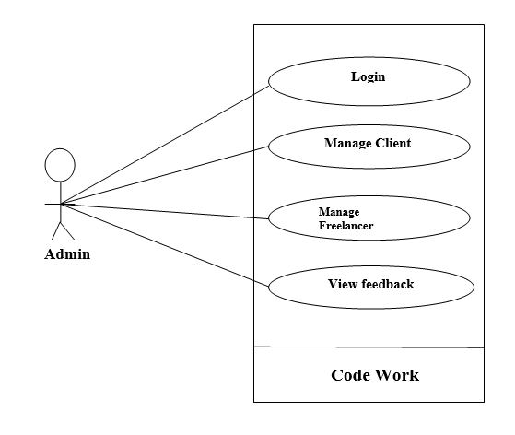
UML Diagram Use case diagram: user-admin

Slide 15
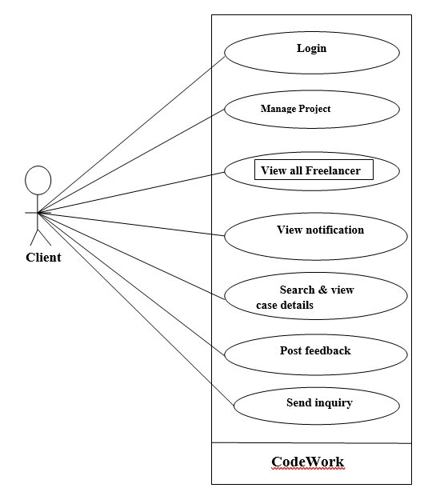
Use case diagram: user-client

Slide 16
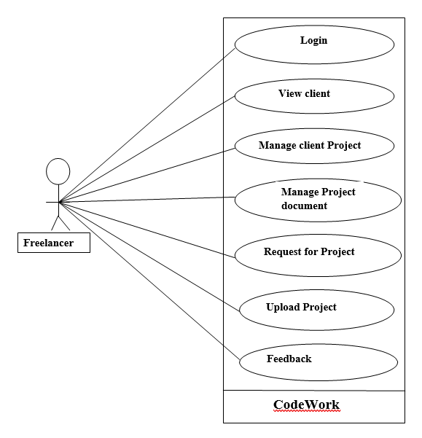
Use case diagram: user-freelancer

Slide 17
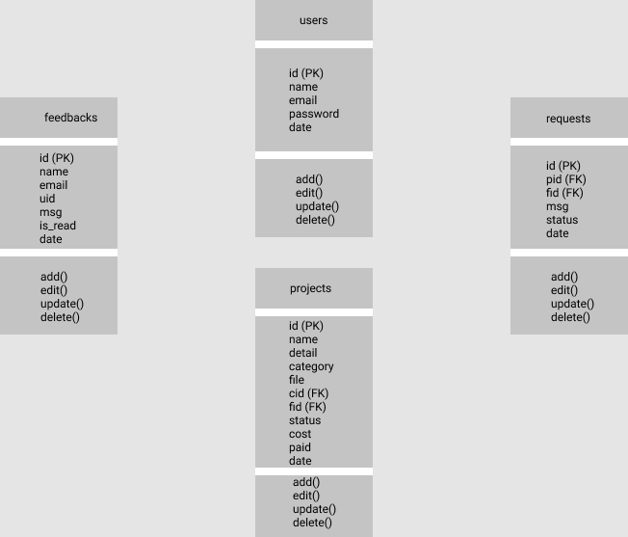
Class Diagram

Slide 18
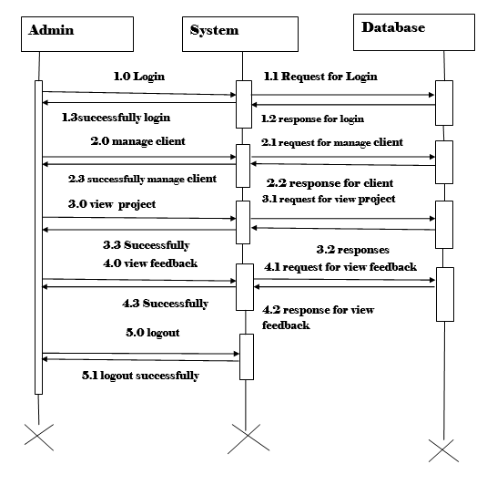
Sequence Diagram: admin

Slide 19
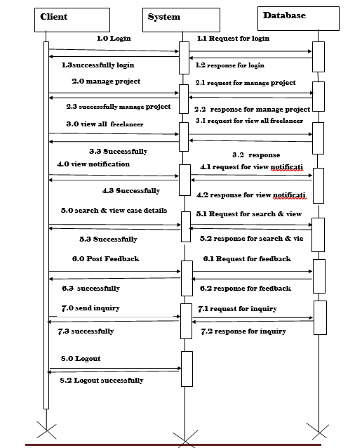
Sequence Diagram: client

Slide 20
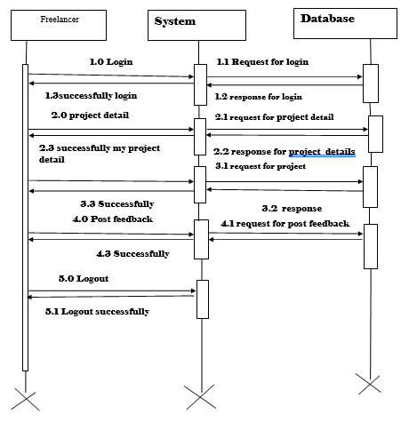
Sequence Diagram: freelancer

Slide 21
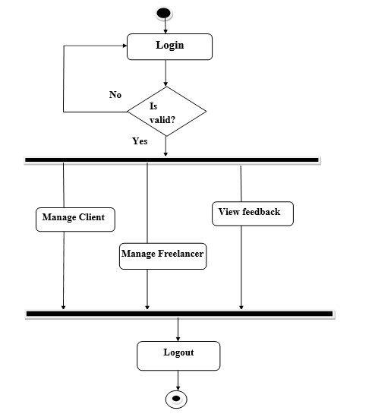
Activity Diagram: admin

Slide 22
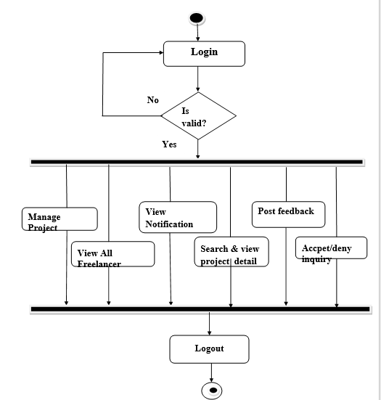
Activity Diagram: client

Slide 23
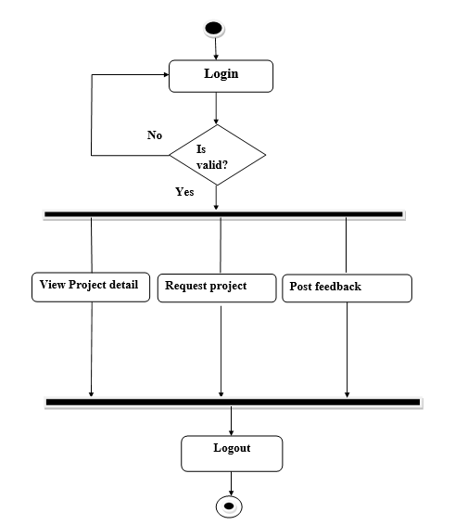
Activity Diagram: freelancer

