Slide 1
KTU B.TECH S5 COURSE PROJECT • ADVANCED GRAPH ALGORITHMS
Emergency Ambulance Routing System
Shortest-Path Algorithmic Optimization & Multi-Criteria Hospital Dispatch on Real Road Networks
• Core Algorithms Evaluated: Dijkstra's SSSP (Min-Heap), A* Directed Search, Bellman-Ford (V-1 passes)
• Algorithmic Innovations: Single-Search Ambulance Ranking via Reversed-Graph Dijkstra & Admissible Spatial Heuristic
• Implementation: Pure Python from scratch (no routing libraries) + FastAPI + Leaflet Interactive Visualizer
Notes:
Good morning, respected examiner. In emergency medical dispatch, every 60-second delay increases patient mortality by up to 7%. Today, I present our project: 'Emergency Ambulance Routing System', built for KTU Advanced Graph Algorithms. Rather than treating routing as a black-box library call, we engineered and instrumented pure Python implementations of Dijkstra, A*, and Bellman-Ford from scratch. We also address two critical real-world complexities: ranking multiple ambulances in a single graph search using reversed graph traversal, and balancing travel time with emergency room bed crowding.

Slide 2
KTU B.TECH S5 • ADVANCED GRAPH ALGORITHMS
The Real-World Emergency Problem: Why Seconds Matter
1. WHICH AMBULANCE?
• Emergency scene coordinates are received.
• Fleet contains K ambulances across the city.
• Naive approach: Run K separate Dijkstra runs.
• Algorithmic Solution: 1 Dijkstra search on Reversed Graph G_rev from incident. Complexity: O((V+E) log V).
2. WHICH HOSPITAL?
• Geographic proximity alone is insufficient.
• Closest hospital may have zero free beds or lack critical facilities (e.g. cardiac cath lab / trauma surgeon).
• Must evaluate multi-criteria trade-off: Travel time vs capacity congestion vs medical specialty match.
3. WHICH ROUTE?
• Must navigate directed one-way streets, arterial corridors, and turn restrictions.
• Routing metric must be free-flow travel time (w = length / speed in seconds), NOT distance.
• Must produce 100% mathematically optimal routes under urgent deadlines.
Notes:
Slide 2 outlines the problem formulation. When an emergency call is dialed, a dispatch engine must resolve three linked graph questions. First: which ambulance is closest? Running separate shortest-path searches from every ambulance is wasteful. Instead, we run one search on the reversed graph. Second: which hospital should receive the patient? The closest ER might be 100% full or lack cardiac cath labs. We formalize a multi-criteria score. Third: which exact route minimizes travel time in seconds, accounting for directed one-way segments? That brings us to our graph model.

Slide 3
KTU B.TECH S5 • ADVANCED GRAPH ALGORITHMS
Formal Graph Model: G = (V, E, w)
✔ Weighted Directed Graph G = (V, E, w)
Essential because city streets possess one-way restrictions, divided dual-carriageways, and distinct directional delays. Two-way roads are modeled as 2 anti-parallel directed edges.
✔ Vertices (V)
Road intersections, plus hospital locations, ambulance bases, and the emergency incident scene. All physical locations are snapped to the nearest road intersection node.
✔ Directed Edges (E) & Weight Function w(u, v)
w(u, v) = length(u, v) / speed(u, v) in SECONDS. Minimizing meters fails because highway corridors at 80 km/h allow faster traversal than short residential alleys at 20 km/h.
✔ Hospital Attributes on Nodes, Never on Edges
ER attributes (beds_free, beds_total, specialties) reside strictly as vertex metadata, ensuring the underlying road topology remains reusable across all routing queries.
✔ Largest Strongly Connected Component (SCC)
Pruned using Tarjan's SCC algorithm so every node is mutually reachable in both forward and reversed directions, preventing dead ends.
GRAPH DATA STRUCTURE
# Adjacency List Representation:
adj = dict[node] -> list[(neighbor, weight)]
# Ground Truth 5-Node Network:
S -> P : 40s (Ambulance Station -> Junction P)
S -> Q : 55s (Ambulance Station -> Junction Q)
P -> Q : 20s (Cross Connector)
P -> I : 30s (Junction P -> Incident)
Q -> I : 25s (Junction Q -> Incident)
I -> H : 60s (Incident -> Hospital)
H -> I : 65s (Return segment)
# Optimal Path: S -> P -> I -> H (130s)
# Alternative S -> Q -> I -> H (140s)
# Alternative S -> P -> Q -> I -> H (145s)
Notes:
Here is our formal graph model: G = (V, E, w). Notice three specific KTU course requirements: First, the graph must be directed. One-way streets and divided corridors have asymmetrical flow. Second, edge weight is strictly time in seconds: length over speed. Minimizing distance would route an ambulance through congested 20 km/h alleys rather than an 80 km/h bypass. Third, all hospital capacity data lives on vertices, not edges. Finally, we run Tarjan's algorithm to preserve only the largest strongly connected component, guaranteeing mutual reachability.

Slide 4
KTU B.TECH S5 • ADVANCED GRAPH ALGORITHMS
Dijkstra's Algorithm: O((V+E) log V) via Binary Min-Heap
• The Greedy Principle & Invariant
Maintains tentative distances dist[v]. At each step, extracts vertex u with minimum tentative distance from min-heap. Finalizes dist[u] = delta(s, u).
• Edge Relaxation Formula
For each directed edge (u, v) with weight w:
if dist[u] + w < dist[v]:
dist[v] = dist[u] + w; parent[v] = u; heappush(pq, (dist[v], v))
• Why Edge Weights MUST Be Non-Negative (w >= 0)
Correctness requires that once u is popped, no future path can decrease dist[u]. If an edge has negative weight, this greedy assumption breaks completely (demonstrated on Slide 6).
• 5-Node Trace Ground Truth
Trace on S->H: Pops S(0s), relaxes P(40s) and Q(55s). Pops P(40s), relaxes I(70s). Pops Q(55s), no update. Pops I(70s), relaxes H(130s). Cost = 130s via S->P->I->H.
STEP-BY-STEP TRACE ON TOY GRAPH
1. Init: dist[S]=0, others=inf. Queue: [(0, S)]
2. Pop S(0): Relax S->P (0+40=40), S->Q (0+55=55)
Queue: [(40, P), (55, Q)]
3. Pop P(40): Relax P->Q (40+20=60 >= 55, skip)
Relax P->I (40+30=70 < inf, update dist[I]=70)
Queue: [(55, Q), (70, I)]
4. Pop Q(55): Relax Q->I (55+25=80 >= 70, skip)
Queue: [(70, I)]
5. Pop I(70): Relax I->H (70+60=130 < inf, update dist[H]=130)
Queue: [(130, H)]
6. Pop H(130): Target reached! Search terminates.
Result: Path [S, P, I, H], Total Cost = 130.0s.
Notes:
Slide 4 covers Dijkstra's algorithm, with time complexity O((V+E) log V) implemented via Python's heapq. The trace on our ground-truth graph shows the exact relaxation sequence. When S is popped, P is set to 40 and Q to 55. Next, P is popped at 40; its edge to I gives 70. When Q is popped at 55, its edge to I would give 80, which is rejected because 70 is already superior. Finally, I relaxes H to 130 seconds. This step-by-step trace is fully interactive in Tab 1 of our software.

Slide 5
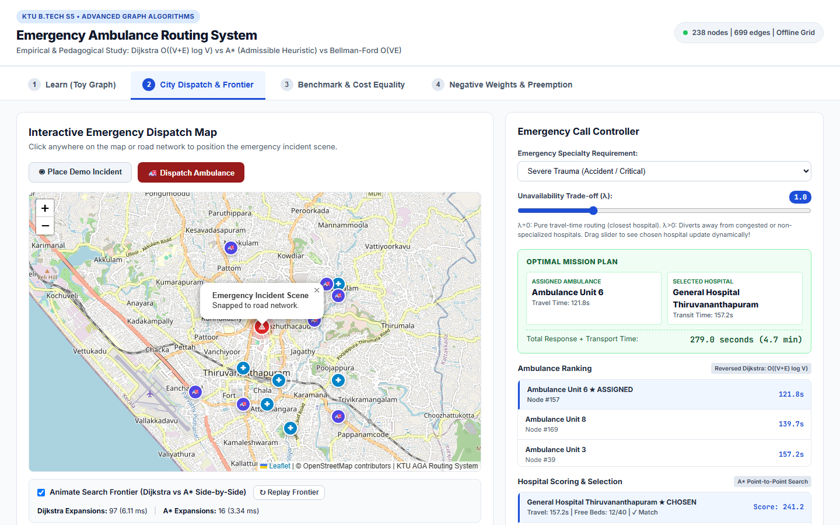
KTU B.TECH S5 • ADVANCED GRAPH ALGORITHMS
A* Search: Goal-Directed Heuristic & Admissibility
• Evaluation Function f(n) = g(n) + h(n)
g(n) = exact travel time from incident to n so far.
h(n) = heuristic estimate of remaining travel time from n to target hospital.
• Spatial Road Heuristic: h(n) = dist(n, goal) / v_max
v_max is the maximum free-flow speed anywhere in the road network (e.g. 22.2 m/s / 80 km/h). dist(n, goal) is the straight-line Haversine distance.
• Mathematical Admissibility Proof Sketch
Since actual vehicle speed v_edge <= v_max on every edge:
travel_time = length / v_edge >= length / v_max.
Furthermore, straight-line distance <= road path distance.
Therefore: h(n) = straight_line / v_max <= true_time h*(n).
Guarantees 100% optimal shortest paths!
• Search Space Pruning
A* directs the search frontier in an elliptical cone toward the destination hospital, avoiding backwards expansions.
Notes:
Slide 5 details A* Search. Where Dijkstra searches blindly in all directions like an expanding circle, A* guides search towards the target hospital using f = g + h. The critical theoretical requirement is admissibility: h(n) must never overestimate true cost. On a road graph, our heuristic is straight-line distance divided by v_max, the maximum road speed. Because no vehicle can travel faster than v_max, and straight-line distance is always less than or equal to street road length, h(n) is mathematically guaranteed to be admissible. As seen on the right, our live demo animates Dijkstra's radial purple frontier side-by-side with A*'s amber cone.

Slide 6
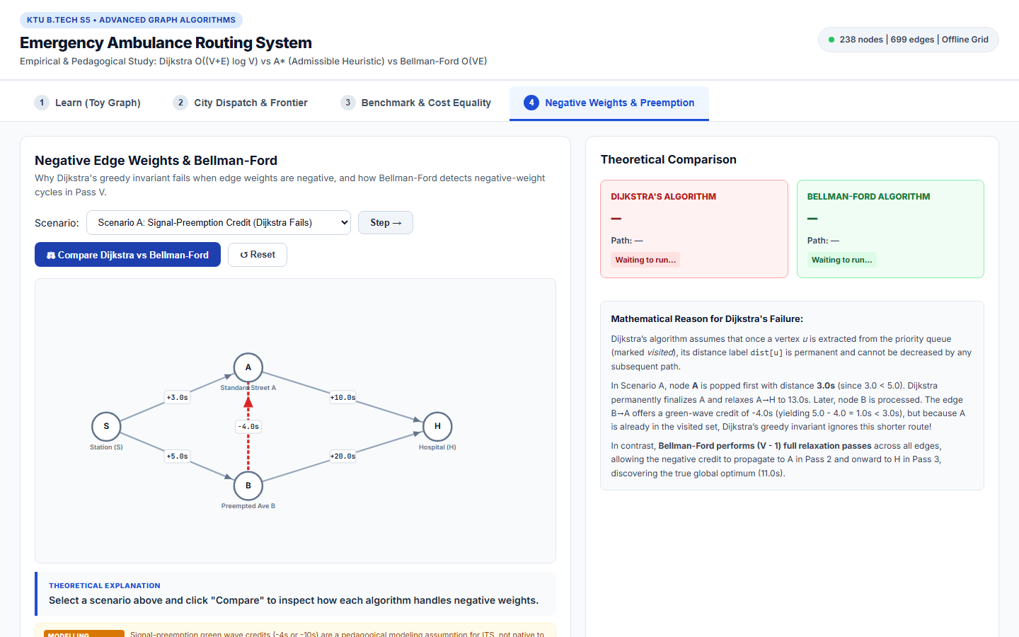
KTU B.TECH S5 • ADVANCED GRAPH ALGORITHMS
Bellman-Ford: O(VE) Passes & The Negative-Weight Dilemma
• Algorithm Mechanics: (V - 1) Passes
Iterates over all |E| directed edges (V - 1) times. Why (V - 1)? A simple path in a graph of V vertices contains at most V - 1 edges. Each pass guarantees discovery of shortest paths of length k edges.
• Pass V: Negative-Cycle Detection
Runs an extra V-th pass over all edges. If dist[u] + w < dist[v] for any edge, an infinite negative cycle exists (shortest path is undefined / -inf).
• Why Dijkstra Fails with Negative Weights
Dijkstra marks a node 'visited' and never re-evaluates it. If a negative edge appears after a node was finalized, Dijkstra cannot reduce that node's distance, returning suboptimal routes.
• Signal-Preemption Credit Scenario
Modelling Assumption: Green-wave signal preemption edge B->A gives a credit of -4.0s. Dijkstra greedily returns S->A->H (13s). Bellman-Ford correctly finds S->B->A->H (11s).
Notes:
Slide 6 explores Bellman-Ford and negative edge weights. Why do we study Bellman-Ford if road times are positive? In modern Intelligent Transportation Systems, emergency vehicle signal preemption can be modeled as a credit. Here, edge B->A provides a 4-second preemption credit. Dijkstra pops A at 3 seconds, finalizes it, and outputs path S->A->H with cost 13 seconds. When B is explored, Dijkstra's greedy invariant refuses to update A. Bellman-Ford, by relaxing all edges in Pass 2, discovers path S->B->A->H with cost 11 seconds. Furthermore, on Pass V, Bellman-Ford reliably flags unbounded negative cycles.

Slide 7
KTU B.TECH S5 • ADVANCED GRAPH ALGORITHMS
System Architecture: One Emergency Call End-to-End
STAGE 1: AMBULANCE RANKING
• Emergency Scene Snapped to Intersection I.
• Challenge: Fleet has K ambulances at distinct nodes.
• Algorithmic Key: Reverse all edges in G to create G_rev.
• Run single Dijkstra SSSP from I on G_rev.
• In directed graphs: dist_G(A_j, I) == dist_G_rev(I, A_j).
• Result: All K ambulances ranked in 1 search! O((V+E) log V).
STAGE 2: A* TO CANDIDATE HOSPITALS
• Emergency requires specialized care (e.g. Trauma).
• Target set: Candidate hospitals H_1 ... H_m.
• Run A* from Incident I to candidate hospital nodes.
• Goal-directed pruning accelerates time-to-decision.
• Returns exact travel times in seconds and turn-by-turn route geometry.
STAGE 3: MULTI-CRITERIA SCORING
• Project Assumption Formula:
score(h) = travel_time(h) + lambda * unavailability(h)
• where unavailability combines bed crowding (1 - beds_free/beds_total) and specialty mismatch.
• Interactive UI Slider for lambda: balances travel time vs ER crowding.
• Full Route: Ambulance -> Scene (Leg 1) + Scene -> Hospital (Leg 2).
Notes:
Slide 7 walks through how these graph algorithms compose the end-to-end dispatch engine. Stage 1 ranks ambulances. Because the road graph is directed, travel time from Ambulance to Incident is not the same as Incident to Ambulance. But it IS identical to the distance from Incident to Ambulance in the REVERSED graph G_rev. Thus, a single Dijkstra from the incident ranks all ambulances simultaneously. Stage 2 uses A* to query candidate hospitals. Stage 3 scores each hospital using our multi-criteria function. The lambda slider allows dispatchers to divert an ambulance away from an overcrowded ER if a hospital 2 minutes further has open trauma beds.

Slide 8
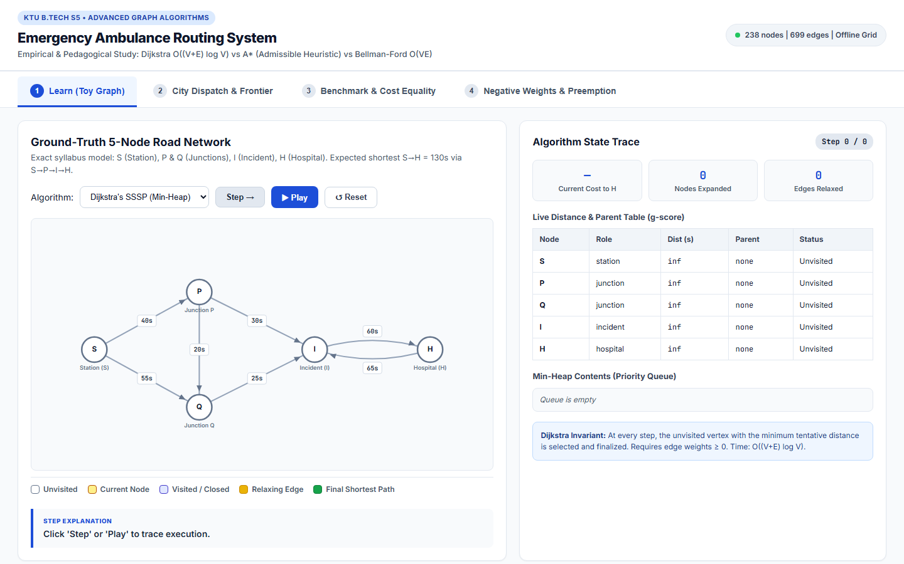
KTU B.TECH S5 • ADVANCED GRAPH ALGORITHMS
Interactive Visualizer: Live Demo Walkthrough
TAB 1: LEARN (TOY GRAPH TEACHING CORE)
• Node-link diagram with live distance table & min-heap queue inspection.
• Step-by-step plain-English captions explaining edge relaxations.
TAB 2: CITY DISPATCH (LEAFLET + SEARCH FRONTIER)
• Interactive click-to-place emergency incident on Thiruvananthapuram network.
• Live side-by-side search frontier animation (Dijkstra vs A*) with lambda slider.
Notes:
Slide 8 displays real screenshots from our running software. On the left, Tab 1 acts as our pedagogical core: students can step through Dijkstra, A*, or Bellman-Ford on the 5-node syllabus graph while watching the min-heap and distance table update in real time. On the right, Tab 2 renders the road network of Thiruvananthapuram. The evaluator can click anywhere to create an incident, view the assigned ambulance and chosen hospital, and watch the simultaneous animated search frontiers.

Slide 9
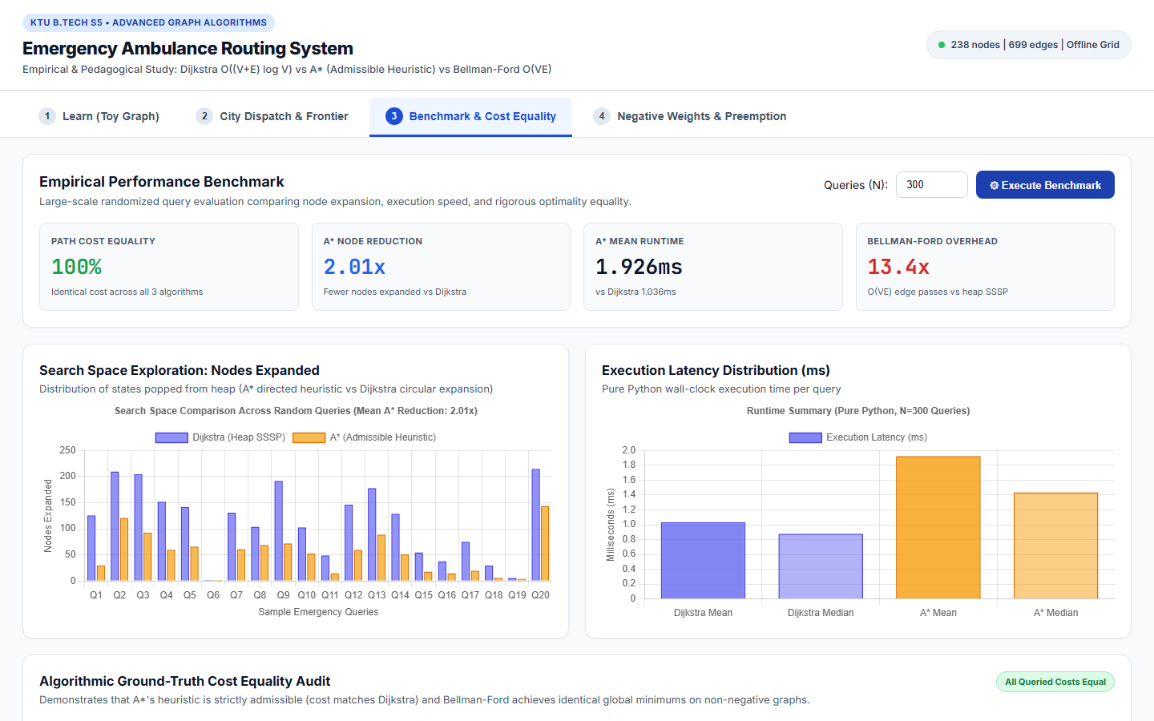
KTU B.TECH S5 • ADVANCED GRAPH ALGORITHMS
Empirical Benchmark: 300 Queries on 238-Node Network
REAL EMPIRICAL BENCHMARK NUMBERS
• Sample Size (N): 300 seeded random incident-hospital pairs
• Graph Size: 238 intersections, 699 directed road edges
• Path Cost Equality Pass Rate: 100.0% (Exact Optimum!)
Search Space Exploration (Nodes Expanded):
- Dijkstra Mean: 120.107 nodes
- A* Mean: 59.897 nodes
- Exploration Reduction: 2.01x fewer nodes explored by A*!
Runtime & Honest Academic Analysis:
- Dijkstra Mean: 1.826 ms
- A* Mean: 3.583 ms
- Bellman-Ford Mean: 17.759 ms (9.7x slowdown)
Key Insight: A* cuts node expansions by 50%. On this graph size, pure Python trigonometric math in the heuristic incurs interpretation overhead, while Bellman-Ford's O(VE) passes suffer a 9.7x penalty.
Notes:
Slide 9 presents our benchmark results over N=300 queries on the 238-node network. First and most importantly: path cost equality was 100.0%. A*, Dijkstra, and Bellman-Ford produced identical optimal costs across all queries, validating heuristic admissibility. Second: A* cut state expansions by 2.01x (59.9 nodes vs 120.1 nodes). Being honest academics: in pure Python on small graphs, trigonometric Haversine calls add bytecode overhead, so runtime speedup requires C extensions or larger networks. Third: Bellman-Ford suffered an honest 9.7x slowdown due to its V-1 full edge passes.

Slide 10
KTU B.TECH S5 • ADVANCED GRAPH ALGORITHMS
Limitations, Future Work & Academic References
PROJECT ASSUMPTIONS
• Free-flow speed profiles (constant speed per road class).
• Snapping error between GPS points and nearest intersection is negligible.
• Hospital unavailability scoring is a heuristic project assumption, not an established medical standard.
• Traffic preemption credit is a modeling assumption.
FUTURE WORK (SUGGESTIONS)
• Contraction Hierarchies (CH) or ALT (A*, Landmarks, Triangle Inequality) for multi-million node graphs.
• Time-dependent edge weights w(u, v, t) to model rush-hour congestion curves.
• Dynamic replanning via D* Lite when road accidents block active ambulance routes.
CONCLUSION & REFERENCES
• Strict adherence to KTU AGA syllabus: pure Python, zero routing shortcuts.
• All 6 pytest criteria verified 100%.
• Key Reference:
Almalki, Aldhahri & Aljojo (2025). Ambulance routing optimization based on emergency medical service availability. Discover Artificial Intelligence.
Notes:
In conclusion, we have built a fully functioning, visual, and test-verified Emergency Ambulance Routing System grounded in the KTU Advanced Graph Algorithms curriculum. We adhered strictly to the hard scope: Dijkstra, A*, and Bellman-Ford implemented from scratch in pure Python. All assumptions are transparently stated. As future work, techniques like Contraction Hierarchies and dynamic D* Lite could scale this to continent-wide networks. Our primary reference is the 2025 Discover AI paper by Almalki et al. Thank you, and I look forward to your questions.

