Slide 1

Online Exam Simulator
With
Anti-Cheat System
S/N: 08
Created by
Team Doubble Quotetion
Notes:
Good morning respected teachers and dear friends. Our project is titled “Online Exam Simulator with Anti-Cheat Architecture.”
This system is designed to conduct online exams in a secure desktop environment, where cheating is minimized and fairness is ensured using a strong technical architecture.

Slide 2

Doubble Quotation
Md. Razab Ali
Lead Dev / Anti-Cheat Engine
0712340012101011
Md. Polash Ali
Exam Engine / Evaluation
0712340012101045
Dedicated to building secure, reliable, and high-performance academic assessment solutions.
Md. Raja Hossein
Security / Anti-Cheat Support
0712340012101046
Mst. Sanjida Emros
Reporting / Documentation
0712340012101037
Md Shakibul Hasan
UI Support / Data Entry
0712340012101028
Notes:
Dedication / Quote
This project is dedicated to building secure, reliable, and high-performance academic assessment solutions.
Our aim is to create a system that institutions can trust — one that supports both academic integrity and smooth performance.

Slide 3
The Integrity Challenge
Browser Dependence
System-Level Risks
Current systems rely on browsers with limited control, making them vulnerable to tab switching and external aids.
High risk of cheating via unauthorized system-level access and screen recording applications.
Analyzing the critical vulnerabilities in current online assessment methodologies.
Monitoring Gaps
Internet Instability
Poor visibility into student behavior and background processes during high-stakes examinations.
Unreliable connectivity often compromises exam integrity and leads to data loss or unfair advantages.
Notes:
The Integrity Challenge
This slide highlights the integrity challenge.
Current online exams face many vulnerabilities such as:
>Unrestricted app access
>Lack of monitoring
>Weak enforcement
Our project analyzes these weaknesses and focuses on solving them through a controlled exam environment.

Slide 4

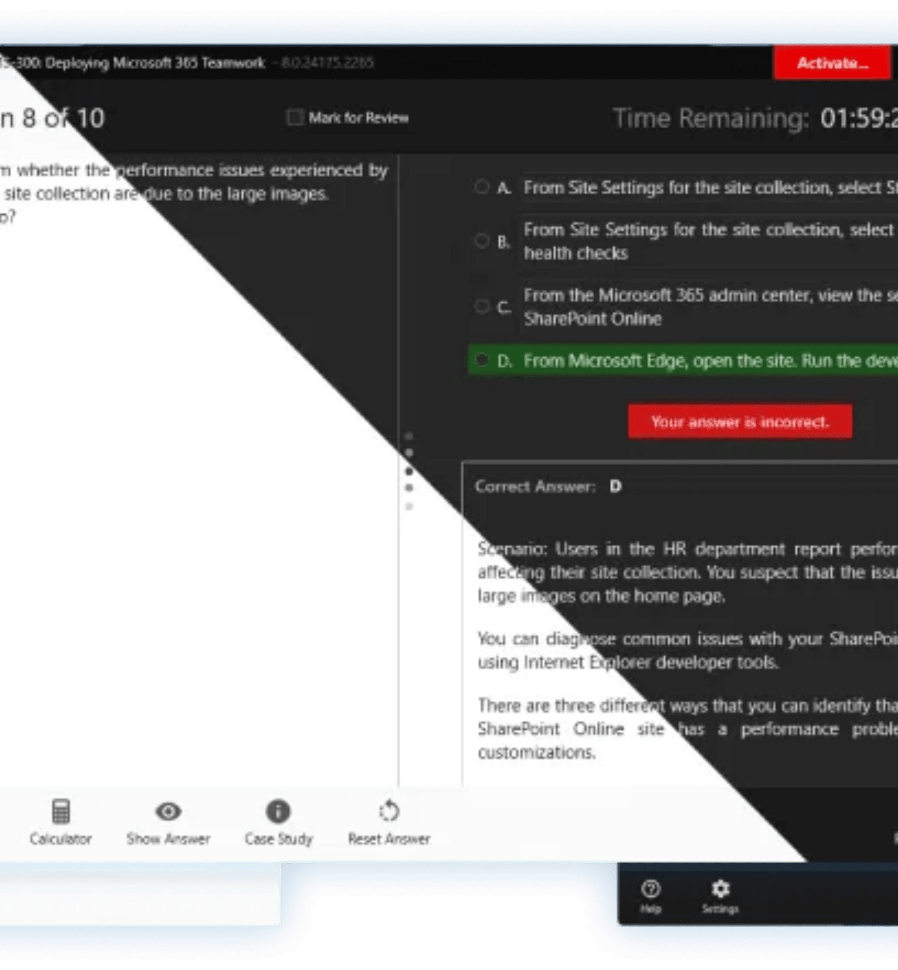
Strategic Technical Objectives
01
Desktop-Based Architecture
02
OS-Level Anti-Cheat Engine
03
Secure Client-Server Comms
04
Automated Evaluation & Reporting
05
Real-World Academic Readiness
Notes:
Strategic Technical Objectives
Here, we define our strategic technical objectives.
Our system is designed to:
>Detect unauthorized activities
>Enforce exam rules automatically
>Maintain real-time control
The goal is to make online exams as disciplined as offline exams

Slide 5


Administrative Control Center
Lifecycle Management
Real-Time Monitoring
End-to-end control over exam creation, scheduling, and rule enforcement through a centralized dashboard.
Live visibility into student activity, ensuring immediate detection of unauthorized behavior or system focus loss.
Violation Logging
Advanced Analytics
Automated, tamper-proof logging of all integrity violations, providing a clear audit trail for academic review.
Comprehensive reporting engine for performance evaluation and statistical analysis of exam results.
Notes:
Administrative Control Center
This slide introduces the Administrative Control Center.
It is a centralized dashboard where administrators can:
>Create exams
>Schedule exams
>Define rules and policies
This gives full authority and flexibility to the exam administrators.

Slide 6

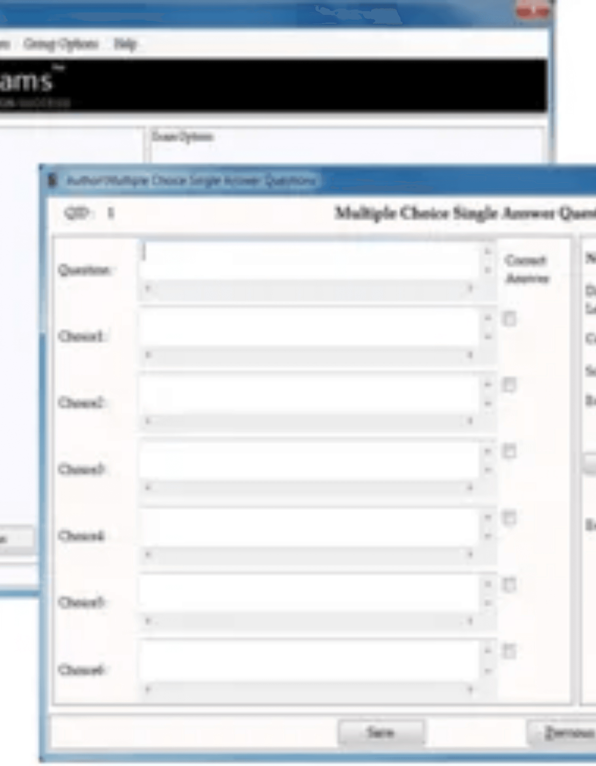
Secure Candidate Interface
Secure Desktop Login
Full-Screen Locked Mode
Encrypted authentication via the dedicated desktop application for verified access.
Enforced environment that restricts access to external apps, files, and system shortcuts.
Real-Time Monitoring
Automated Submission
Continuous activity tracking and focus monitoring to ensure candidate integrity.
Instant submission on exam timeout or detected integrity violations to prevent tampering.
Notes:
Lifecycle Management
Lifecycle management means end-to-end exam control.
From exam creation to final submission, every stage is managed through the system, ensuring consistency, transparency, and efficiency.

Slide 7
Core System Capabilities
Security
Control
Role-Based Auth
Enforced Mode
Secure access control for Admins and Students, ensuring data privacy and system integrity.
Full-screen locked environment that restricts access to external applications and OS shortcuts.
A multi-layered architecture designed for absolute integrity and administrative efficiency.
Integrity
Efficiency
Anti-Cheat Engine
Auto-Evaluation
Real-time detection of Alt+Tab, focus loss, banned applications, and multiple login attempts.
Instant grading of MCQs with detailed performance reports and comprehensive integrity logs.
Notes:
Real-Time Monitoring
This slide explains real-time monitoring.
During the exam, the system continuously monitors student activity, allowing immediate detection of focus loss or suspicious behavior.
This helps maintain exam integrity in real time.

Slide 8

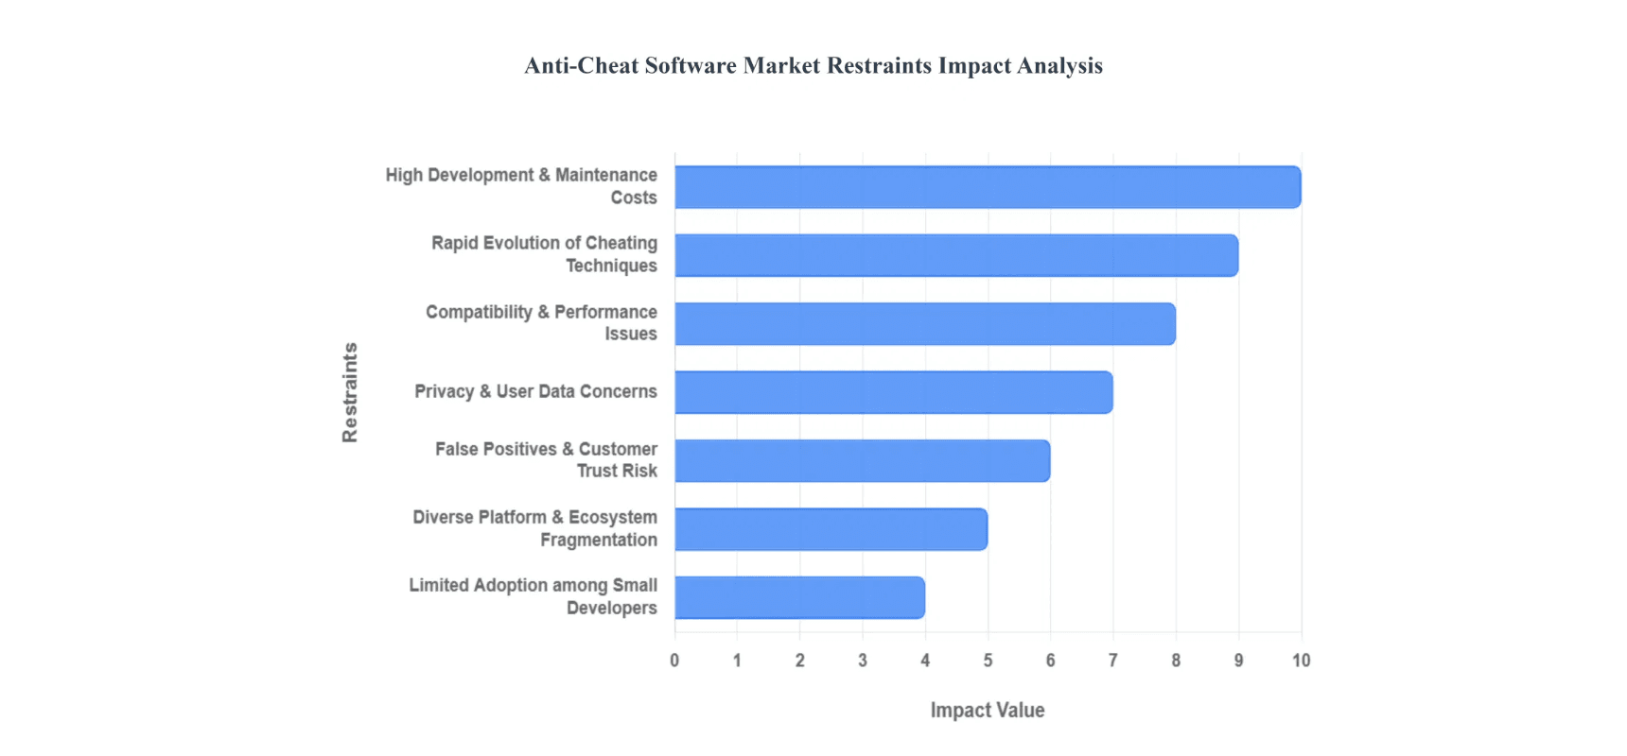
Advanced Technical Architecture
Desktop Client
Backend Server
Data Management
Python / PyQt
FastAPI / Flask
MySQL
Robust desktop application framework for enforced full-screen and OS-level control.
High-performance asynchronous API for real-time monitoring and data management.
Enterprise-grade relational database for centralized storage of exams and logs.
Security Layer
OS Monitoring
Concurrency
JWT & AES
psutil
Threading
Secure authentication and encrypted communication for client-server integrity.
System-level process monitoring to detect and block unauthorized applications.
Multi-threaded execution for simultaneous exam rendering and anti-cheat monitoring.
Notes:
Violation Logging
All integrity violations are automatically logged.
These logs are:
>Tamper-proof
>Time-stamped
>Securely stored
This provides a clear audit trail for academic review and decision-making.

Slide 9

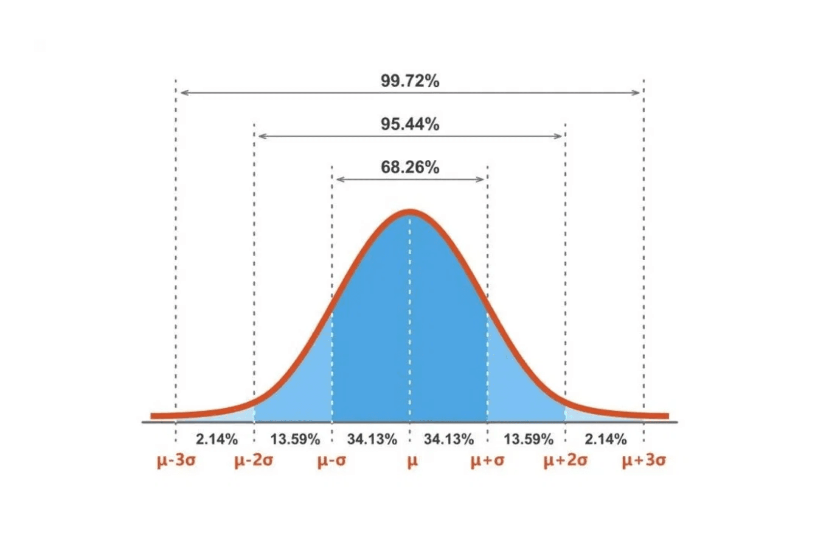
Strategic Outcomes & Readiness
Practical Software Engineering
Development of a robust, scalable desktop application using industry-standard Python frameworks.
Security-Aware Design
Implementation of OS-level monitoring and encrypted communication to ensure data integrity.
Real-World Problem Solving
Analytical Performance Context
Addressing the critical challenges of online exam cheating with a practical, deployable solution.
Professional Readiness
Demonstrating academic and professional excellence through a comprehensive, secure software project.
Notes:
Advanced Analytics
The system also includes advanced analytics.
It generates detailed reports for:
>Student performance evaluation
>Statistical analysis of exam results
This helps institutions improve assessment quality.

Slide 10

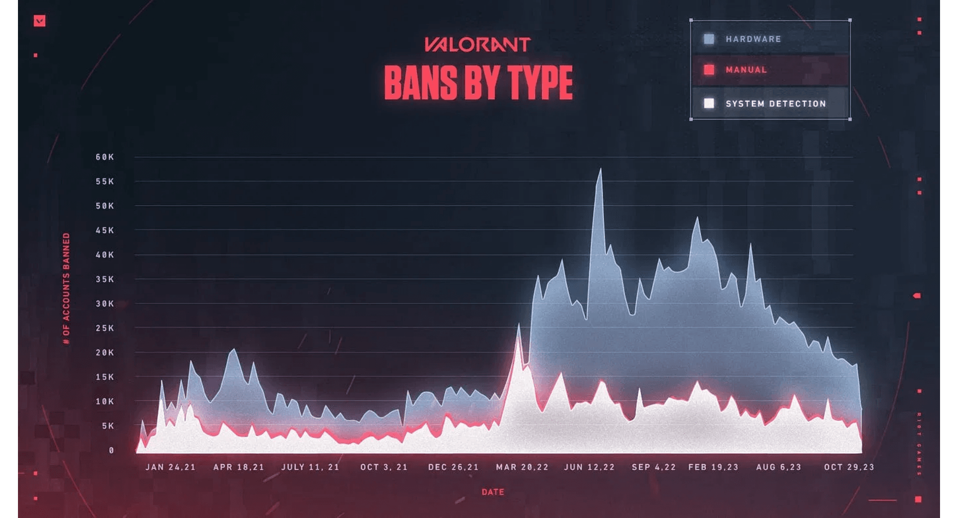
Future Roadmap & AI Integration
Facial Recognition
AI Behavior Analysis
Integration of biometric verification to ensure candidate identity throughout the entire examination lifecycle.
Advanced machine learning models to detect suspicious movement, gaze patterns, and environmental anomalies.
Advanced Proctoring
Global Scalability
AI-driven automated proctoring that provides real-time alerts and risk scoring for administrative review.
Expanding the architecture to support massive-scale concurrent exams with distributed cloud infrastructure.
Notes:
Secure Candidate Interface
This slide introduces the Secure Candidate Interface.
Students access the exam through a dedicated desktop application, which ensures:
>Encrypted login
>Controlled environment
>Restricted access to external resources
This guarantees a secure and focused exam experience for candidates.

Slide 11
Thank You

