Slide 1
Hello & Welcome

Slide 2
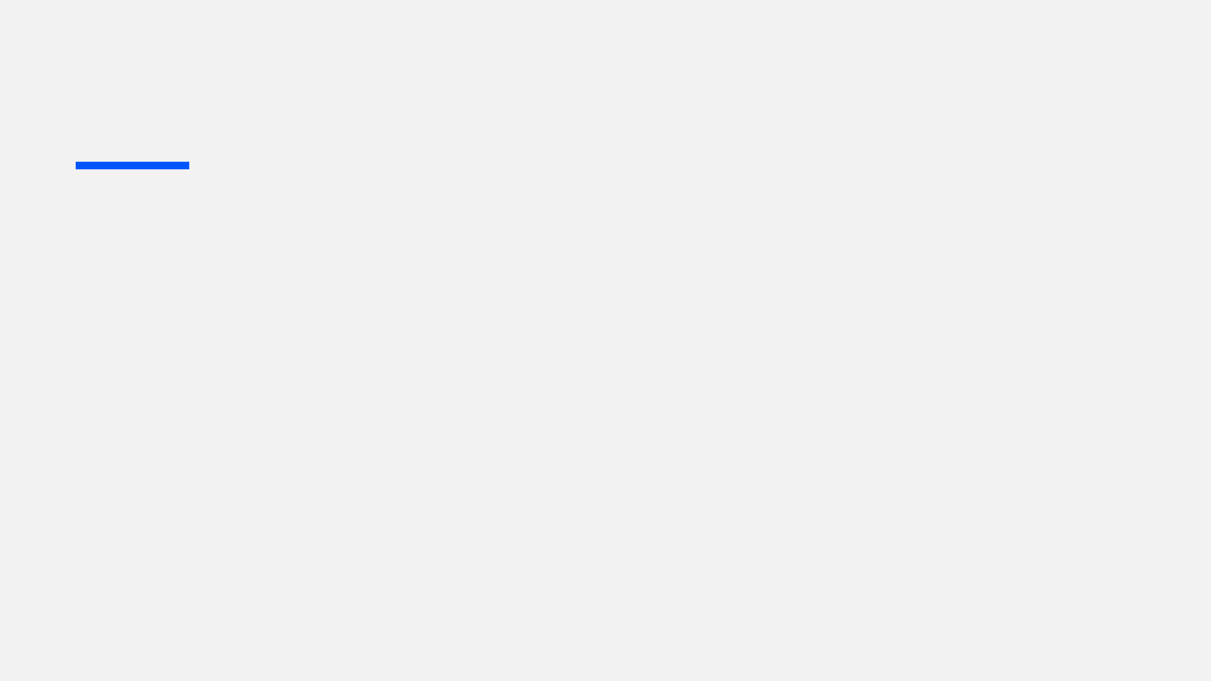

Online Exam
Simulator with Anti-Cheat System
Empowering Academic Integrity Through Innovation
Team "Double Quotation"
Team No: 08
Notes:
Hello everyone! Welcome! We are absolutely thrilled to share our super cool project with you today: the Online Exam Simulator with Anti-Cheat System! We're Team "Double Quotation," and our mission is to make exams fair and, dare I say, a little bit fun!

Slide 3
Razab
Team "Double Quotation"
Ovi
Polash
Team Lead, Backend Dev. & Anti-Cheat Architect
QA & Anti-Cheat Testing Assistant
Sanjida
Desktop Developer (Admin & Student)
Raja
Network & Security Specialist
Docs, Diagrams & Presentation Lead
Notes:
Now, let me introduce you to the incredible minds behind this innovation. This is our amazing Team "Double Quotation"! Each of us brings a unique superpower to the table, from coding wizards to security guardians, ensuring every aspect of our system is top-notch.

Slide 4
System Architecture
Designing the high-level technical blueprint for robust client-server communication and system scalability.
Md. Razab Ali
FastAPI Backend
Developing a high-performance asynchronous server to handle concurrent exam sessions with minimal latency.
Leader, Backend Dev. &
Anti-Cheat Architect
Anti-Cheat Engine
Engineering the core logic that detects unauthorized system calls, background processes, and suspicious behavior.
Database Management
Planning scalable schemas for secure storage of exam data, student logs, and automated evidence collection.
Notes:
Here, you'll see the heart of our project: our System Architecture. Think of it as our secret recipe, carefully crafted to ensure everything runs smoothly, securely, and scales beautifully. It's robust, smart, and ready for anything!

Slide 5
Admin Interface
Creating a robust dashboard for educators to manage exams and monitor live sessions with real-time data visualization.
Md. Polash Ali
Student Environment
Building a secure, distraction-free interface using Python (Tkinter/PyQt) that locks down system resources during testing.
Desktop Software Engineer
Integrated Features
Implementing countdown timers, auto-save functions, and intuitive answer submission flows for a seamless user experience.
Cross-Platform Stability
Ensuring consistent performance and security across various Windows desktop environments and hardware configurations.
Notes:
For our wonderful educators, we've designed a special Admin Interface – your command center for managing exams and monitoring everything in real-time. And for students, we've created a super-focused Student Environment, locking down distractions so they can shine!

Slide 6

Secure Communication
Session Management
Designing encrypted API request handling to prevent data interception and man-in-the-middle attacks.
Implementing token-based authentication and advanced session control to maintain secure user states.
Md. Raja Hossein
Network Resilience
Data Integrity
Network & Security Specialist
Developing "Reconnect & Resume" logic to protect student progress during unexpected network outages.
Validating end-to-end security to ensure that exam submissions are authentic and untampered.
Notes:
When it comes to Security, that's our middle name! We've built a fortress around your exam data, ensuring it's super safe and sound. Our system uses encrypted communication, like a secret language, to keep everything private and protected from prying eyes.

Slide 7
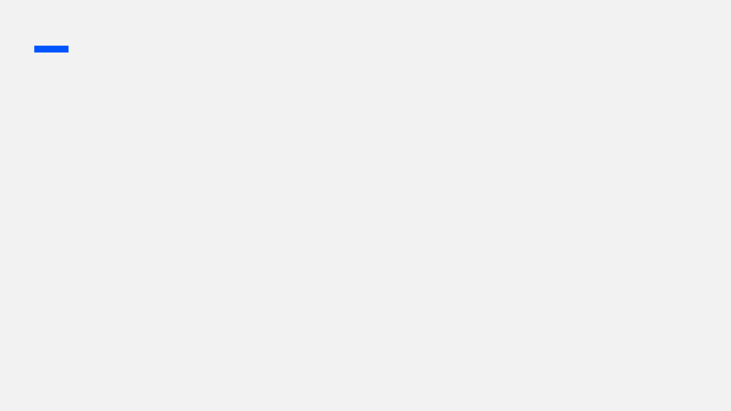
Md. Shakibul Hasan
Simulating "black-hat" tactics like Alt+Tab, browser access, and virtual machines to verify system triggers and security responses.
Anti-Cheat Validation
Rigorous Testing & Quality Assurance
Identifying potential vulnerabilities in low-bandwidth or low-resource environments to ensure platform stability for all users.
Edge Case Analysis
Managing the automated evidence collection system, including encrypted screenshots and system logs for administrative review.
Log Collection
Ensuring the application remains lightweight and responsive while maintaining high-level security monitoring.
Performance Benchmarking
QA/QC
Notes:
We've put our Anti-Cheat System through the wringer! We've tried every sneaky trick in the book to outsmart it, but guess what? It's too clever! It catches all those tricky attempts, making sure exams are fair for every single student.

Slide 8
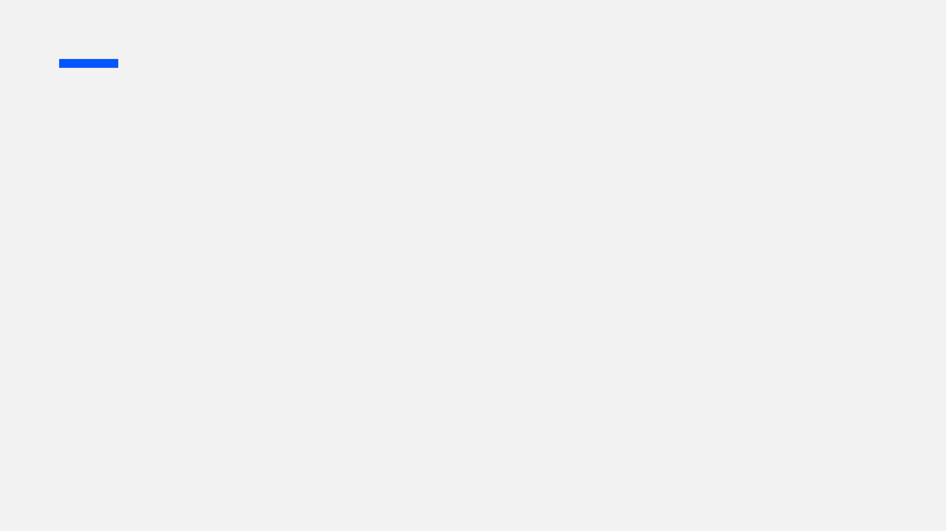
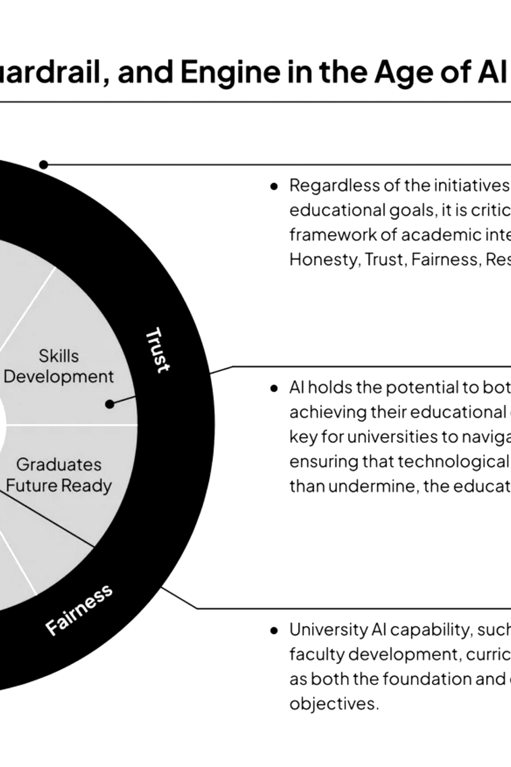
Technical Documentation & Visual Architecture
Mst. Sanjida Emros — Docs & Diagrams Lead
Technical Reporting
Authoring project reports and professional research proposalcomprehensives to ensure technical clarity.
Creating essential visualizations including Data Flow (DFD) and ER Diagrams for system transparency.
Diagrammatic Design
Developing clear, step-by-step guides for both administrators and students to ensure platform accessibility.
User Manuals
Crafting professional materials to communicate complex technical concepts effectively to stakeholders.
Visual Presentation
Notes:
Our Technical Documentation & Visual Architecture is like your friendly guide to our system. We've created clear, easy-to-follow instructions and beautiful diagrams, so understanding how everything works is a breeze!

Slide 9


Advanced Technical Stack
Backend Architecture
Frontend Systems
Security Layer
Python 3.x
for core logic
Tkinter / PyQt
frameworks
Process Lockdown
engine
FastAPI
for async services
Native Desktop
environment
Registry Monitoring
SQL Database
for persistence
Real-time UI
updates
Token Validation
Notes:
Take a peek at our Advanced Technical Stack! We've handpicked the best tools and technologies to power our system. It's like having a super-powered engine under the hood, making sure everything performs perfectly and reliably

Slide 10
Thank You
Team “Double Quotation”
Notes:
Thank you so much for your time and attention! We hope you enjoyed about our project.
Thank You.

