Slide 1
Hello & Welcome

Slide 2


Online Exam
Simulator with Anti-Cheat System
Empowering Academic Integrity Through Innovation
Team "Double Quotation"
Team No: 08
Notes:
Hello everyone, We are Team “Double Quotation”, Today, we are presenting our project: Online Exam Simulator with Anti-Cheat System. Our goal is to ensure fairness and integrity in digital examinations.

Slide 3
Overview:
Generic Phases:
In Development Phase-
Database
Backend
├── Admin Portal
│ ├── Admin Dashboard
│ └── Admin Tools
│
└── Student Portal
└── Exam Selection
Frontend
Definition phase
(Complete)
Development phase
Maintenance phase
Notes:
We already complete Definition phase, and currently we are working in development phase.
In the development phase, we built the core components of our system. This includes the database, backend logic, admin portal, student portal, and frontend interface.

Slide 4
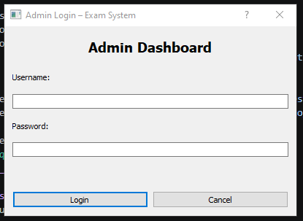
ADMIN PORTAL:
Authentication & Security
Password-protected entry for authorized personnel only.
Dedicated portal ensuring system-wide administrative control.
Clean, efficient interface designed for rapid login workflow.
Notes:
The admin portal provides secure access for administrators. It includes authentication, dashboard monitoring, and full control over exam management.

Slide 5
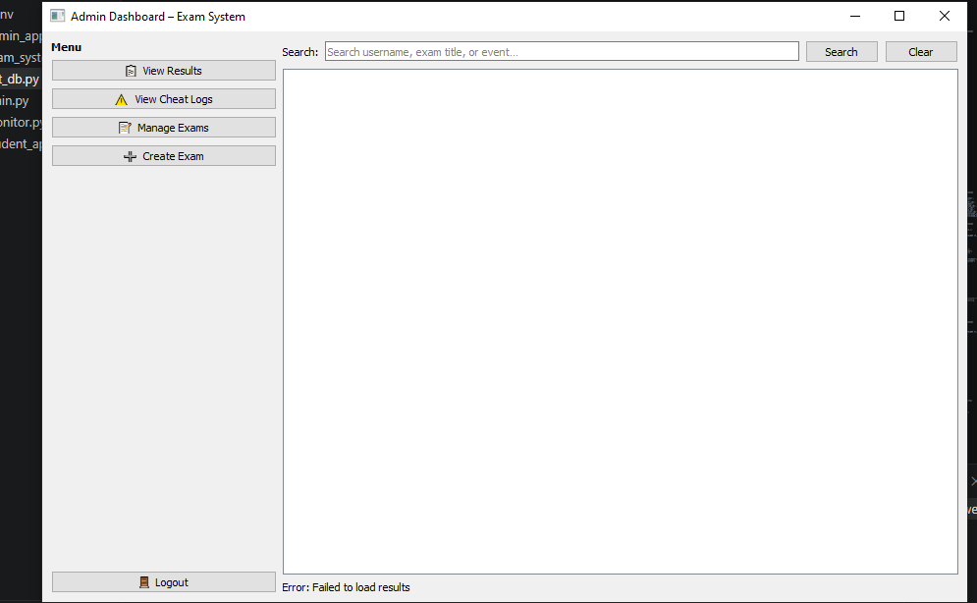



ADMIN DASHBOARD:
Centralized Management
View Results
Analyze student performance metrics and export comprehensive reports for academic review.
View Cheat Logs
Review flagged incidents and security alerts captured by the anti-cheat monitoring system.
Manage & Create
Full control over the lifecycle, from initial creation to final assessment management. examination
Notes:
Admins can view results, analyze student performance, and monitor cheating logs. This helps maintain transparency and control.

Slide 6
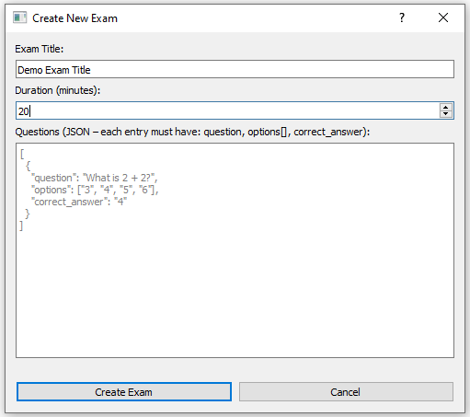


ADMIN TOOLS: EXAM CREATION
Dynamic Content Management
Customization
Administrators can define unique exam titles and set precise time durations (e.g., 20 minutes) to match curriculum requirements.
JSON-Based Questions
Questions are managed in a structured format for easy importing, exporting, and precise answer mapping.
{ "question": "What is 2 + 2?", "options": ["3", "4", "5", "6"], "correct_answer": "4" }
Notes:
Admins can create and customize exams. Questions are stored in JSON format, making them flexible and easy to manage.

Slide 7
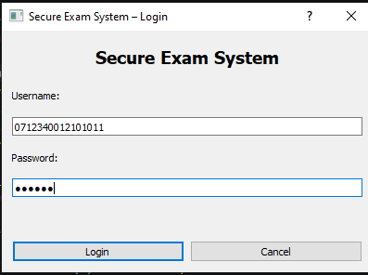
STUDENT PORTAL:
Access & Environment
Login via unique student ID or secure credentials.
Initializes the secure environment for the examination.
Minimalist interface designed to reduce pre-exam anxiety.
Notes:
Students can log in securely and access their assigned exams. The interface is simple and designed to reduce stress.

Slide 8
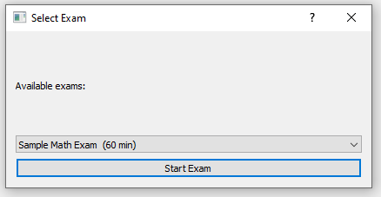
STUDENT PORTAL: EXAM SELECTION
Session Initialization
Dynamic listing of all active exams assigned to the student.
Clear display of exam duration to ensure correct session selection.
Action-oriented "Start Exam" trigger to begin the assessment.

Slide 9
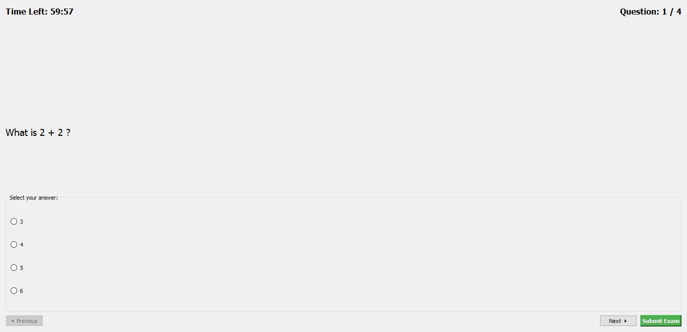
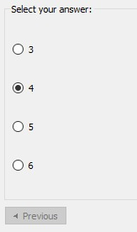
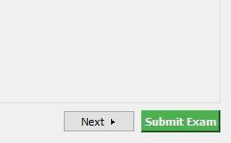
INTERACTIVE EXAM INTERFACE:
Real-time Monitoring
Time Management: Prominent countdown timer helps students pace themselves effectively.
Progress Tracking: Clear indication of current question position (e.g., "Question 1 / 4").
Integrity Monitoring: Background checks for suspicious activity while the exam window is active.
Notes:
During the exam, students can see a timer and their progress. The system ensures smooth and interactive experience.

Slide 10
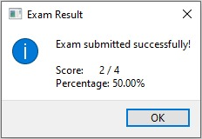

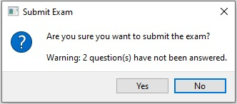

RESULTS & SUBMISSION SAFETY
Feedback & Safeguards
Instant Feedback
Students receive their score and percentage immediately upon completion, providing transparency and reducing wait times.
Submission Safeguards
Confirmation prompts prevent accidental submissions, while unanswered alerts warn students before they finalize their test.
Notes:
After submit the exam, system show the score and percentage of the submitted exam.

Slide 11
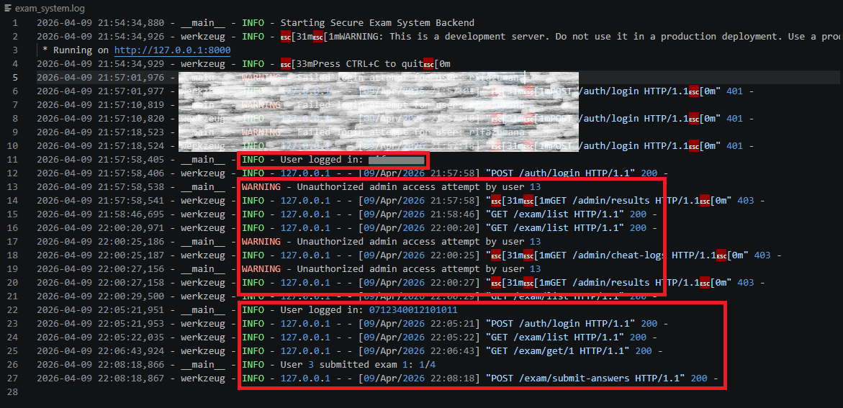
LOG FILE:
Notes:
In log file, system store all activity of user

Slide 12
Backend Architecture:
Framework: Flask
Chosen for its lightweight nature and extensibility, allowing for rapid REST API development.
# Core Backend Configuration
Database: SQLite
from flask import Flask | app = Flask(__name__)
Integrated with custom row factories for high-performance data retrieval and storage.
# Token-based Security def hash_password(password): return hashlib.sha256(password.encode()).hexdigest()
# DB Connection Helper def get_db(): conn = sqlite3.connect(DB_PATH); conn.row_factory = sqlite3.Row; return conn
Security: SHA-256
Implemented robust password hashing and Bearer token-based session management.

Slide 13




Student Interface: Immersive Exam Experience
Full-Screen Environment
Forced full-screen mode using PyQt5 to minimize distractions and prevent unauthorized application switching.
Smart Timer System
PYQT5 DESKTOP APP
Integrated countdown timer with real-time updates and automatic exam submission upon time expiry.
Seamless Navigation
Intuitive previous/next question flow with a persistent progress tracker for optimal time management.
SYSTEM_UI: ACTIVE
RENDER_MODE: FULL_SCREEN

Slide 14




Anti-Cheat System: Multi-Layered Protection
Process Monitoring
Real-time scanning for banned applications: Chrome, Firefox, VS Code, and Telegram.
VIOLATION LOGIC
System Integrity
IF violation_detected:
OS-level detection of Alt+Tab events and screen locking to prevent external resource access.
log_event(event_type)
violation_count += 1
IF violation_count >= 5:
Network Analysis
terminate_exam()
notify_admin(critical)
Monitoring for suspicious external socket connections exceeding predefined thresholds.
AUTOMATED SESSION TERMINATION

Slide 15
Thank You
Building the future of digital education integrity through secure and innovative examination solutions.
Team “Double Quotation”
Notes:
Our system ensures secure, fair, and efficient online examinations.
Thank you for your time and attention! We hope you enjoyed about our project.
Thank You.

