Slide 1


Online Exam
Simulator with Anti-Cheat System
Empowering Academic Integrity Through Innovation
Team "Double Quotation"
Team No: 08
Notes:
Hello everyone, We are Team “Double Quotation”, Today, we are presenting our project: Online Exam Simulator with Anti-Cheat System. Our goal is to ensure fairness and integrity in digital examinations.

Slide 2
MEET THE MINDS — TEAM DOUBLE QUOTATION
Doubble Quotation
Dedicated to building secure, reliable, and high-performance academic assessment solutions.
Md. Razab Ali
Md. Polash Ali
Md. Raja Hossein
0712340012101011
0712340012101045
0712340012101046
Mst. Sanjida Emros
Md Shakibul Hasan
0712340012101037
0712340012101028
OES-ACS | Testing Stage | Team Double Quotation
Notes:
Let me quickly introduce our team. We are five members who worked together on this project — Razab Ali, Polash Ali, Raja Hossein, Sanjida Emros, and Shakibul Hasan. Each of us contributed to building this secure and reliable exam platform.

Slide 3
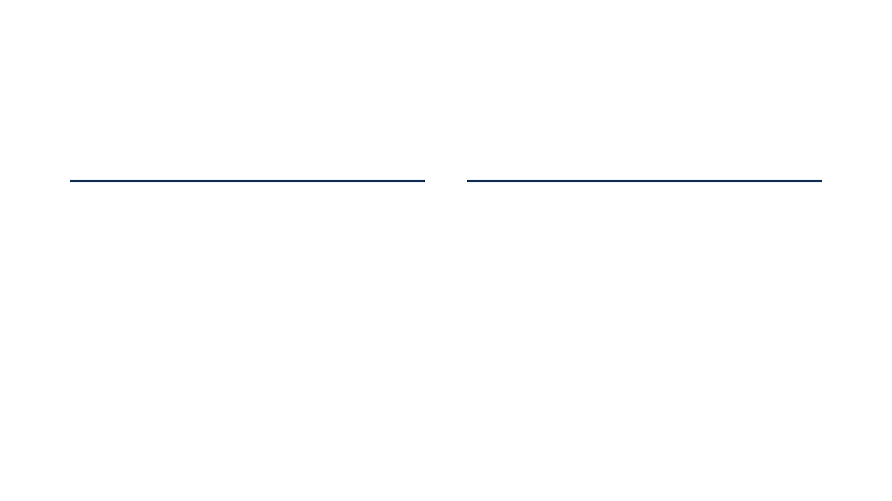
Introduction
SYSTEM OVERVIEW & CORE MISSION
The OES-ACS Platform
Core Objectives
OES-ACS is a robust desktop-based examination software designed to enforce a strictly controlled environment. It bridges the gap between digital convenience and absolute academic integrity.
The platform is engineered to address critical vulnerabilities in traditional browser-based systems, such as unauthorized tab switching, screen recording, and external application access.
"Prioritizing security, reliability, and practical applicability in real-world academic settings."
Notes:
So, what is OES-ACS? Simply put, it is a desktop application that creates a fully controlled exam environment. Unlike browser-based systems, this platform makes it much harder for students to cheat. Our main goal was to combine digital convenience with strong academic integrity.

Slide 4





Motivation
Requirement
THE PROBLEM
THE SOLUTION
A clear requirement emerged for a system that provides a secure, stable, and monitored examination platform.
Limited Control: Browser-based systems provide insufficient control over the local environment.
High Cheating Risk: Ease of access to external apps increases the risk of academic dishonesty.
Ensure fair assessment across all student demographics.
Internet Instability: Connectivity fluctuations can disrupt and compromise exam integrity.
Uphold high academic standards in remote settings.
Provide teachers with reliable monitoring tools.
Notes:
Why did we build this? Because current online exam tools have serious problems. Students can easily switch tabs, use other apps, or lose connection. We needed a solution that is secure, stable, and fair — for both students and teachers. That is exactly what OES-ACS delivers.

Slide 5
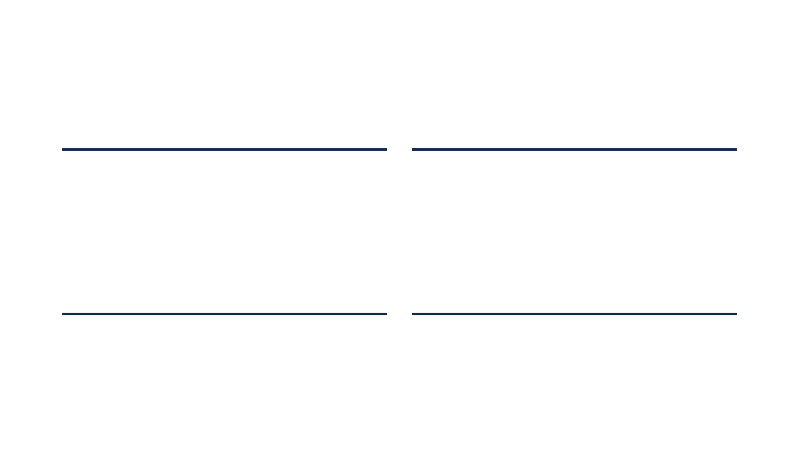




Key Features
THE CORE CAPABILITIES OF OES-ACS
Anti-Cheat Engine
Role-Based Access
Full-screen enforced mode with lockdown logic.
Secure portals for both Teachers and Students.
Shortcut blocking (Alt+Tab, Win key, Esc).
Multiple login detection for identity integrity.
Real-time focus monitoring and violation logging.
Differentiated management and attempt levels.
Dynamic Management
Automated Evaluation
Flexible question banking and subject creation.
Instant grading for Multiple Choice Questions.
Customizable exam formats and timing settings.
Detailed performance reporting for students.
Real-time tracking of active examinations.
Automated generation of violation integrity logs.
Notes:
Our system has four major features. First, the Anti-Cheat Engine — it locks the screen and blocks shortcuts like Alt+Tab. Second, Role-Based Access — separate logins for teachers and students. Third, Dynamic Management — teachers can create exams, set timers, and manage questions easily. Fourth, Automated Evaluation — the system instantly grades MCQs and generates reports.

Slide 6

Workflow & Methodology
THE INCREMENTAL DEVELOPMENT MODEL
Why Incremental?
1. REQUIREMENTS & DESIGN
Defining core exam features and initial anti-cheat logic.
The Incremental Model was chosen to ensure a functional core foundation could be delivered early, while allowing complex security features to be integrated in planned, manageable releases.
2. CORE BUILD
Developing the primary exam engine and UI framework.
3. TESTING & FEEDBACK
This approach facilitated iterative testing and refinement, ensuring each feature was battle-tested before final deployment.
Identifying bugs in anti-cheat and UI scaling.
4. ENHANCEMENT & DEPLOYMENT
Fixing critical issues and polishing the user experience.
Notes:
We followed the Incremental Development Model. This means we built the system step by step — starting with the core exam engine, then adding security features, then testing and fixing, and finally polishing for deployment. This approach let us catch and fix problems early before they became big issues.

Slide 7





Used Technologies
THE TECHNICAL FOUNDATION OF OES-ACS
Frontend
Security & DB
Utilities
SQLite3
Threading
Python Tkinter
Secure Local Data Storage
Non-blocking Background Tasks
UI Framework & Custom Gradients
Win32 API
Keyboard Lib
Responsive Grid
Low-level OS Focus Monitoring
System-wide Shortcut Blocking
Dynamic Layout Management
Hashlib
SHA-256 Password Hashing
PROJECT REPOSITORY
github.com/RZBv2/Team-Double-Quotation
Notes:
For the technical side, we used Python Tkinter for the user interface. The database runs on SQLite3, which stores all exam data locally. For security, we used the Win32 API to monitor focus and Hashlib for password protection with SHA-256 hashing. We also used the Keyboard Library to block system shortcuts. Our code is publicly available on GitHub.

Slide 8





System Walkthrough
VISUAL JOURNEY OF THE OES-ACS ENVIRONMENT
Secure Portal Access
Management Dashboards
Unified login interface with role-based selection for Students and Teachers, ensuring identity verification from the start.
Intuitive control centers for teachers to create exams and students to view their schedules and past performance.
Locked Exam Environment
Real-Time Monitoring
The core student interface: a distraction-free, full-screen environment where all unauthorized system functions are disabled.
Teacher oversight view showing active student status and immediate logging of any detected anti-cheat violations.
* Interfaces built with Python Tkinter featuring custom modern gradients and responsive layouts.
Notes:
Let me walk you through the system. When a user opens the app, they see a login screen where they choose their role — student or teacher. Teachers get a dashboard to create and manage exams. Students enter a full-screen locked environment where all other apps and shortcuts are disabled. Teachers can also monitor students live and see any violation alerts in real time.

Slide 9
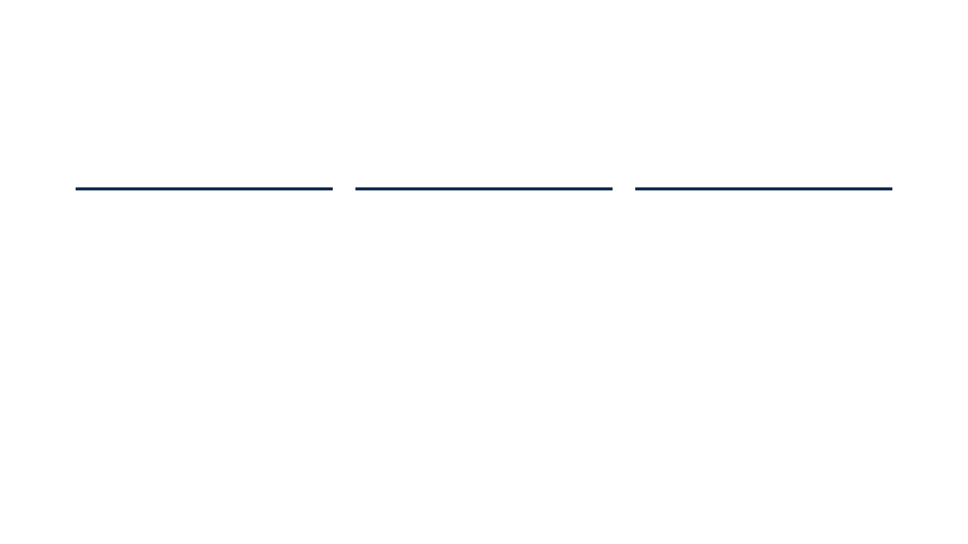




SQA & Testing Strategies
ENSURING INTEGRITY THROUGH RIGOROUS VALIDATION
Unit Testing
Integration
Security
Validation of individual modules including password hashing, database interactions, and anti-cheat detection logic in isolation.
Focused on the critical interaction between the login system, database, and the real-time exam display with anti-cheat monitoring.
Dedicated stress testing of anti-cheat mechanisms to identify and close potential bypasses and system-level vulnerabilities.
Critical Security Fix
"Successfully addressed a high-priority bug where the main anti-cheat system was not functioning correctly, allowing full-screen lock bypass and window switching."
Notes:
We took testing very seriously. We did unit testing on individual features like login and password hashing. We did integration testing to make sure the exam system and database work together smoothly. We also did security testing to find and close any loopholes in the anti-cheat system. In fact, we discovered and fixed a critical bug where students were able to bypass the full-screen lock — that was a major win for us.

Slide 10

Contributions & Roadmap
IMPACT, CONSTRAINTS, AND FUTURE VISION
CONTRIBUTIONS
LIMITATIONS
FUTURE WORK
Robust Proctoring: Built a secure desktop solution with OS-level enforcement.
•
Platform: Currently optimized exclusively for Windows environments.
•
Cross-Platform: Expanding security features to macOS and Linux.
•
AI Integration: Facial recognition and ML-based behavior proctoring.
•
Integrity Focus: Developed a non-bypassable environment for fair assessment.
•
Scalability: SQLite backend is limited for large-scale concurrent use.
•
Cloud Migration: Moving to FastAPI/MySQL for institutional scalability.
Analysis: Relies on rule-based detection rather than AI behavior analysis.
•
•
Automation: Streamlined grading and violation logging for educators.
•
VISION
Bridging the gap between digital convenience and absolute academic integrity.
Notes:
Our key contributions are a secure proctoring system, automated grading, and violation logging. However, we do have limitations — currently it only works on Windows, and the database is not ideal for very large numbers of students. In the future, we plan to add AI-based proctoring, facial recognition, support for macOS and Linux, and move to a cloud-based backend for scalability.

Slide 11




Discussion & Problems
REFLECTIONS ON THE DEVELOPMENT JOURNEY
Critical Reflections
PROBLEMS FACED & SOLVED
The development of OES-ACS proved that low-level system control is the only way to truly secure digital exams. The flexibility of the Incremental Model was vital in managing the complexity of OS-level hooks.
Anti-Cheat Failure: Initially, the system failed to block shortcuts, allowing students to switch windows freely.
UI Scaling Issues: Buttodifferentn sizes and layout alignment were inconsistent across screen resolutions.
We learned that security is not a "set and forget" feature but an iterative process of breaking and fixing until the environment is truly non-bypassable.
The Solution: Implemented low-level Win32 API hooks for keyboard and transitioned to a dynamic grid layout for UI stmonitoringability.
Notes:
During development, we faced two major problems. First, our anti-cheat system wasn't blocking shortcuts properly — students could freely switch windows. Second, the UI looked different across screen sizes. We solved the first problem using low-level Win32 API hooks, and the second by switching to a dynamic grid layout. These challenges taught us that security is not something you set once — it needs continuous testing and improvement.

Slide 12
Thank You
Building the future of digital education integrity through secure and innovative examination solutions.
Team “Double Quotation”
Notes:
And that brings us to the end of our presentation. Thank you all for your attention. OES-ACS is our step toward making digital exams more fair, secure, and trustworthy. We are happy to answer any questions you may have.

