Slide 1
PythonDayTimeProject
A simple batch file and Python script program to display the day and time of a searched place.
By Rajkumar Damor

Slide 2
Overview:
Displays the day and time for any entered place.
Combines a batch file and a Python script.
Runs cleanly without showing a console window.
Simple User Interface and User experience

Slide 3
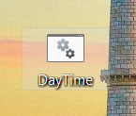
Running the program:
Double-click the "DayTime.bat" file, Ensure the correct path to the Python script is set in the batch file.

Slide 4
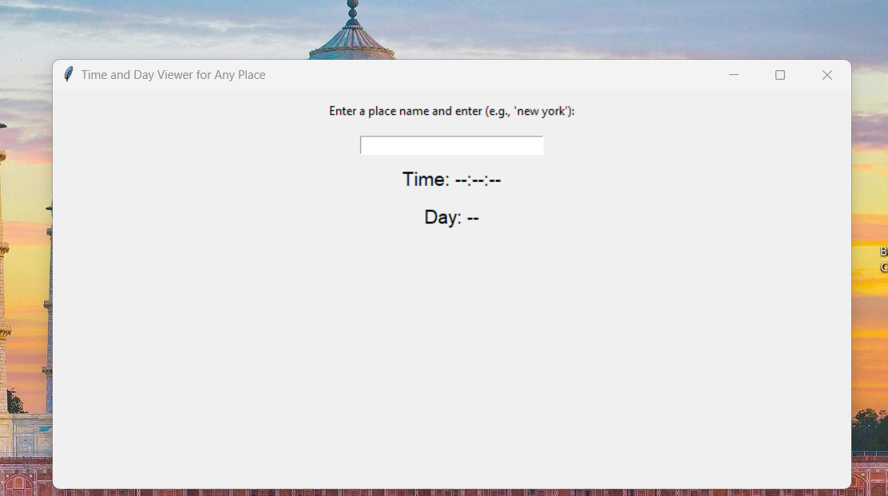
2. Enter the place name in the program, letter case doesn't matters but space matters and hit enter

Slide 5
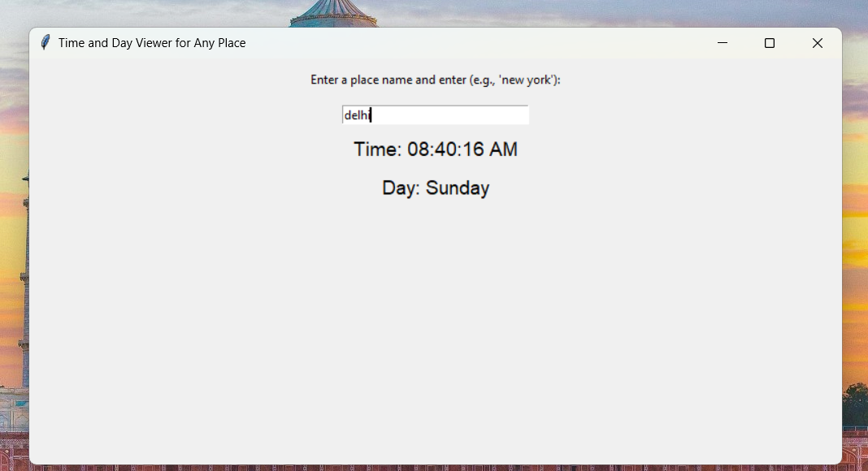
3. It will displays the current day and time of the desired place, in AM or PM and with the name of the day

Slide 6
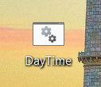
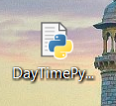
Files in the project:
DayTime.bat: Main file, where by double-clicking it, runs the program. A batch file to run the Python script.
DayTimePython.pyw: A Python script with all the programs and its logic.

Slide 7
DayTime.bat
@echo off: Hides command output.
start pythonw: Runs the Python script in no-console mode, make sure the correct path is set to the python script “DayTimePython.pyw” after the “pythonw” command.
exit: Closes the batch file after execution

Slide 8
DayTimePython.pyw
You type a place, the program figures out where it is, checks the local time and day there, and shows it on the screen.
How it works:
Input: The user types the name of a place (like "New York" or "Tokyo") in a text box and press the enter key
Find Location: The program uses a tool called Nominatim (from the geopy library) to find the location of the place. This gives its latitude and longitude.
Find Timezone: Using the latitude and longitude, the program uses another tool, TimezoneFinder, to find the timezone for that location.
Get Time and Day: Once it has the timezone, the program figures out the current time and day of the week in that location using the datetime library.
Show Results: The program updates the screen to show the time (like 02:30:45 PM) and the day (like Monday) for the entered location.
Error Handling: If the program cannot find the place or timezone (e.g., a typo or invalid name), it shows an error message.

Slide 9
Libraries used:
Tkinter: For the GUI interface.
Geopy: For geocoding place names.
TimezoneFinder: To find timezones.
Pytz: For timezone handling.
Datetime: For formatting and displaying time

Slide 10
Some of the things I learned:
Creating a simple but efficient GUI for the program.
Using external libraries like Geopy, TimezoneFinder, Pytz, and Datetime to fetch and manipulate data.
How to read/understand official documentation of languages and libraries.
Use geocoding to convert place names to coordinates.
Handle time zones and local time using external libraries.
How to handle user input, geocode it, and display results interactively.
Display the results in a simple user-interactive window.

Slide 11
Conclusion
This project helped demonstrate the power of Python libraries and how they can be used together to build useful applications, which here was the program that can tell the current time and day of any place in the world, entered by the user.
I would like to Thanks professor Shoaib for his guidance and support throughout the course. I can see how much effort he put into making the course engaging and valuable for us. It really made a difference for me.

