Slide 1

Approximate Nearest Neighbor Search
Lukas Bosshart
Renato Rao

Slide 2

Good fences make good neighbours
Robert Frost

Slide 3



Agenda
Topic one
Purpose of data structure
Example
Implementation
Future Works

Slide 4

Purpose of data structure
One popular application is in recommender systems, the goal is to find similar rows/columns in matrix. Similar measured by some distance metric,e.g. Euclidean distance.
In the case of Spotify, consider a (m x n)-matrix:
 | Pop Song 1 Rating | Classic Song 2 Rating | Pop Song 3 Rating
User 1 | 5 | 0 | 5
User 2 | 0 | 5 | 0
User 3 | 5 | 0 | 5
Which Users have the same taste in songs?
By calculating Euclidean distances between all users, we can discover similar users and recommend songs to them that they will like.

Slide 5
Purpose of data structure
More formally:
Nearest neighbor search (NNS)
Given a set of S of points in a space M and a query point q ∈ M , find the closest point in S to q
M is mostly a metric space and similarity is defined through a distance metric
Variant in the paper:
k-Nearest neighbor search (k-NN)
approximate (probabilistic) trade-off for better time complexity

Slide 6
Approximate k-NN
Intuition
Construction & INSERTION
The graph is constructed such that is fulfils navigable small-world network properties.
What does that mean:
“The "small-world effect" is the observation that one can find a short chain of acquaintances, often of no more than a handful of individuals, connecting almost any two people on the planet.” [https://arxiv.org/abs/1310.2636]
Graph G(V, E)
Consecutive insertion of Vertices/Points
During insertion of point X we find the approximate nearest neighbors and connect them to point X
Through this we generate long-range and short-range links (short-range links become long-range links with subsequent insertions)

Slide 7
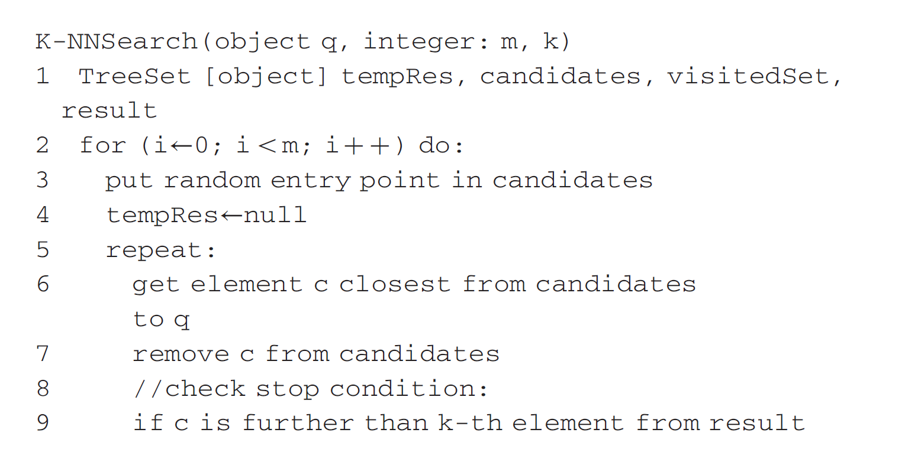
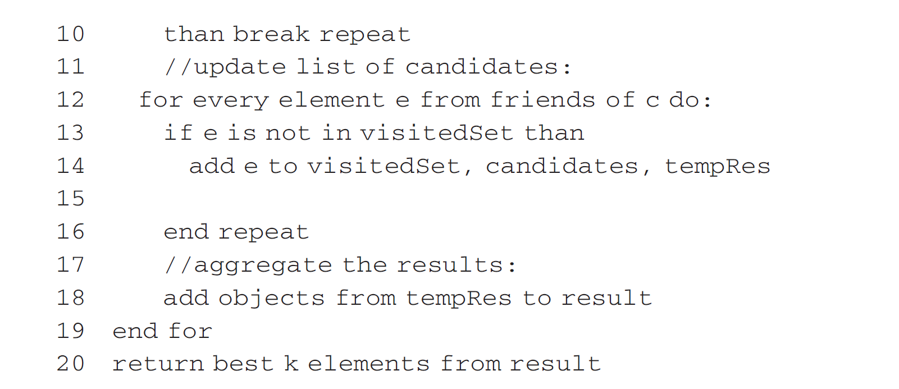
Approximate k-NN
LOOK UP
kNN-Search(point q, integer m)
m denotes the amount of searches
Optimized greedy search
Holds visited points

Slide 8

Implementation

Slide 9
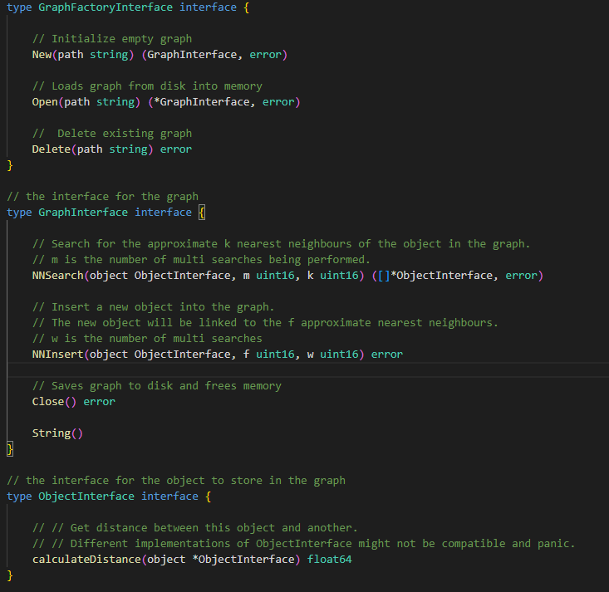
Graph_interfaces.go

Slide 10
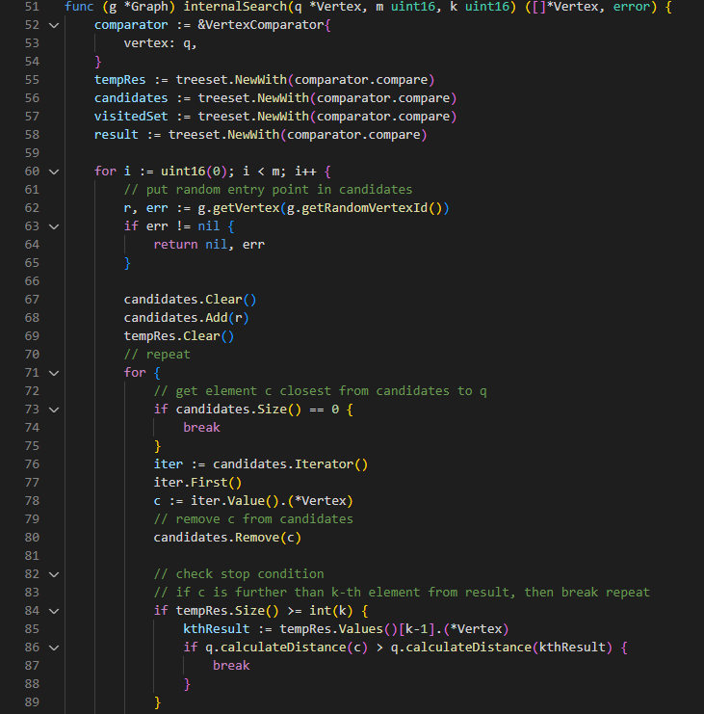
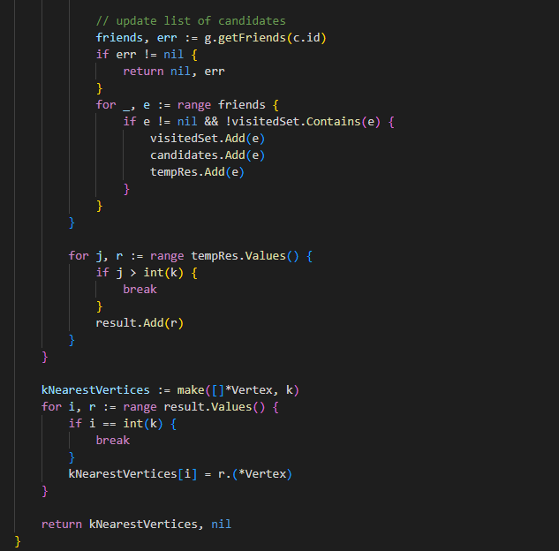
Graph.go

Slide 11
Evaluation
Dataset: 4500 coordinate points (lat,long) in Switzerland
f: Amount of neighbors connected on insertion, w/m : Multi-searches (during insertion and lookup)

Slide 12

Performance
+ High accuracy even with large dimensions. Approximation-Accuracy trade-off very good
- Currently no proper way of swapping graph parts from disk to memory and vice versa (for very large datasets)

Slide 13


Thank You
Let us discuss

Slide 15
Content
Subtitle
Subtitle
Add text, images, art, and videos.
Add transitions, animations, and motion.
Save to OneDrive, to get to your presentations from your computer, tablet, or phone.
Open the Design Ideas pane for instant slide makeovers.
When we have design ideas, we’ll show them to you right there.

