Slide 1

Approximate Nearest Neighbor Search
Lukas Bosshart
Renato Rao

Slide 2

Good fences make good neighbours
Robert Frost

Slide 3



Agenda
Purpose of data structure
Example
Implementation
Evaluation
Performance
Next Steps

Slide 4

Purpose of data structure
One popular application is in recommender systems, the goal is to find similar rows/columns in a matrix. Similarity is measured by some distance metric,e.g. Euclidean distance.
In the case of Spotify, consider a (m x n)-matrix:
 | Pop Song 1 Rating | Classic Song 2 Rating | Pop Song 3 Rating
User 1 | 5 | 0 | 5
User 2 | 0 | 5 | 0
User 3 | 5 | 0 | 5
Which Users have the same taste in songs?
By calculating the Euclidean distances between all users, we can discover similar users and recommend songs to them that they will like.

Slide 5
Purpose of data structure
More formally:
Nearest neighbor search (NNS)
Given a set of S of points in a space M and a query point q ∈ M , find the closest point in S to q [1]
M is mostly a metric space and similarity is defined through a distance metric
Variant in the paper [2]:
k-Nearest neighbor search (k-NN)
approximate (probabilistic) trade-off for better time complexity

Slide 6
Approximate k-NN
Intuition
Construction & INSERTION
The graph is constructed such that it fulfils navigable small-world network properties.
What does that mean:
“The "small-world effect" is the observation that one can find a short chain of acquaintances, often of no more than a handful of individuals, connecting almost any two people on the planet.” [https://arxiv.org/abs/1310.2636]
Graph G(V, E)
Consecutive insertion of Vertices/Points
During insertion of point X we find the approximate nearest neighbors and connect them to point X
Through this we generate long-range and short-range links (short-range links become long-range links with subsequent insertions)

Slide 7
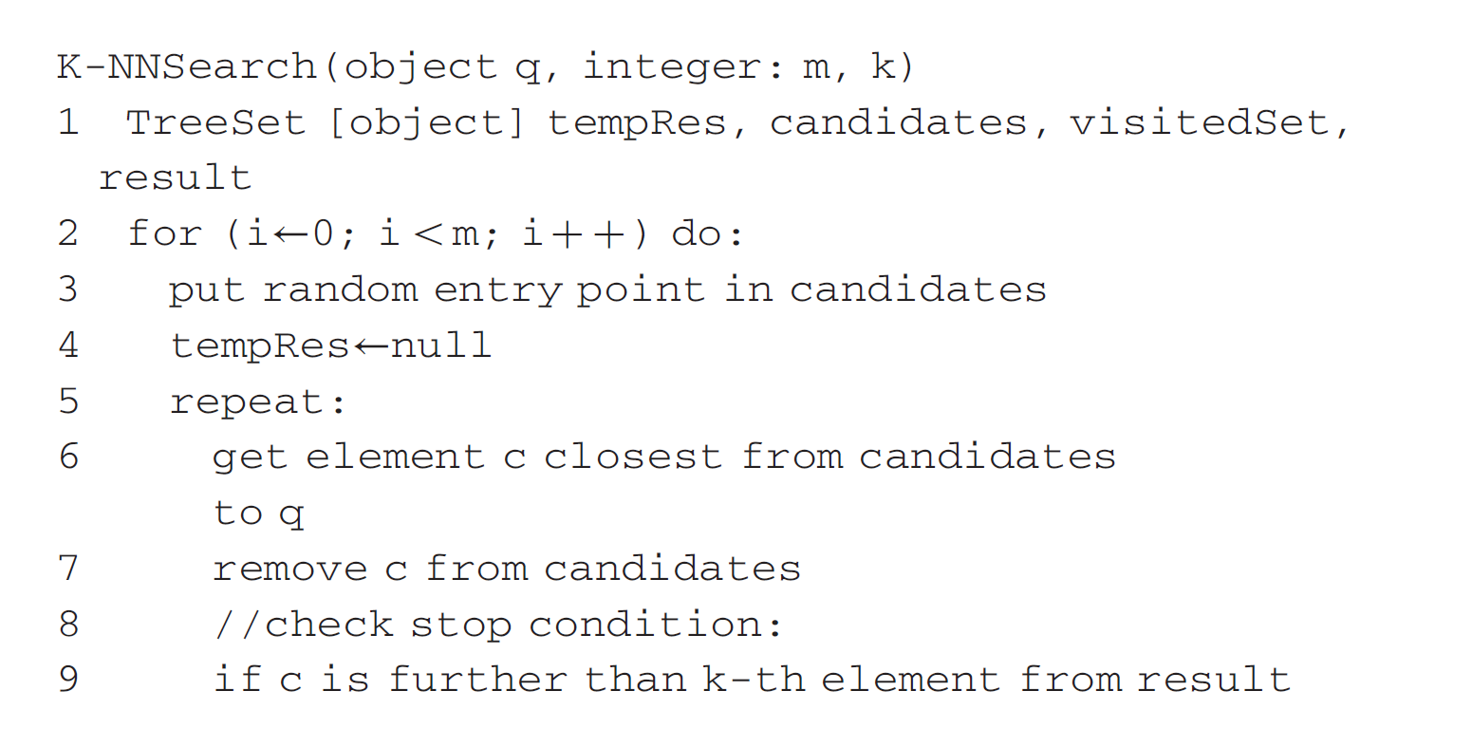
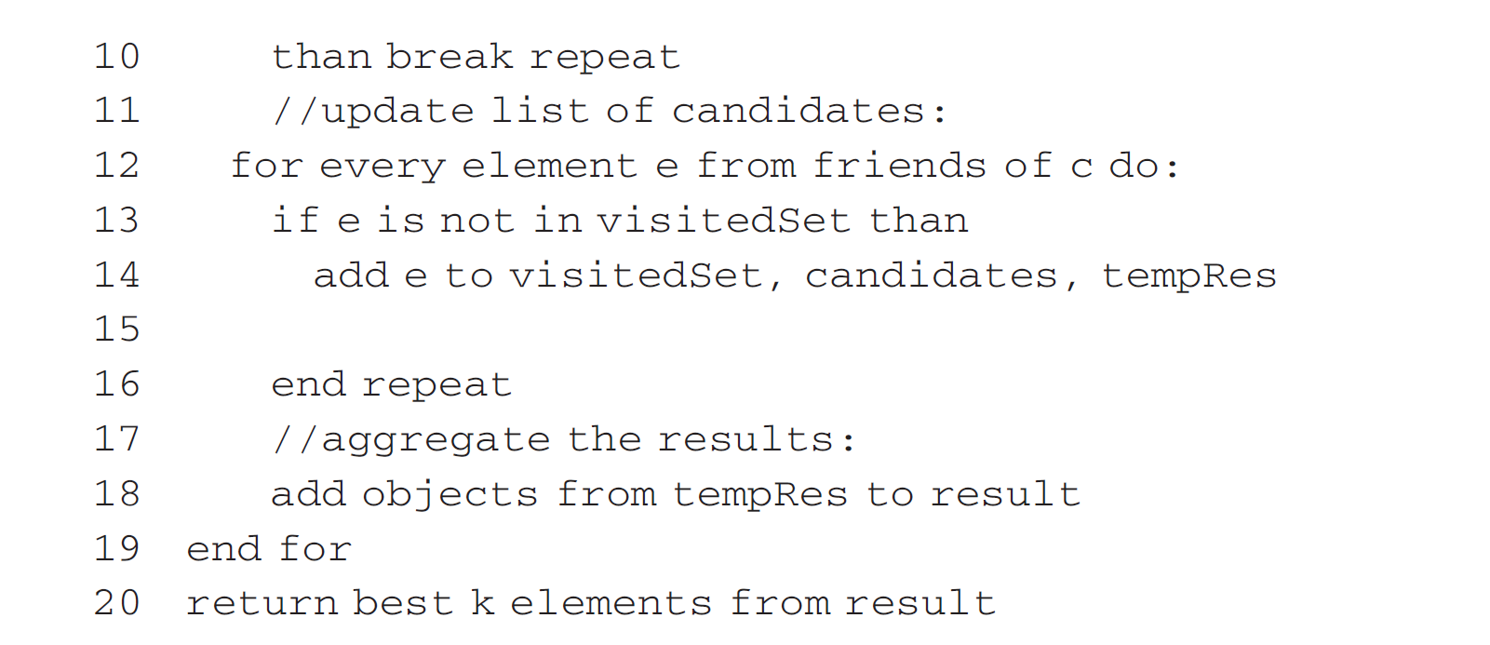
Approximate k-NN
LOOK UP
kNN-Search(point q, integer m)
m denotes the amount of searches
Optimized greedy search
Holds visited points

Slide 8

Implementation

Slide 9
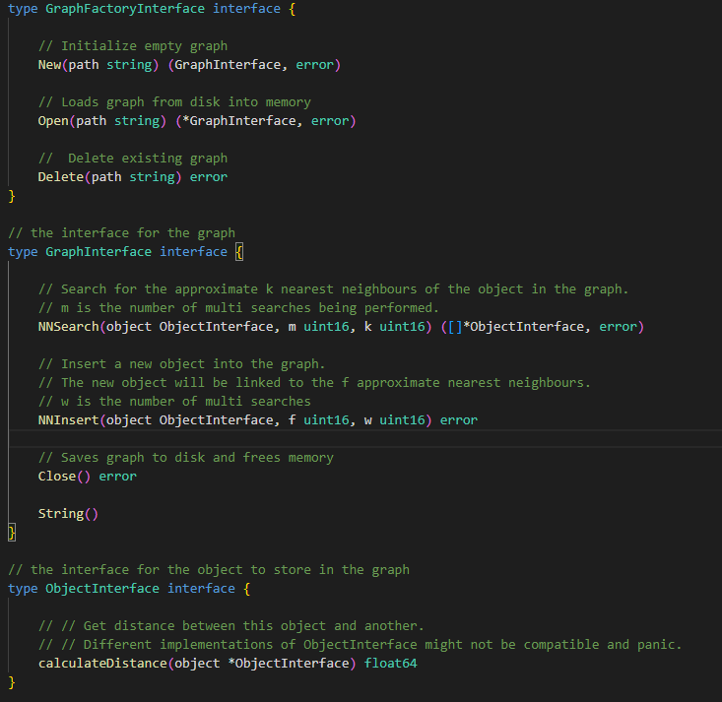
Graph_interfaces.go

Slide 10
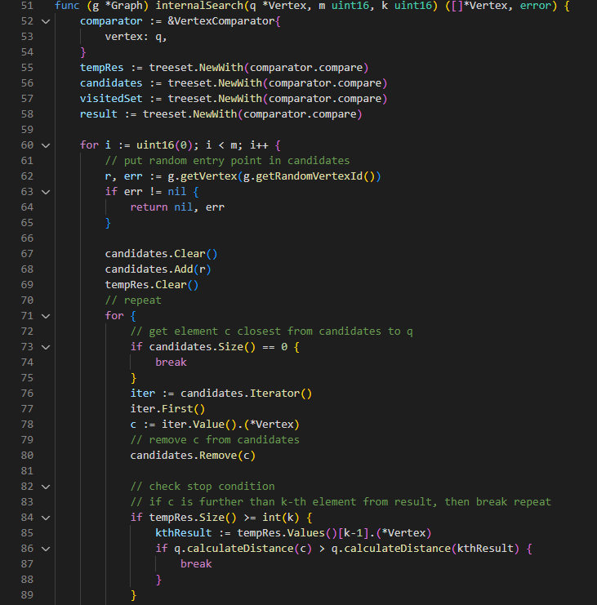
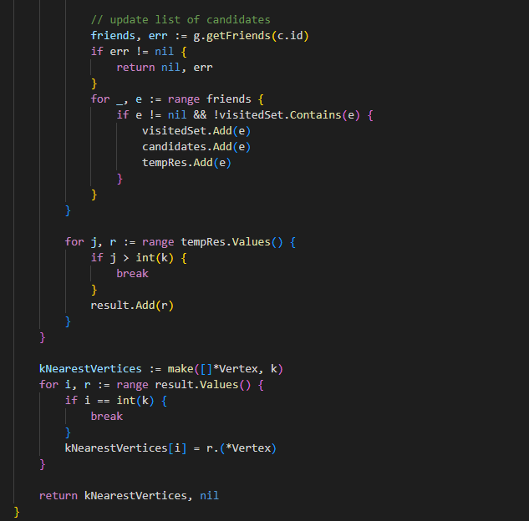
Graph.go

Slide 11
Evaluation
Dataset: 4500 coordinate points (lat,long) in Switzerland
f: Amount of neighbors connected on insertion, w/m : Multi-searches (during insertion and lookup)

Slide 12

Performance
+ High accuracy even with large dimensions. Approximation-Accuracy trade-off very good
+ Runtime (almost) independent of dimensionality
- Currently no proper way of swapping graph parts from disk to memory and vice versa (for very large datasets)

Slide 13
Next steps
Performance/Accuracy improvements
Testing with bigger dataset
Load graph partially from disk

Slide 14


Thank You
Let us discuss
[1] https://en.wikipedia.org/wiki/Nearest_neighbor_search
[2] Y. Malkov, A. Ponomarenko, A. Logvinov, and V. Krylov, ‘Approximate nearest neighbor algorithm based on navigable small world graphs’, Information Systems, vol. 45, pp. 61–68, 2014.

Slide 15
Sources

