Slide 1
App Name
Location
Name:
Submit

Slide 2
Name’s Newsfeed
Pic
Pic
Pic
Pic
Pic
Pic
Pic
Pic
Pic
Pic
Pic
Pic
Pic
Pic
Pic
Upload
Map View

Slide 3
< Newsfeed
Map View
Map

Slide 4
< Newsfeed
Upload
Photo to upload
Title:
Caption:
Take Picture
Browse Photos

Slide 5
< Newsfeed
Pic Title
Photo
Downvote
Upvote
Caption

Slide 6
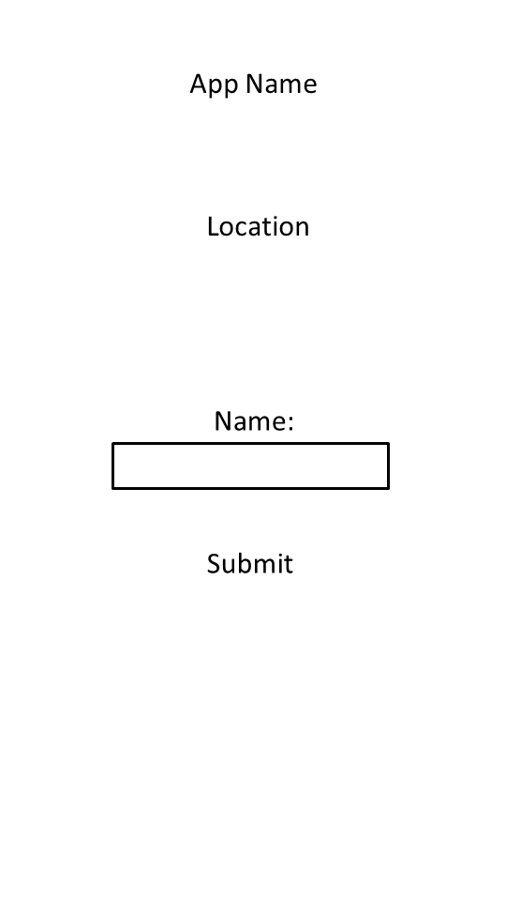
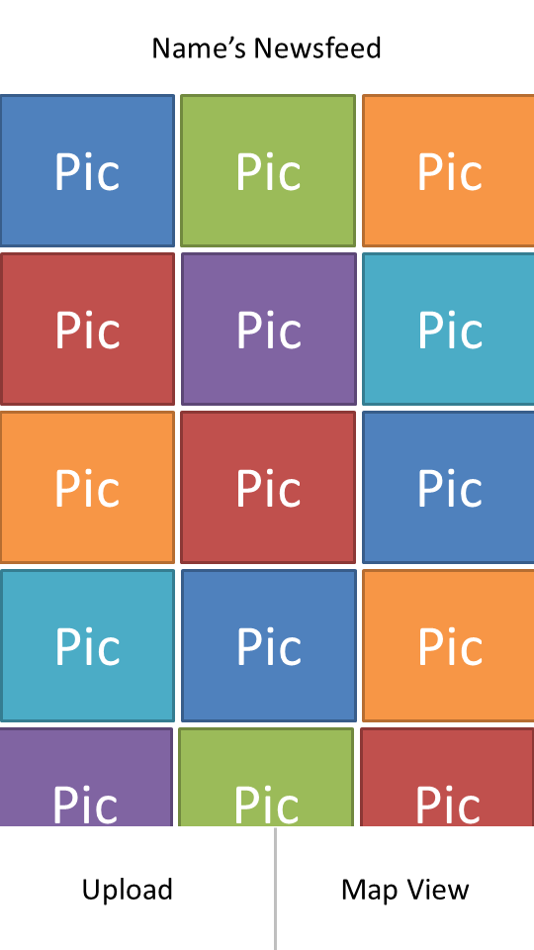
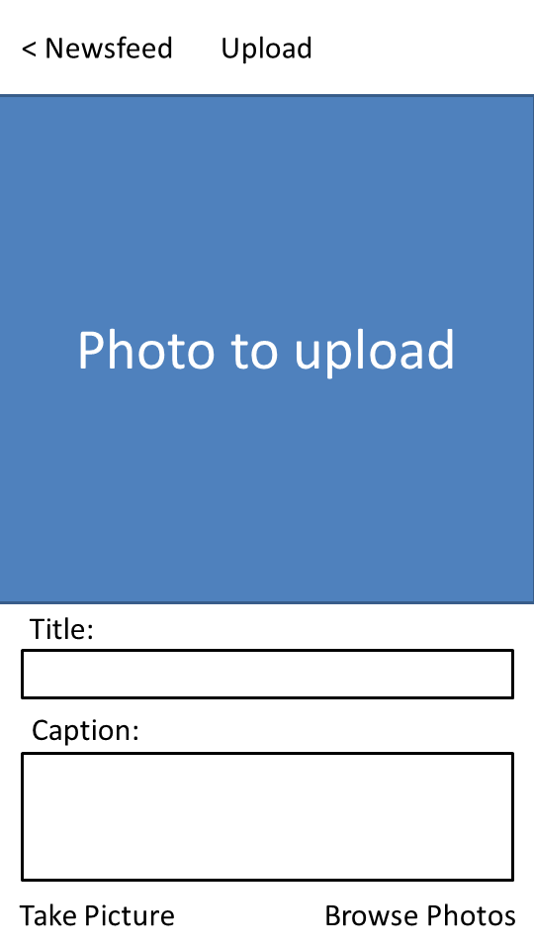
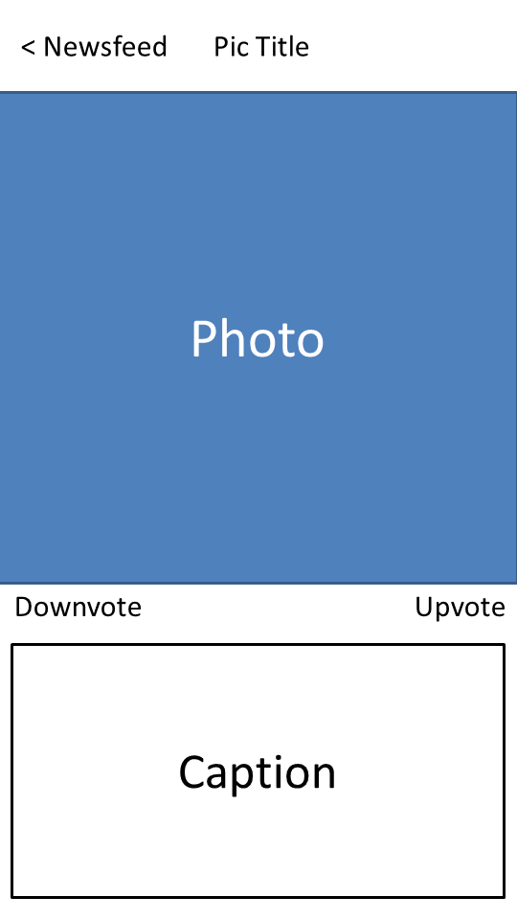

Main menu
Back
Upload photo
Back
Back
Map view
Photo view

