Slide 1
Music Location App
____’s Music Player
See Local Hits
Random Song
Lat: ___
Long: ___

Slide 2
Music Location App
Title
Artist
SoundCloud Logo
Num Votes
Up
Down
Album Cover

Slide 3
Music Location App
0
Song 1
0
3
Song 2
3
0
Song 3
0
1
Song 4
1
3
Song 5
3
2
Song 6
2
10
Song 7
10
4
Song 8
4
11
Song 9
11

Slide 4
Music Location App
Fade in fast track
Pick random song from list (rather than top song)
Add bias to listen history
Back to Song

Slide 5
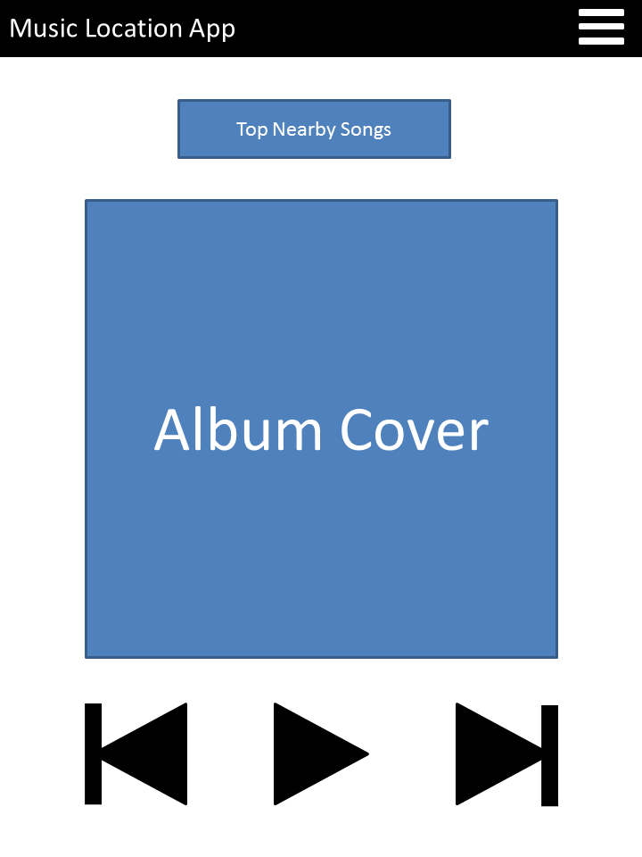
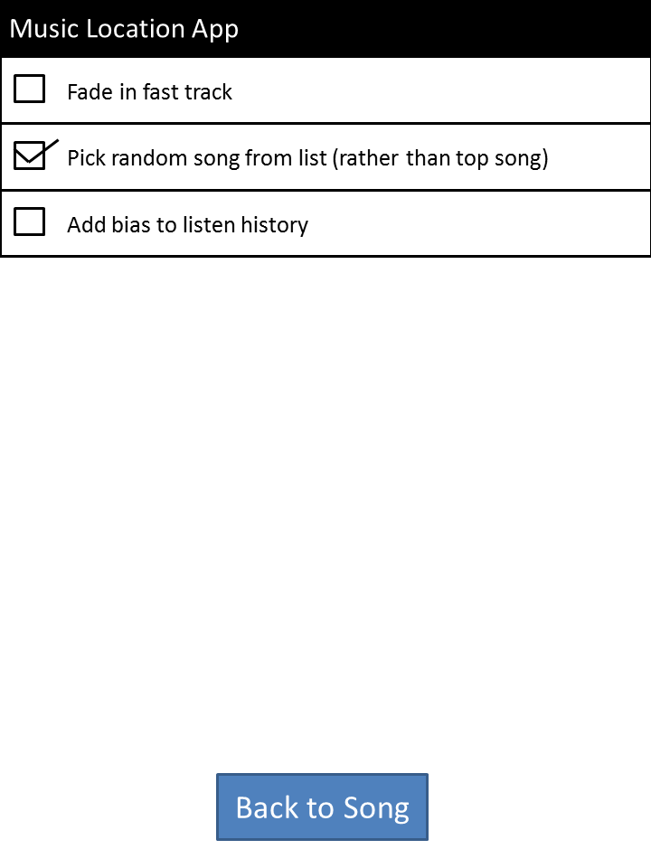
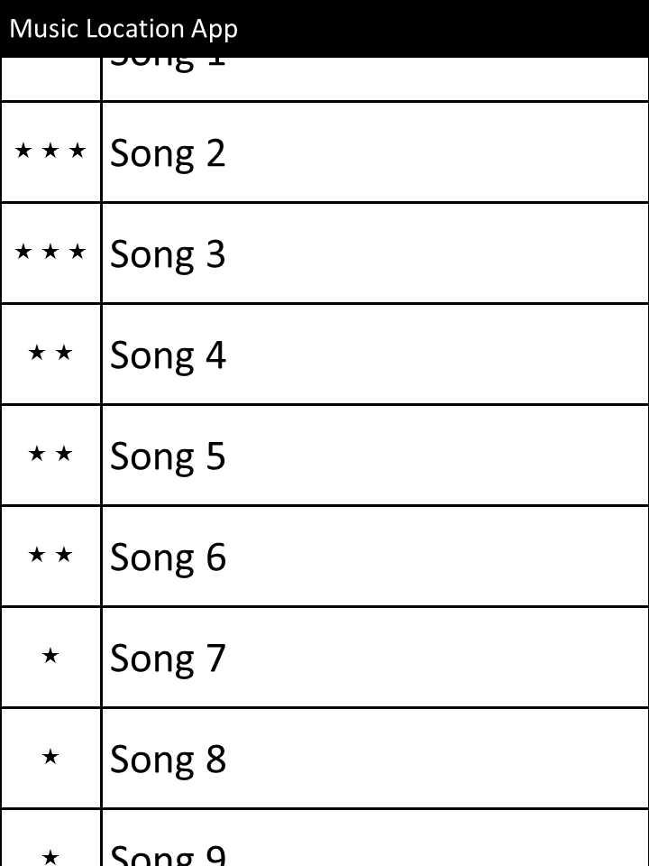
Main Screen
Open Options
See Popular Local Songs
Return to Songs
Choose Song
Options Menu
< Popular Songs List

