Slide 1
Music Location App
Top Nearby Songs
Album Cover

Slide 2
Music Location App
★  
Song 1
★  
Song 2
★  
Song 3
★ 
Song 4
★ 
Song 5
★ 
Song 6
★
Song 7
★
Song 8
★
Song 9

Slide 3
Music Location App
Fade in fast track
Pick random song from list (rather than top song)
Add bias to listen history
Back to Song

Slide 4
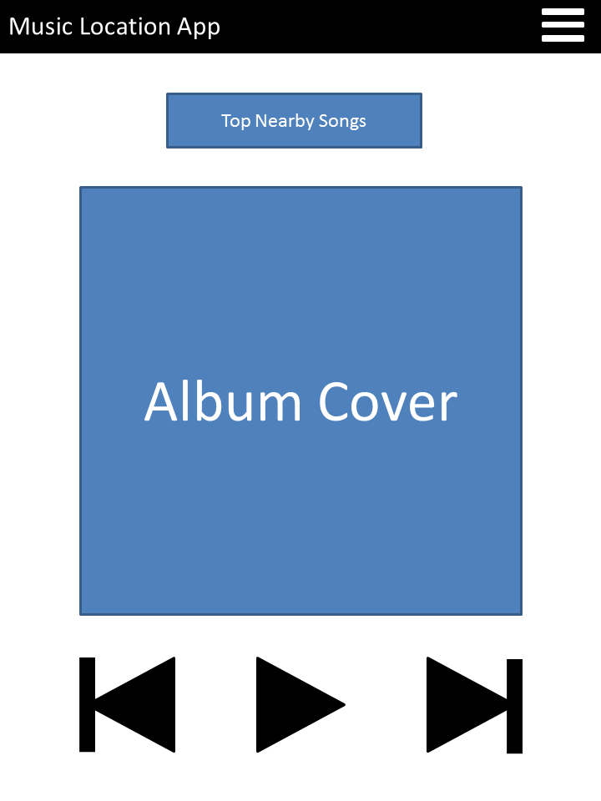
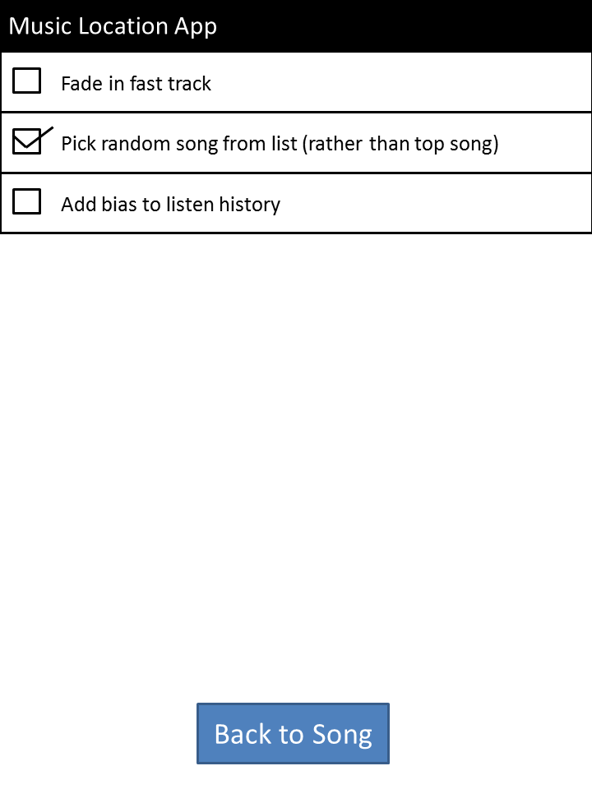
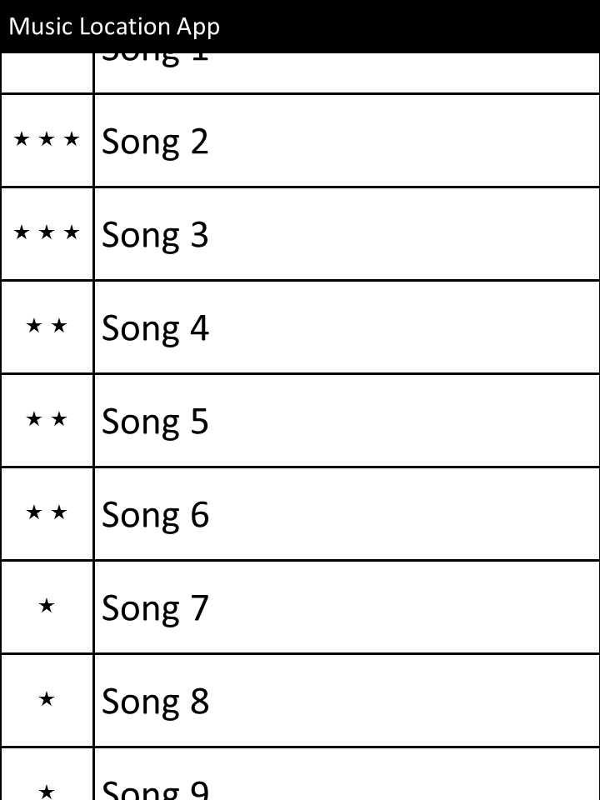
Main Screen
Open Options
See Popular Local Songs
Return to Songs
Choose Song
Options Menu
< Popular Songs List

