Slide 1
Music Location App
Enter Your Name:
_______________________________________________
Enter Name

Slide 2
Music Location App
____’s Music Player
See Local Hits
Random Song
Lat: ___
Long: ___

Slide 3
Music Location App
Title
Artist
SoundCloud Logo
Num Votes
Up
Down
Album Cover

Slide 4
Music Location App
Votes
Song Name
Plays
0
Song 1
0
3
Song 2
3
0
Song 3
0
1
Song 4
1
3
Song 5
3
2
Song 6
2

Slide 5
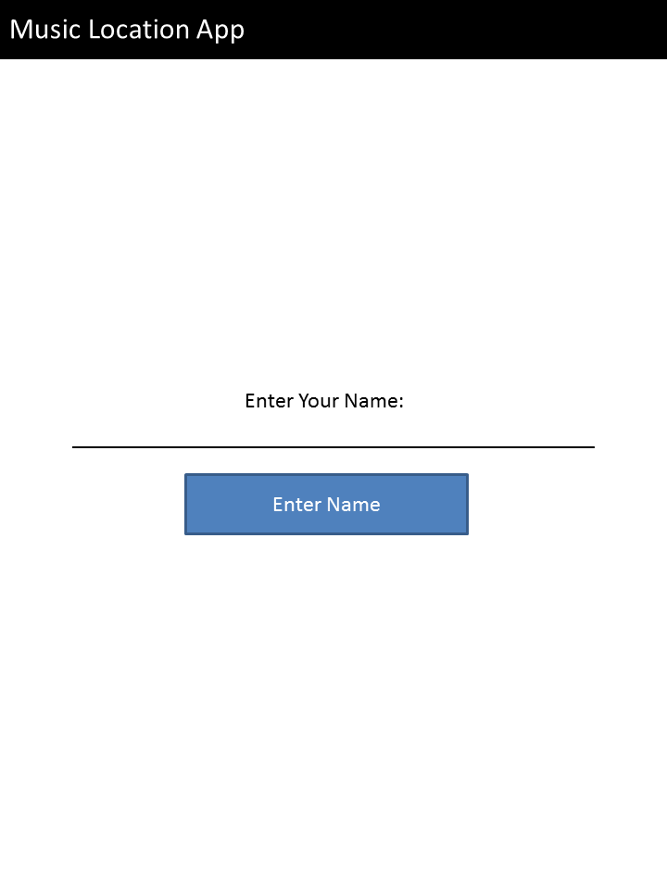
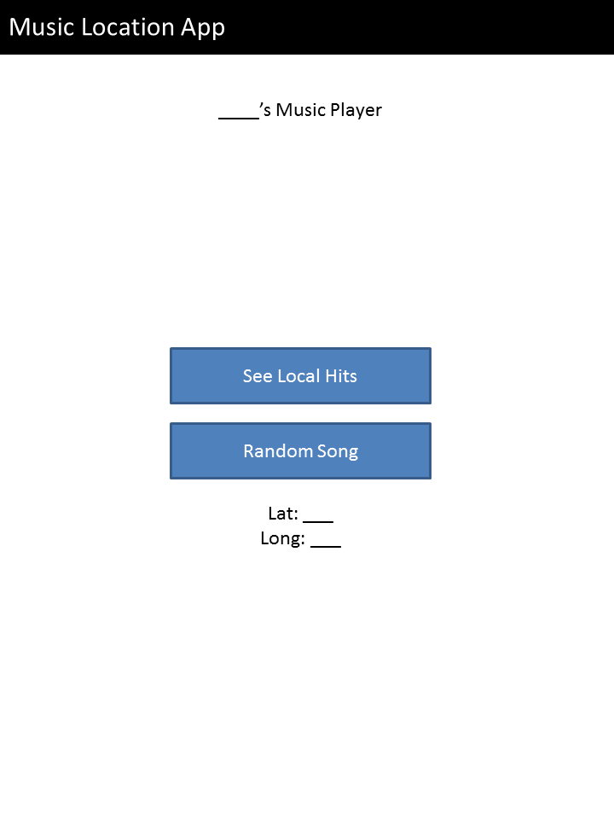
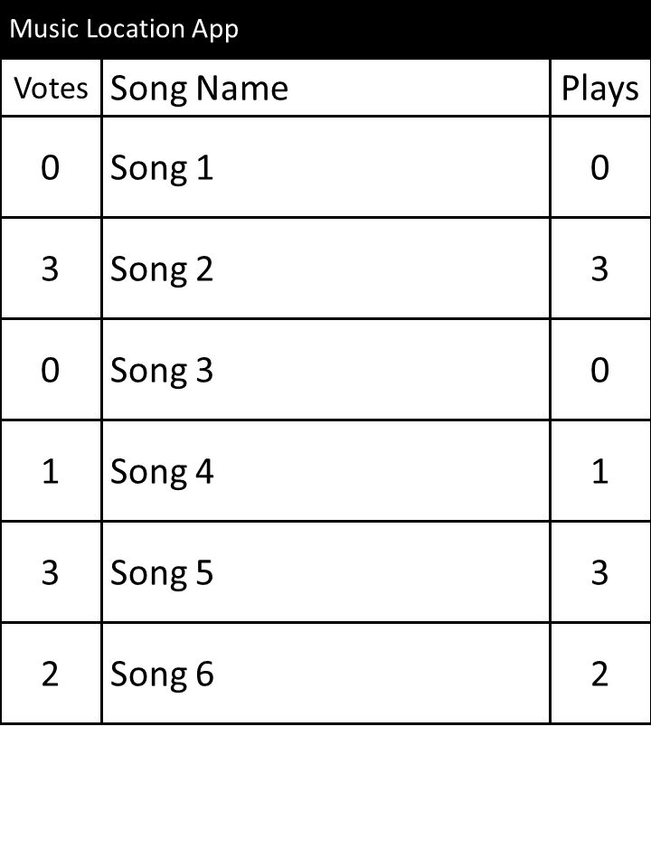
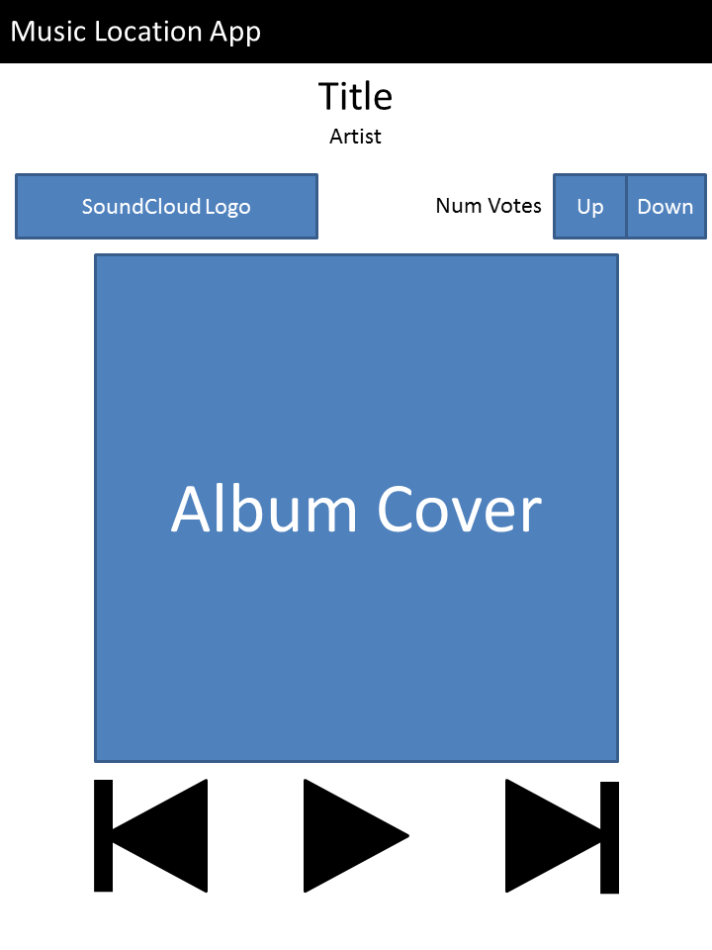
Welcome Screen
Main Screen
Open Options
Open List
Play Song
Play Song
Popular Songs List
Song Player

