Slide 1
Tableau

Slide 2
What Is tableau?
Tableau is a Business Intelligence tool for visually analyzing the data. Data visualization is the process of describing information through visual rendering.
Tableau is easy, Powerful and fast and help in taking important business decision.
We don’t need any prior coding skill or technical background in order to learn Tableau.

Slide 3
Explain several option of the start page of tableau desktop.
1. Connect – Connect sections allows tableau to connect with desktop files(different file type) and different database type.
File type can be ms excel, pdf, csv, json, statistical file etc
2. Open - You can open your existing workbook or workbook in which you have work earlier.
By clicking on open you can access earlier version of workbook that you have created for visualization.
3. Discover – In the discover section, we get short tutorial provided by tableau community.
Important blogs or also some important work done by all contributor in tableau community

Slide 4
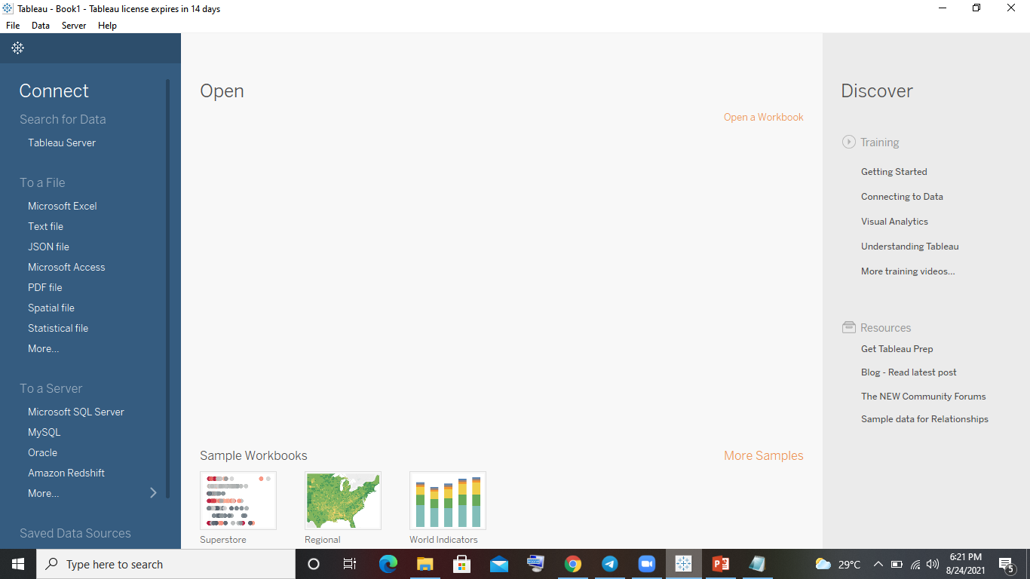

Slide 5
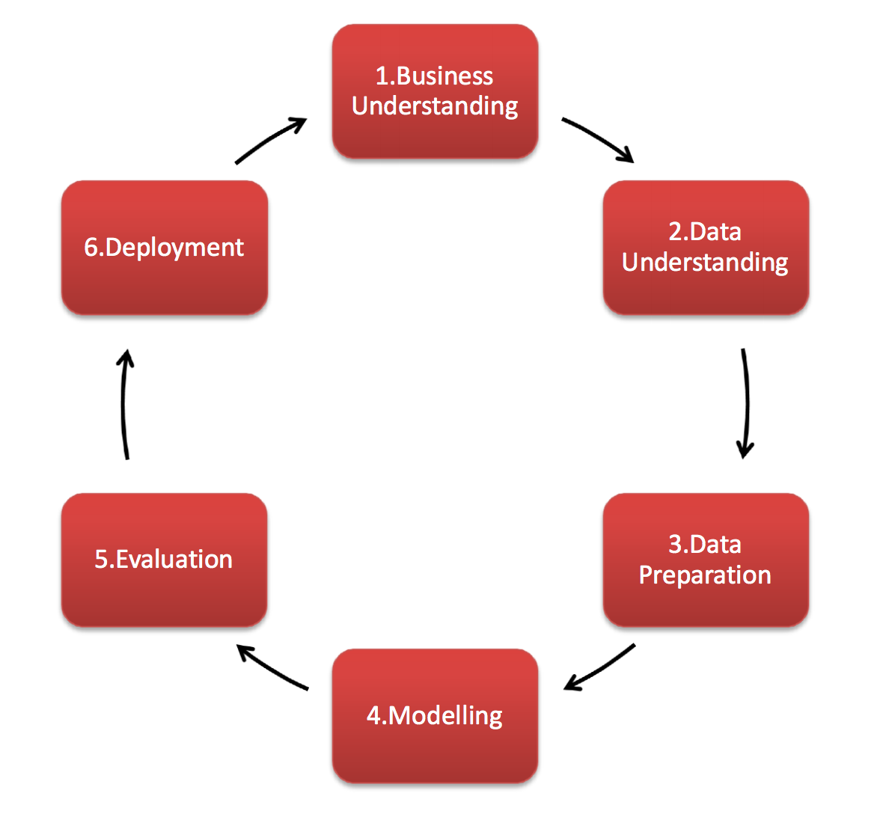
Explain all the steps of process flow of BI Project.

Slide 6
1.Business understanding : The goal of this stage of the process is to uncover important factors that could influence the outcome of the project. Neglecting this step can mean that a great deal of effort is put into producing the right answers to the wrong questions.
2. Data Understanding: This initial collection includes data loading, if this is necessary for data understanding. For example, if you use a specific tool for data understanding, it makes perfect sense to load your data into this tool. If you acquire multiple data sources then you need to consider how and when you’re going to integrate these.
3.Data preparation: This is the stage of the project where you decide on the data that you’re going to use for analysis. The criteria you might use to make this decision include the relevance of the data to your data mining goals, the quality of the data, and also technical constraints such as limits on data volume or data types. Note that data selection covers selection of attributes (columns) as well as selection of records (rows) in a table.

Slide 7
4. Modelling:you’ll select the actual modelling technique that you’ll be using. Although you may have already selected a tool during the business understanding phase, at this stage you’ll be selecting the specific modelling technique e.g. decision-tree building with C5.0, or neural network generation with back propagation. If multiple techniques are applied, perform this task separately for each technique.
5.Evaluation:During this step you’ll assesses the degree to which the model meets your business objectives and seek to determine if there is some business reason why this model is deficient. Another option is to test the model(s) on test applications in the real application, if time and budget constraints permit.
6.Deployment: In the deployment stage you’ll take your evaluation results and determine a strategy for their deployment. If a general procedure has been identified to create the relevant model(s), this procedure is documented here for later deployment. I

