Slide 1
Photoshoot Slot Booking System
TS- WEB/CC/AI TRACK CAPSTONE PROJECT
Presented By:
1. M Radhika
2. S A Reshma Parveen
3. S Fyrose
Guided By :Mr. Poova Ragavan

Slide 2
OUTLINE
Abstract
Problem Statement
Proposed System/Solution
System Design
System Development Approach(Technology Used)
Conclusion
References

Slide 3
Abstract
Photo is a form of visual story telling way to present a narrative through a series of Images. A great Photo is powerful cable to store emotion and Understanding without using words. Now a days photoshoot plays an special role. For Every occasion the photoshoot is common today. To capture an occasion, the photos are necessary. Photos help to remember those occasion times all good moments just by seeing. In this project we tried to develop a online based website on Photoshoot Slot Booking System. Our main intention is to promote Photographs Studio with help of online website, which is available free to register. People can log into website and browser the entire website and even book the Photoshoot slots by defining the mode. The photographers then contact the clients with help of details provided by them, while booking the slot.

Slide 4
Problem Statement
Early days most of photoshoot booking is done by meeting the photographer
or studios and save the date in records. The person need to do enquiry about the studios by asking others and the meet
the studios directly. As Technology is growing rapidly we are also moving to a technical
world where everything we want to done in easy way and fast.

Slide 5
Proposed Solution
So with the help of this project we Have to use of technology in the field of management to store all the information relating to the photo studios so that clients can browse website see ratings given by others then book the slot.
Then the team maintaining this software or the admin can see the information of clients who booked for slot.

Slide 6
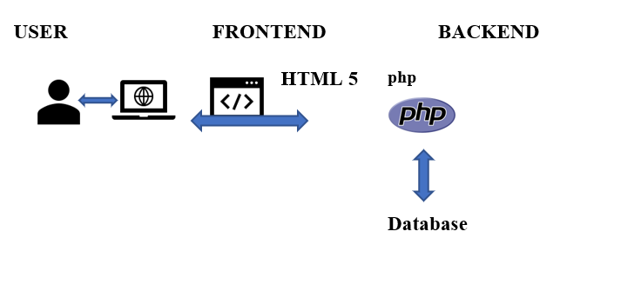
System Architecture

Slide 7
System Deployment Approach
This project is based on Web Development. This is developed by using HTML, CSS, JS, SQL and PHP . Code Editor used for this project is Visual Studio Code (VS Code). It displays the background of types of photoshoot modes available in the studio. It enables the user to render the website .
Here we have two categories owner and user.The user can book the slot by entering the details.The details are stored in database which are viewed by the owner.

Slide 8
Conclusion
Photoshoot Slot Booking System is very much graceful and user friendly. User have to register to the portal by giving their details to admin . The users are added by admin are staff of hospital. They will all the records of patients and drugs (medicines). The patient details can be viewed by admin any time.
Automation of the entire system improves the productivity.
It provides a friendly graphical user interface
It gives appropriate access to the authorized.
It effectively overcomes the delay in communications.
Updating of information becomes so easier.
System security, data security and reliability are the striking features.
The System has adequate scope for modification in future if it is necessary.

Slide 9
References
For PHP
https://www.w3schools.com/php/default.as
https://www.sitepoint.com/php https://www.php.net/
For MySQL
https://www.mysql.com/
http://www.mysqltutorial.org
For XAMPP
https://www.apachefriends.org/download.html

Slide 10
THANK YOU

