Slide 1
RetailMart: Sales & Business Performance Dashboard
A Power BI Analysis of Sales, Profitability & Customer Trends (2023–2025)

Slide 2
Problem Statement
RetailMart's total sales look healthy on paper, but performance is far from even — some regions and categories are quietly declining while others carry the business
Central and East together generate barely a third of the profit that South alone does, and leadership has no easy way to see this gap forming
Sales dip sharply every February and slow months often go unnoticed until quarterly reports land — too late to act on
Without a consolidated view, no one can tell whether a region, category, or customer segment is genuinely declining, or just fluctuating
Objective: build an interactive Power BI dashboard that surfaces exactly where sales and profit are slipping, so leadership can act before small gaps turn into bigger losses

Slide 3
Project Overview
Fictional Indian retail company, "RetailMart"
Dataset: 75,000 transaction records, 22 columns, Jan 2023 – Dec 2025
Tool: Microsoft Power BI
Goal: Turn raw sales data into clear, actionable business insight

Slide 4
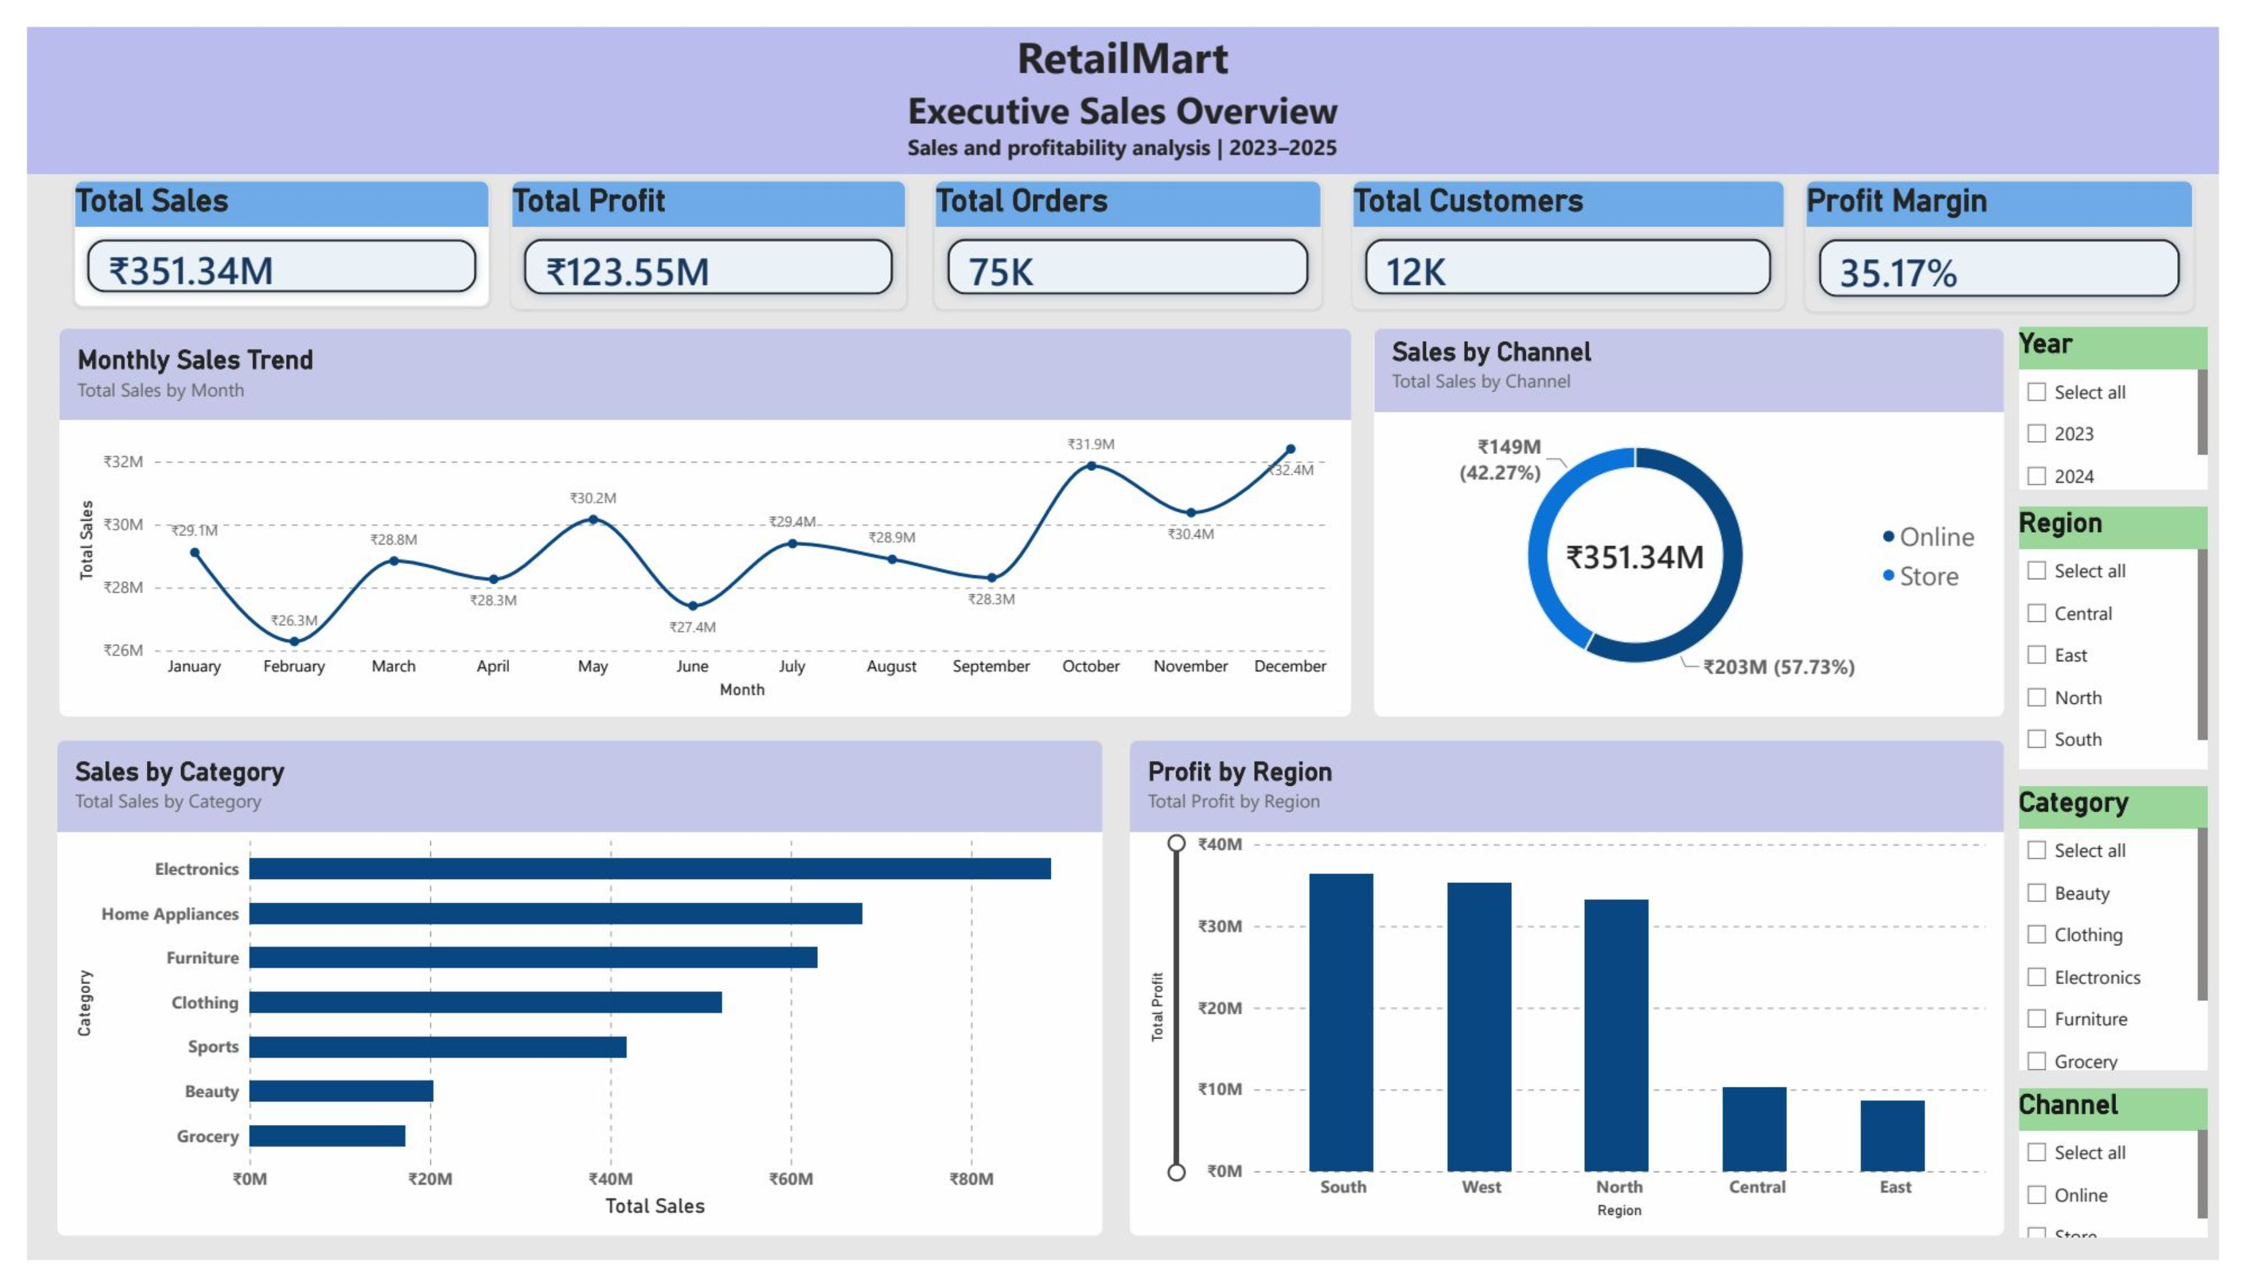
Executive Sales Overview

Slide 5
Executive Sales Overview
Overall Business Performance: Displays Total Sales of ₹351.34M, Total Profit of ₹123.55M, 75K Orders, 12K Customers, and a 35.17% Profit Margin through KPI cards.
Sales and Profit Analysis: Combines monthly sales trends, Online vs Store channel performance, category-wise sales, and regional profitability in a single dashboard.
Management Overview: Provides a quick and clear view of overall business performance, revenue sources, and areas where profit is concentrated.
Key Insight: The business maintains a 35.17% profit margin, while sales show stronger performance toward the later months. Differences across regions and product categories help identify areas for further focus and improvement.

Slide 6
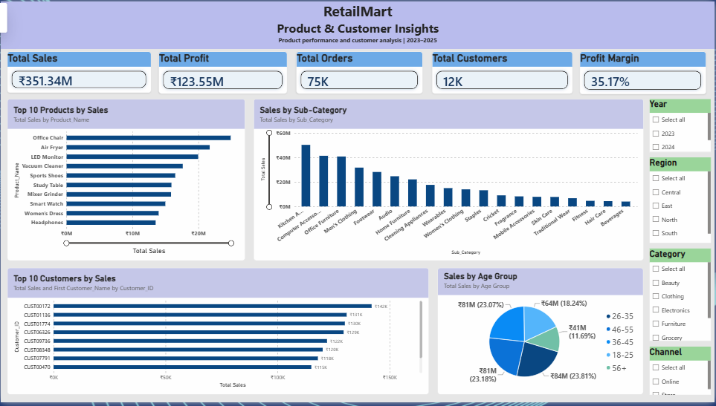
Product & Customer Insights

Slide 7
Product & Customer Insights
Top 10 Products by Sales: Highlights the products contributing the highest sales and helps identify strong-performing products.
Sales by Sub-Category: Compares sales across different sub-categories to understand product-level performance.
Top 10 Customers by Sales: Identifies the highest-value customers based on their total sales contribution.
Sales by Age Group: Shows how sales are distributed across different customer age groups and helps understand customer segments.
Interactive Filters: Year, Region, Category, and Channel allow users to explore the dashboard from different perspectives.
Business Purpose: Helps answer practical questions such as which products perform best, which customers contribute more sales, and which customer age groups generate higher revenue.
Key Insight: The dashboard helps identify high-performing products and customers while showing how sales are distributed across different age groups, supporting more focused business and marketing decisions.

Slide 8
Interactive Filters (Slicers)
Both pages include Year, Region, Category, and Channel slicers
Let viewers filter the entire report live — e.g., only 2024 Electronics sales in the North
Built for self-service exploration, not just static reporting

Slide 9
Key Takeaways
Sales peak at year-end, dip in February
A handful of categories and products drive most revenue
Regional performance is uneven — opportunity to grow lagging regions
A loyal top-customer base adds outsized value
This dashboard pinpoints exactly where sales and profit are slipping — turning a vague worry into a clear, actionable plan

