Slide 1
Big Data, Fast Data Using Spark and PySpark to Scale Data Insights
Ra Inta
March 31, 2021

Slide 2
The Big Picture
The purpose of this webinar is to discuss what the fuss about Big Data is, through the prism of the most widely adopted open-source tools for this purpose: Apache Spark, and in particular, its Python API, PySpark.
In particular, we will cover:
What is Big Data?
Where does Spark and PySpark come in?
Data management with PySpark
Spark MLlib: machine learning at scale
Spark Streaming: introduction to stream processing with Spark and Kafka
Conclusion

Slide 3
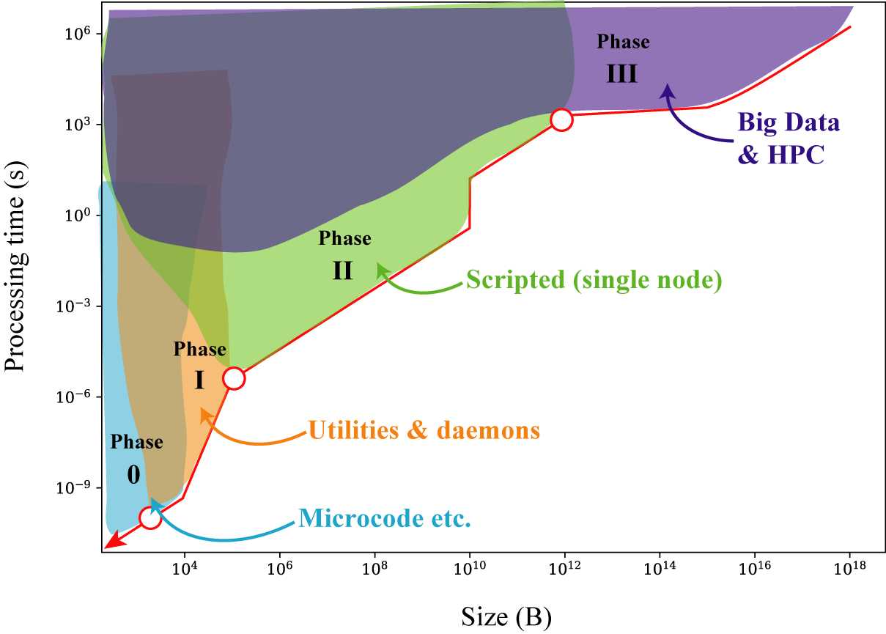
What is Big Data?
No objective threshold
‘Big’ is a relative term!
It’s not just about the size
Check out my blog article on this!
https://www.accelebrate.com/blog/how-big-is-the-big-in-big-data/

Slide 4

How to Scale?
Initially easier to scale vertically
Data processing bottlenecks come in all flavors of the rainbow
Usually a combination of compute and I/O bounds
Always dependent on what you need the data for!
Image: University of Texas at Austin

Slide 5
The Four Vs of Big Data
There are four main factors determining whether it is time to scale horizontally — i.e. to adopt distributed computing:
Volume
Velocity
Variety
Veracity

Slide 6
The Four Vs of Big Data
There are four main factors determining whether it is time to scale horizontally — i.e. to adopt distributed computing:
Volume: “My dataset is over a bajillion gigabytes!”
Velocity: “I need it all ASAP!”
Variety: “My data come from different places and are in different formats!”
Veracity: “I need to double-check every transaction!”

Slide 7
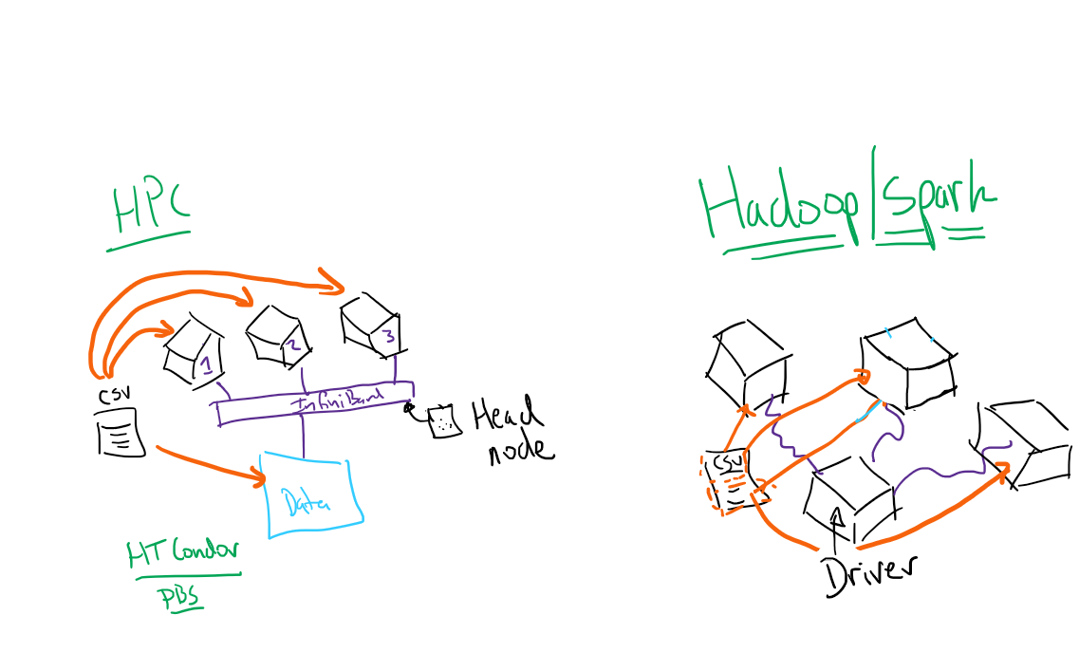
Big Data Architectures
Two separate paradigms for distributed computing: HPC and Hadoop
Hadoop:
No specialized hardware or data access (commodity hardware)
“Your machines aren’t pets — they’re cattle”
Notion of resilient computing
“Bring the compute to the data”
High Performance Computing (HPC):
High-speed backplane
Specialized access to data
“Every node is sacred”

Slide 8
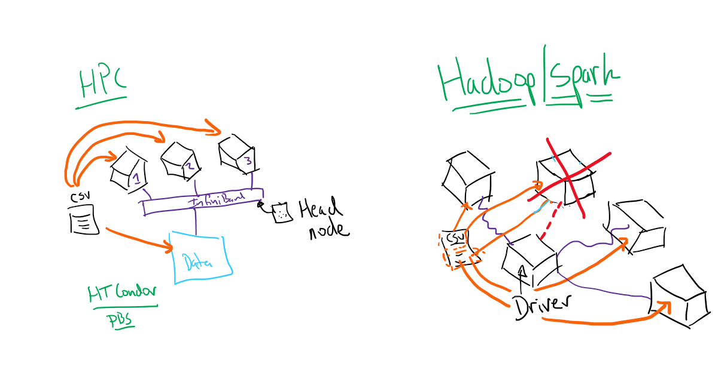
Big Data Architectures
Two separate paradigms for distributed computing: HPC and Hadoop
Hadoop:
No specialized hardware or data access (commodity hardware)
“Your machines aren’t pets — they’re cattle”
Notion of resilient computing
“Bring the compute to the data”
High Performance Computing (HPC):
High-speed backplane
Specialized access to data
“Every node is sacred”

Slide 9
Hadoop
Was the premier Big Data tool from ~2006 until the mid-2010s
Both a data storage model (HDFS) and a compute model (MapReduce)
Highly scalable
Cost-effective
Fault-tolerant
However…
MapReduce is a blunt instrument!

Slide 10
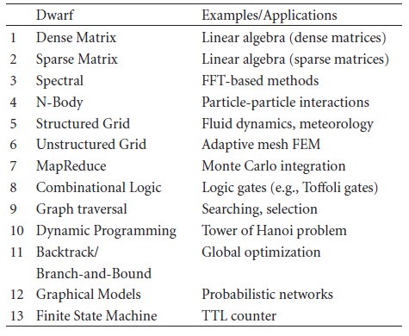
Problems with MapReduce
The 13 Dwarves of Berkeley — a catalog of all parallel algorithms
Inta, R., Bowman, D. J. and Scott, S. M.: “The 'Chimera': An Off-The-Shelf CPU/GPGPU/FPGA Hybrid Computing Platform,” Int. J. Reconfigurable Computing 2012 (241439), 10pp. (2012)

Slide 11
Apache Spark
2009 — UC Berkeley AMPlab — a research project examining some of the deficiencies of the Hadoop parallel computing paradigm
2010 — Matei Zaharia et al.: “Spark: Cluster Computing with Working Sets,” 2nd USENIX Workshop on Hot Topics in Cloud Computing, Boson MA (well worth a read!)
2013 — explosion of contributors to the Spark project (100, from more than 30 organizations) — project handed off to the Apache Foundation
2013 — AMPlab spins out software services related to Spark: Databricks
2014 — Spark SQL
2016 — Spark Streaming

Slide 12
The Heart of Sparkness: The RDD
The core data element of Spark
Resilient Distributed Dataset
From original paper: “An RDD is a read-only collection of objects partitioned across a set of machines that can be rebuilt if a partition is lost”
Builds on fault-tolerance of Hadoop
Iterative and interactive computations
Tracks the lineage of the data
Immutable

Slide 13
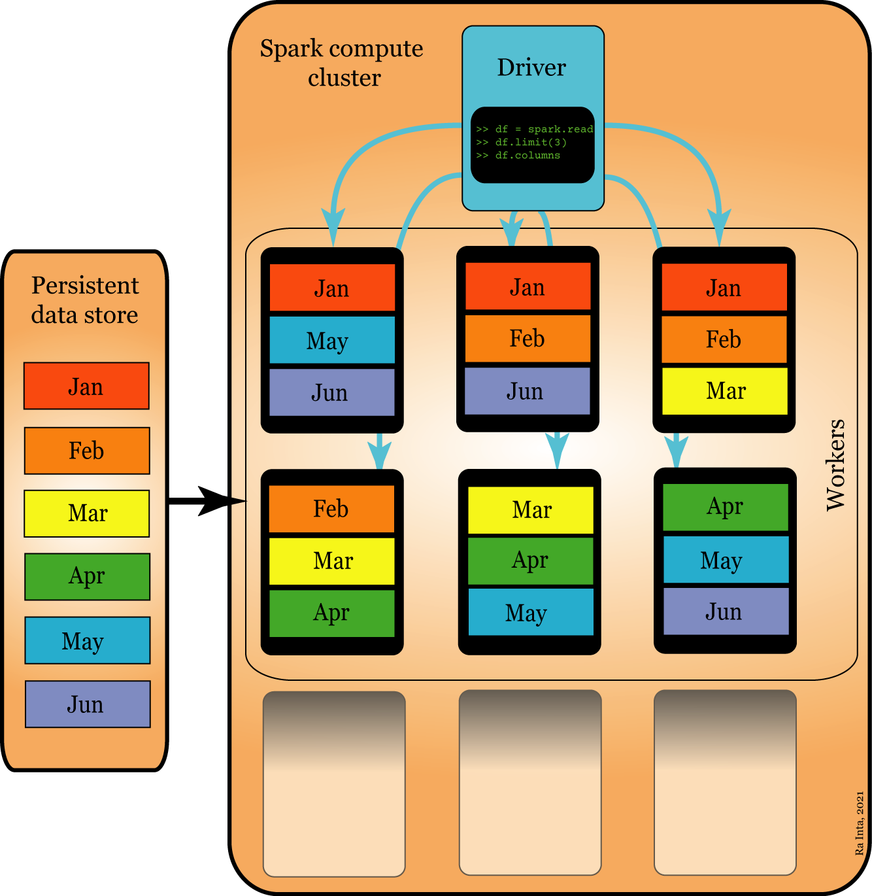
How Spark Achieves Resilience

Slide 14
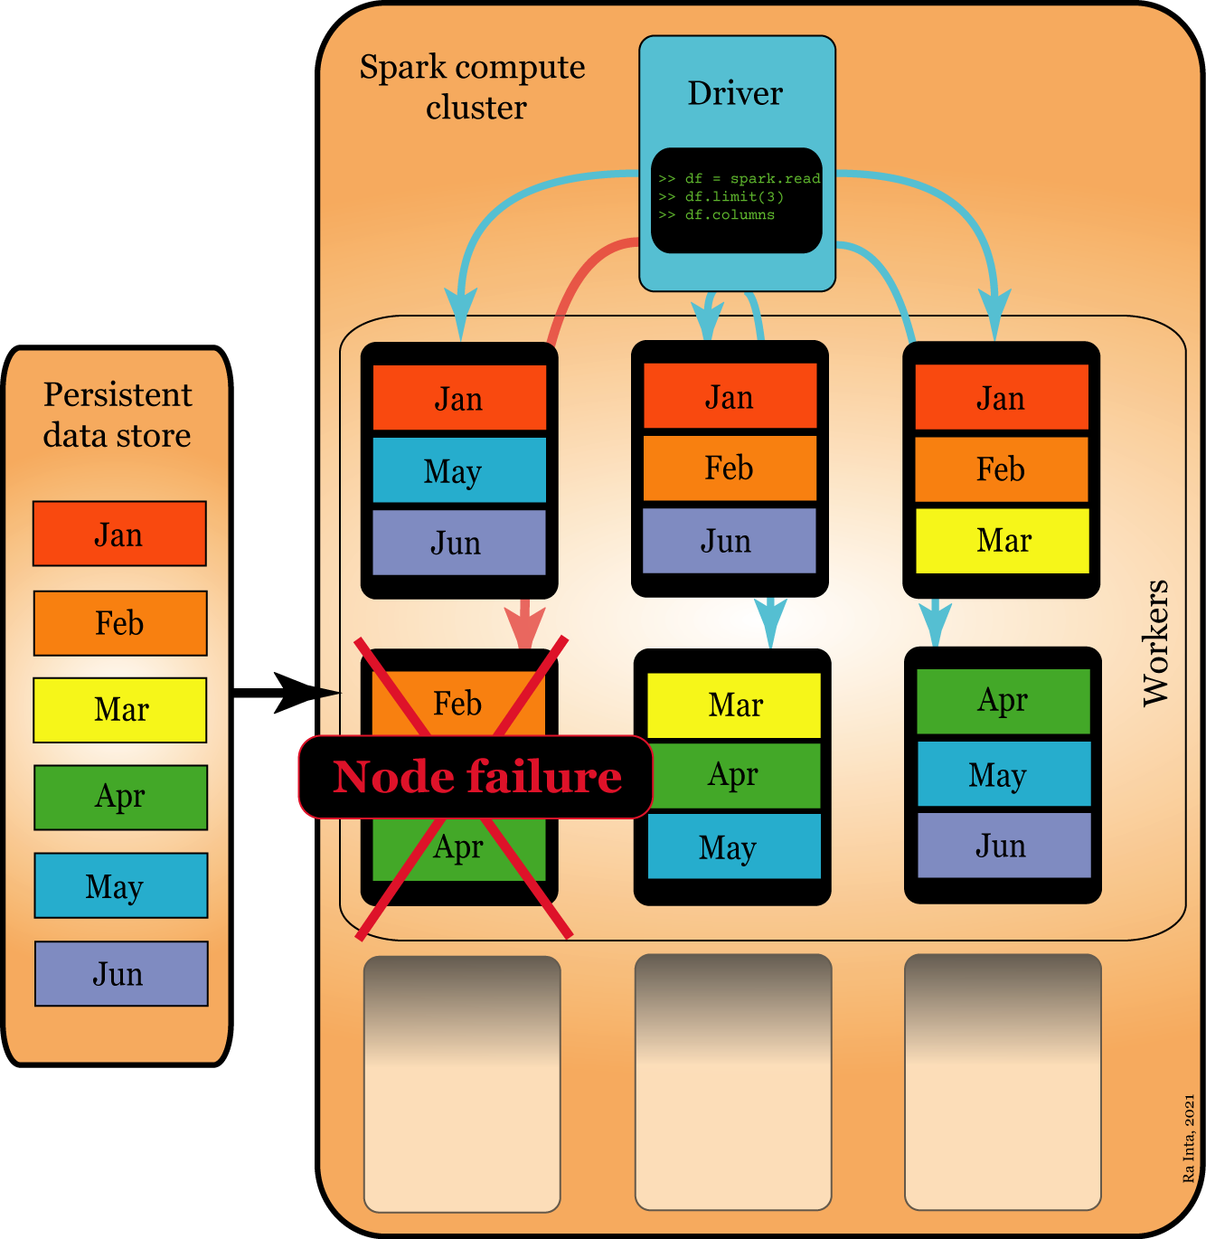
How Spark Achieves Resilience

Slide 15
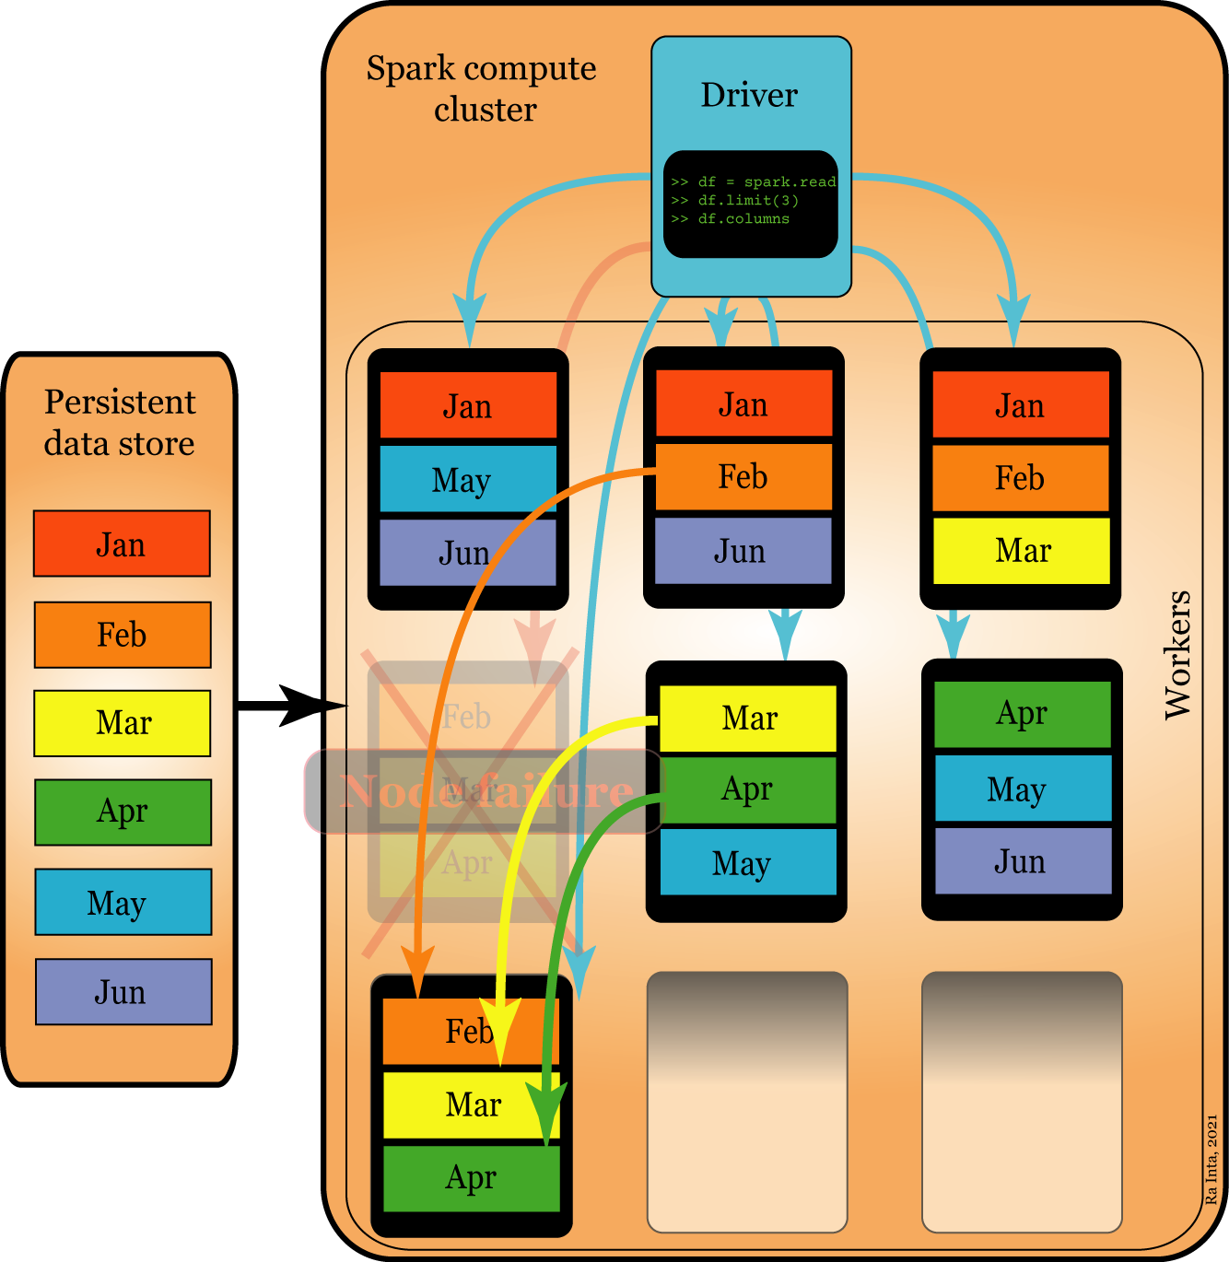
How Spark Achieves Resilience

Slide 16
Tenets of Spark
There are three core tenets driving Spark:
Computational engine only
Unified API
Library eco-system
This allows:
Iteration (good for e.g. machine learning)
Interactivity (good for e.g. exploratory data analysis)
Flexible, in-memory (extensible, fast and low latency)

Slide 17
The Spark Eco-system
What we call 'Spark‘ includes more than the core. The following APIs are supported, and we will cover many of them here (albeit briefly for some!)
RDD — the old API (but still has its uses)
Spark SQL and the Spark SQL DataFrame — the modern way to manage and explore data in Spark
Spark Mllib — machine learning in Spark
Spark Streaming — low latency data processing
GraphX — graph-based analysis

Slide 18

PySpark
PySpark gives us an interface into using a Spark distributed computing environment using the Python programming language
Spark 3.+ improved support for Python via the PySpark API

Slide 19
PySpark Interactive Shell
The command pyspark should result in output like the following:
Python 3.8.5 (default, Sep 3 2020, 21:29:08) [MSC v.1916 64 bit (AMD64)] :: Anaconda, Inc. on win32
Type "help", "copyright", "credits" or "license" for more information.
21/03/23 14:37:55 WARN NativeCodeLoader: Unable to load native-hadoop library for your platform... using builtin-java classes where applicable
Using Spark's default log4j profile: org/apache/spark/log4j-defaults.properties
Setting default log level to "WARN".
To adjust logging level use sc.setLogLevel(newLevel). For SparkR, use setLogLevel(newLevel).
Welcome to
____ __
/ __/__ ___ _____/ /__
_\ \/ _ \/ _ `/ __/ '_/
/__ / .__/\_,_/_/ /_/\_\ version 3.1.1
/_/
Using Python version 3.8.5 (default, Sep 3 2020 21:29:08)
Spark context Web UI available at http://Archimedes:4040
Spark context available as 'sc' (master = local[*], app id = local-1616528277019).
SparkSession available as 'spark'.
>>

Slide 20
Spark Session and Context
Spark always starts with a cluster containing a driver and one or more workers
The driver schedules tasks and traces data via the SparkContext and SparkSession interfaces
The sparkContext object also represents a connection to the remote or local spark cluster, and was the main entry point for earlier versions of Spark
At the end of every Spark Session, we should terminate the Spark engine, although this usually happens automatically upon exiting the pyspark session

Slide 21

“Hello World” in Big-data-ese
Word count!
How many times does the word ‘nevermore’ occur in Edgar Allen Poe’s The Raven?
lines = spark.read\
.text(INPUT_FILE)\
.rdd\
.map(lambda r: r[0])
sortedCount = lines\
.flatMap(lambda x: x.split())\
.map(lambda x: (str(x), 1))\
.reduceByKey(add)\
.sortBy(lambda x: x[1], ascending=False)
Gustave Doré

Slide 22
“Hello World” in Big-data-ese
Word count!
How many times does the word ‘nevermore’ occur in Edgar Allen Poe’s The Raven?
lines = spark.read\
.text(INPUT_FILE)\
.rdd\
.map(lambda r: r[0])
sortedCount = lines\
.flatMap(lambda x: x.split())\
.map(lambda x: (str(x), 1))\
.reduceByKey(add)\
.sortBy(lambda x: x[1], ascending=False)
MapReduce
Gustave Doré

Slide 23
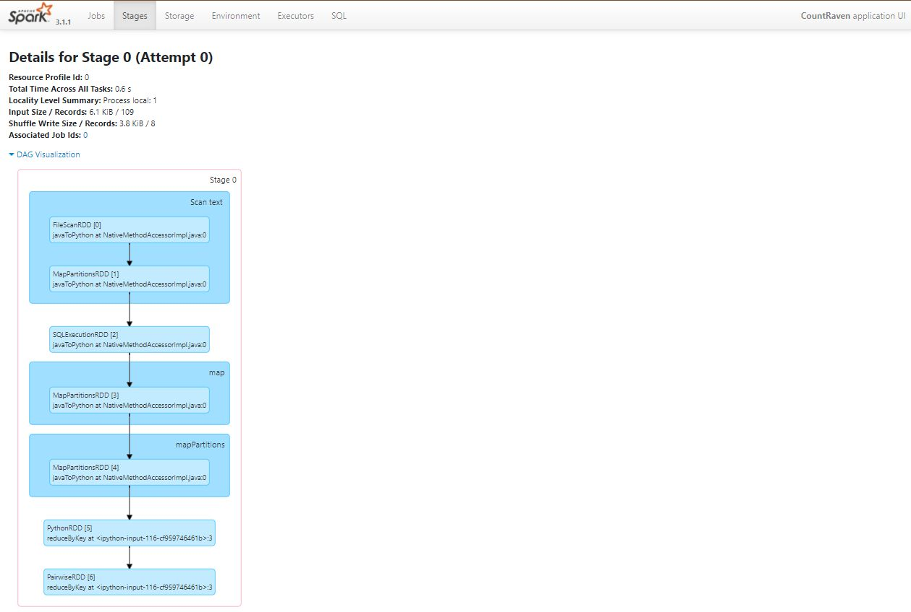
Monitor Jobs with Spark UI
Local access to SparkUI:
http://localhost:4040

Slide 24
Spark SQL
Spark SQL is Spark’s modern data interface
Higher-level abstractions inspired by SQL
Built on top of RDD
Originated from Apache Hive (FaceBook)
Has a DataFrame API
Also includes native support for CSV, Text, JSON, Parquet, ORC files and JDBC (database) connections
Included in Spark 2.+

Slide 25
Spark DataFrames
Can interact with Spark data objects as DataFrames
Familiarity to those with pandas , SQL or R backgrounds
The direct RDD API is available for some lower-level tasks when necessary, but not as cognitively simple, nor as performant, as the DataFrame API
Similar to a pandas DataFrame (which it is closely modeled after)
Can easily create a Spark DataFrame from a pandas DataFrame:
col_names = “ABCDE”
n_cols = len(col_names)
n_rows = 10
pandas_df = pd.DataFrame({x: np.random.randn(n_rows) for x in col_names})
spark_df = spark.createDataFrame(pandas_df)

Slide 26
Typical Data Management
Here are typical commands we can use to manage data.
We’re only showing limited output
df_person.printSchema()
df_person.count()
df_person.describe().show()
df_person[["Age","p_id"]].show(5)
df_person.select('Age','p_id').show(5)
df_person.filter(df_person['Age'] > 90).show(5)
df_person.filter(df_person['Age']>90).describe('Age').show(5)
+---+------+
|Age| p_id|
+---+------+
| 50|101108|
| 50|100944|
| 54|102421|
| 45|107152|
| 27|108180|
+---+------+

Slide 27
Loading Data
Let's load some data into the Spark environment and examine it
We will use a basic DataFrame on person demographics
# import csv
df_person = spark.read.csv('person_demo.csv',
header=True,
inferSchema=True)
# examine object
df_person
# results
DataFrame[Clust_id: string, p_id: int, Age: int, Baseline_date: string, Gender: string, Income: int, Education: string, value_1: double, value_2: double, value_3: double, outcome: int]

Slide 28
Data
What kind of object is returned?
Examine the first line:
Or the first three...
type(df_person)
pyspark.sql.dataframe.DataFrame
df_person.first()
Row(Clust_id='A1', p_id=101108, Age=50, Baseline_date='12/3/2006', Gender='Male', Income=49500, Education='College', lab_value_1=70.33352343, lab_value_2=100.4719416, lab_value_3=11.07336381, outcome=0)
df_person.limit(3)
DataFrame[Clust_id: string, p_id: int, Age: int, Baseline_date: string, Gender: string, Income: int, Education: string, lab_value_1: double, lab_value_2: double, lab_value_3: double, outcome: int]

Slide 29
Variables
What are the column names? Note the difference from what is returned by Pandas.
df_person.columns
['Clust_id',
'p_id',
'Age',
'Baseline_date',
'Gender',
'Income',
'Education',
'lab_value_1',
'lab_value_2',
'lab_value_3',
'outcome']

Slide 30
Seeing the Data
We can ask for a printout of a dataframe using the .show() method
The output is rendered in a fixed width font for terminal display.
df_person\
.limit(10)\
.show()
+--------+------+---+-------------+------+------+---------------+-----------+-----------+-----------+-------+
|Clust_id| p_id|Age|Baseline_date|Gender|Income| Education|lab_value_1|lab_value_2|lab_value_3|outcome|
+--------+------+---+-------------+------+------+---------------+-----------+-----------+-----------+-------+
| A1|101108| 50| 12/3/2006| Male| 49500| College|70.33352343|100.4719416|11.07336381| 0|
| A1|100944| 50| 7/24/2010| Male| 49500| College|66.01584426|107.1737512|11.02291056| 0|
| A1|102421| 54| 6/5/2005| Male| 82500| College|77.13456135|91.35113871|5.572683635| 0|
| A1|107152| 45| 7/13/2010|Female| 44000| null|55.40809524|97.84178219|15.18728765| 0|
| A1|108180| 27| 6/2/2010| Male| 44000|Graduate Degree|62.07755533|83.99464934|11.24109239| 0|
| A1|107342|186| 8/9/2010| Male| 55000| College|65.55094933|111.0197736| null| 0|
| A1|108232| 54| 4/9/2011| Male| 27500| null|74.05220356|101.0372772|8.032567485| 1|
| A1|101126| 36| 3/8/2007|Female| 71500| College|69.44593198|97.95854607|16.87163049| 0|
| A1|103262| 47| 5/2/2009| Male| 55000|Graduate Degree|62.87294722| 107.947926|14.32868659| 0|
| A1|108125| 41| 6/19/2005|Female| 71500| High School|36.79072475|91.47644801|7.324619722| 0|
+--------+------+---+-------------+------+------+---------------+-----------+-----------+-----------+-------+

Slide 31
Data Warehousing: Extract, Transform, Load
Extract – Transform – Load (ETL) processes all in one line
What are the total transactions and account balances, for transactions more than $0.01, grouped by year and month?
ETL_FILE = os.path.join(OUTPUT_DIRECTORY, "ETL.csv")
spark.read.csv(TRANSACTIONS_DIR, header=True,
inferSchema=True)\
.filter("transaction_amount > 0.01")\
.groupBy("year_month")\
.sum()\
.coalesce(1)\
.write.mode("append").csv(ETL_FILE)

Slide 32
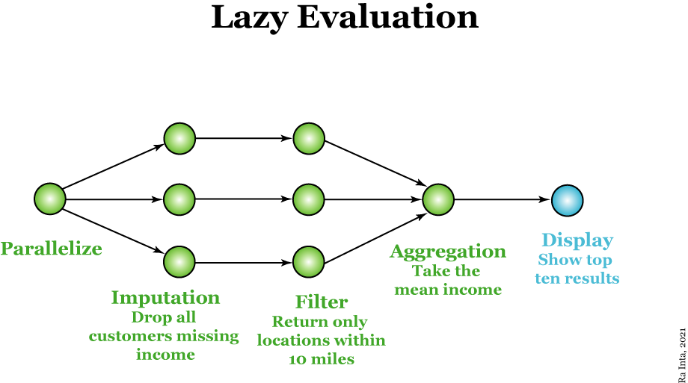
Lazy Evaluation in Spark

Slide 33
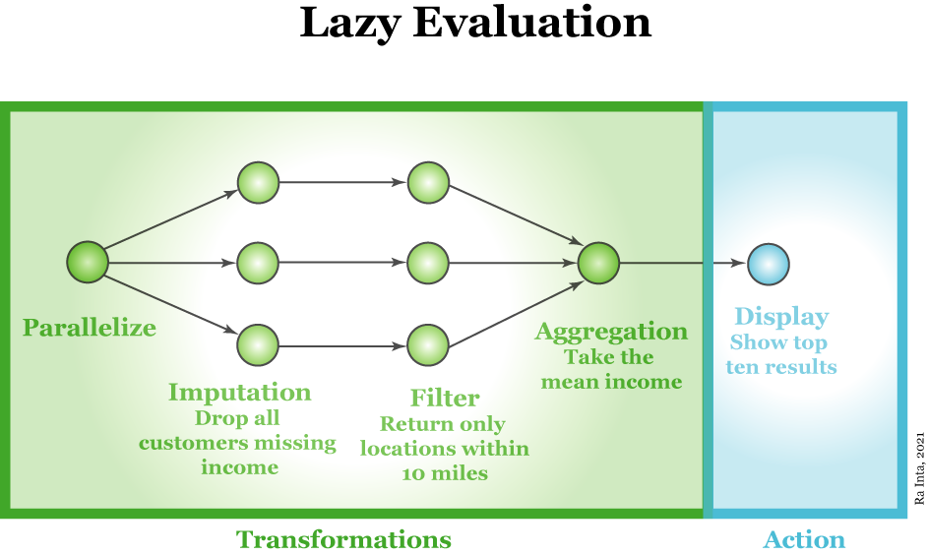
Lazy Evaluation in Spark

Slide 34
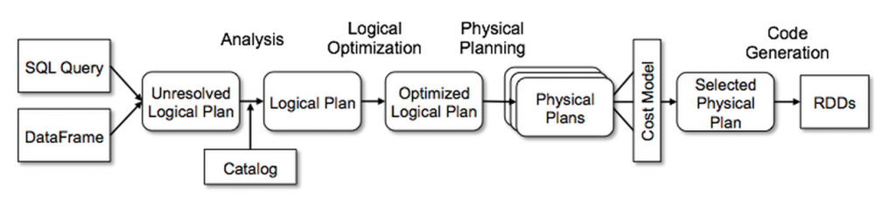
Spark SQL Optimization Engines
Catalyst Engine:
Provides optimization of compute tasks
Project Tungsten:
Efficiency improvements to memory and CPU (cache awareness, memory management, loop unrolling)

Slide 35
Spark DataFrame from Pandas
spark_df.head(5)
[Row(A=1, B=1, C=5, D=3, E=7),
Row(A=2, B=2, C=2, D=1, E=5),
Row(A=5, B=2, C=3, D=2, E=4),
Row(A=6, B=3, C=9, D=3, E=3),
Row(A=9, B=4, C=5, D=3, E=7)]
spark_df.columns
['A', 'B', 'C', 'D', 'E']
type(spark_df)
pyspark.sql.dataframe.DataFrame

Slide 36
Schemas
However, generation of Spark SQL DataFrames are not as flexible as their pandas counterparts, because:
The underlying RDD objects are immutable
Type checking is based on Scala’s strict typing
While Spark will attempt to infer the schema upon creation of a DataFrame, this will not work, e.g., for the following:
# create pandas dataframe
df2_pd = pd.read_csv("person_demo.csv")
df2_spark = spark.createDataFrame(df2_pd)
# Error! Why?

Slide 37
Missing Data
There is missing data that was encoded by pandas using np.NaN, which is currently handled differently to the type-specific null used by Spark.
We could get around this by dropping the NaNs and then creating the Spark SQL DataFrame:
df2_pd.isnull().mean()
Clust_id 0.0000
p_id 0.0000
Age 0.0040
Baseline_date 0.0053
Gender 0.0041
Income 0.0057
Education 0.0151
value_1 0.0070
value_2 0.0043
value_3 0.0045
outcome 0.0000
df2_spark_dropped = spark.createDataFrame(df2_pd.dropna())
# No error, but dropped any row with a piece of missing data

Slide 38
Contrasting PySpark with pandas
The concept of the data frame has become ubiquitous in Data Science
Inspired by SQL — leveled up with R — stolen by pandas
Pandas is in-memory only, Spark SQL is distributed
Pandas is tightly integrated into the Python scientific stack
Spark is native to Scala and the Java stack
The core data object in Spark (RDD) is immutable

Slide 39

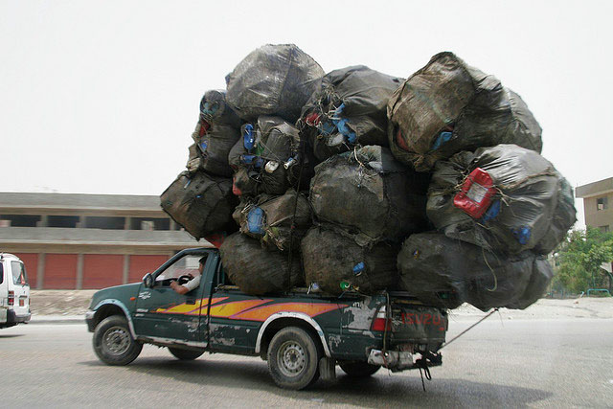
Contrasting PySpark with pandas
The comparative user experience feels a little like the following:
Pandas
PySpark
Left image: Universal Pictures

Slide 40
Contrasting PySpark with pandas
The comparative user experience feels a little like the following:
Pandas
PySpark
Performant at scale
Fault tolerant
Powerful data warehousing
Stream-capable
Machine learning
Mostly un-Pythonic
Slow with UDFs
Fast
Flexible
Rapid visualization
Pythonic
Widely integrated
Not easily scalable

Slide 41
Spark SQL: For the SQL Lovers!
If you register a DataFrame as a table, you may interact with the table using SQL queries
transactions_df.createOrReplaceTempView('transactions')
query = 'SELECT corr(account_balance, transaction_amount) AS corr FROM transactions '
query += 'WHERE transaction_date > "2019-06-01"'
spark.sql(query).show()
+------------------+
| corr|
+------------------+
|0.8867978680229694|
+------------------+

Slide 42
Big Data File Formats
HDFS (HaDoop FileSystem)
Parquet
ORC (Optimized Row Columnar)
Avro
Like Hadoop itself, HDFS is distributed and fault-tolerant
Avro is optimized for row serialization and carries its schema around with it, allowing for schema evolution (good for changing data)
Parquet is column-optimized, which is great for selecting variables and accessing aggregate functions
ORC can process rows in parallel and stores vital statistics

Slide 43

Machine Learning
Machine learning (ML) primarily concerned with prediction
I don’t have time to cover ML theory in these five minutes!
“Prediction is hard — especially about the future” — Yogi Berra
“Every model is broken — some are more useful than others” — John Tukey
Universal Pictures

Slide 44
The Four Key Ingredients for ML
Although there are a dizzying array of machine learning algorithms and architectures available, every machine learning model requires the following four ingredients, in order of importance:
Data
Algorithm
Loss (accuracy) function
Optimization scheme

Slide 45
Choosing an ML Strategy
Essential: identify the key variable, or target of prediction
This dictates your choice of algorithm
No labels: you must choose an unsupervised algorithm
Labels: you must consider the nature of your target variable:
Continuous | Discrete/categorical
Regression | Classification

Slide 46
Supervised vs Unsupervised ML
Supervised
Unsupervised
Has labels or targets
No explicit labeling (no ‘ground truth’)
Linear/logistic regression
Random forest
Support vector machines
Artificial neural networks
Gradient-boosted decision trees
Dimensionality reduction
PCA
Factor Analysis
Clustering
K-means
DBSCAN

Slide 47
Supervised vs Unsupervised ML
Supervised
Unsupervised
Has labels or targets
No explicit labeling (no ‘ground truth’)
Reinforcement Learning
Linear/logistic regression
Random forest
Support vector machines
Artificial neural networks
Gradient-boosted decision trees
Dimensionality reduction
PCA
Factor Analysis
Clustering
K-means
DBSCAN
Markov-chain Monte Carlo
Deep reinforcement learning

Slide 48
Machine Learning and Spark — Spark MLlib
Spark’s unified API(s) to machine learning
Confusingly, there are spark.ml and spark.mllib libraries
The official name is ‘MLlib,’ but we will only deal with spark.ml imports
Similar features to scikit-learn (your one-stop shop for all your traditional machine learning needs™)
Documentation online: https://spark.apache.org/mllib/

Slide 49
Data Preparation
As is common with machine learning libraries, a lot of data preparation is required to be properly ingested by the various libraries. Spark MLlib has convenience functions for this purpose. We will need to prepare CNC mill data to have features and labels:
# To generate labels column from categorical data
from pyspark.ml.feature import OneHotEncoder, StringIndexer
# To generate features vector
from pyspark.ml.linalg import Vectors
from pyspark.ml.feature import VectorAssembler

Slide 50
Import the data
Import the data
from pyspark.sql import SparkSession
spark = SparkSession.builder.appName('spark_ml').getOrCreate()
DATA_DIR = "../data" #or wherever this might be
FILE_PATH = os.path.join(DATA_DIR, "manufacturing", "CNC_Tool_Wear", "cnc_experiments_all.csv")
cnc_data = spark.read.csv(FILE_PATH, header=True, inferSchema=True)

Slide 51
CNC data
Can we predict the tool condition on a CNC mill, given a whole lot of sensor data? We have labels for tool_condition, namely 'worn' and 'unworn'. We need to convert these to a numerical format.
NOTE: the off-the-shelf classifiers in Spark MLlib tend to have default names of the features ('features') and the class labels ('label'). We could alter these with featuresCol='features', and labelCol='label'; we instead choose the default names hereafter.
cnc_class_labels = StringIndexer(inputCol='tool_condition', outputCol='label')
cnc_data = cnc_class_labels.fit(cnc_data).transform(cnc_data)

Slide 52
Converting Features
Convert the non-string features to a feature vector:
cnc_feature_labels = cnc_data.columns[0:47] + cnc_data.columns[49:51]
cnc_feature_vector = VectorAssembler(
inputCols=cnc_feature_labels,
outputCol="features")
# Note the strict naming convention here
cnc_data = cnc_feature_vector.transform(cnc_data)
cnc_data.sample(0.001).select("features", "label").show(10)
Converted features and labels for CNC wear dataset:
+--------------------+-----+
| features|label|
+--------------------+-----+
|(49,[0,3,6,7,8,10...| 1.0|
|(49,[0,3,6,7,8,11...| 1.0|
|(49,[0,3,6,7,8,11...| 1.0|
|[162.0,0.85,-113....| 1.0|
|[154.0,-18.0,-31....| 1.0|
|[141.0,0.075,25.0...| 1.0|
|(49,[0,3,6,7,8,9,...| 1.0|
|[153.0,6.25,56.3,...| 0.0|
|[145.0,-19.6,75.0...| 0.0|
|[159.0,-0.1,-56.3...| 0.0|
+--------------------+-----+
only showing top 10 rows

Slide 53
Splitting Data
Split the data into training and test sets at 75%
cnc_train, cnc_test = cnc_data.randomSplit([0.75, 0.25], seed=42)
print(f"\nRows of data for training: {cnc_train.count()}, testing: {cnc_test.count()}\n")
Rows of data for training: 18948, testing: 6338

Slide 54
Fitting a Model
Once the data are prepared, it is relatively simple to apply the various algorithms in the Spark MLlib eco-system. We can easily produce a logistic regression classifier. We can even throw in an elastic net!:
from pyspark.ml.classification import LogisticRegression
logReg = LogisticRegression(maxIter=10, regParam=0.3, elasticNetParam=0.8)
logRegModel = logReg.fit(cnc_train)
print(f"Coefficients: {logRegModel.coefficients}; Intercept: {logRegModel.intercept}")
Coefficients: (49,[],[]); Intercept: -0.10946107408676813

Slide 55
Evaluating a Model
Once the data are prepared, it is relatively simple to apply the various algorithms in the Spark ML eco-system. We can easily produce a logistic regression classifier. We can even throw in an elastic net!:
from pyspark.ml.evaluation import BinaryClassificationEvaluator
validation = logRegModel.transform(cnc_test)\
.select("rawPrediction", "label")
evaluator = BinaryClassificationEvaluator()\
.setMetricName("areaUnderROC")
print(f"\nValidation accuracy: {evaluator.evaluate(validation)*100}%\n" )
# Results (oof)
Validation accuracy: 50.0%

Slide 56
Linear Regression
This concrete data-set has compressive strength (in MPa) -- a continuous outcome -- of various concrete mixtures given a range of controlled conditions. This is a potentially promising application of linear regression.
First, we import the data:
FILE_PATH = os.path.join(DATA_DIR, "manufacturing", "concrete”, "concrete.csv")
concrete_data = spark.read.csv(FILE_PATH, header=True, inferSchema=True)

Slide 57
Preparing Data
We rename the last column (compressive strength) to 'label':
We would like to make the rest into a feature vector, and the rest of the logic is similar to that of the logistic regression example above.
Once the logic is clear, we may wish to formalize this as a pipeline. This will apply each of the data transforms and model fits into a single operation.
concrete_data = concrete_data\
.withColumnRenamed(concrete_data.columns[-1], "label")
concrete_feature_labels = concrete_data.columns[0:8]
concrete_feature_vector = VectorAssembler(
inputCols=concrete_feature_labels,
outputCol="features")
# Note the strict naming convention here

Slide 58
Split the Data
Produce a random split at 75%:
concrete_train, concrete_test = concrete_data\
.randomSplit([0.75, 0.25], seed=42)
print(f"\nRows of data for training: {concrete_train.count()}, testing: {concrete_test.count()}\n")
Rows of data for training: 755, testing: 275

Slide 59
Instantiate the Model
Instantiate the model
Create the feature vector and fit the model (i.e. make it concrete) in a single pipeline:
from pyspark.ml.regression import LinearRegression
linReg = LinearRegression(maxIter=10,
regParam=0.3,
elasticNetParam=0.8,
solver='normal')
# Train the model:
from pyspark.ml.pipeline import Pipeline
lin_pipeline = Pipeline(stages=[concrete_feature_vector,
linReg])
linRegModel = lin_pipeline.fit(concrete_train)

Slide 60
Coefficients and Intercept
Print the coefficients and intercept.
Note our model is now part of a Pipeline object, so we have to access the particular stage:
print(f"Coefficients: {linRegModel.stages[-1].coefficients}")
print(f"Intercept: {linRegModel.stages[-1].intercept}")
# Results
Coefficients: [0.0936665960519165,0.06849622690485915,0.04590487140394453,-0.19188302288262057,0.35295136896926355,-0.00045596407641536747,-0.002703227695496029,0.10675020499988706]
Intercept: 70.23881543887695

Slide 61
Summarize the Model
Summarize the model
numIterations: 11
objectiveHistory: [0.5, 0.42945313726996776, 0.23856623783097589, 0.23521281729190635, 0.2374158720444947, 0.23130903077422738, 0.23078584407547983, 0.23016805290289782, 0.22962161678497606, 0.22927831795910597, 0.22888638669437644]
+-------------------+
| residuals|
+-------------------+
| -8.23426309945674|
| -9.722840003308011|
| -4.758138503307559|
| 5.870555683694814|
| 7.889798301701813|
| -9.325139420882834|
|-5.9427853408823825|
| 4.073654158119989|
| 6.130817956126993|
|-11.669990650086342|
+-------------------+
only showing top 10 rows
RMSE: 10.688765723925156
r2: 0.5985691067028458
trainingSummary = linRegModel.stages[-1].summary
print(f"numIterations: {trainingSummary.totalIterations}")
print(f"objectiveHistory: {trainingSummary.objectiveHistory}")
trainingSummary.residuals.show(10)
print(f"RMSE: {trainingSummary.rootMeanSquaredError}")
print(f"r2: {trainingSummary.r2}")

Slide 62
Regression Evaluator
Alternatively, we can use the regression evaluator
from pyspark.ml.evaluation import RegressionEvaluator
concrete_test = concrete_feature_vector.transform(concrete_test)
validation = linRegModel.stages[-1].transform(concrete_test).select("prediction", "label")
evaluator = RegressionEvaluator()
print(f"\nRMSE: {evaluator.evaluate(validation)}\n" )
# Results
RMSE: 9.764103640724203

Slide 63
Hyperparameter Tuning
We quite arbitrarily chose the hyperparameters regParam (or 𝛼 ) and elasticNetParam ( 𝜆 ) to have the values 0.3 and 0.8 respectively. How do we know this model is optimal?
There are a handful of viable approaches. Spark ML has a tuning library to help address this issue.

Slide 64
Single Validation Split
One possibility is to split a single validation set at random from the training data and select the best model, from a given range of hyperparameters (grid search), according to some evaluation metric. This is the purpose of TrainValidationSplit:
from pyspark.ml.tuning import ParamGridBuilder, TrainValidationSplit
paramGrid = ParamGridBuilder()\
.addGrid(linReg.regParam, [0.1, 0.01, 5.0])\
.addGrid(linReg.elasticNetParam, np.arange(0.0, 1.25, 0.25))\
.addGrid(linReg.fitIntercept, [False, True])\
.build()

Slide 65
Single Validation Split cont’d
Then we will split off 25% of the training data to a single validation set. We'll make use of the linReg linear regressor and RegressionEvaluator we created above (which has an RMSE default output metric):
We can then fit the best model, according to the evaluator, by exploring the hyperparameter grid:
trainValSplit = TrainValidationSplit(estimator=linReg,
estimatorParamMaps=paramGrid,
evaluator=RegressionEvaluator(),
trainRatio=0.75)
concrete_train = concrete_feature_vector.transform(concrete_train)
linReg_tvs = trainValSplit.fit(concrete_train)

Slide 66
Single Validation Split cont’d
See how the model fares on the test (hold-out) set:
linReg_tvs.transform(concrete_test)\
.select("features", "label", "prediction")\
.show(10)
+--------------------+------------------+------------------+
| features| label| prediction|
+--------------------+------------------+------------------+
|[102.0,153.0,0.0,...| 7.675936308|11.887723568571928|
|[102.0,153.0,0.0,...|17.275510655999998|14.252651403160122|
|[102.0,153.0,0.0,...|25.460969728000002| 21.23481929575385|
|[122.6,183.9,0.0,...|10.354550567999999|14.652295072086943|
|[132.0,206.5,160....|33.306517131999996| 37.68101937780991|
|[135.0,105.0,193....| 21.91154728|28.022623766474318|
|[135.7,203.5,0.0,...| 18.19871902|23.174122032140367|
|[139.6,209.4,0.0,...| 28.23748958|22.090826382597918|
|[139.6,209.4,0.0,...|39.358047983999995|29.072994275191647|
|[143.6,0.0,174.9,...| 15.42357812| 28.92680820376973|
+--------------------+------------------+------------------+
only showing top 10 rows

Slide 67
Single Validation Split cont’d
The default RegressionEvaluator requires a prediction and a label column:
We can see what coefficients were chosen
linReg_valid = linReg_tvs.transform(concrete_test).select("prediction", "label")
evaluator = RegressionEvaluator()
print(f"\nRMSE: {evaluator.evaluate(linReg_valid)}\n" )
RMSE: 9.755693708471133
print(f"Model coefficients: {linReg_tvs.bestModel.coefficients}")
print(f"Model intercept: {linReg_tvs.bestModel.intercept}")
Model coefficients: [0.09625488539648308,0.0756262560769295,0.05296609168869118,-0.2460377986689199,0.21939325569769869,-0.013659480718306126,-0.01583410333619682,0.11261561117086652]
Model intercept: 54.26264613578681

Slide 68
Single Validation Split cont’d
Accessing the actual hyperparameters is currently an arcane process -- we have to query the underlying Java object:
print(f"Chosen regularization parameter: {linReg_tvs.bestModel._java_obj.getRegParam()}")
print(f"Chosen elastic net parameter: {linReg_tvs.bestModel._java_obj.getElasticNetParam()}")
Chosen regularization parameter: 0.01
Chosen elastic net parameter: 0.25

Slide 69
K-fold Cross Validation
We can potentially improve upon a single validation split by selecting a model by sequentially 'folding' out a small number ( 𝑘 ) of non-overlapping validation sets. Each fold is used once as a test set against the remainder of the training data. As with the single validation split approach above, the model hyperparameters are selected from a grid of values, according to an evaluation metric.
This is straightforward to apply using the tuning library CrossValidator class:
from pyspark.ml.tuning import CrossValidator
crossValid = CrossValidator(estimator=linReg,
estimatorParamMaps=paramGrid,
evaluator=RegressionEvaluator(),
numFolds=5)

Slide 70
K-fold Cross Validation
Here we have set 𝑘=5 and recycled the paramGrid, estimator and evaluator from above. This may take a while to train, depending on the parameter grid size and number of folds.
Again, assessing the performance of the model on the test set:
linReg_cv = crossValid.fit(concrete_train)
linReg_cv.transform(concrete_test)\
.select("features", "label", "prediction")\
.show()
+--------------------+------------------+------------------+
| features| label| prediction|
+--------------------+------------------+------------------+
|[102.0,153.0,0.0,...| 7.675936308|11.562356043988999|
|[102.0,153.0,0.0,...|17.275510655999998|13.972489803035376|
|[102.0,153.0,0.0,...|25.460969728000002|21.088122805934212|

Slide 71
K-fold Cross Validation
validation = linReg_cv.transform(concrete_test).select("prediction", "label")
evaluator = RegressionEvaluator()
print(f"\nRMSE: {evaluator.evaluate(validation)}\n" )
validation = linReg_cv.transform(concrete_test).select("prediction", "label")
evaluator = RegressionEvaluator()
print(f"\nRMSE: {evaluator.evaluate(validation)}\n" )
print(f"Model coefficients: {linReg_tvs.bestModel.coefficients}")
print(f"Model intercept: {linReg_tvs.bestModel.intercept}")
Model coefficients: [0.09625488539648308,0.0756262560769295,0.05296609168869118,-0.2460377986689199,0.21939325569769869,-0.013659480718306126,-0.01583410333619682,0.11261561117086652]
Model intercept: 63.98154088443192

Slide 72
K-fold Cross Validation
It is interesting to note that the elastic net parameter, 𝜆 has a minimal value compared to the single validation split procedure. Performance, however, has only marginally improved. This is a tough set to perform a linear regression upon, and likely requires more feature engineering to improve further.
print(f'Best Param (regParam): {linReg_cv.bestModel._java_obj.getRegParam()}')
print(f'Best Param (elasticNetParam): {linReg_cv.bestModel._java_obj.getElasticNetParam()}')
Best Param (regParam): 0.01
Best Param (elasticNetParam): 0.0

Slide 73
Deep Learning, with Spark, in One Line!
Spark ML has a Multilayer Perceptron (MLP) built-in function
A feed-forward artificial neural network, used in many classification problems.
Powerful classifier/regressor
Relatively simple to implement in Mllib
Non-trivial models require a lot of computational power to train
from pyspark.ml.classification import MultilayerPerceptronClassifier
from pyspark.ml.evaluation import MulticlassClassificationEvaluator

Slide 74
Deep Learning with Spark
Construct MLP architecture by specifying layers as a list:
The input layer must be the same as the number of features
The output layer must be the same as the number of classes (here: two)
We choose here two hidden layers, each of width 128.
mlp_architecture = [len(cnc_feature_labels), 128, 128, 2]

Slide 75
OK, Maybe Two Lines…
Instantiate the model
and train the model (fit)
mlp_template = MultilayerPerceptronClassifier(
maxIter=100,
layers=mlp_architecture,
blockSize=128,
seed=13579)
mlp_model = mlp_template.fit(cnc_train)

Slide 76
Model Validation
Validate against the test data
validation = mlp_model.transform(cnc_test).select("rawPrediction", "label")
evaluator = BinaryClassificationEvaluator()
print(f"\nValidation accuracy: {evaluator.evaluate(validation)*100}%\n" )
Validation accuracy: 67.71074245241383%

Slide 77
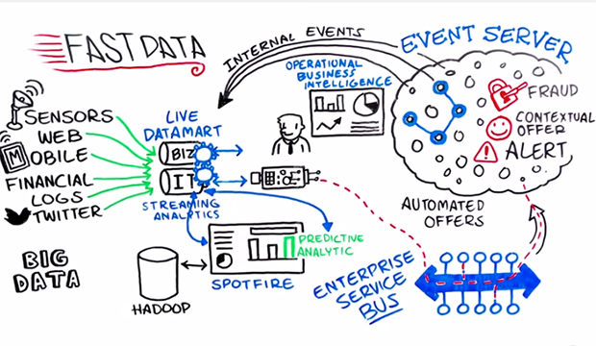
Introduction to “Fast Data”: Streaming
Stream processing: real-time processing of data continuously and concurrently
High ratio of event throughput versus numbers of queries
IoT, edge devices, financial systems
Image: TIBCO/Lindsey Ashjian

Slide 78


Two Streaming Frameworks
Spark Streaming
receives live input data streams, chunks into batches (micro-batches)
Processed by the Spark engine to generate results stream
Kafka Streams
Event-at-a-time processing (not micro-batch)
Millisecond latency
Distributed processing and fault-tolerance with fast failover

Slide 79

Producers, Consumers and Topics
Topic 1
Topic 2
Topic 3
Consumer
Consumer
Consumer
Producer
Background image: InHabitat/Cat DiStasio

Slide 80
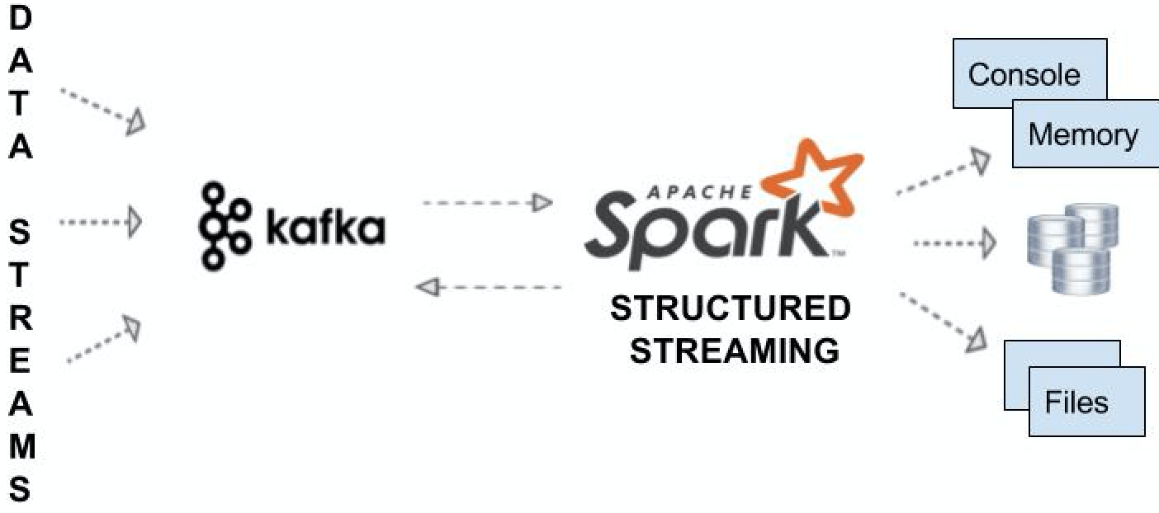
Spark + Kafka
Image: Databricks/Sunil Sitaula

Slide 81
Anomaly Detection
The three types of anomaly:
Point — with respect to any other data element
Contextual — within a given context or baseline
Collective — anomalous in a grouped space
Outliers aren’t necessarily anomalies!

Slide 82
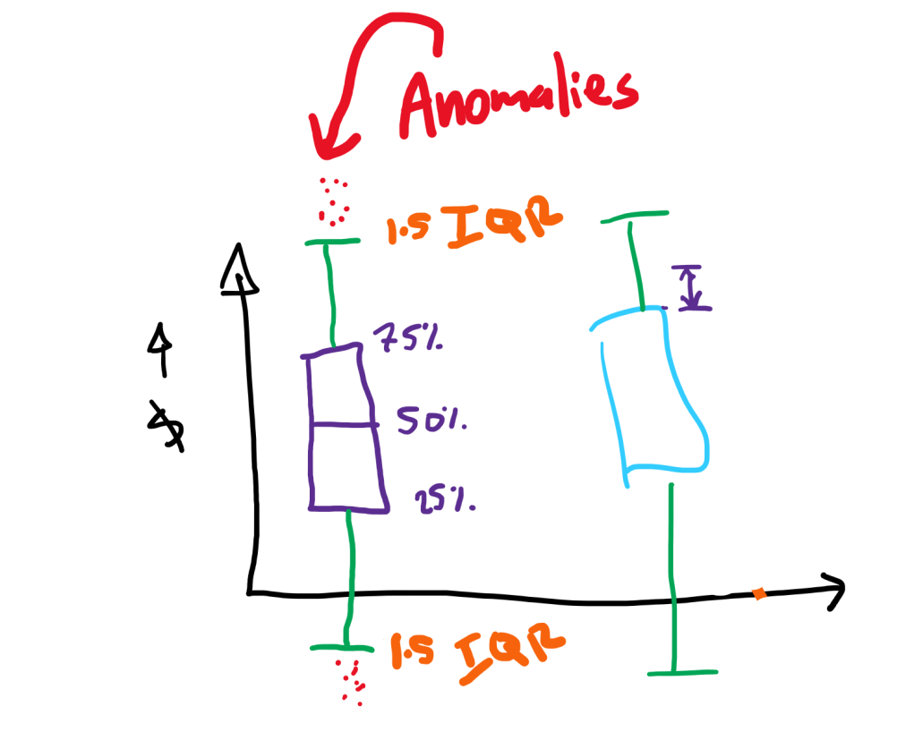
Interquartile Range Method
Interquartile Range (IQR) is a robust measure of statistical dispersion
75th percentile – 25th percentile
Common measure for extremity is 1.5xIQR, either side (thanks, John Tukey!)

Slide 83
Kafka/Spark Demo

Slide 84
Further Resources
Spark: the Definitive Guide (Bill Chambers & Matei Zaharia) — O’Reilly
Advanced Analytics with Spark (Sandy Ryza, Uri Laserson, Sean Owen, & Josh Wills) — O’Reilly
Kafka: The Definitive Guide (Neha Narkhede, Gwen Shapira & Todd Palino) — O’Reilly
Databricks’ blog: https://databricks.com/blog
Luminousmen blog: https://luminousmen.com/
Read the original paper (do it!): Matei Zaharia et al.: “Spark: Cluster Computing with Working Sets,” 2nd USENIX Workshop on Hot Topics in Cloud Computing, Boson MA (2010)

Slide 85
Conclusion
This was an overview of Big Data, Spark and PySpark. We covered:
What is Big Data?
Where does Spark and PySpark come in?
Data management with PySpark
How to create, query and manipulate Spark SQL DataFrames
Spark MLlib: machine learning at scale
An overview of streaming in Kafka: Spark Streaming and Kafka
This hopefully gives you a taste for exploring the Spark and PySpark landscape further!
Get these slides and the code here: https://github.com/RaInta/PySparkWebinar

