Slide 1
Boolean Algebra
by,
T.Kalaiselvi,AP(SLG-I) / CSE

Slide 2
LOGIC GATES
Formal logic: In formal logic, a statement (proposition) is a declarative sentence that is either
true(1) or false (0).
It is easier to communicate with computers using formal logic.
• Boolean variable: Takes only two values – either
true (1) or false (0).
They are used as basic units of formal logic.

Slide 3
Boolean function and logic diagram
• Boolean function: Mapping from Boolean variables to a Boolean value.
• Truth table:
  Represents relationship between a Boolean function and its binary variables.
  It enumerates all possible combinations of arguments and the corresponding function values.

Slide 4
Boolean function and logic diagram
• Boolean algebra: Deals with binary variables and logic operations operating on those variables.
• Logic diagram: Composed of graphic symbols for logic gates. A simple circuit sketch that represents inputs and outputs of Boolean functions.

Slide 5
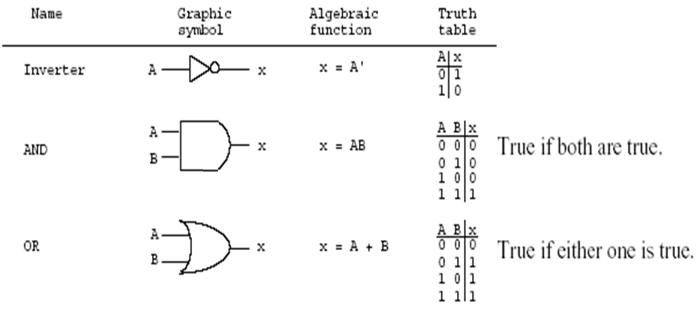
Gates
Refer to the hardware to implement Boolean operators.
The most basic gates are

Slide 6
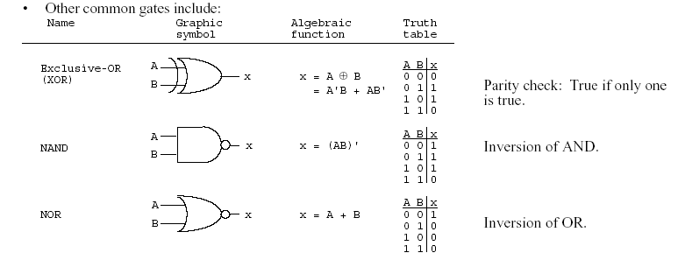
Boolean function and truth table

Slide 7
BASIC IDENTITIES OF BOOLEAN ALGEBRA
Postulate 1 (Definition): A Boolean algebra is a closed algebraic system containing a set K of two or more elements and the two operators · and + which refer to logical AND and logical OR

Slide 8
Basic Identities of Boolean Algebra
(Existence of 1 and 0 element)
x + 0 = x
x · 0 = 0
x + 1 = 1
x · 1 = 1
(Table 1-1)

Slide 9
Basic Identities of Boolean Algebra (Existence of complement)
(5) x + x = x
(6) x · x = x
(7) x + x’ = x
(8) x · x’ = 0

Slide 10
Basic Identities of Boolean Algebra (Commutativity):
(9) x + y = y + x
(10) xy = yx

Slide 11
Basic Identities of Boolean Algebra (Associativity):
(11) x + ( y + z ) = ( x + y ) + z
(12) x (yz) = (xy) z

Slide 12
Basic Identities of Boolean Algebra (Distributivity):
(13) x ( y + z ) = xy + xz
(14) x + yz = ( x + y )( x + z)

Slide 13
Basic Identities of Boolean Algebra (DeMorgan’s Theorem)
(15) ( x + y )’ = x’ y’
(16) ( xy )’ = x’ + y’

Slide 14
Basic Identities of Boolean Algebra (Involution)
(17) (x’)’ = x

Slide 15
Function Minimization using Boolean Algebra
Examples:
(a) a + ab = a(1+b)=a
(b) a(a + b) = a.a +ab=a+ab=a(1+b)=a.
(c) a + a'b = (a + a')(a + b)=1(a + b) =a+b
(d) a(a' + b) = a. a' +ab=0+ab=ab

Slide 16
Try
F = abc + abc’ + a’c

Slide 17
The other type of question
Show that;
1- ab + ab' = a
2- (a + b)(a + b') = a
1- ab + ab' = a(b+b') = a.1=a
2- (a + b)(a + b') = a.a +a.b' +a.b+b.b'
= a + a.b' +a.b + 0
= a + a.(b' +b) + 0
= a + a.1 + 0
= a + a = a

Slide 18
More Examples
Show that;
(a) ab + ab'c = ab + ac
(b) (a + b)(a + b' + c) = a + bc
  (a) ab + ab'c = a(b + b'c)
  = a((b+b').(b+c))=a(b+c)=ab+ac
(b) (a + b)(a + b' + c)
= (a.a + a.b' + a.c + ab +b.b' +bc)
= …

Slide 19
DeMorgan's Theorem
(a) (a + b)' = a'b'
(b) (ab)' = a' + b'
Generalized DeMorgan's Theorem
(a) (a + b + … z)' = a'b' … z'
(b) (a.b … z)' = a' + b' + … z‘

Slide 20
DeMorgan's Theorem
F = ab + c’d’
F’ = ??
F = ab + c’d’ + b’d
F’ = ??

Slide 21
DeMorgan's Theorem
Show that: (a + b.c)' = a'.b' + a'.c'

Slide 22
More DeMorgan's example
Show that: (a(b + z(x + a')))' =a' + b' (z' + x')
  (a(b + z(x + a')))' = a' + (b + z(x + a'))'
  = a' + b' (z(x + a'))'
  = a' + b' (z' + (x + a')')
  = a' + b' (z' + x'(a')')
  = a' + b' (z' + x'a)
  =a‘+b' z' + b'x'a
  =(a‘+ b'x'a) + b' z'
  =(a‘+ b'x‘)(a +a‘) + b' z'
  = a‘+ b'x‘+ b' z‘
  = a' + b' (z' + x')

Slide 23
More Examples
(a(b + c) + a'b)'=b'(a' + c')
ab + a'c + bc = ab + a'c
(a + b)(a' + c)(b + c) = (a + b)(a' + c)

