Slide 1



Exploring National Parks: A Roadtrip Adventure
By Rasila, Pratistha, Adarsh and Afia
by Rasila Thapa

Slide 2
Project Objective
Cost-Effective
Enjoyable Experience
Comprehensive Planning
Plan a budget-friendly road trip to based on your requirement.
Ensure the trip is filled with memorable activities and stunning natural wonders.
Account for travel expenses mainly gas and weather conditions to optimize the itinerary.

Slide 3
Consideration of Gas Expenses and Weather Conditions
Travel Expenses
Weather Conditions
Carefully budget for fuel to ensure a financially responsible trip.
Monitor weather data to plan activities and packing your essentials.

Slide 4
Importance of Planning
1
Maximize Experience
2
Mitigate Risks
3
Effective Budgeting
Thoughtful planning ensures you can fully immerse yourself in the natural wonders of the parks.
Looking at past weather data allows you to understand the trend and prepare accordingly to overcome any risks.
A well-planned itinerary helps you manage costs and allocate resources efficiently.

Slide 5
Project Components
1
Data Collection
Gather crucial information on gas prices, park distances, and daily temperature data. Build a comprehensive dataset for informed decisions.
2
Calculations
Crunch the numbers for fuel costs, total trip expenses, and temperature ranges. Use vehicle MPG for accurate fuel estimates.
3
Analysis
Interpret the data to determine optimal travel dates, budget allocation, and route planning. Ensure a balanced and enjoyable trip.

Slide 6
Data Collection
Gas Prices
Monthly CSV files with pricing information.
Distances
CSV file containing inter-park distances for route planning
Temperature Data
Daily temperature CSV files for each national park based on last years data.

Slide 7
User Inputs and Assumptions
User Inputs:
Assumptions:
Number of Travelers:
Daily Travel Distance:
Example: 3
0-500 miles per day.
Travel Days:
Round Trip Calculation:
Example: 2
Distance from Fremont multiplied by 2 for return.
Travel Date:
Monthly Gas Price:
Example: June 17
Example: $4.4 per gallon (June).
Car's MPG:
Example: 30 MPG

Slide 8
Calculation Methodology
Total Round Trip Distance
Fuel Efficiency
Calculate the total round trip distance by doubling the one-way mileage between destinations.
Determine the fuel efficiency of the vehicle in miles per gallon (MPG) to estimate the total gallons required.
Example: 1000 miles (500 miles each way).
Example: 30 MPG.
Total Fuel Cost
Cost Per Person
Multiply the total gallons required by the current gas price to calculate the total fuel cost for the trip.
Divide the total trip cost by the number of travelers to determine the cost per person.
Example: 1000 miles / 30 MPG = 33.33 gallons. 33.33 gallons * $4.4 = $146.65.
Example: $146.65 / 3 = $48.88 per person

Slide 9
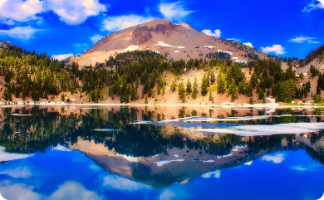
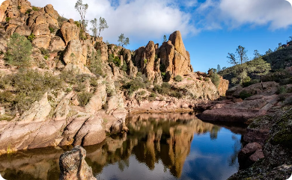
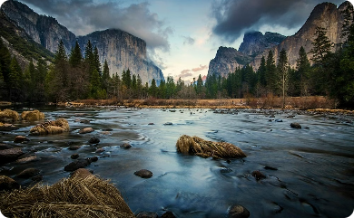
Recomended Parks
Lassen Volcanic National Park
Pinnacles National Park
Yosemite National Park
78°F
54°F
High Temp
Low Temp
380
$27.85
Miles
Cost Per Person
Yosemite's temperate climate, with highs around 78°F and lows near 54°F, offers the perfect conditions for exploring the park's vast network of hiking trails and taking in the natural beauty. The 380-mile round trip distance from our starting point in Fremont makes Yosemite an accessible and cost-effective destination at just $27.85 per person.
72°F
50°F
High Temp
Low Temp
500
$36.65
Miles
Cost Per Person
Lassen Volcanic National Park, located in Northern California, offers a unique geothermal landscape with steaming fumaroles, boiling mud pots, and stunning volcanic peaks. With a round trip distance of 500 miles and average temperatures ranging from 72°F to 50°F, Lassen is a slightly more distant but still accessible option at $36.65 per person.
85°F
65°F
High Temp
Low Temp
180
$13.20
Miles
Cost Per Person
Pinnacles National Park, situated in Central California, offers a unique landscape of towering rock formations and diverse wildlife. With a round trip distance of just 180 miles and average temperatures ranging from 85°F to 65°F, Pinnacles is a more compact and cost-effective option at $13.20 per person.

Slide 10
Other Enhancements:
Provide a brief into about the recomeded parks.
Suggest essentials to packl based on activities users are instrested in.

Slide 12
Thank you

