Slide 1

CSE431: Natural Language
Processing
Individual Presentation
Name: Ashabul Yamin Raad
ID: 23141088
Section: 02

Slide 2
Bengali Speech Recognition
A double layered LSTM-RNN approach
Reference
M. M. H. Nahid, B. Purkaystha and M. S. Islam, "Bengali speech recognition: A double layered LSTM-RNN approach," 2017 20th International Conference of Computer and Information Technology (ICCIT), Dhaka, Bangladesh, 2017, pp. 1-6, doi: 10.1109/ICCITECHN.2017.8281848.

Slide 3

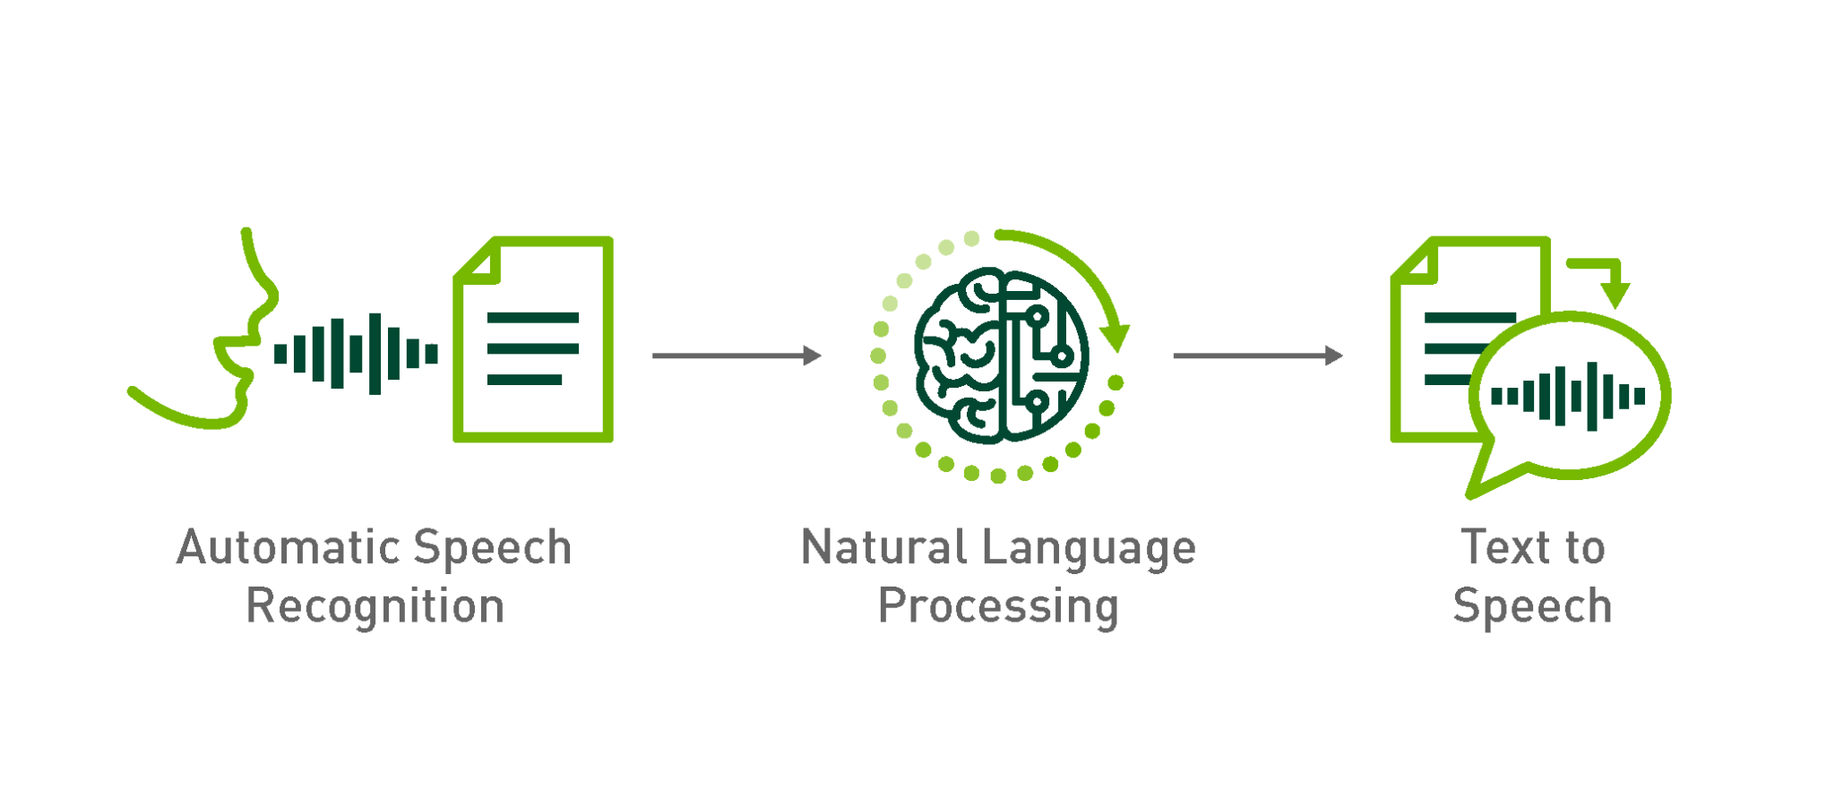
Introduction

Slide 4

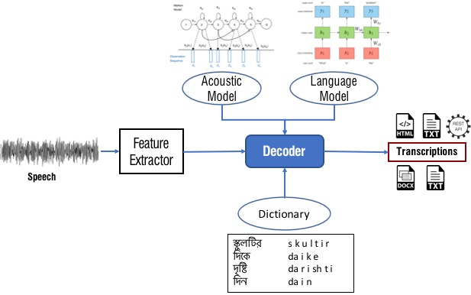
Challenges
Inherent complexity of the language
Bengali words are intricate, and there is a dearth of comprehensive data to train effective recognition models

Slide 5
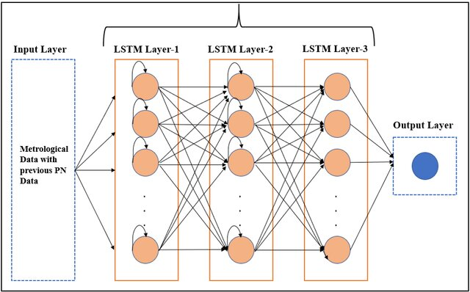
LSTM Approach
Long Short-Term Memory (LSTM), a specialized type of recurrent neural network.
Particularly well-suited for handling variable-length sequences

Slide 6
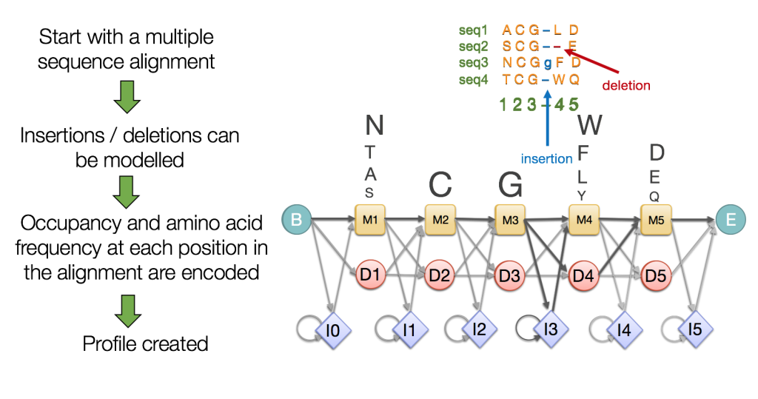
Limitations
HMMs were also effective in modeling the acoustic features and a small set of phonemes that make up words in various languages.
Traditional models like HMM have practical limitations
To address this issue, Gaussian Mixture Models (GMM) were combined with HMM

Slide 7

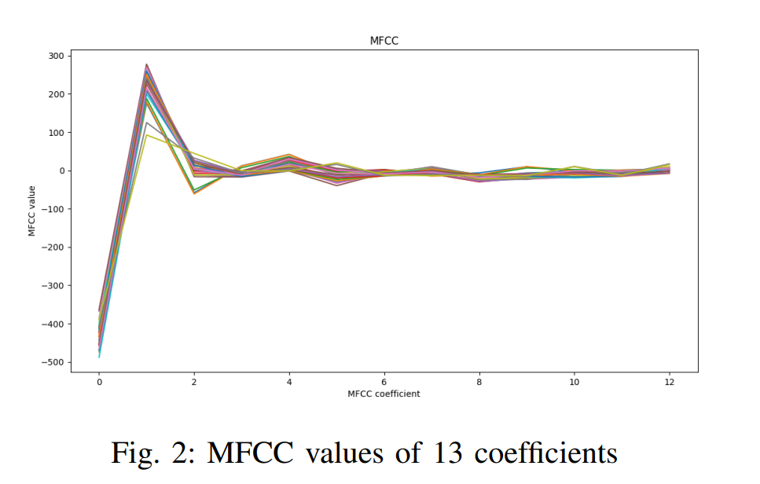
Future Prospects
Deep neural networks are likely to perform exceptionally well in Bengali speech recognition
In this study, the Bengali words are divided into frames, each containing 13 mel-frequency cepstral coefficients (MFCC)
Trained a deep LSTM model to recognize the most probable phonemes

Slide 8
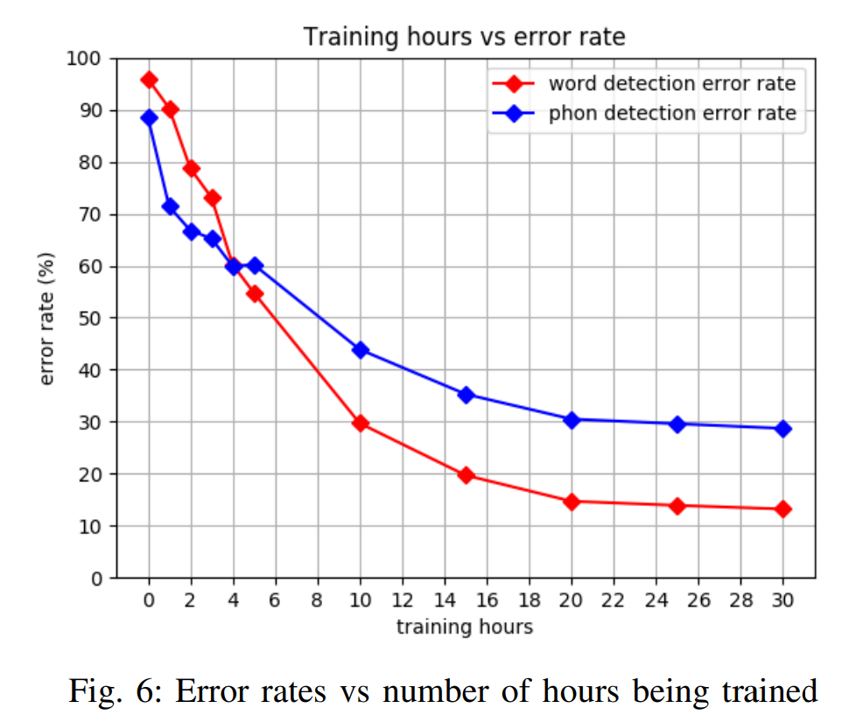
Result Analysis
Achieved a word detection error rate of 13.2%
Phoneme detection error rate of 28.7%
Results are based on Bangla-Real-Number audio dataset

Slide 9
Conclusion
The work opens the door to more efficient and accurate Bengali speech recognition
Reduces the communication gap between humans and machines in this complex and linguistically rich language
Ability to harness the power of Long Short-Term Memory (LSTM) networks, which have proven to be exceptionally well-suited for recognizing individual Bengali words

Slide 10
Thank You

