Slide 1

CSE431: Natural Language
Processing
Individual Presentation
Name: Ashabul Yamin Raad
ID: 23141088
Section: 02

Slide 2
Identifying the Writing Style of Bangla Language Using Natural Language Processing
Reference
S. F. Shetu, M. Saifuzzaman, M. Parvin, N. N. Moon, R. Yousuf and S. Sultana, "Identifying the Writing Style of Bangla Language Using Natural Language Processing," 2020 11th International Conference on Computing, Communication and Networking Technologies (ICCCNT), Kharagpur, India, 2020, pp. 1-6, doi: 10.1109/ICCCNT49239.2020.9225670.

Slide 3

Introduction
Bangla is the eighth most spoken language globally, known for its morphological richness.
It has two styles: Sadhu Bhasha and Cholito Bhasha.
Mixing these styles in writing is considered a grammatical error called Guruchondali Dosh.

Slide 4

Literature
Literature review focuses on syntax and morphology differences in natural languages.
Emphasizes slight grammar variations make languages distinct; cites American and British English.
Grammar, defined as syntax and morphology combinations, is crucial for forming sentences.

Slide 5
Methodology
Research methodology section focuses on theoretical aspects of the study.
Discusses research subject and instrumentation; "instrument" refers to tools like questionnaires.
Two types of data collected: Sadhu data and Cholito data.

Slide 6
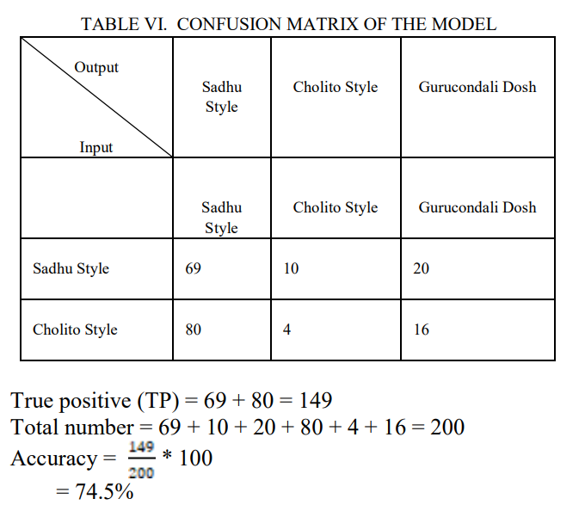
Result Analysis
Cholito data comprises 148,702 sentences, ranging from 24 to 5,180 sentences per paragraph.
Frequency graph shows optimal threshold between 72.5% and 77.5% for identifying Sadhu and Cholito styles.
Experimental results indicate an overall accuracy of 75%, derived as a mean value from both rates.

Slide 7
Conclusion
Research involved developing a library for Sadhu word extension in Bangla language.
Enables identification of Sadhu or Cholito style.
Suggests potential future extensions, including style conversion tools for users to switch styles.
Highlights broader applications of Natural Language Processing (NLP) in collaboration with IoT, Security, and Data Mining.

Slide 8
Thank You

